Slide 1
DSpacing the CGSpace Way
Lessons in content tagging, vocabularies, and curation
Alan Orth
Linux Systems Administrator
Data and Research Methods Unit (DRMU), ILRI
UNEP
Nairobi (April 4, 2023)

Slide 2
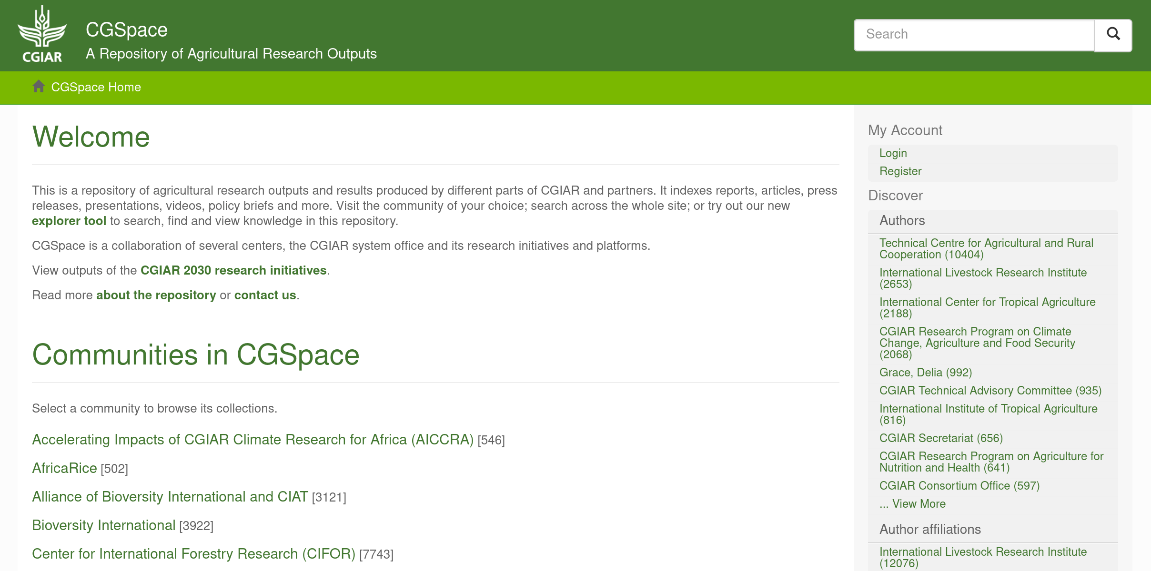
CGSpace Intro
CGSpace began as ILRI’s institutional repository in 2009.
By 2011 we had partnered with a few other CGIAR centers and programs to create a “multi-tenant” repository for cost and expertise sharing. Bottom up! 😃
In 2022 CGSpace was mandated as the repository for digital outputs in the CGIAR. Top down! 🙃
Currently ~105,000 items.

Slide 3
General Lessons Learned
Use the item’s output type as the primary method of content organization (not institutional hierarchy!)
Use the item mapper to show items in multiple collections
Use controlled vocabularies and unique identifiers wherever possible
Instead of hacking the DSpace core, build an ecosystem around the repository
Sell the repository as publishing rather than archiving

Slide 4
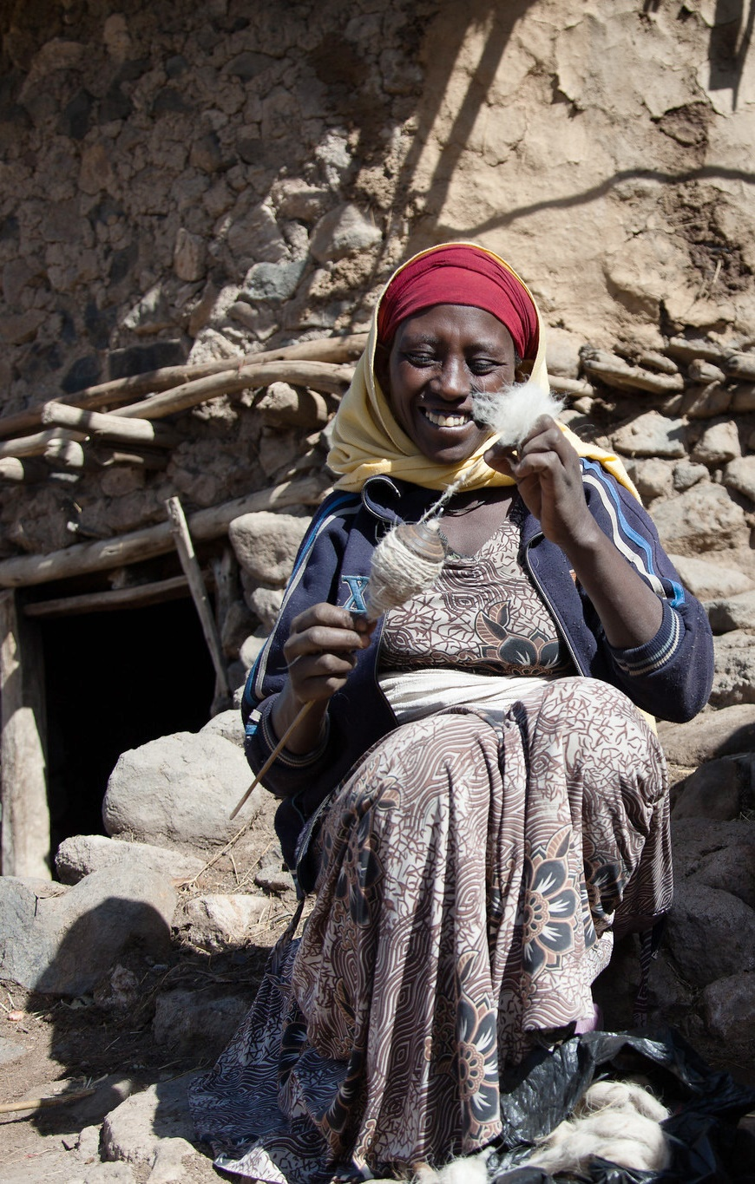
CGSpace Content Submission
Content is submitted by library, comms, and knowledge management staff across the CG.
Fifty-seven metadata fields in the submission form, only seven of which are mandatory.
These fields are a mix of Dublin Core “DC”, “DCTERMS”, and “CG”. The first two are well supported on the web (Google Scholar), the last is a custom one.

Slide 5
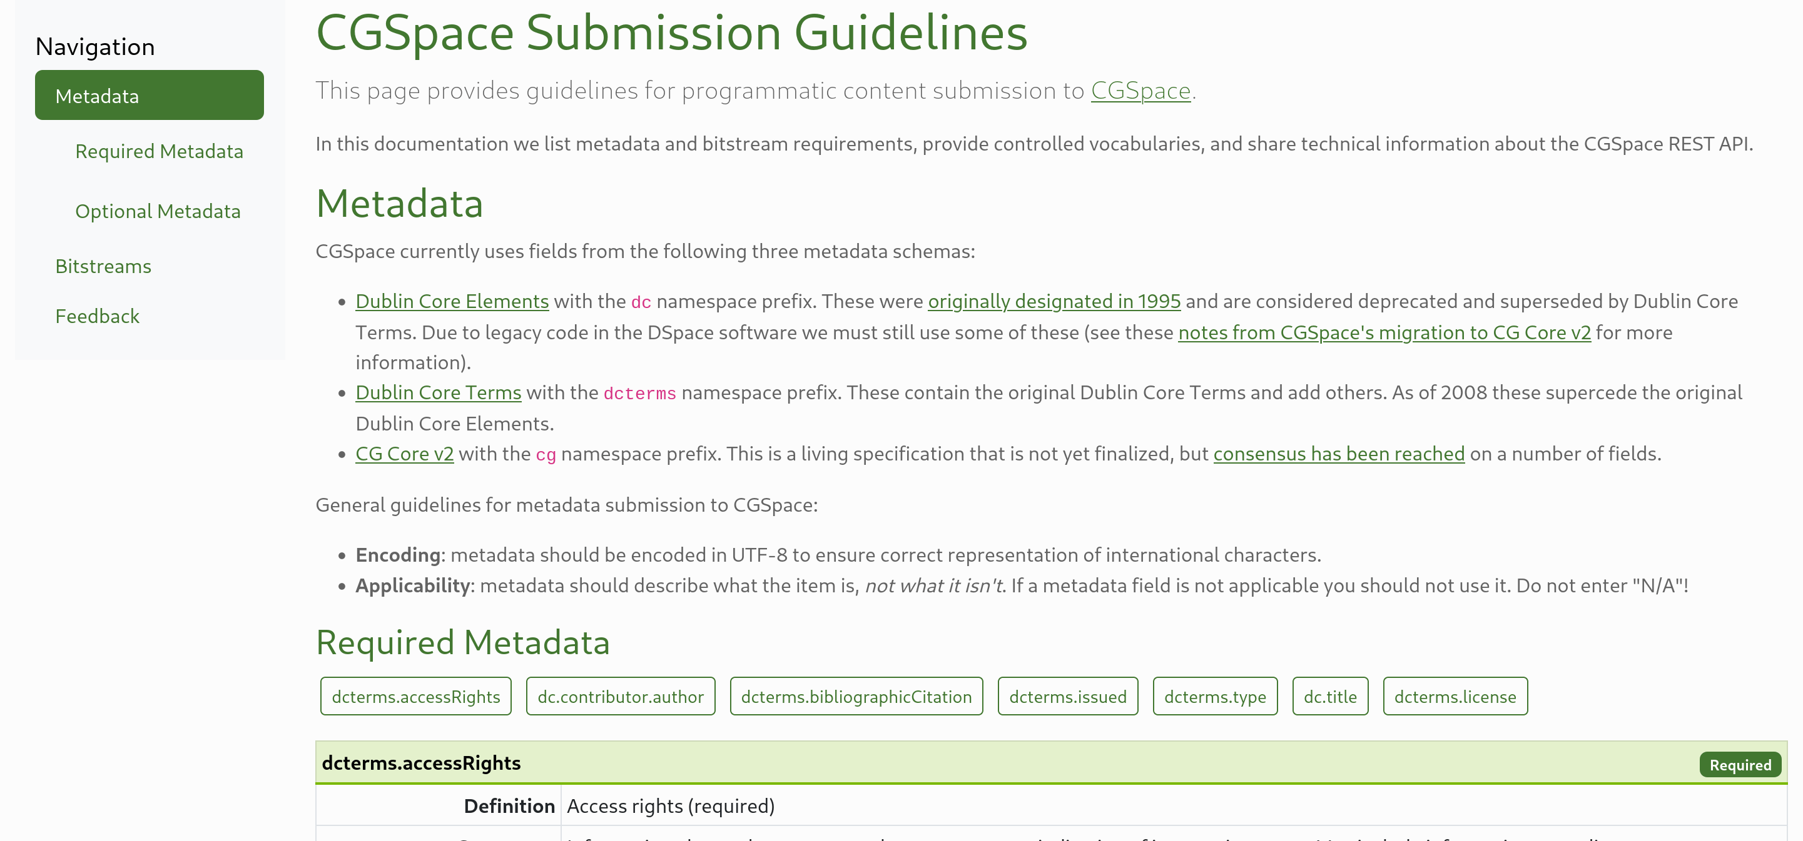
CGSpace Submission Guidelines
https://ilri.github.io/cgspace-submission-guidelines 🔗

Slide 6
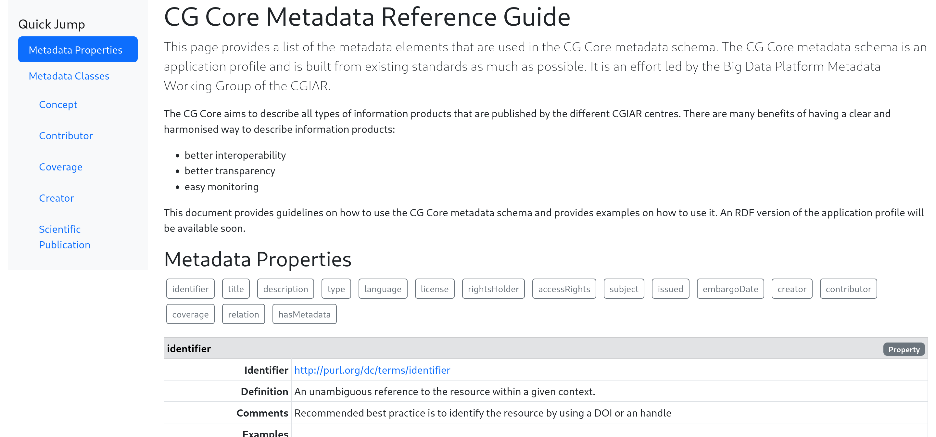
“CG Core” Metadata Schema
https://agriculturalsemantics.github.io/cg-core/cgcore.html 🔗

Slide 7
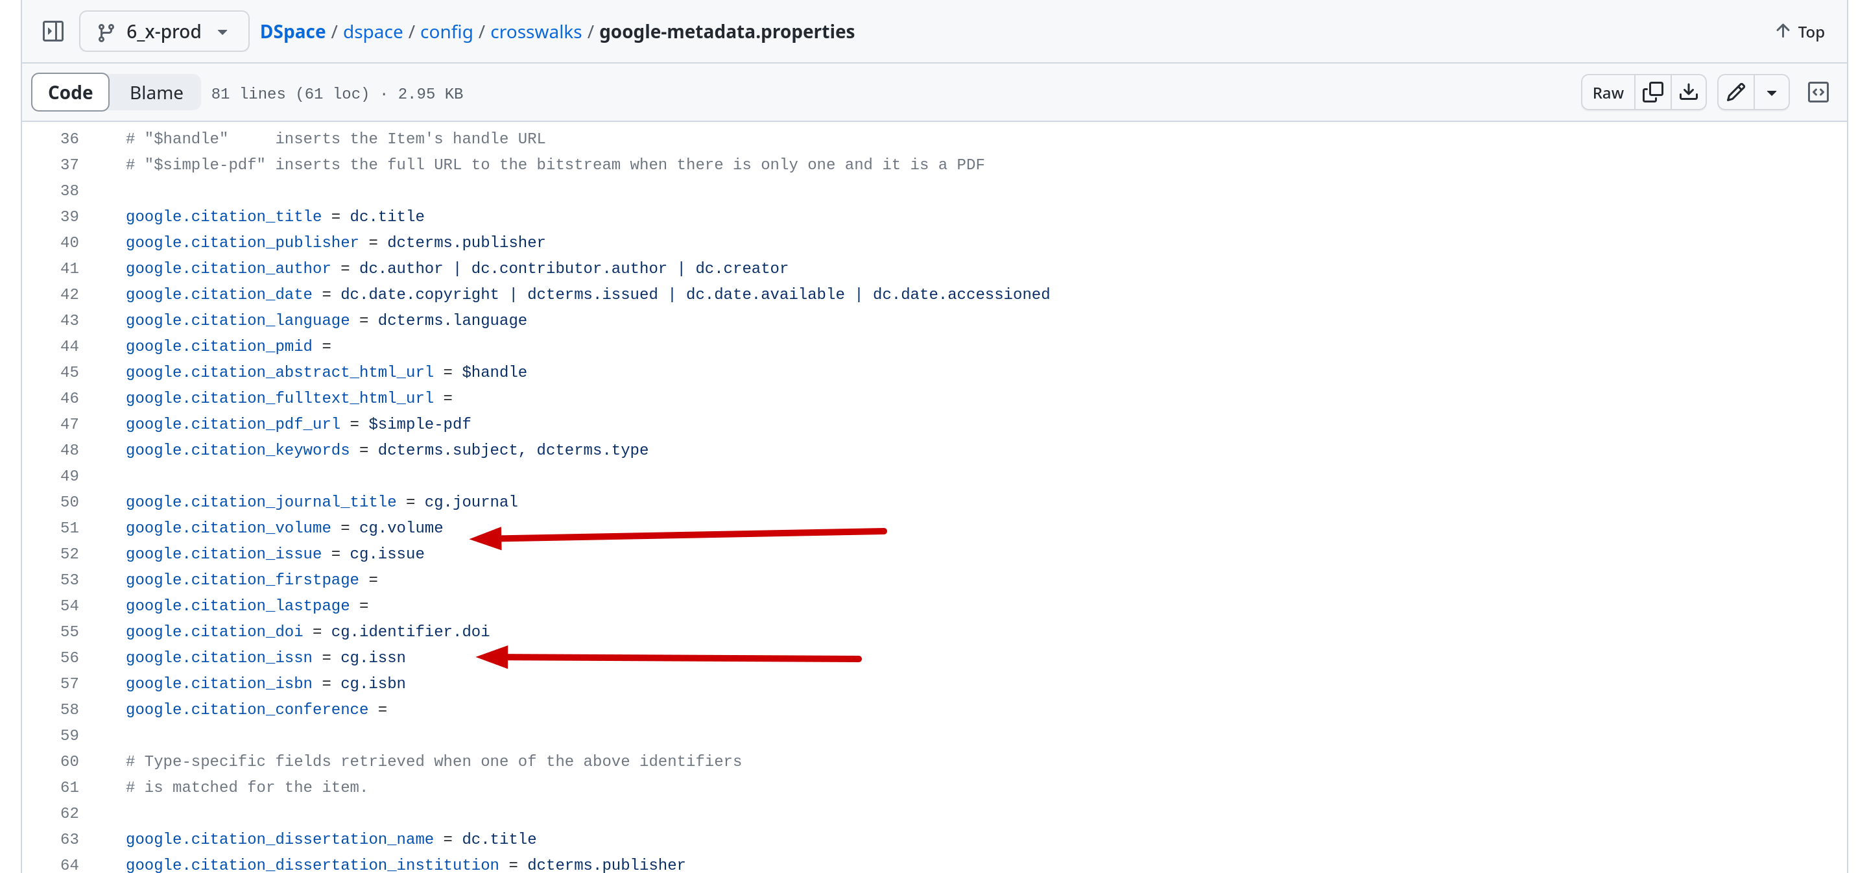
Google Scholar Crosswalk
dspace/config/crosswalks/google-metadata.properties

Slide 8
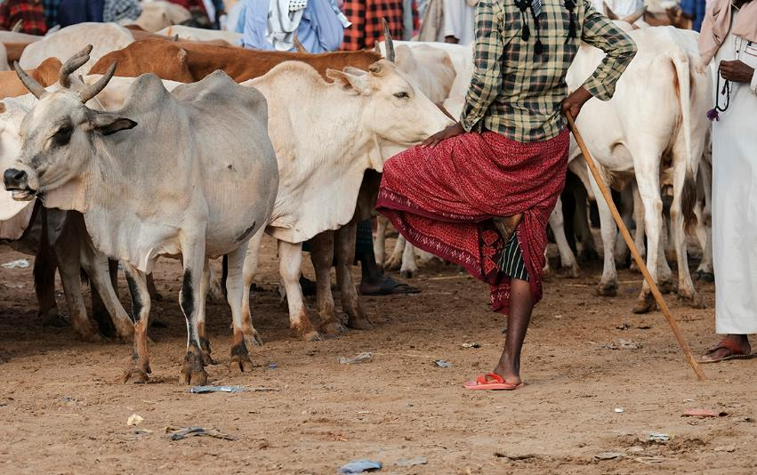
Controlled Vocabularies
Reduce errors introduced during submission compared to free text entry and increase interoperability between systems.

Slide 9
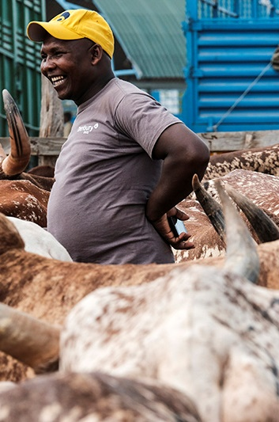
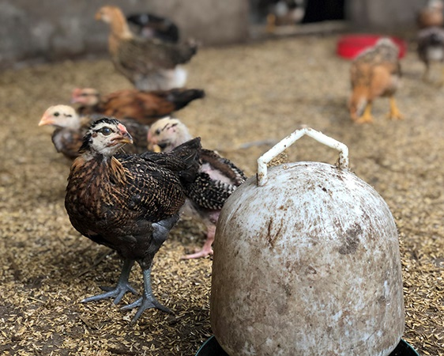
Controlled Vocabularies
We use a mix of internal and external controlled vocabularies.
Many internal vocabularies like subjects specific to CGIAR centers, research themes, and project codes.
A handful of external vocabularies where we are not the authority. I prefer this!

Slide 10
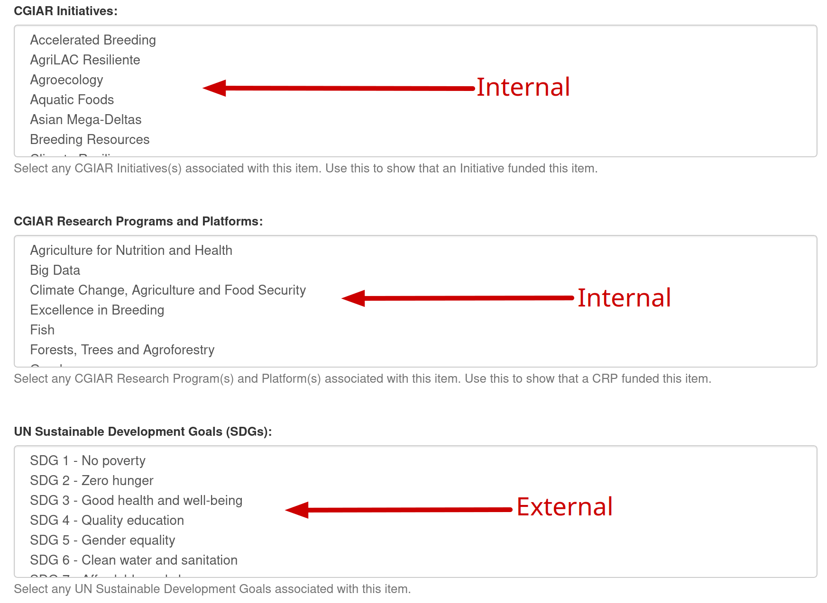
Controlled Vocabularies During Submission

Slide 11
External Vocabularies
Subjects: AGROVOC
License / usage rights: SPDX
Countries: ISO 3166-1*
Regions: UN M.49
Subregions: ISO 3166-2
Languages: ISO 639-1 (Alpha 2)
UN SDGs
We are evaluating ROR.org for organizations, affiliations, and donors.

Slide 12
Unique Identifiers
Using unique identifiers makes it possible to cross reference and enhance metadata from other systems:
DOIs for formally published products
ISSNs for journals
ORCID identifiers
These identifiers are keys into other systems, which is useful for interoperability and content curation.

Slide 13
Content Curation
We do a lot of content curation
We periodically export the repository to CSV for cleaning, validation, and normalization, then re-import to DSpace
We also do updates directly in SQL (careful!)...
This used to be manual, but we use tools like OpenRefine and Python more and more
See: github.com/ilri/csv-metadata-quality 🔗

Slide 14
Content Curation Examples
Enriching item metadata from external sources
Matching countries/regions
Validating subjects against AGROVOC
Updating author names from ORCID
Removing duplicate metadata values
Verifying languages based on titles/abstracts
If you can code it, you can do it! Example scripts:
github.com/ilri/DSpace/tree/6_x-prod/ilri 🔗

Slide 15
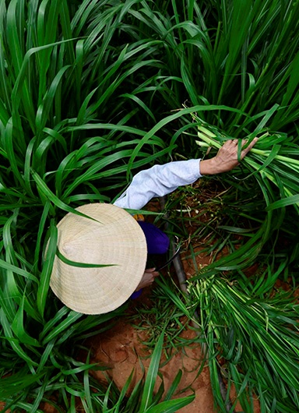
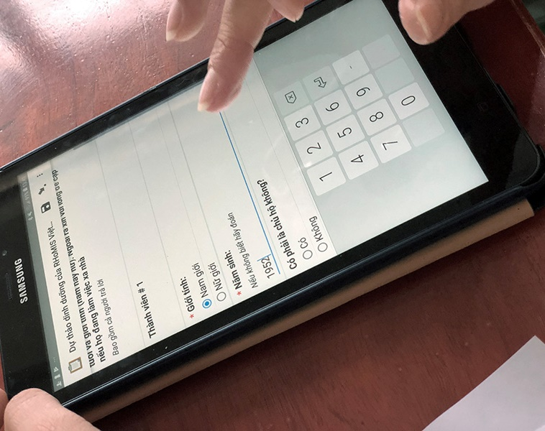
What Can a DOI Tell You?
Publisher, funder, affiliations
License
Date(s) published
Author names and ORCID identifiers
Subjects
Title and abstract
Etc…
Using APIs from Crossref, Unpaywall, OpenAlex, and Sci-Hub (😉) you can get a lot of information!

Slide 16
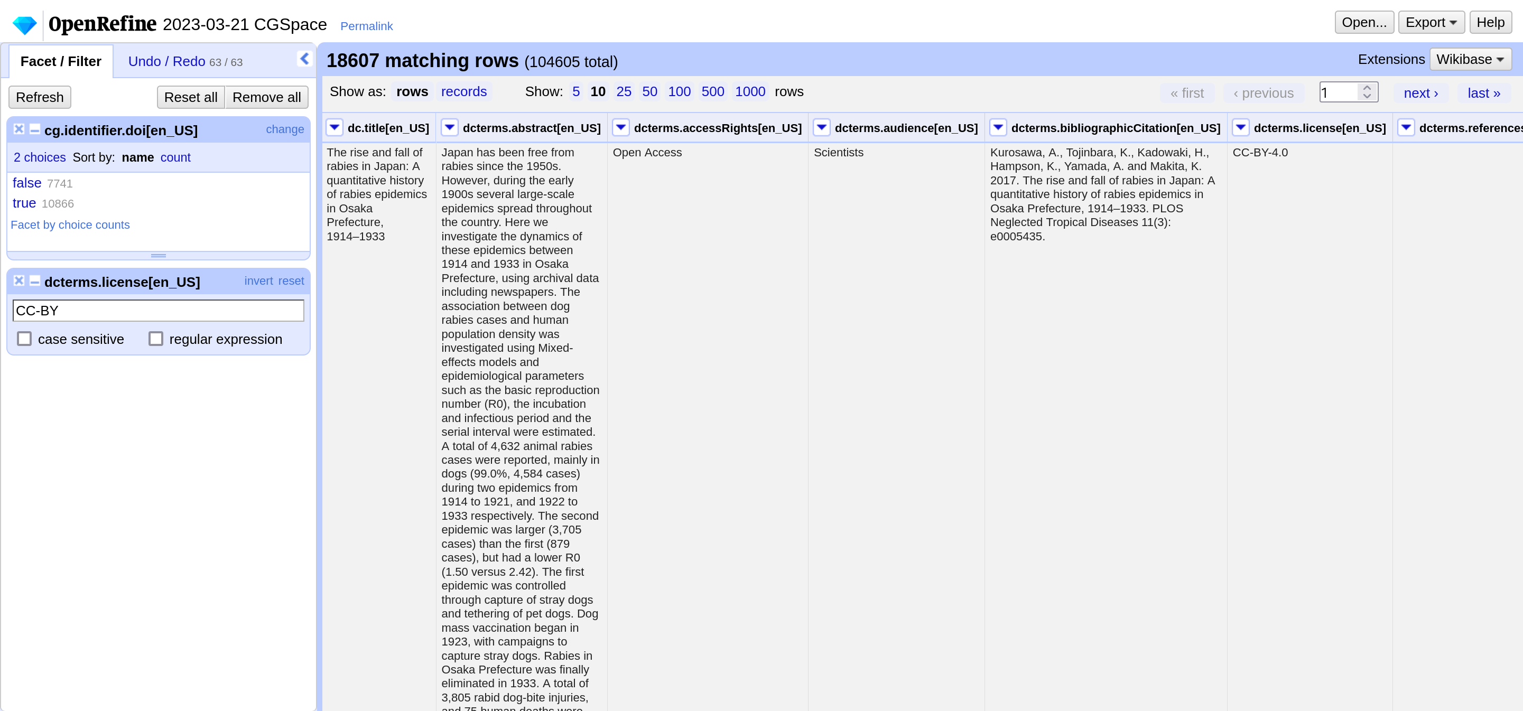
Working With Messy Data in OpenRefine

Slide 17
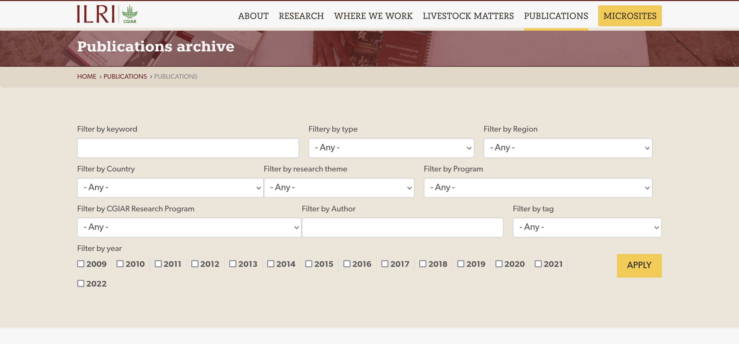
We work closely with the ILRI.org web team
https://www.ilri.org/knowledge/publications/archive 🔗

Slide 18
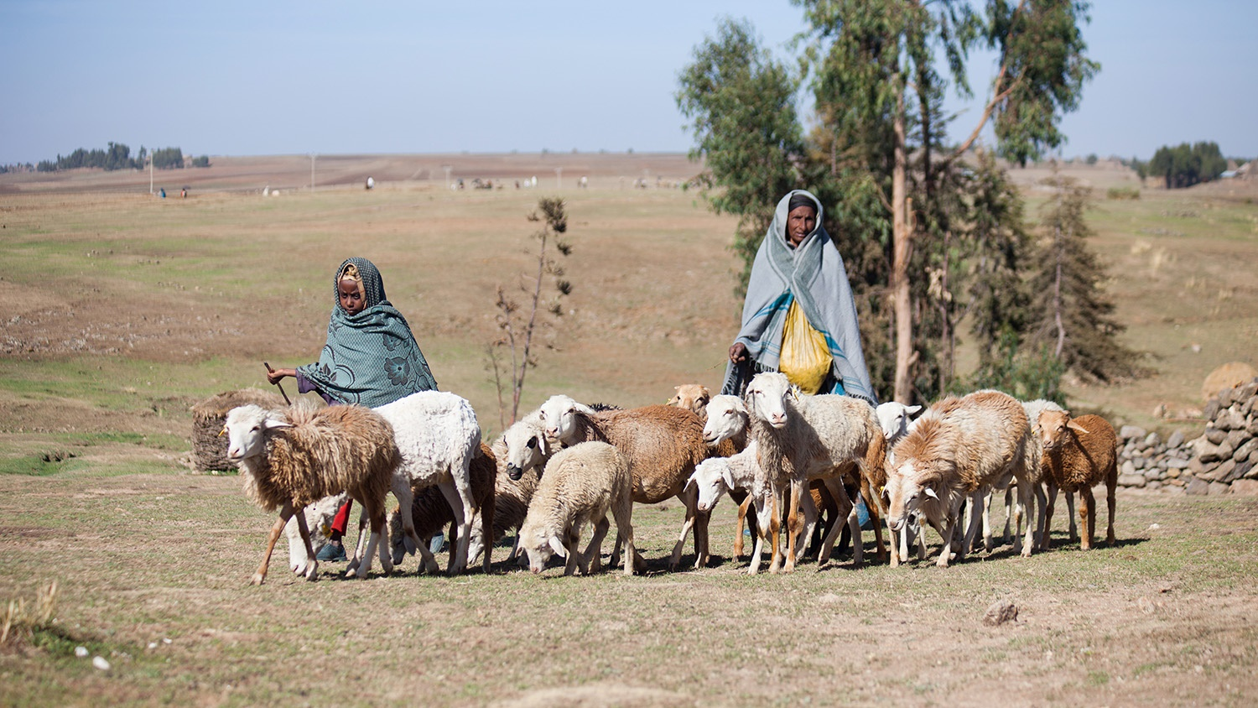
Thank You
You can contact me on a.orth@cgiar.org if you have any questions!

Slide 19

THANK YOU

