Slide 1
STRENGTHENING RICE AND LEGUMES SEED SYSTEMS: ACTIVITIES AND ACHIEVEMENTS 2018/2019
FILBERT MZEE
ACDI/VOCA
AFRICA RISING - NAFAKA PROJECT ANNUAL REVIEW AND PLANNING MEETING
3 – 4 JULY 2019, DAR ES SALAAM, TANZANIA

Slide 2
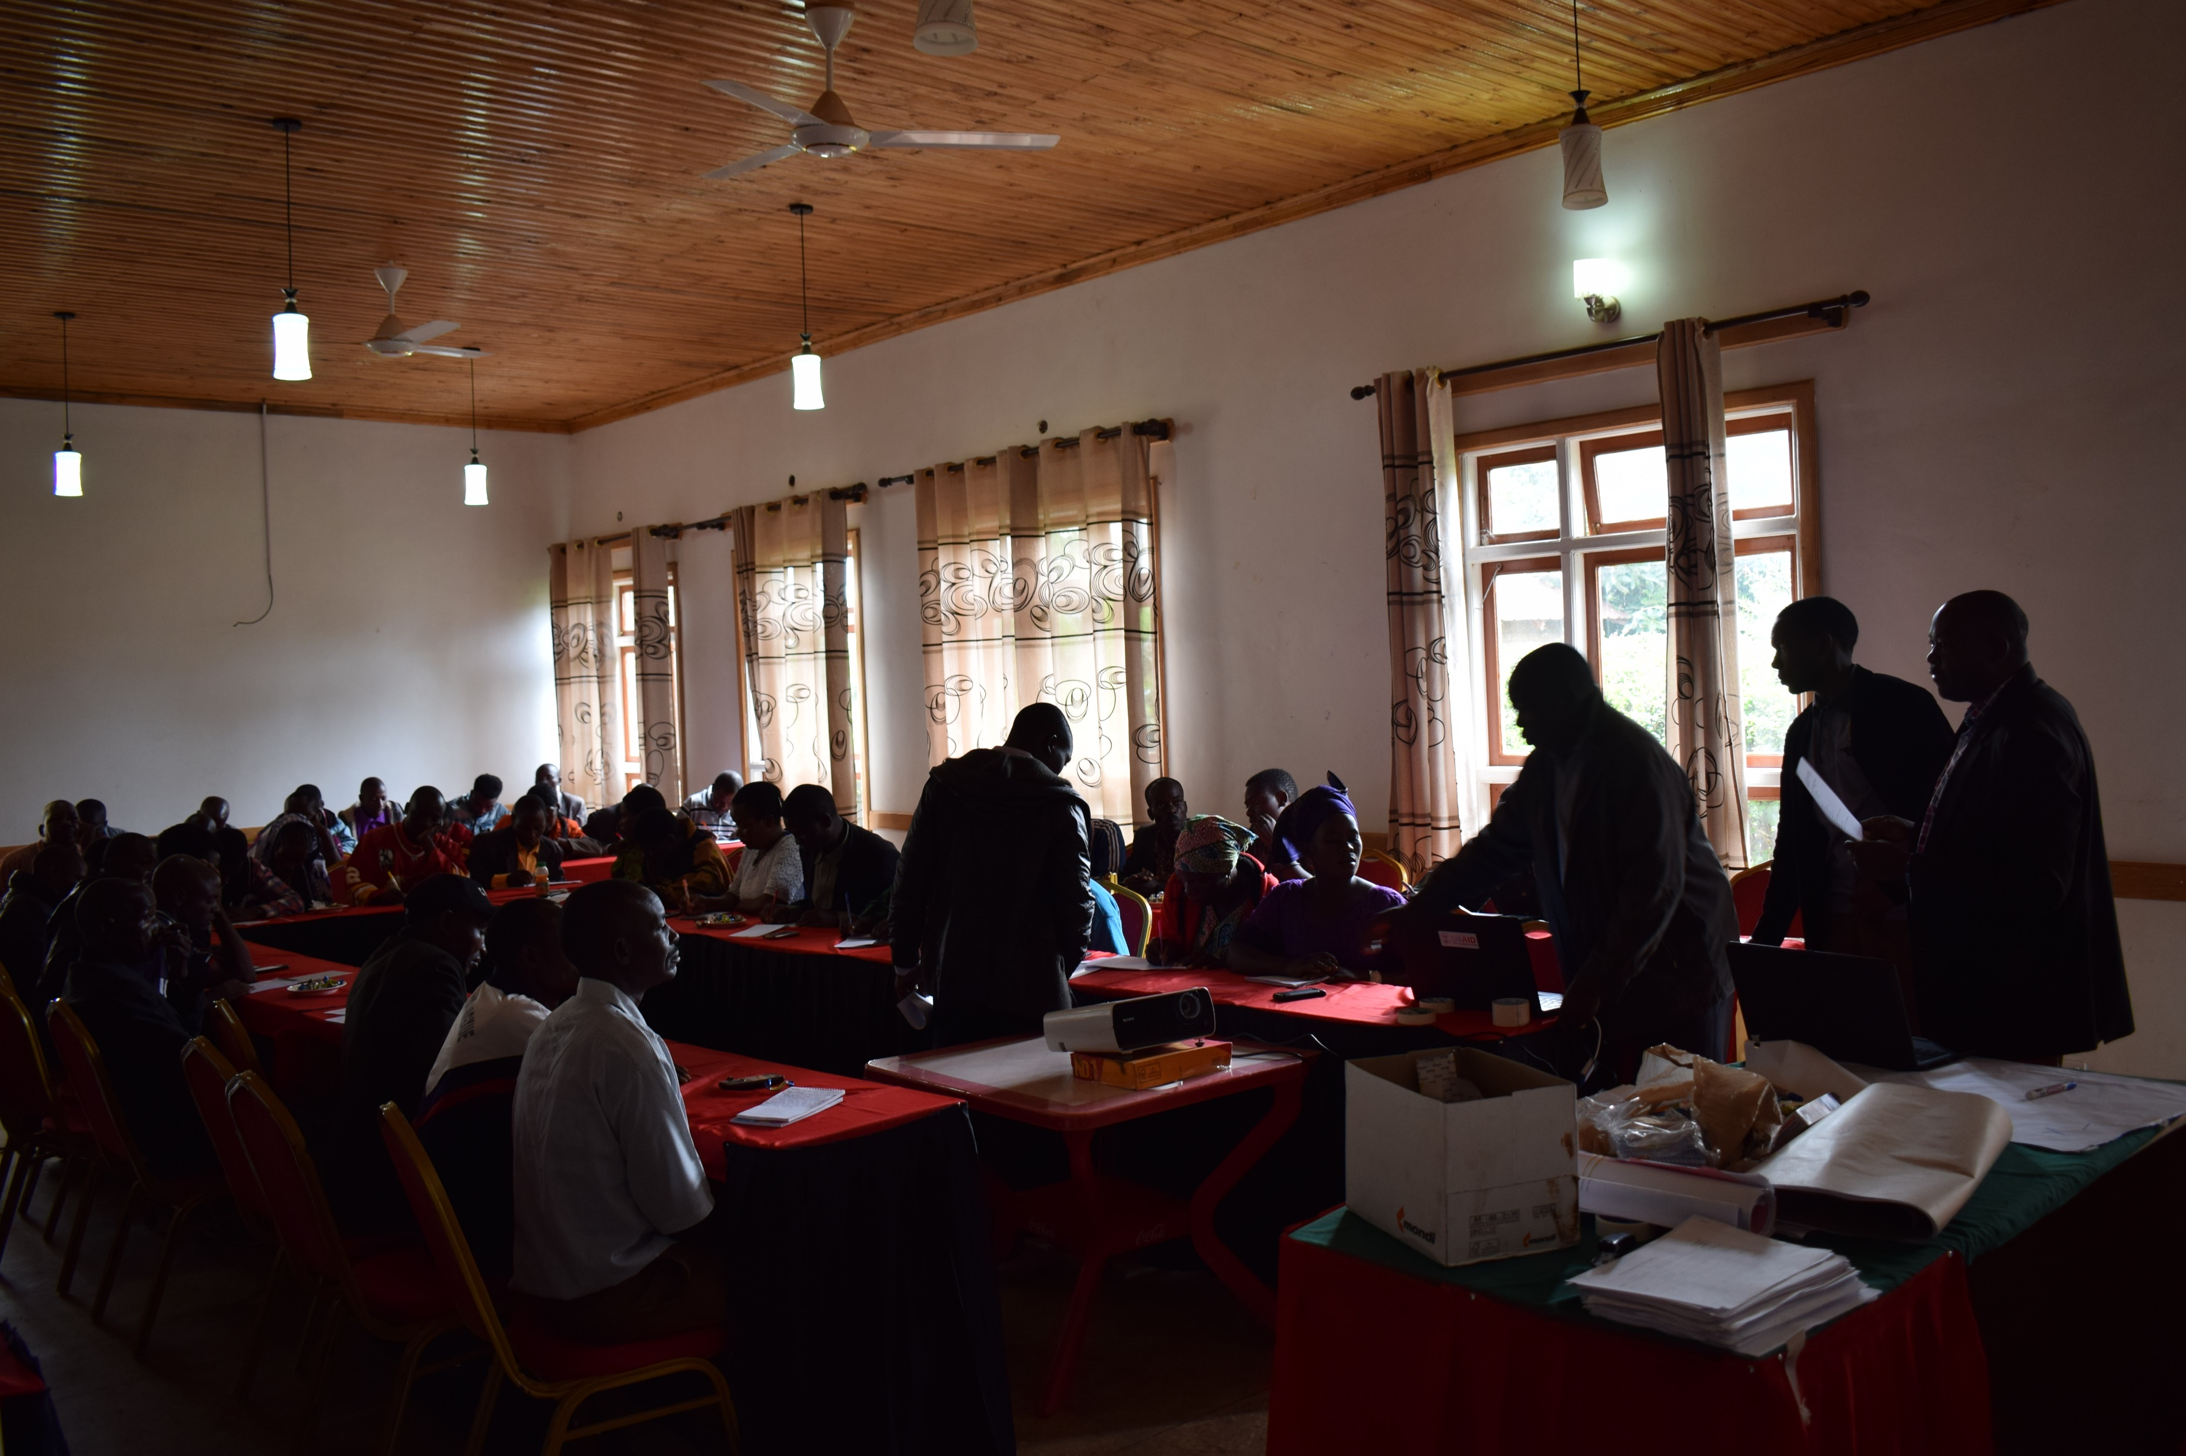
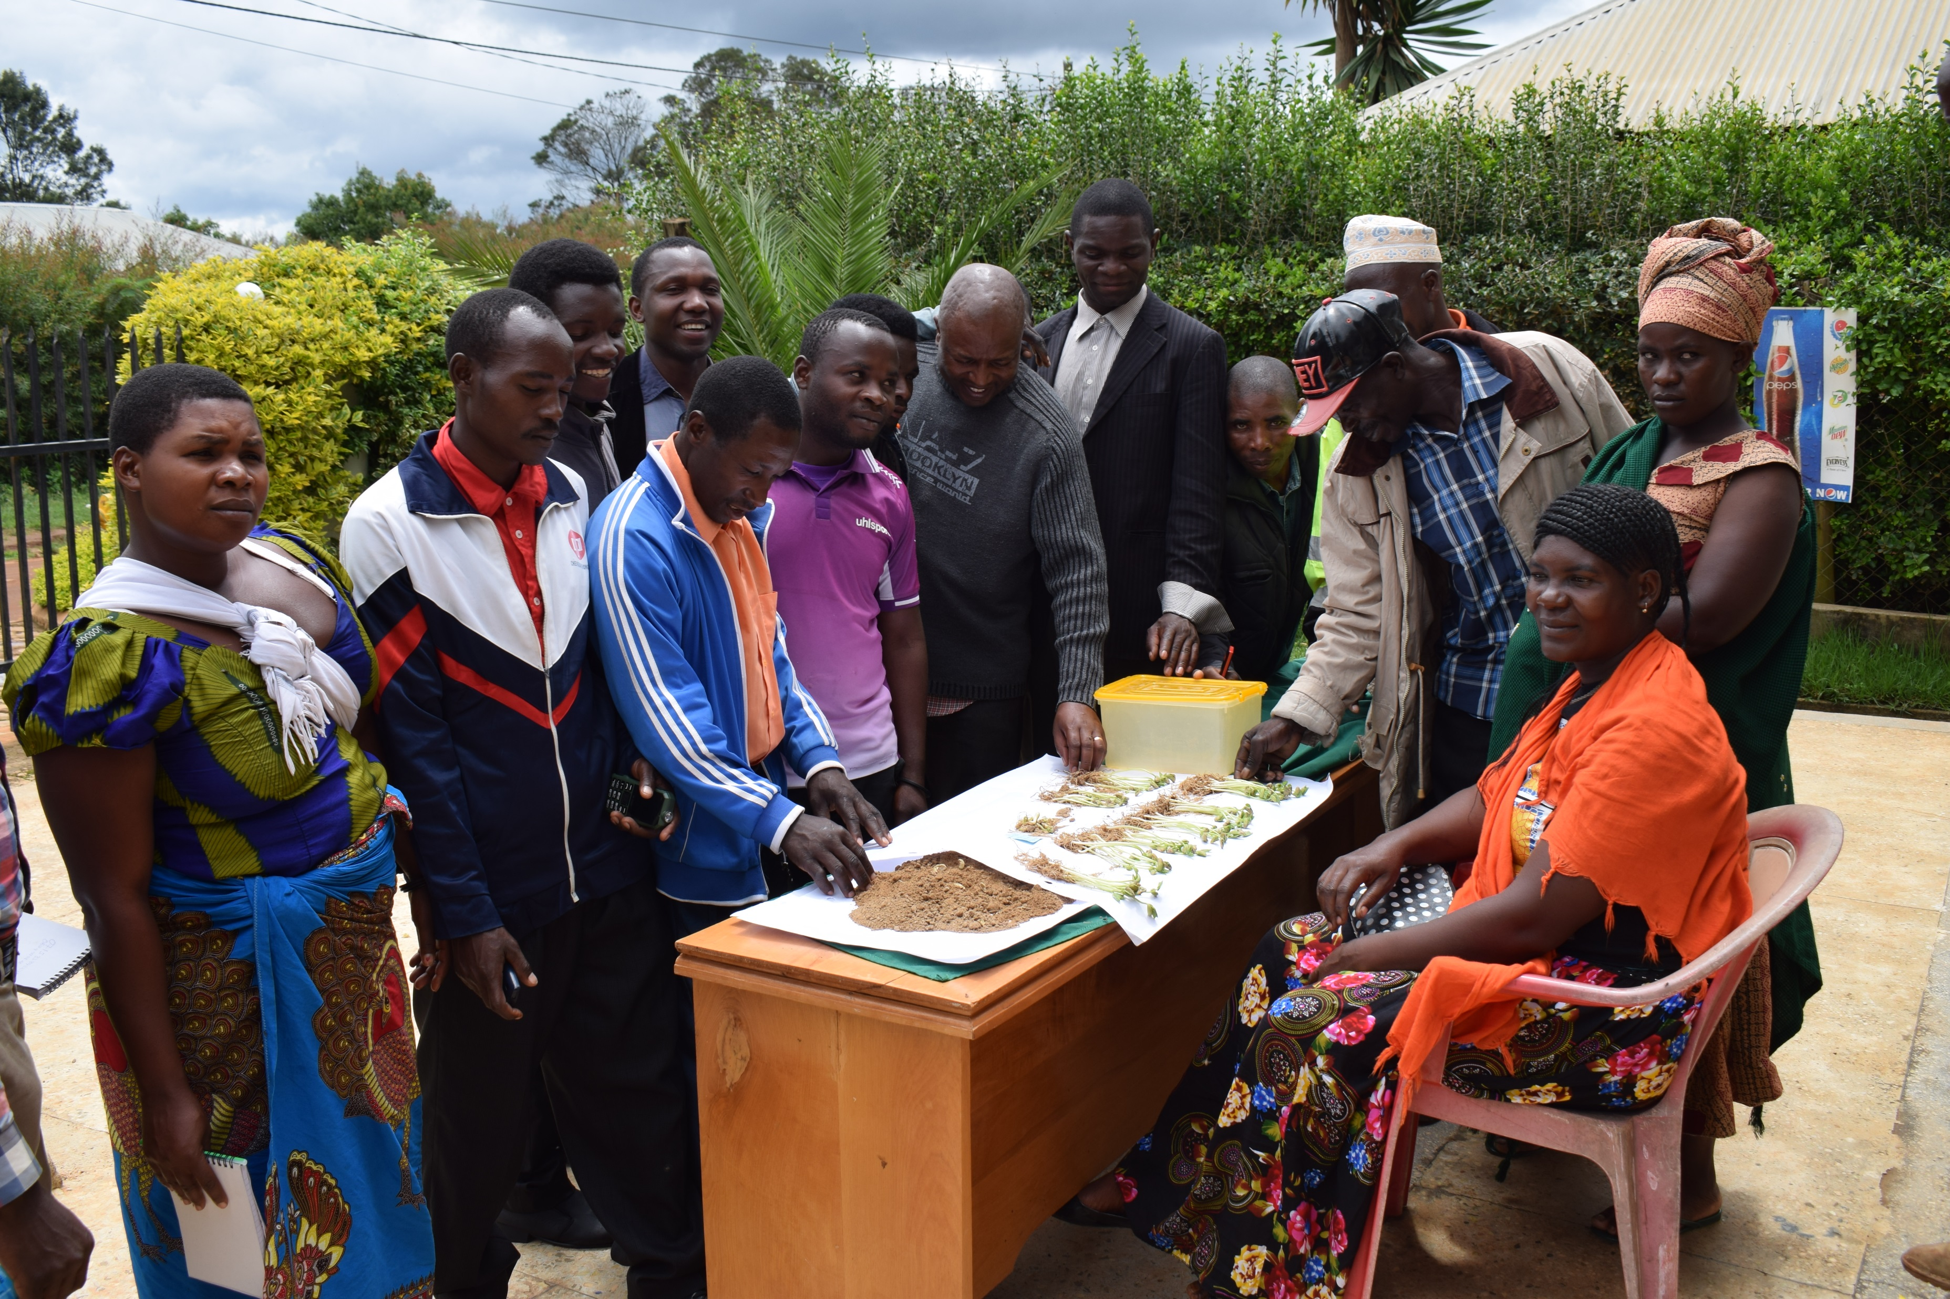
QDS producers training.
Training of New QDS producers
District | Total New QDS producers Trained | Male | Female
Mbozi | 10 | 2 | 8
Momba | 20 | 17 | 3
Wanging’ombe | 7 | 6 | 1
Mufindi | 10 | 8 | 2
Total | 47 | 33 | 14

Slide 3
LEGUME QDS 2018/2019
District | Number of producers | Male | Female | Number of Acreage | Yield expected in (MTS) | Expected revenue (USD)
Mbozi | 30 | 16 | 14 | 30 | 21 | 19091
Momba | 19 | 17 | 2 | 19 | 13 | 12091
Wanging’ombe | 7 | 6 | 1 | 7 | 5 | 4455
Mufindi | 26 | 15 | 11 | 26 | 18 | 16545
Iringa DC | 15 | 7 | 8 | 15 | 11 | 9545
Kilolo DC | 10 | 7 | 3 | 10 | 7 | 6364
TOTAL | 107 | 68 | 39 | 107 | 75 | 68091

Slide 4
RICE QDS 2018/2019
District | Number of producers | Male | Female | Total acreage | Expected yield ( MTS) | Expected revenue (USD)
Momba | 8 | 7 | 1 | 8 | 16 | 10909
Mbarali | 50 | 31 | 19 | 81 | 162 | 110 453.6
Kilombero | 60 | 39 | 21 | 60 | 120 | 81 817.5
Iringa DC | 11 | 6 | 5 | 11 | 22 | 14999,8
Mvomero | 4 | 2 | 2 | 19 | 38 | 25908.8
TOTAL | 133 | 85 | 48 | 179 | 358 | 244,088.7

Slide 5
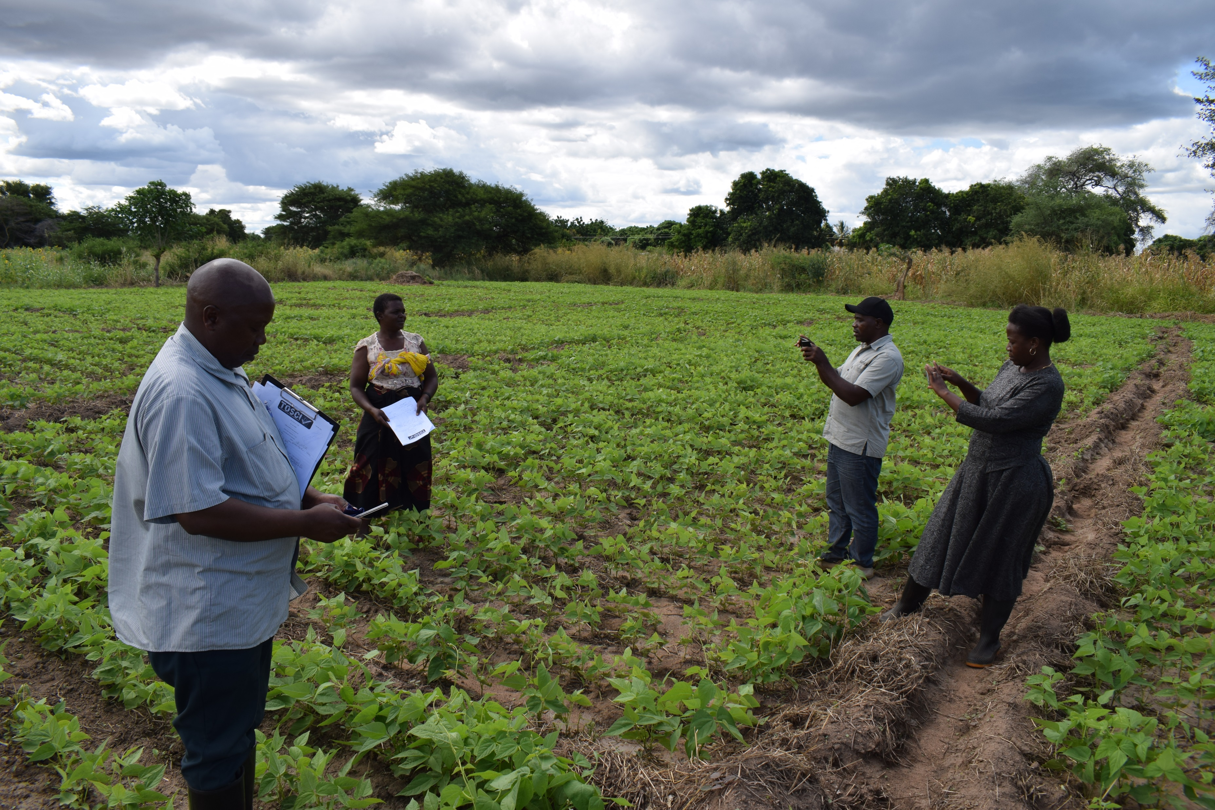
QDS field inspection
Inspection status
QDS producers are already linked with TOSCI and the authorized district seed inspector for inspection of their fields.
QDS producers during the training on association formation also were linked to sources of basic seeds.

Slide 6
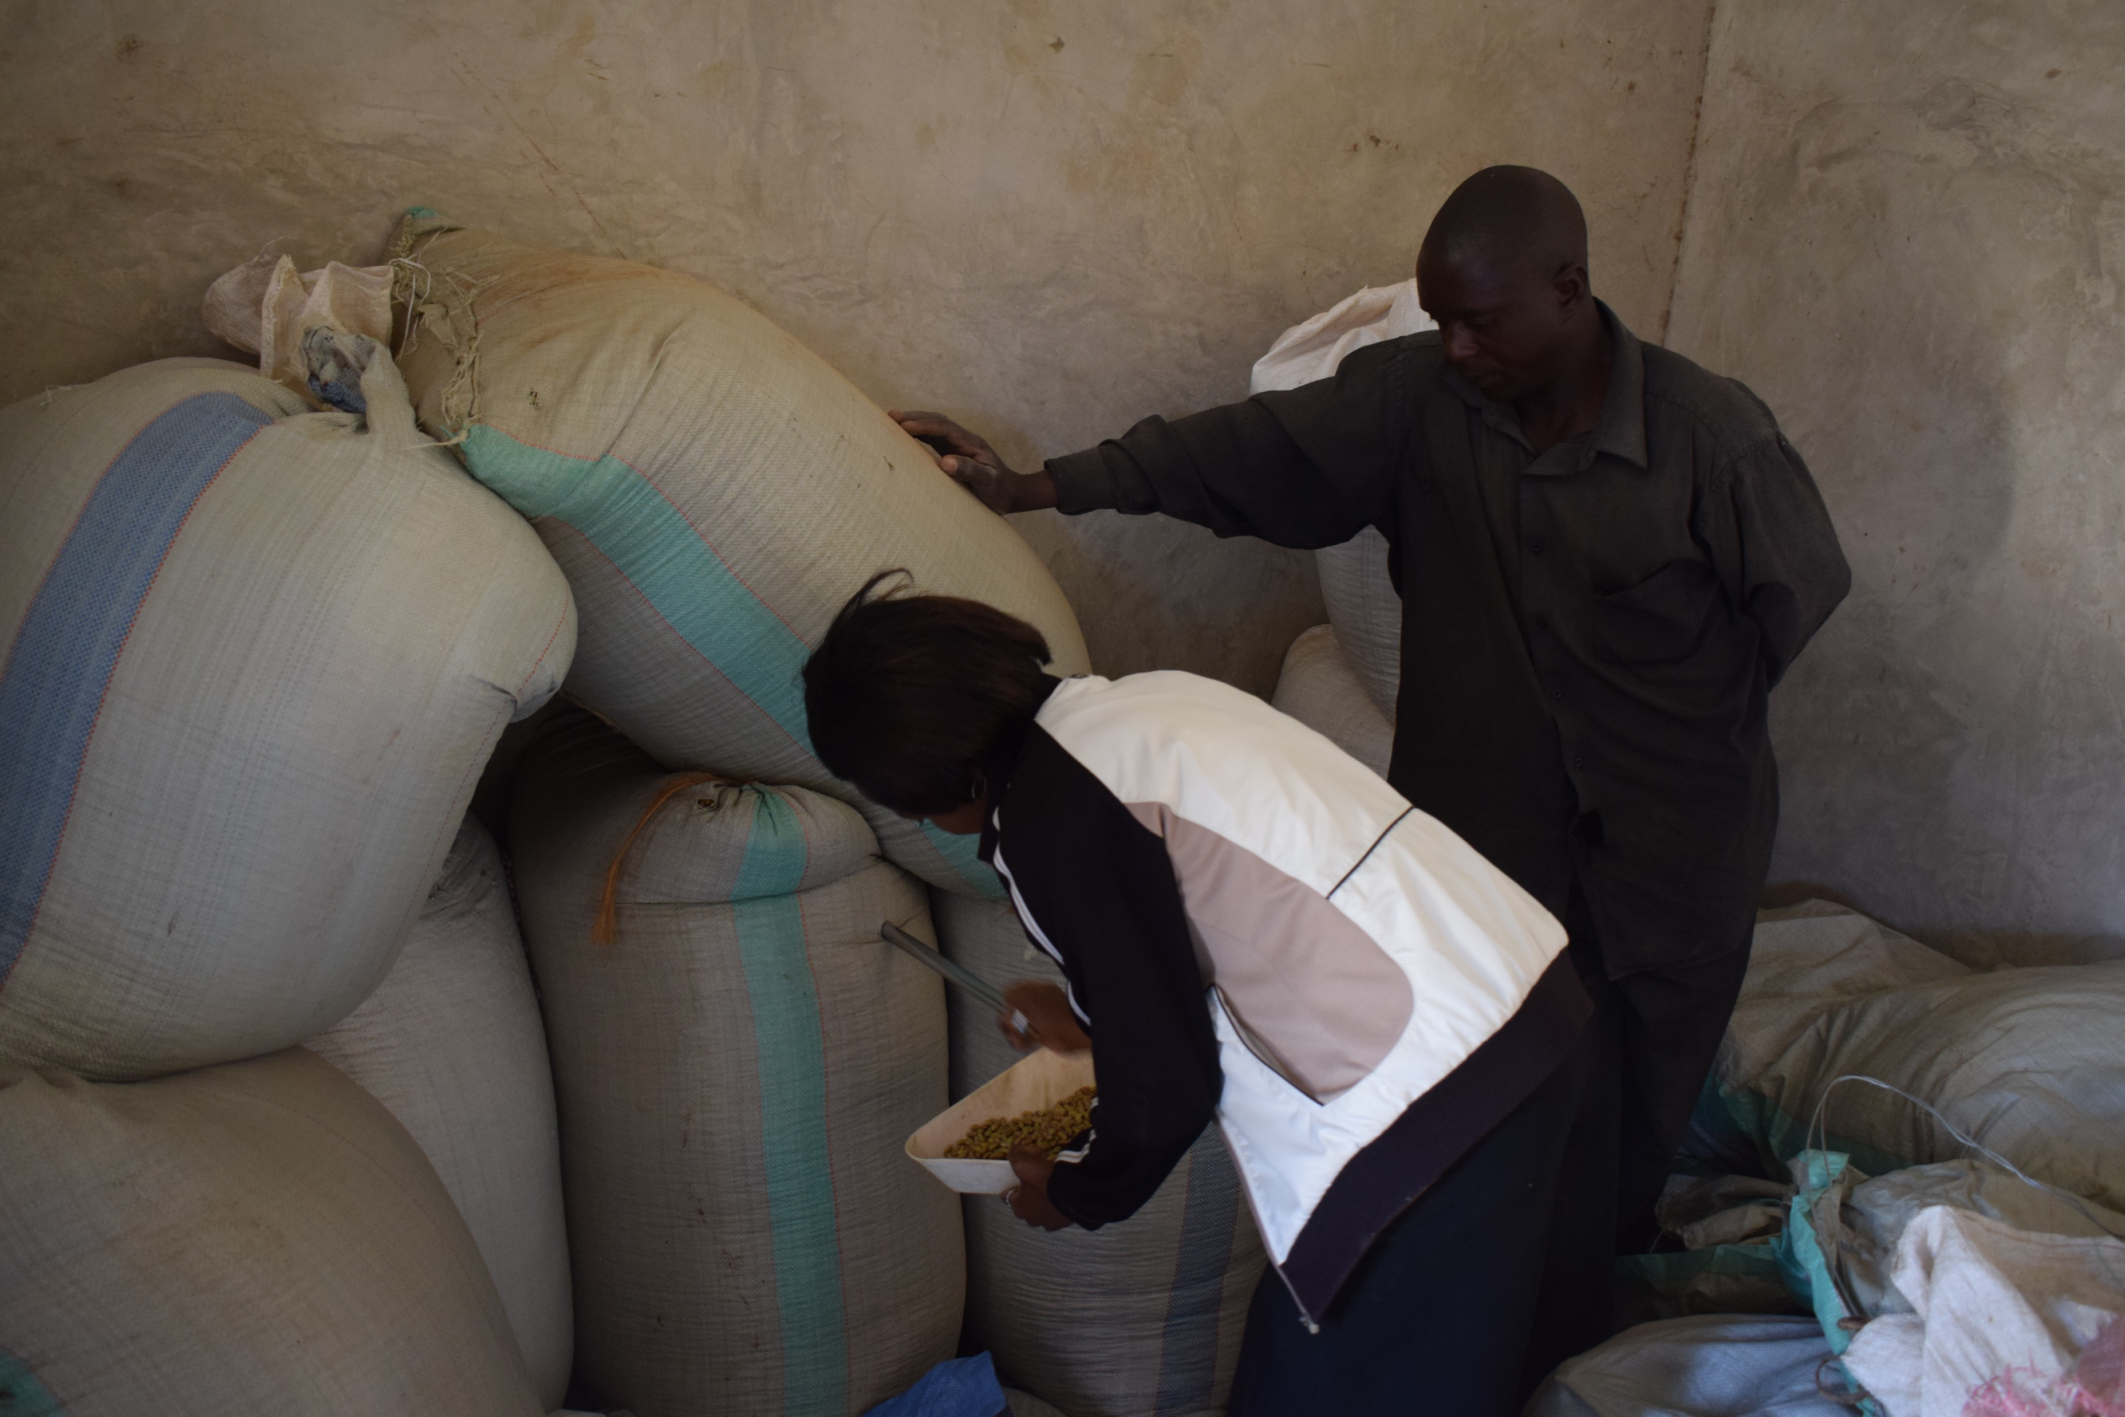
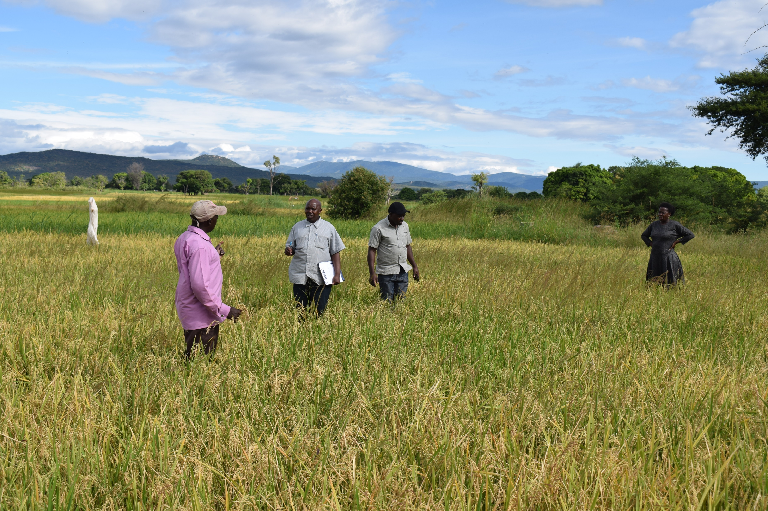
Strengthening seed system rice and legumes
  Strengthen the bond between QDS association and the district councils.
  Having strong leadership of the association by capacitating them on Record keeping, leadership and advocacy.
  Association having plan to form a seed company.

Slide 7
What has been done in Africa RISING –NAFAKA to strengthen the association and QDS production?
  Capacitating the DCO on the principles of seed production and formalizing the farmers /farmers groups on the procedures of seed production.
  The DCOs were capacitated on how to register QDS fields and application for field inspection to TOSCI.
  Fully involvement of the DCOs during field Inspection by TOSCI .
  The association chairperson visiting other farmers.

Slide 8
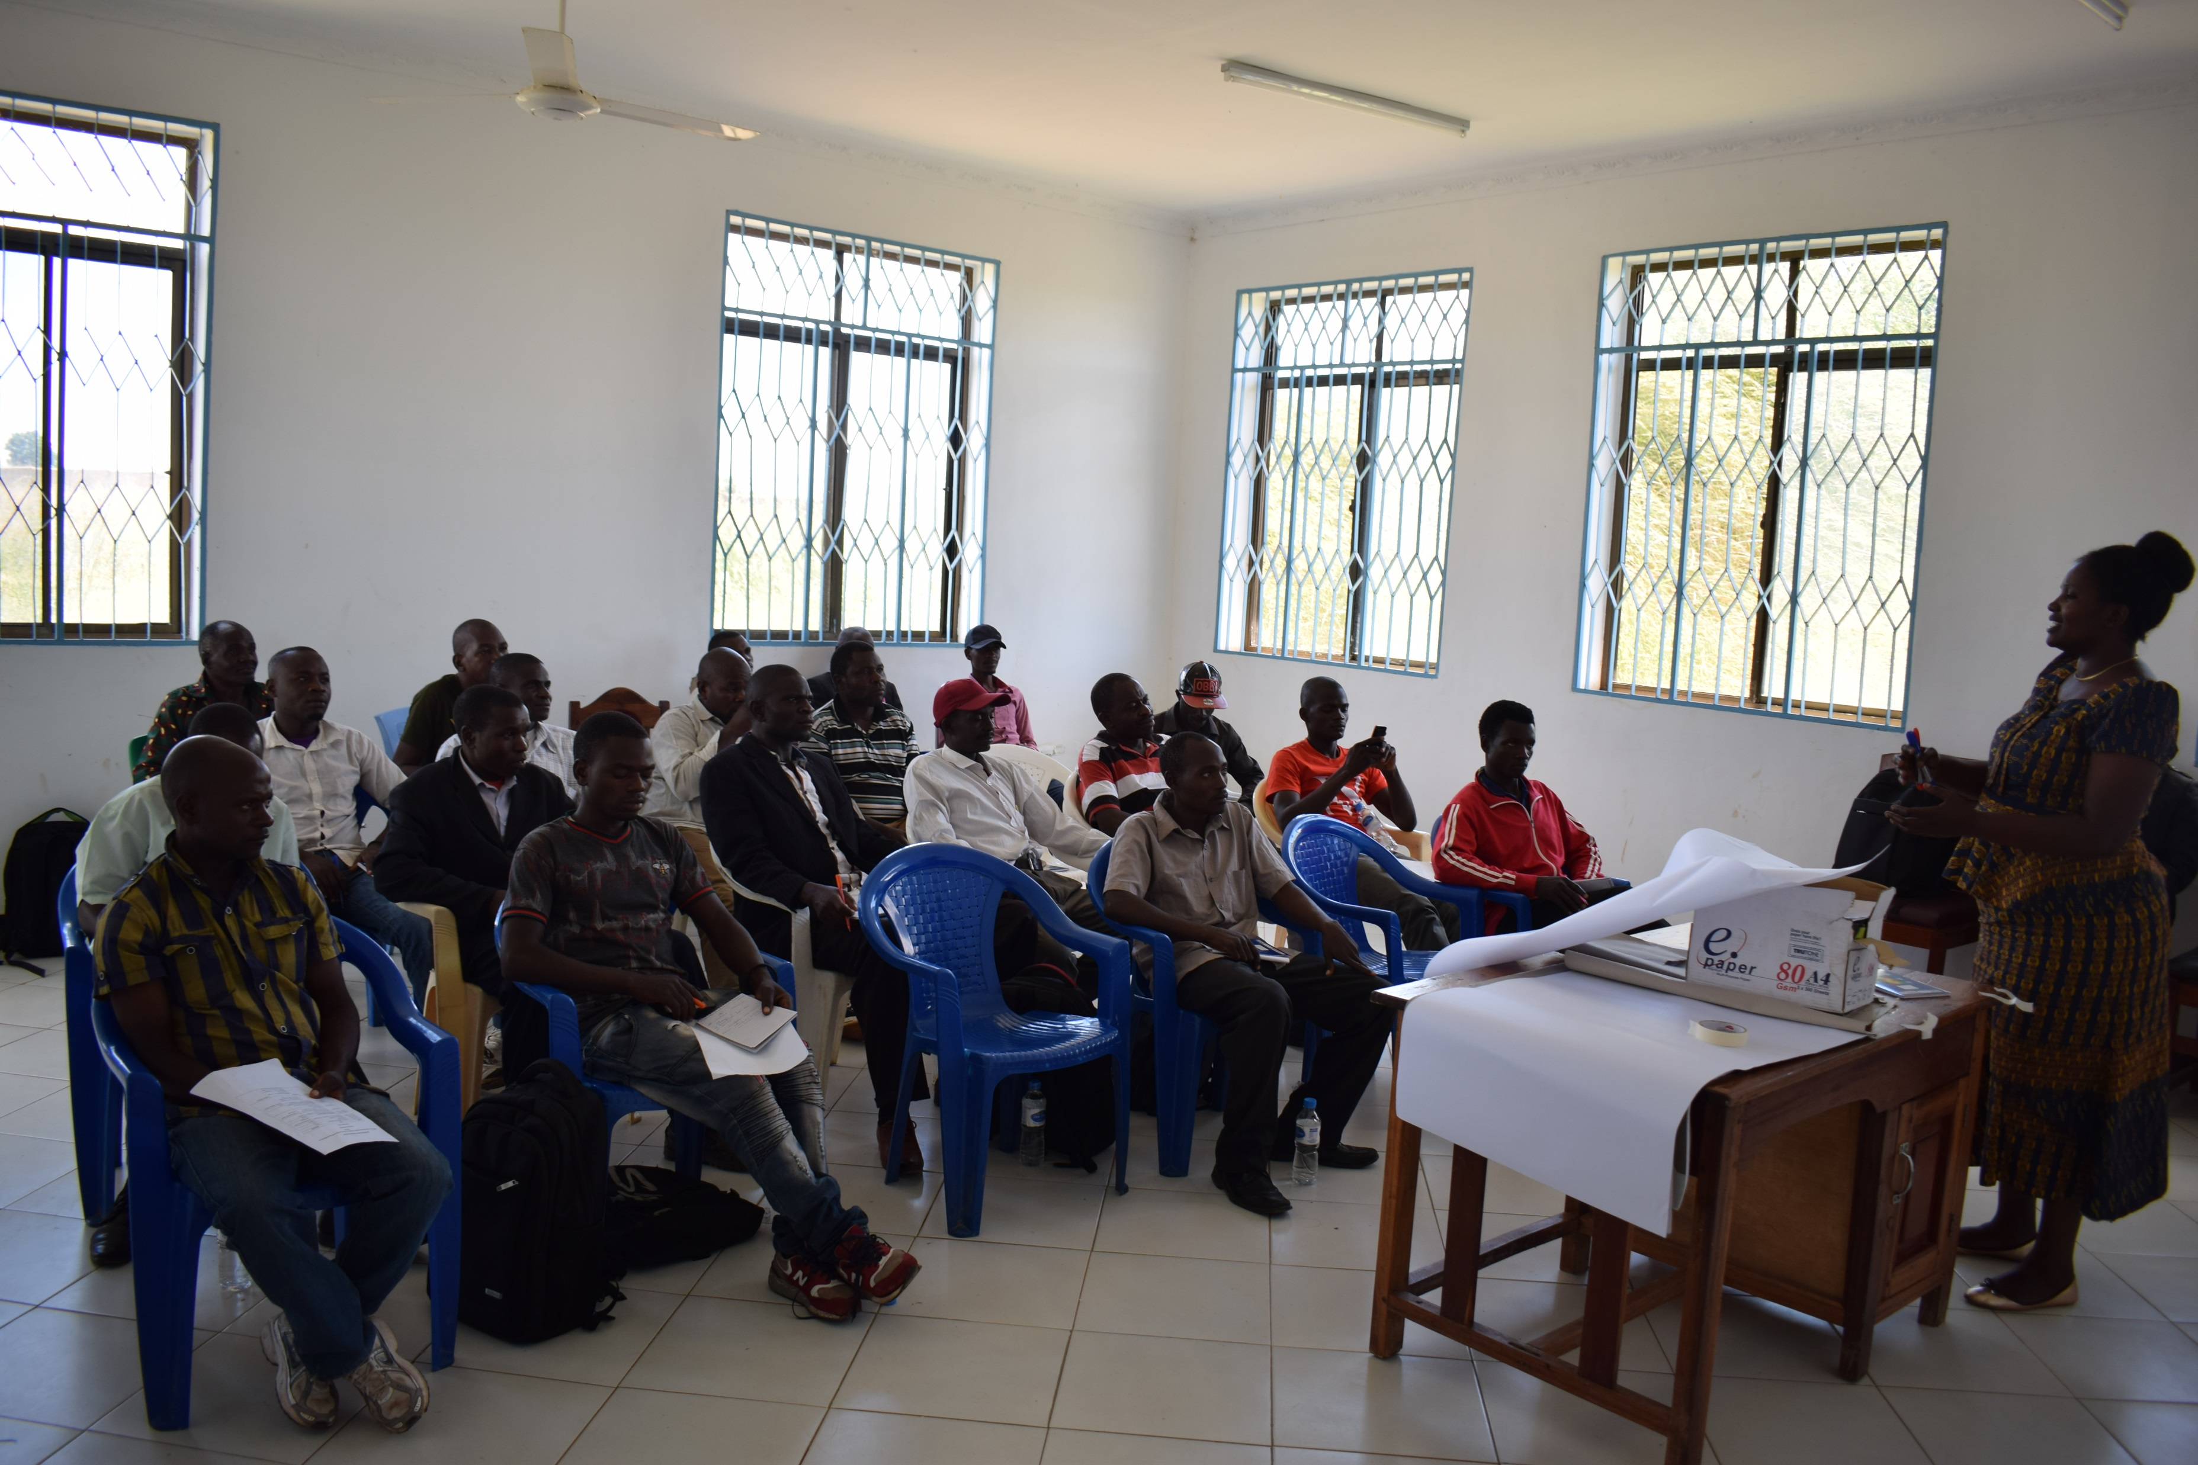
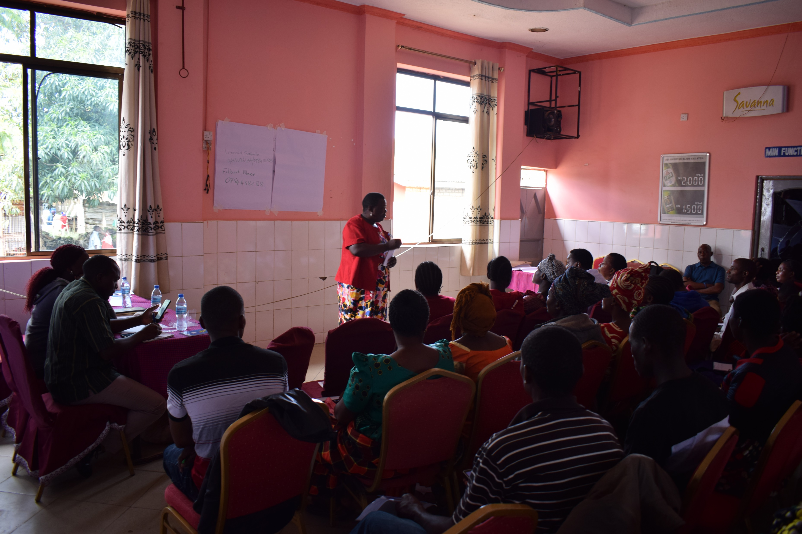
Association development Training.
Status of association development
For sustainability there are some of the district who have completed the legumes and rice QDS Producers Association in district level.
  Mbozi
  Momba-2 Rice and Legumes
  Mufindi
  Kilombero -3 Clusters
  Mbarali -3 Clusters
For Iringa DC and Kilolo DC will be the next district to form association of QDS producers.

Slide 9
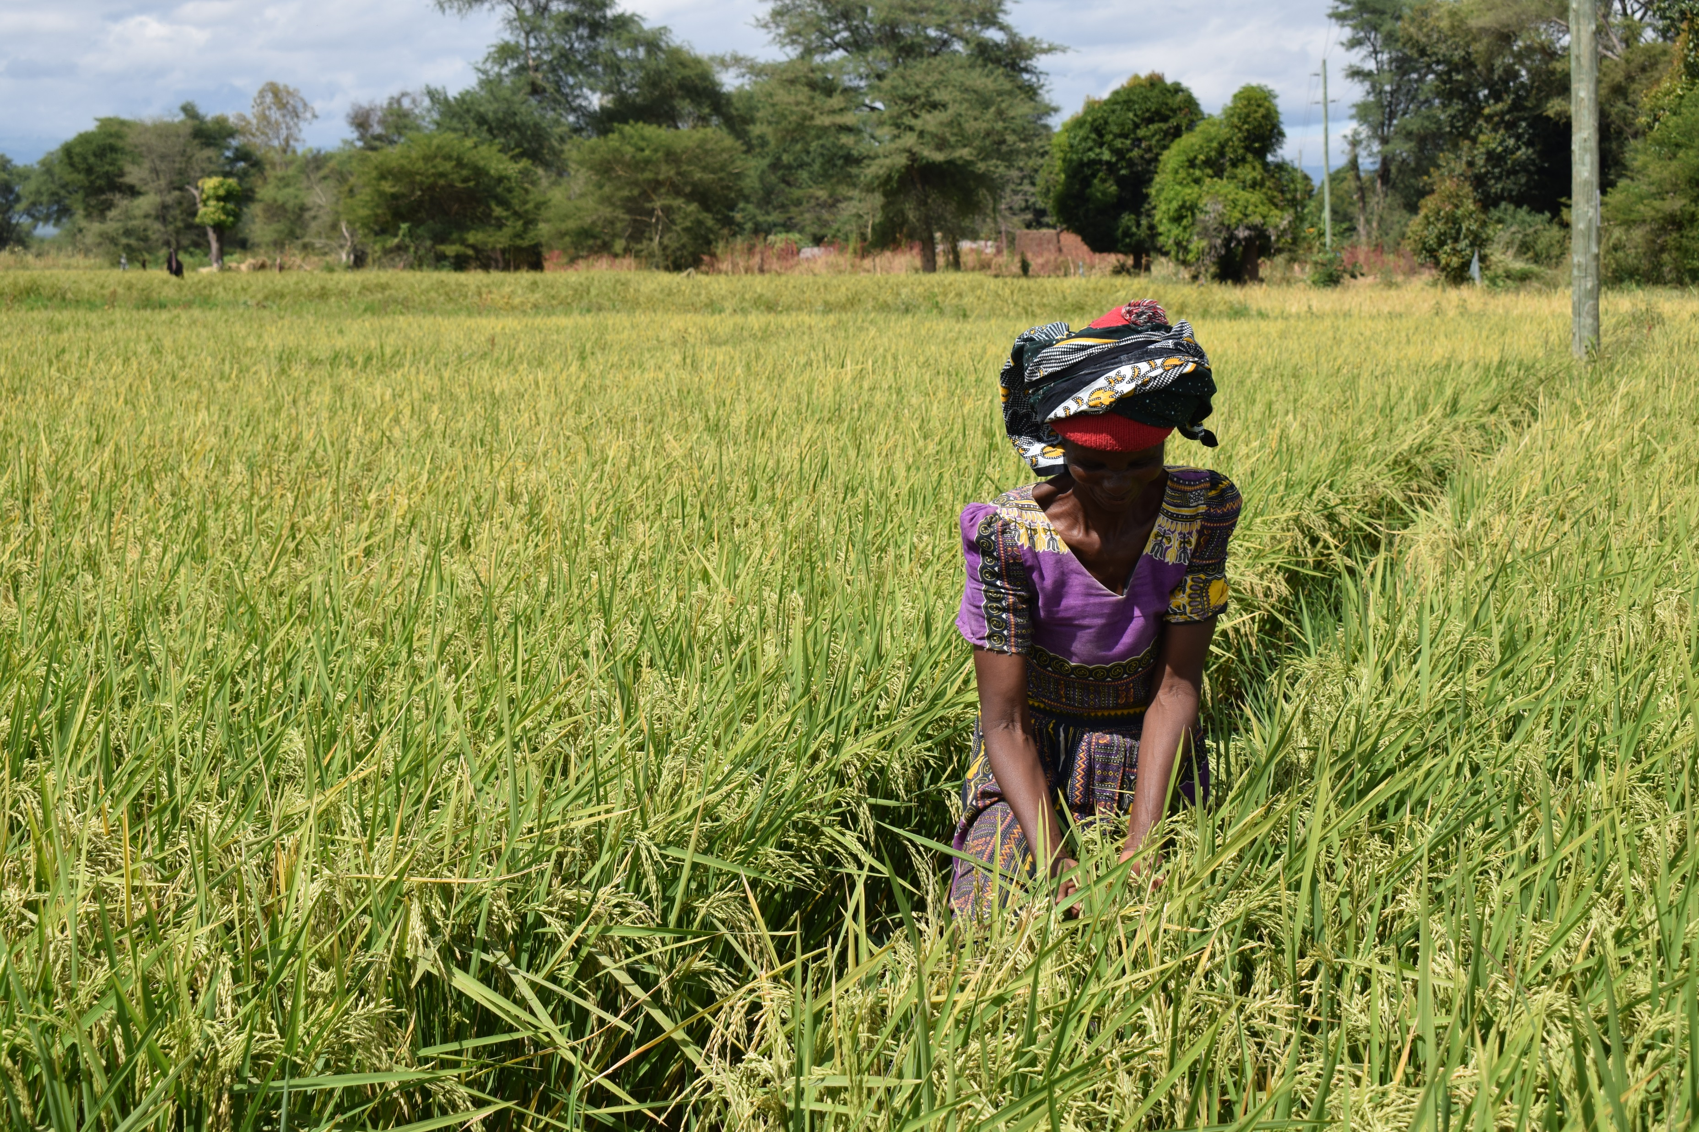
Making the association strong
APEX association formation at Kilombero and Mbarali due to the Geography of the district.
Increase the number of QDS producers especially in rice areas due to the request of Women and Youth groups who shown interest in production of QDS after seeing the opportunity.
Community Development offices becoming the patron of the association and manage conflicts

Slide 10
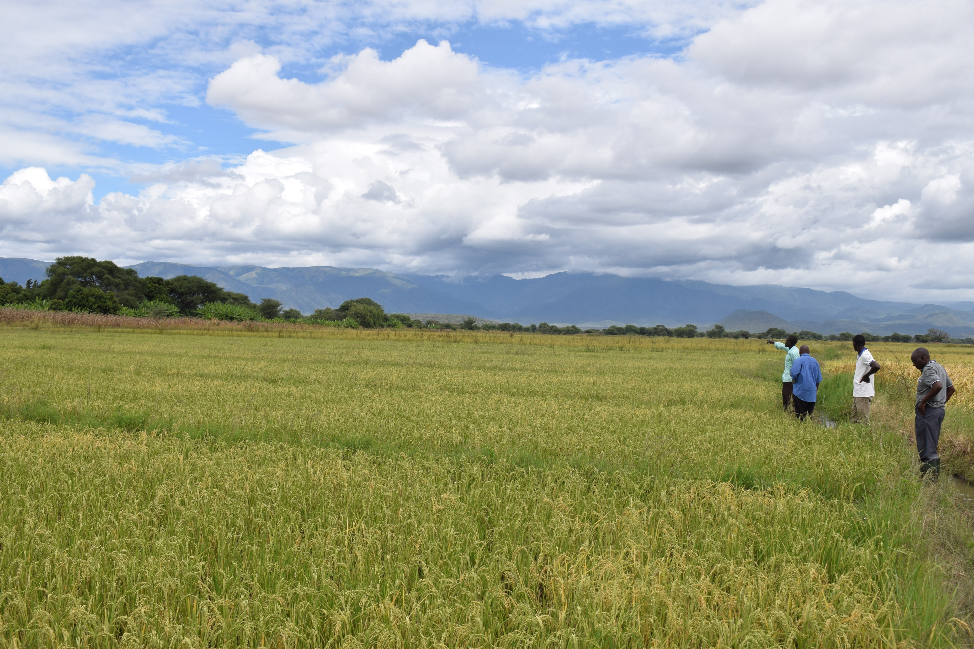
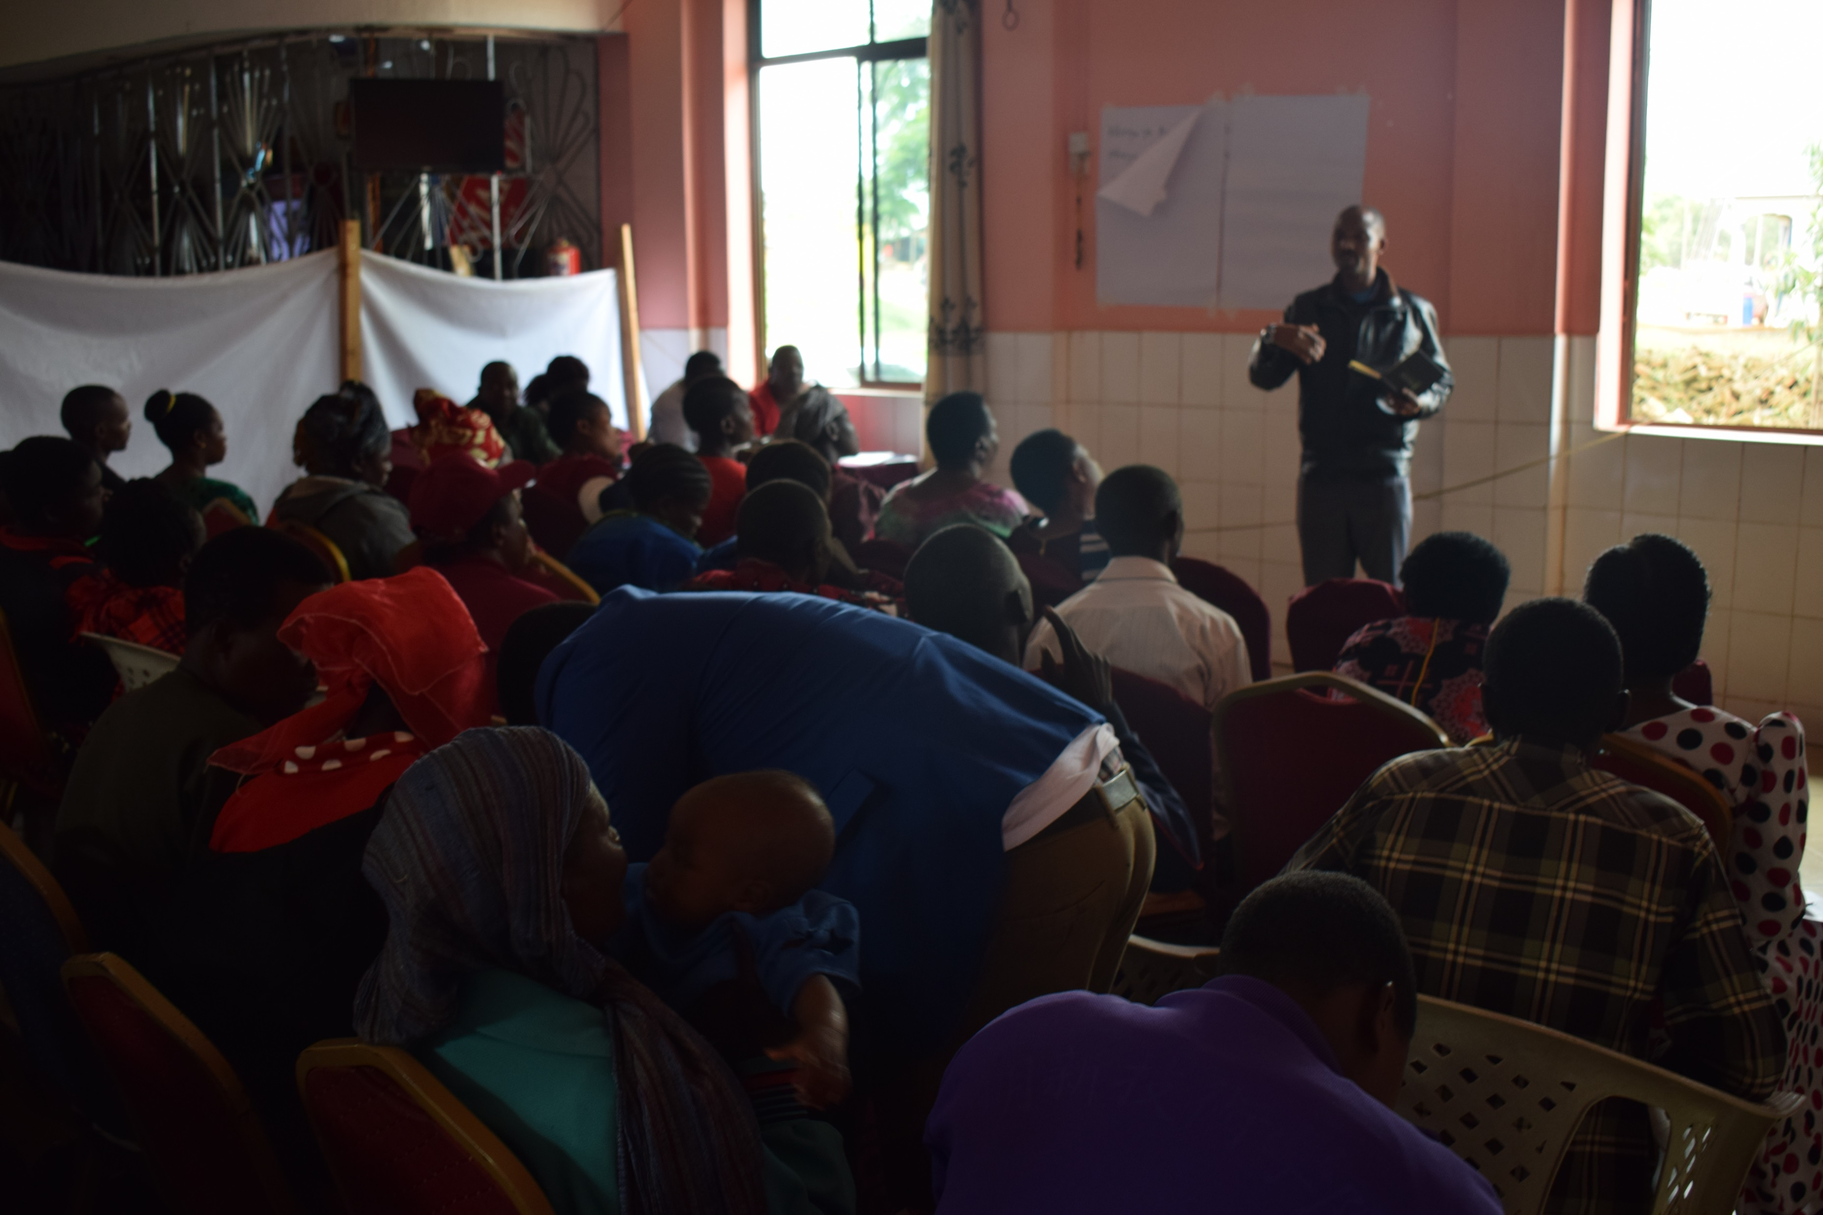
Strengthening seed production system
Collaborate with other stakeholders in the seed sectors to make QDS producers graduate and start producing certified seeds.
Observe the opportunity of the association been formed to a seed company that can supply the seeds all over the country.
Strengthen the Marketing of the seeds produced.

Slide 11
Way forward
  Strengthen the link with all the seed stakeholders
  Having projections on the quantity of basic seed needed by association.
  Having apex association in place for the districts that have cluster associations.
  Having contributions within the association to make their association work.
  Strengthen the leadership and record keeping to the association.

Slide 12
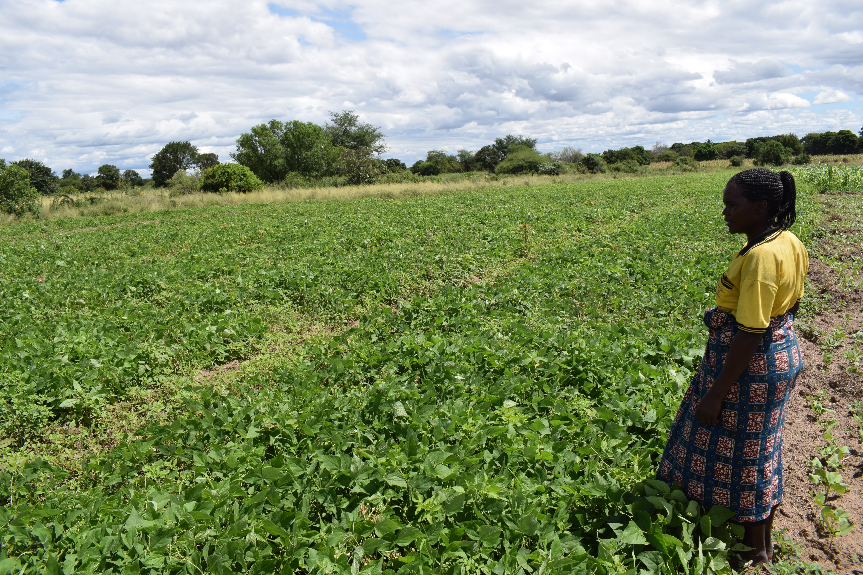
Thank you

Slide 13












PARTNERS
Notes:
ESA Africa

