Slide 1
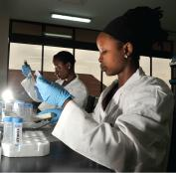
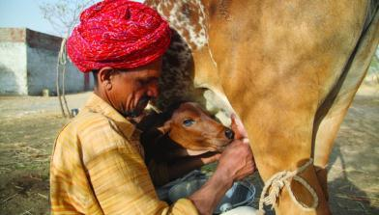
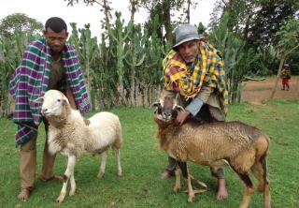


Animal nutrition approaches for profitable livestock operations and sustainable rural livelihoods
Blümmel, M.¹, Garg, M.R.,² Jones, C.¹, Baltenweck, I.¹ and Staal, S.¹
International Livestock Research Institute
National Dairy Development Board⁻², India
Indian Animal Nutrition Association XI Biennial Conference, Patna, India, 19-21 November 2018

Slide 2
Structure of Presentation
Feed costs as challenge to livestock producers and therefore animal nutritionist
Improving economics of feeding through animal nutrition approaches
Feed resourcing and feeding at the interface where positive and negative effects from livestock are negotiated
Feed interventions and wider livelihood implication

Slide 3
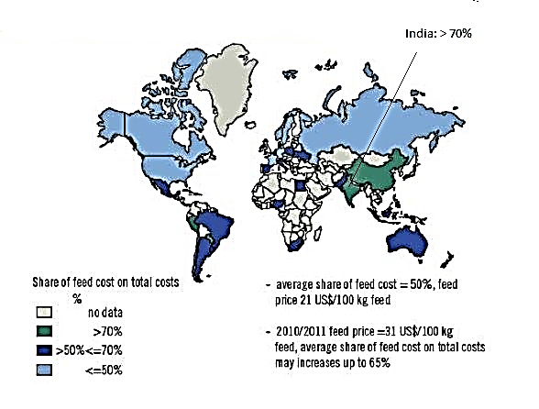
Share of feed costs in total costs of dairy production
(Hemme et al. 2013)

Slide 4
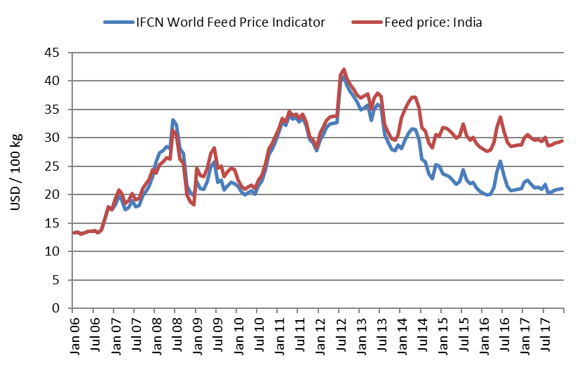
Global and Indian Feed Price Development
(IFCN, 2018)

Slide 5
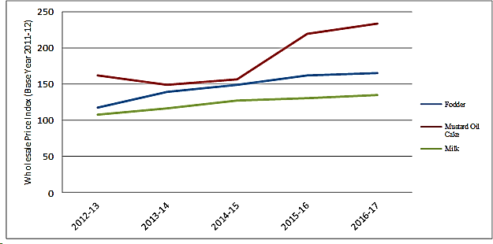
Feed Price and Milk Farm Gate Price Developments in India
(GAIN Report IN7123, 2018)

Slide 6
Feed Costs as Challenge
Feed costs already the major input cost into livestock production
Global and India feed prices diverge to the detriment of the latter
Feed prices in India rise faster than farm gate prices of produce, producing a scissor effect

Slide 7
Improving economics of feeding through animal nutrition approaches
Importance of feed quality –price relations, develop a culture to combine both information
Improve feed biomass quality: support plant breeding, upgrading ligno-cellulosic biomass
Improving on-farm feeding, matching and balancing nutrients and animal performance

Slide 8
Feed quality –price relations
Variations in prices in 65 compound and concentrate feeds collected in Bihar in 2015 accounted for by CP, NDF,
ADF, ADL, IVOMD,ME and Fat using
stepwise multiple regression
(Singh et al. 2016)
Feed quality traits | Partial R² | Total R² | P < F
Metabolizable Energy | 0.155 | 0.155 | 0.001
Crude Protein | 0.076 | 0.231 | 0.02
Feed dependent estimates to produce on additional kg of milk ranged from 10.3 to 24.5 IRs

Slide 9
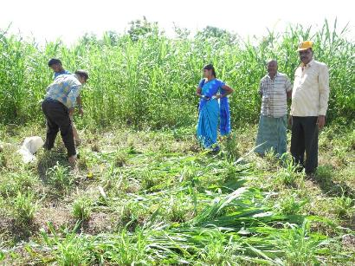
Forages and (in)attention to their quality: a study of Co FS 29
Trait | Mean | Range
Forage fresh yield (kg/ha/cut) | 34 126 | 15 157 - 61 282
Forage dry yield (kg/ha/cut) | 5 951 | 2 242 - 9 500
Forage N (%) | 2.00 | 1.55 - 2.22
Forage IVOMD (%) | 49.1 | 42.3 - 53.4
Highly successful for example in Mulkanoor Woman Dairy Co-operative!
But do we need to settle for a mean IVOMD of below 50% in a green forage ?
Ramachandra et al, unpublished

Slide 10
Variations in forage quality in 84 forage gene bank accessions of Napier from a single cut
Trait | Mean | Range
 |  | Leaf | Stem
Crude protein (%) | 16.5 | 5.9 to 23.6 | 6.4 to 20. 9
IVOMD (%) | 62.1 | 53.7 to 68.0 | 54.1 to 73.0
ME (MJ/kg DM) | 8.6 | 7.8 to 9.7 | 7.8 to 10.4
(Jones et al., 2018)

Slide 11
Breeding advance in dual purpose maize stover fodder quality relative to different sorghum stover traded in rainfed India

Slide 12
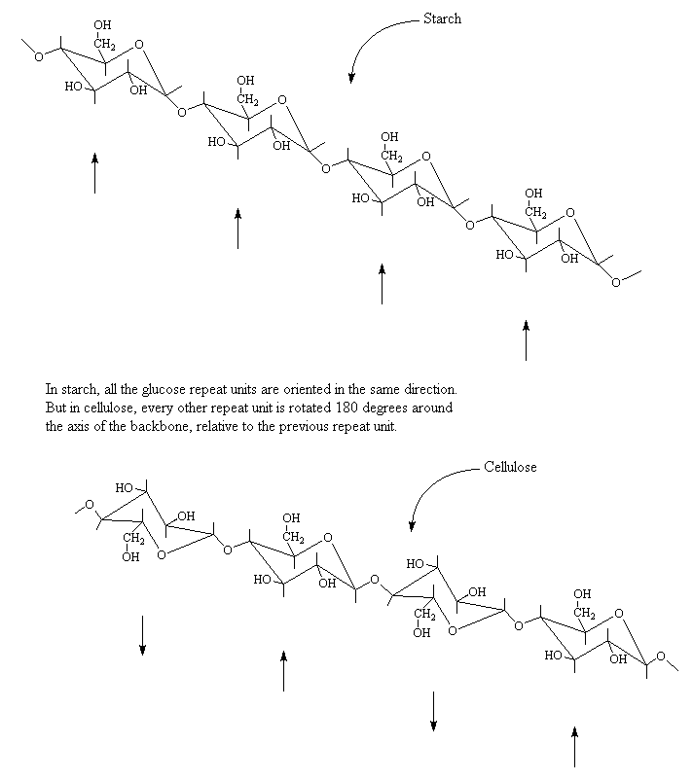
Leveraging spin-off technologies from 2nd generation
for deconstructing ligno-cellulosic biomass
10 – 50 Billion tons biomass annually and about 4 Billion tons are from crop residues
Billions of $ investment to leverage for different steps along the value chain starting from collection of high bulk low density feed stocks to bio-manufacturing and de novo synthesis of enzymes
Dissolve boundaries between food-feed-fodder, livestock species and even animal and human nutrition
Potential game changer technologies

Slide 14
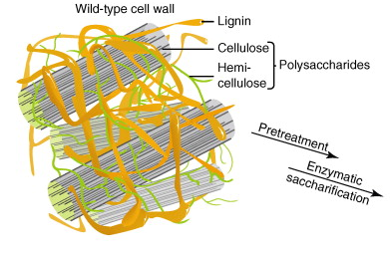
Leveraging 2nd generation biofuel technologies
    Steam Explosion Treatment
    [Nagarjuna Fertilizer]
    Ammonia Fiber Expansion (AFEX)
    [Michigan Biotechnology Institute]
    2-Chemical Combination Treatment
    [Indian Institute for Chemical Technology,
    joint patent application with ILRI under consideration]

Slide 15
Summary of effects of steam, ammonia fiber expansion and 2CC treatment on in vitro gas production (GP) and true in vitro digestibility⁻¹ (IVOMD) after 48 h of incubation. U = untreated; T = Treated
Spin-off technology | n | In vitro GP after 48 h (ml/200 mg) |  | True IVOMD after 48 h (%)
 |  | U | T | U | T
Steam Treatment | 4 | 48.6 | 53.6 | 62.9 | 71.8
AFEX Treatment | 10 | 42.9 | 51.5 | 65.1 | 84.4
2CC Treatment | 11 | 39.7 | 66.7 | 55.9 | 94.1
⁻¹The average difference between true and apparent IVOMD is about 12.9 percentage units (van Soest, 94). Increments in digestibility were similar independent of expression as apparent or true digestibility.
Blümmel et al. (2018)

Slide 16
Intake and weight gain in sheep fed complete diets consisting of 70% untreated and steam and 2CCT treated rice straw
⁻

Slide 17
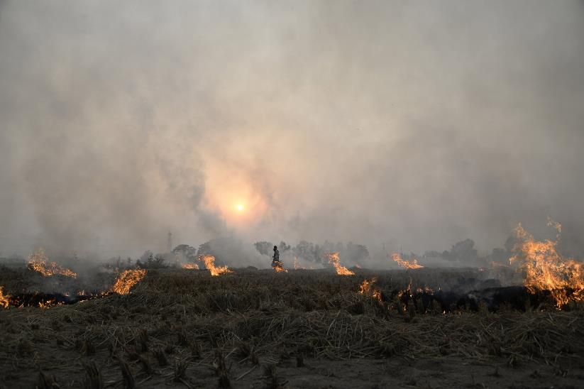
Would rice straw with a digestibility of more than 80% still burn?

Slide 18
Improve feed biomass quality: support plant breeding, upgrading ligno-cellulosic biomass
Improving economics of feeding through animal nutrition approaches
Co-operation of animal nutrition and plant improvement can contribute significantly to more feed biomass with
higher fodder quality
Potential game changer technologies to be harvested from 2nd generation biofuel - animal nutritionists
need to be the driver!

Slide 19
Improving on-farm feeding, matching and balancing nutrients and animal performance performance nimal nutrition approaches
Ration Balancing: a comprehensive approach of NDDB to apply animal nutrition principles to improve on-farm feeding:
      Increase in production
      Increase in economics of dairy and its components
      Positive associated effects

Slide 20
Summary of key dairy productivity variables after implementing ration balancing (RB) feeding, matching and balancing nutrients and animal performance nimal nutrition approaches
Impact on | Cows (n=1.74 million) |  | Buffalo (n=1.05 million)
 | Mean | Range | Mean | Range
Milk production before RB kg/d) | 9.1 | 7.9 to 15.6 | 7.8 | 5.6 to 11.4
Milk production after RB (kg/d) | + 0.85 | 0.40-3.10 | + 0.42 | 0.15-2.20
Milk fat (% units) | + 0.3 | 0.1-1.5 | + 0.3 | 0.1-1.8
Feed costs (IRs / kg Milk) | - 1.8 | 0.5-3.5 | - 1.1 | 0.4-3.2
Milk efficiency (kg FCM/kg DMI) | + 0.2 | 0.58 to 0.78 | + 0.13 | 0.53 to 0.66
Reduction in CH₄ (% / kg Milk) | -18 | 11-24 | -16 | 10-20
Daily benefit per animal* (IRs /d) | + 25 | 15-40 | + 25 | 10-35
* In animals yielding about 8 to 10 kg/d

Slide 21
Improving on-farm feeding, matching and balancing nutrients and animal performance nimal nutrition approaches
Ration Balancing applied to millions of dairy animals had significant positive effect on key dairy productivity variables
The comprehensive approach of NDDB to apply animal nutrition principles to improve on-farm feeding has general appeal to LMC countries – South to South collaborative opportunities
A serious study is warranted (and facilitated) to understand if current findings
    describe ceiling values for what is achievable through on-farm targeted feed interventions

Slide 22
Feed resourcing and feeding and environmental foot prints
Structure of Presentation
Feed production and water requirements for feed production
Feed characteristics and greenhouse gas emissions
Intensification and reduction of feed requirements and environmental foot prints

Slide 23
Life cycle analysis of irrigation water use in dairy production in Gujarat in India
 | S. Gujarat |  | W. Gujarat |  |  | N. Gujarat
 | B | CB | B | CB | LC | B | CB | LC
Milk kg/d | 1.87 | 2.90 | 4.72 | 6.39 | 4.08 | 3.82 | 5.14 | 4.0
Liter H₂O drinking water | 39 | 32 | 41 | 34 | 28 | 52 | 49 | 38
Liter H₂O feed | 5970 | 5510 | 7730 | 8790 | 6680 | 11760 | 11630 | 7060
Liter H₂O per kg of milk | 3226 | 1887 | 2041 | 1724 | 1667 | 4546 | 2941 | 2941
B = Buffalo; CB = cross breed; LC = Local cow
H₂O requirement for production of 1 kg of Milk
Gujarat: 3 400 l Global: 1 000 l
Data adapted from Singh et al., 2004

Slide 24
A simplified framework to combine feed resources data
base and water input requirement estimates
Climatic and water data
Min and Max-Temperature ( ºC)
Humidity (%)
Rain fall
Wind speed ( km day⁻¹)
Sunshine (hrs day⁻¹)
Radiation (Mj m⁻² day⁻¹)
Volume of water per irrigation and number of irrigation
Crops and soil parameters
Soil type and structure
Crop types and management practices ( food and fodder crops)
Length of growing period for different stages of development
Soil types
Land use land cover (ha) as structured in Table 4
Examples of tools and procedures
Budget (Raes et al., 2006)
CropWat (FAO 1998;
Allen et al., 1998)
Total evapotranspired water by feed sources type (m³ ha⁻¹)
Feed Dry Matter (kg m⁻³)
Feed resources by types (Kg ha⁻¹)
NIANP FeedBase Concept
NIANP FEEDBASE
Conversion factors,
HI, feed use factor (as structured in Table 4)
(Blummel et al, 2014b)

Slide 25
Methane production from 1 kg of feed truly digested in the rumen in dependence of SCFA proportion and Efficiency of Microbial Production
(modified from Blümmel and Krishna 2003)

Slide 26
Feed requirement in dependency of per dairy animal productivity: c. 70 M dairy, 82 Mt milk
(Blummel et al, 2013 calculated from data of Anandan et al. 2009)

Slide 27
Effect of producing the same amount of milk with fewer dairy animals on methane production
(Blummel et al., 2013 calculated from data of Anandan et al. 2009)

Slide 28
Feed resourcing and feeding and environmental foot prints
Structure of Presentation
Feed sourcing is the driving factor for livestock water productivity
With awareness, animal nutritionist can estimate water requirement and design water use efficient rations
Ration choice and design effect SCFA proportion and EMP and both effect enteric CH₄ production
Intensification has potentially an overriding effect on feed requirement and total and proportional CH₄ production

Slide 29
Feed interventions and wider livelihood implications
Feed interventions, feeding and labor
Limitations to improvement of feed resources on-farm
Need to increase affordable off-farm produced feed
Win-win situation through production of affordable off- farm produced feed

Slide 30
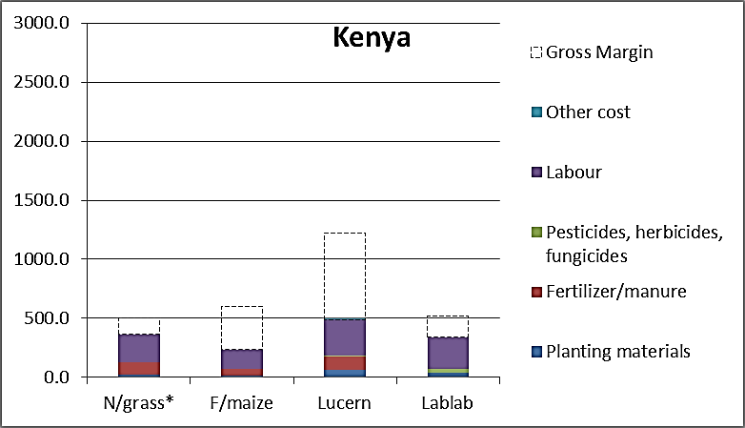
Labor implication of feed interventions

Slide 31
Cost of Milk Production in India
IFCN, 2018

Slide 32
Labor input per dairy animal on 4 farms in India with differing numbers of animals and land sizes
(modified from

Slide 33
Gender Role in Dairy Production
Activities | Men | Women
Livestock/ Dairy | Animal treatment | Fodder collection
 | Breeding | Feeding
 | Feed purchase | Watering
 | Delivery of milk/marketing | Cleaning shed
 | Sweet manufacturing | Milking
 |  | Delivery of milk/marketing
 |  | Care of sick animals
Total labor hours for dairy | 0.5-1 hours | 4-5 hours 2-3 hrs. for feeding tasks
(Source: Kumaraswamy et al., 2014. A gendered assessment of the Mulukanoor Women’s Cooperative Dairy value chain, Telangana, India;
Ravichandran et al., 2018. Determinants of women’s participation and control over dairy income from dairy cooperatives: Evidence from Bihar and Telangana villages, India)

Slide 34
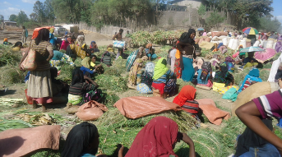
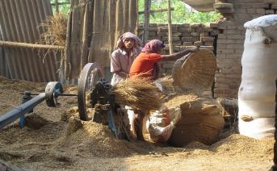
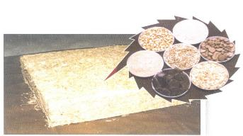
More off-farm produced feed and its implication for wider rural livelihood implications
Forages as a cash crop
Simple, low biophysical and socio economic investment
Highly competitive for example with vegetables
Fodder marketing, service provision
Fodder collection and transactions
Chopping, grinding
Silage, hay making
Feed processing
Mineral and other supplements
Total mixed rations

Slide 35
Conclusions
Increase the economic benefit from ASF production by decreasing feed costs and/or increasing ASF production,
Decrease the environmental footprint of ASF production
Reduce labour requirements and drudgery involved in feed resourcing and feeding
Provide opportunities for micro, small and medium enterprises (MSME) in feed production, marketing and processing

Slide 36
Conclusions
However to achieve this we need to work within a wide disciplinary and institutional framework:
      Economists and socio-economists
      Natural resource management
      Plant improvement
      Key life science actors
      Development actors, NGOs
      Private sector
      Policy makers

Slide 37
Thank you very much for your attention!
and

