Slide 1


Uganda MorePork project intervention plan 2021 - Deep dive scaling assessment
Iddo Dror, Edwin Kangethe, Murat Sartas (ILRI)
Uganda ‘MorePork’ project stakeholder workshop
Kampala, 23-24 February 2021
Notes:
Apologies for not being able to be there in person. I will present results from Nairobi together with my colleague John Mutua, senior research associate at Alliance Bioversity Int and CIAT
This research started a few years ago, and is fed from several scientific publications, stakeholder workshops and MSc thesis – summary is in policy brief in your folder
We acknowledge the technical review and endorsement by Deogracious Wonekha MAAIF and Derrick Senyonga MWE
We will show you why heat stress in pigs is an important issue for Uganda and should feature high on the adaptation agenda, what future heat stress exposure we expect, who will be impacted and how, and what can be done to adapt.

Slide 2
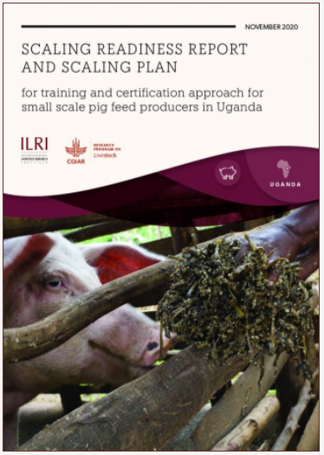
A highlight
To improve performance of the training and certification plan and market arrangement model in Uganda and increase their use at scale, the study recommends:
studying the experience of feed certification implementation group and feed standards associations in similar contexts to Uganda
prepare and possibly implement plans for supporting existing implementation groups
establishment statement as well as a business plan for a new association (alternatively for updating organizational structure and business plans of existing suitable associations) that can fulfil tasks required for feed standards monitoring and enforcement

Slide 3
Planned objectives and deliverables
Scaling Scan Report
Scaling Readiness Assessment
Scaling Plan

Slide 4
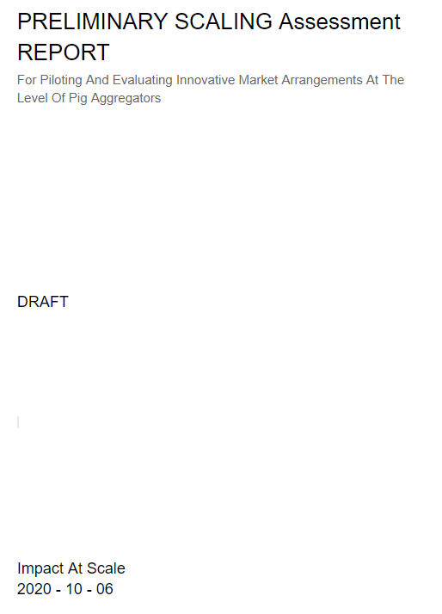
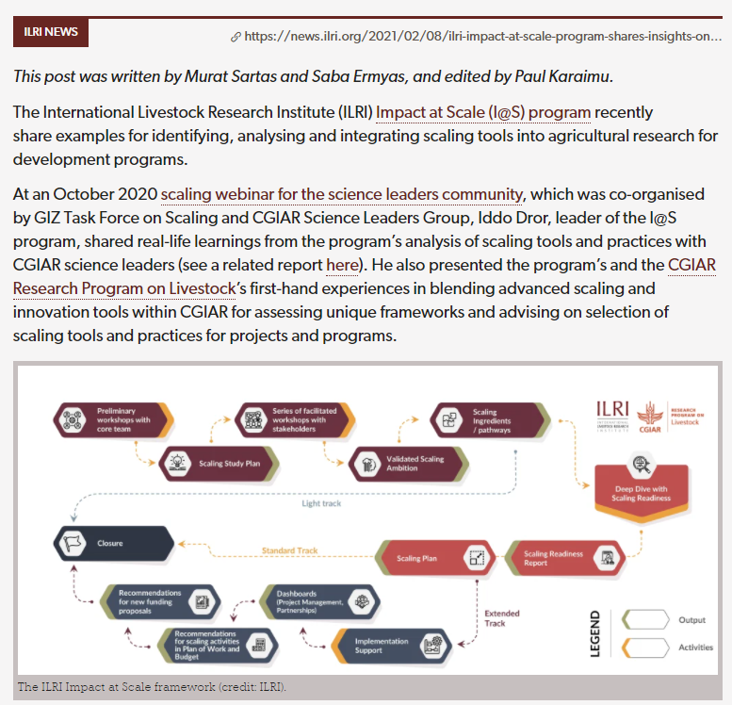


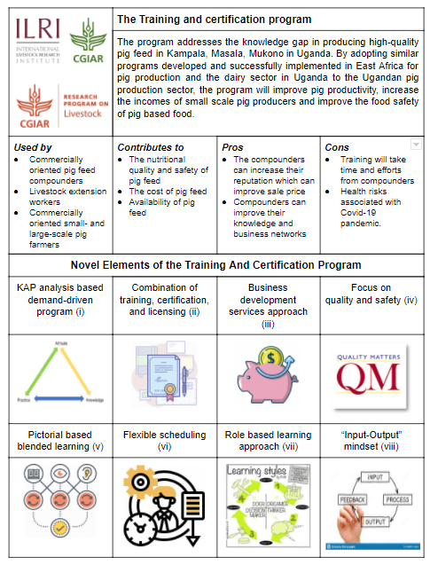
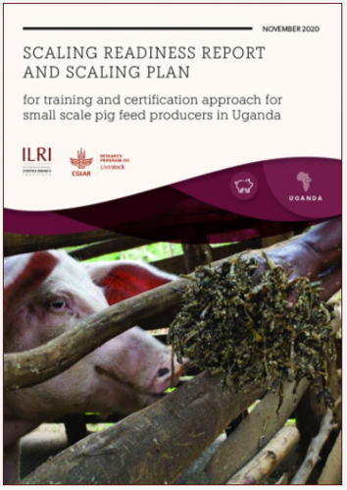
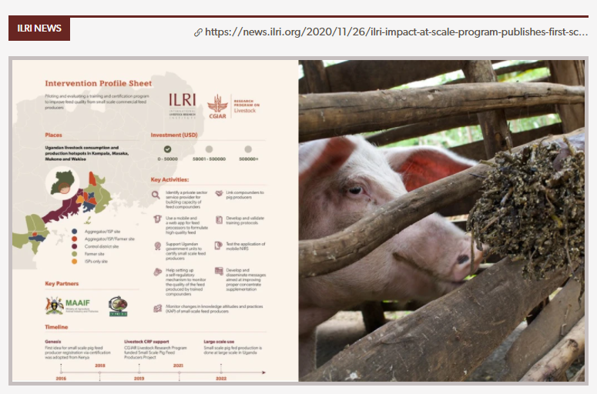
Progress 2019-date
ILRI started implementation of I@S Framework with a in person workshop
2020
Feb
2020
June
2020
Nov
2021
Jan
2019 Nov
2020
Mar
2020
Oct
2020
Dec
2021
Feb
2nd Scaling Scan Workshop was conducted

Slide 5
Our 2021 plans for this intervention
Present the findings and insights of the reports with MorePork team members and key stakeholders
  Deliverable 1: 2-3 Debriefing Sessions Conducted
  Deliverable 2: 1-2 Blogs on summarizing the findings and insights of the reports
Complete Deep-Dive Study (Scaling Readiness Report and Scaling Plan) for Market Arrangement Model
  Deliverable 3: Approximately 35 pages Scaling Readiness Report
  Deliverable 4: A 5-pager Scaling (Strategic) Plan
Support implementation of training certification program and market arrangement components
  Deliverable 5: to be determined

Slide 6
Emerging opportunities
Any new activities we want to add; and how/when to include
  Complementary proposals whenever they are available
  Support MorePork in sharing and utilizing its learning
  How can we better contribute?

Slide 7

Outlook post 2021
Which elements of this intervention area must/should continue post 2021
  Which elements does the project team/leadership feel should continue?
What do you think?
Source: www.pork.org

