Slide 1

Improving collaboration between research and the private sector to accelerate livestock innovation for sustainability into use: Can the private sector pay for public health?
Delia Grace, Sinh Dang and Fred Unger, ILRI
Lightning presentation at a parallel session, 9th Multi-Stakeholder Partnership Meeting of the Global Agenda for Sustainable Livestock, Manhattan, Kansas, 9-12 September 2019

Slide 2
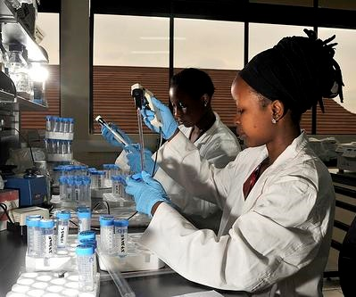
Introducing me!
Delia Grace Randolph
International Livestock Research Institute
ILRI & the private sector
  Long experience
  Wide range of partners
  Lots of promise; lots of high impact factor papers; little proven impacts
#LivestockAgenda
Notes:
Long experience with little to show for it

Slide 3
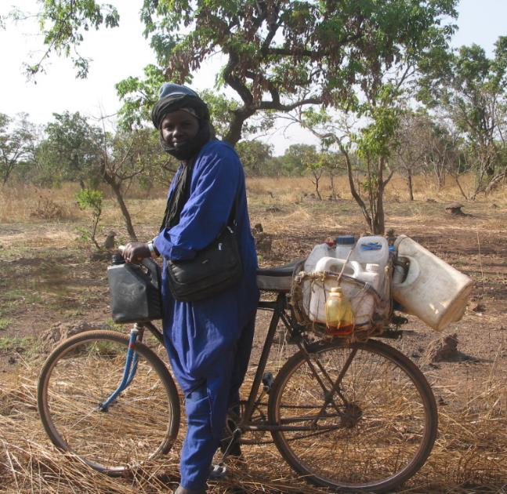
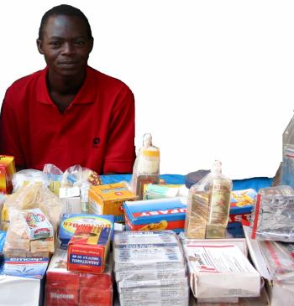
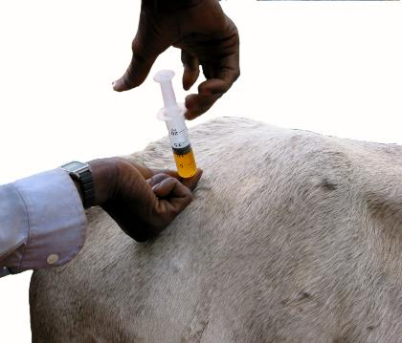
Rational Drug Use

Slide 4

Rational Drug Use
BEFORE

Slide 5
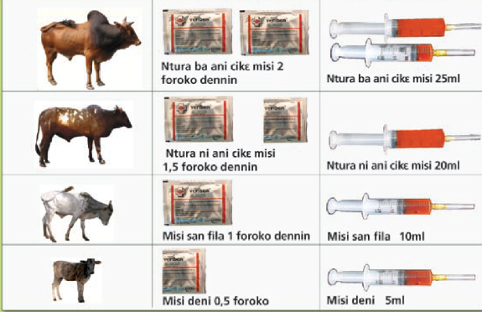
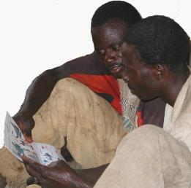
Rational Drug Use
BEFORE
DURING

Slide 6
Rational Drug Use
BEFORE
DURING
AFTER
Gave 30% more correct dosages
Had 10% more successful treatments
Had 10% fewer injection side affects

Slide 7
PP partnership that worked, wasn’t taken up the the private sector, but may be
Rational Drug Use for Farmers
In LMIC most vet drugs are given by farmers (untrained personnel)
Giving simple, previously unobtainable, information on diagnosis, and dosage improved treatments and reduced drivers of drug resistance
Why? – the success of the intervention
  One of the rare cases when information does make a difference (genuine ignorance, desire to change behaviour and opportunity to act)
  Win-win: better drug use, minimal cost (simple change to package), less resistance: we assumed private sector would deliver
Why? – the failure of adoption
  Drug companies did not take forward – small market, no one cared, disabling policy environment
  Now AMR has become a big issue. Could this proven approach come back from the dead?
#LivestockAgenda

Slide 8
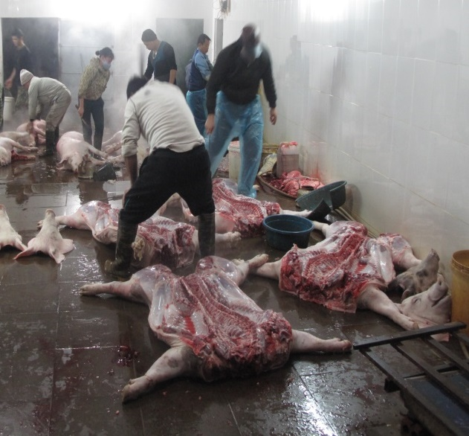
BEFORE
On GRID

Slide 9
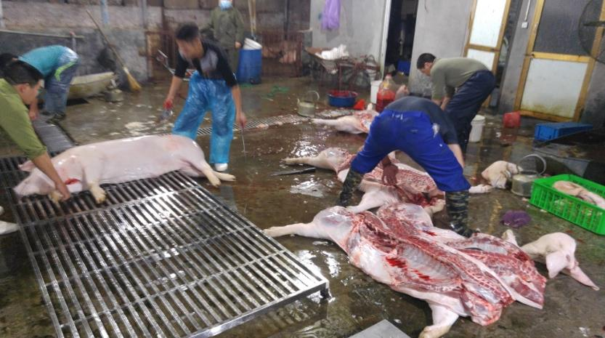
BEFORE
DURING
lower faecal bacteria (p = 0.002) on the grid carcass surface
On GRID

Slide 10
BEFORE
AFTER
DURING
lower faecal bacteria (p = 0.002) on the grid carcass surface
On GRID

Slide 11
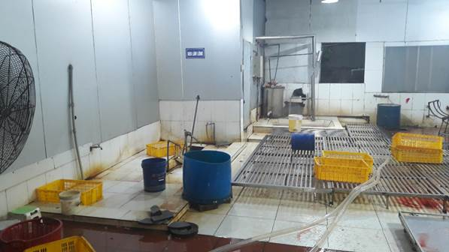
BEFORE
AFTER
DURING
LATER
lower faecal bacteria (p = 0.002) on the grid carcass surface
On GRID

Slide 12
PP partnership that worked, wasn’t taken up the the private sector, and then was
On the Grid: off-floor slaughter of pigs
Reduce the enormous burden of Food Borne Disease
Why success?
  Critical factor 1: Cheap, appropriate technology, tested effective
Why private sector initially failed to continue using?
  Extra work and incentive of safer pork and fewer sickness and death not compelling motivation
Why private sector started using and invested in 15 more grids & other infrastructure? (9-12months after pilot ended)
  Grids & other visible improvements (e.g. clean and dirty zone) attracted major companies supplying pork to their workers’ canteens
  Transition to higher scale (before 30-40, now 80-100 pigs/day) made investment easier and pork quality more a priority
#LivestockAgenda

Slide 13
Conclusions
For investors
  Research is still too supply driven
  Improving human health is not a powerful incentive for the private sector
For implementors
  It is not enough for interventions to be effective, low cost and acceptable
  The time may not be ripe now but may come for private sector investment
If I spend somebody else’s money on somebody else, I’m not concerned about how much it is, and I’m not concerned about what I get
Milton Friedman
#LivestockAgenda

