Slide 1
Important!
This module is designed to potentially serve a wide variety of audiences (nutritionists and agronomists, policymakers, extension workers, farmers).
Not all of the material will be relevant to all audiences.
Please refer to the accompanying Facilitator’s Guide for guidance on how to adapt these materials to your audience and facilitation best practices.

Slide 2




Legend
Icon | Description
 | Expected Duration, minutes
 | Quick Review/Survey Questions
 | Brainstorming Session
 | Discussion Session
 | Group Activity
 | Animated Slide
 | End of Animation
Xm

Slide 3
Legal
Unless otherwise noted, all images copyrighted to International Potato Centre.
Attribution-NonCommercial-ShareAlike 2.0 Generic (CC BY-NC-SA 2.0).

Slide 4
Everything You Ever Wanted to Know About Sweetpotato
Topic 11: Gender and Diversity Aspects

Slide 5
Introduction
Gender and Diversity Aspects

Slide 6
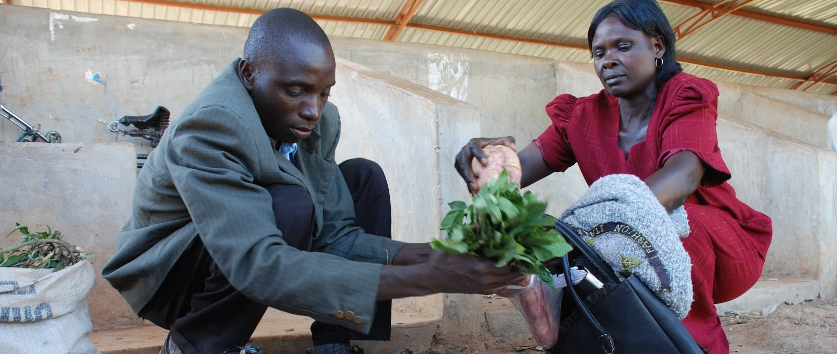
Welcome
During this session, we will examine the importance of recognising gender and diversity issues in agriculture and sweetpotato systems.

Slide 7
Defining Gender and Diversity
Unit 1

Slide 8
Objectives
By the end of this unit, you should be able to:
Compare the terms “gender” and “sex.”
Explain the basic biological (average) differences between men and women.
List some basic characteristics of gender related laws and customs in traditional and modern African societies.
Define gender equality, mainstreaming, and empowerment.

Slide 9
Defining Gender and Diversity
Sex and gender interrelated not identical
  “Sex” refers to biological traits that define men and women
    Women give birth, have breasts, menstruate
    Men have testicles, larger muscles
  “Gender” refers to men and women’s societal roles, behaviours, activities, attributes
    Since gender roles are social construct, they can be altered to better suit communities’ needs
Different societies have different cultural norms around gender. For example, in many African societies, inheritance and family name traditionally handed down through the woman, whereas the tradition was reversed in the West.
Some norms are more consistent around the world, e.g. women worldwide do the lion’s share of housework.

Slide 10
Important Gender Concepts
Gender equality: Goal state where men and women have equal rights, responsibilities, and access to resources.
Gender mainstreaming: Process of giving attention to gender issues as integral principle in projects.
Empowerment of women:
  Process giving women power and control over their lives
  Does not mean coercing or disempowering men
Diversity is about more than gender. It encompasses all different groups that may be disempowered or disadvantaged in society, e.g. religious minorities, living in generational poverty, etc.

Slide 11
What is the difference between terms ‘gender’ and ‘sex’?
Besides gender, what other groups should be considered from the diversity angle?
Notes:
Answers
“Sex” refers to biological traits that define men and women; “Gender” refers to men and women’s societal roles, behaviours, activities, attributes
Religious groups, poorer groups

Slide 12
Key Points
Sex and gender are interrelated but not identical. “Sex” refers to biological traits that define men and women, while “gender” refers to men and women’s roles in a society.
Different societies have different cultural norms around gender, but some norms are more consistent around the world.
For example, in many African societies, inheritance and the family name were traditionally handed down through the woman, whereas the tradition was reversed in the West; but women worldwide do the lion’s share of housework.
Because gender roles are a social construct, they can be altered to better suit communities’ needs.

Slide 13
Key Points
Gender equality is a goal state in which men and women have equal rights, responsibilities, and access to resources.
Gender mainstreaming is a process of giving attention to gender issues as an integral principle in a project.
Gender empowerment is the process of giving women power and control over their lives. Empowerment of women does not mean coercing or disempowering men.
Diversity is about more than gender, encompassing all of the different groups that may be disempowered or disadvantaged in society, such as religious minorities, those living in generational poverty, etc.

Slide 14
Why Gender and Diversity Issues Are Important In Agriculture and in Sweetpotato Enterprise
Unit 2

Slide 15
Objectives
By the end of this unit, you should be able to:
Explain the links between women’s disempowerment and economic underperformance.
Tell why gender issues are important to understand when facilitating sweetpotato supply chain projects in Sub-Saharan Africa (SSA).
Discuss the household decisions that tend to be made by men in SSA, and those that are made by women.
Describe the Towards Sustainable Nutrition Improvement (TSNI) project’s approach and findings around gender issues.

Slide 16
Why Gender and Diversity Issues Are Important in Agriculture
Women farmers produce more than 50% food grown worldwide
In SSA, women make up 50% agricultural labour force.
Yet women face many constraints, such as accessing resources and markets.
“Gender gap” results in:
  Less food grown
  Less income generated
  Higher levels of poverty and food insecurity
It is estimated that 12% to 17% hungry people in the world could be fed if women had equal opportunities.

Slide 17
SSA Gender Consideration Importance
Men tend to control productive resources in agricultural sector, although women sell and produce more.
Crop tends to be controlled by women as food security crop. If commercialized (cash crop), it tends to be controlled by men.
Women are key nutrition decision-makers and are typically responsible for feeding children and household.

Slide 18
Towards Sustainable Nutrition Improvement (TSNI) Project
Covered range of topics including breastfeeding, hygiene, malnutrition, what foods, how, when to feed infants, etc.
Found that giving women nutrition instruction for all family members resulted in a decrease in vitamin A deficiency in children, from 60% to 38%.
  Project offered information on sweetpotato as well as other rich vitamin A sources such as papaya
Men who were given access to the learning sessions tended to drop off and let the woman continue to represent the family in the sessions.

Slide 19
Worldwide, do women produce more than half of all grown food or less?
What are some of the challenges that women face in sweetpotato production?
Notes:
Answers
More
Access to resources, access to markets, men control commercialised crop

Slide 20
Key Points
Although they grow 50% of the world’s food, women’s lack of access to resources and opportunities results in reduced food and income production in the sweetpotato market and in agricultural sectors generally.
It is estimated that 12 to 17 percent of hungry people in the world could be fed if women had equal opportunities.
Men tend to control productive resources in SSA and in the agricultural sector.
Sweetpotato farming tends to be dominated by women where it is a food security crop and by men when it becomes a cash crop.

Slide 21
Key Points (cont.)
Women are key nutrition decision makers in many parts of SSA, but men make decisions around spending money and planting crops; thus, both sexes must be consulted and informed in sweetpotato development projects.
The TSNI project in Mozambique found that giving women instruction around nutrition for all family members resulted in a drop in vitamin A deficiency in children, from 60% to 38%. (The project offered information on sweetpotato as well as other rich vitamin A sources such as papaya.) Men were given access to the learning sessions, but they tended to drop off and let the woman continue to represent the family in the sessions.

Slide 22
Gender Roles and Responsibilities in the Sweetpotato Value Chain
Unit 3

Slide 23
Objectives
By the end of this unit, you should be able to:
Compare male and female roles in sweetpotato farm ownership, management, and labour input.
Relate an example of gender roles in sweetpotato production changing in a region over time.

Slide 24
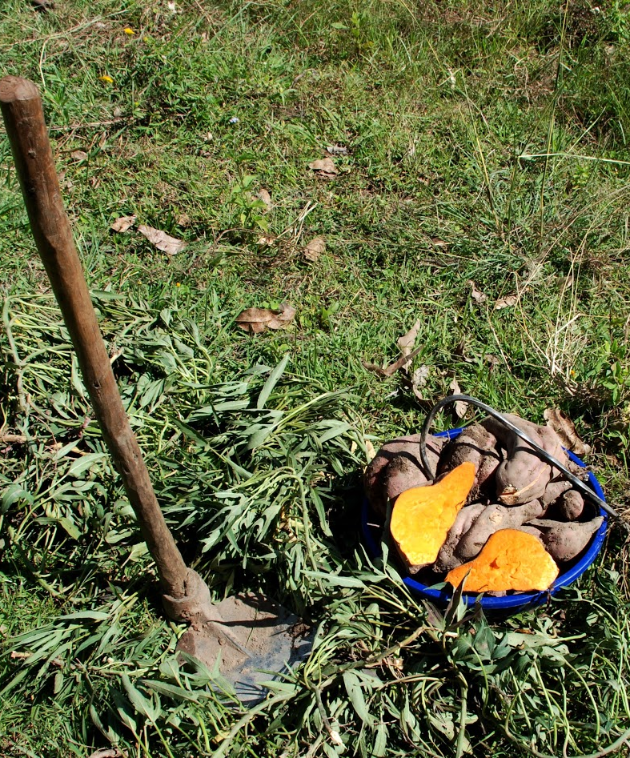
Three Types of Ownership
Sweetpotato is traditionally a female crop; few or no men grow it
Sweetpotato is traditionally a male crop; few or no women grow it
Sweetpotato is grown by both men and women on individually owned or family plots

Slide 25
Different roles in sweetpotato production
Owner
  Makes legal decisions
Management
  Person who “initiates” the farm
  Makes most production decisions
Labour
  Provides input in production activities
A man who is a legal owner of a sweetpotato farm may leave management decisions to women.

Slide 26
Gender Roles Changing Over the Years
Tanzania, 1995 study
  Sweetpotato produced by women for home consumption
  Women also obtained planting material, picked suitable land for planting and sold vines for fodder.
  Where commercialised sweetpotato production was common, men have become more actively involved in production and marketing.
Tanzania, 2012 study
  In parts of Tanzania men are becoming increasing interested and involved in production.
  Men started contributing more labour and working together with their wives on sweetpotato fields.

Slide 27
Growing Crops by Gender
Parts of SSA, some crops are considered “male” and others “female”, though categories can fluctuate.
Intercropping means that sometimes men and women will work different crops in the same field.
  Men often grow maize
  Women tend to grow sweetpotato

Slide 28
Is the farm owner the same as farm manager?
Who is more likely to grow crops for household consumption? For selling?
Notes:
Answers
No. Owner makes legal decisions. Manager ‘initiates’ the farm.
Women for household consumption. Men for commercialised crops.

Slide 29
Key Points
In some parts of Sub-Saharan Africa, sweetpotato farming is a men-only or women-only enterprise, while elsewhere, both sexes partake.
When discussing the involvement of men and women in sweetpotato farming, it is important to consider the difference between ownership, management, and labour. A man who technically owns a sweetpotato farm may leave management decisions to women.
In many parts of SSA, some crops are considered “male” and others “female.” But these categories can fluctuate.
A 1995 survey found that in some regions of Tanzania, women made most decisions and did most of the labor relating to sweetpotato.

Slide 30
Key Points (cont.)
However, by 2012, when sweetpotato growing had become more commercialized, and some crops considered “male” men were becoming difficult to grow, men were taking over sweetpotato farming.
Intercropping means that sometimes men and women will work different crops in the same field.

Slide 31
Constraints, Needs and Priorities of Male and Female Sweetpotato Farmers
Unit 4

Slide 32
Objectives
By the end of this unit, you should be able to:
Compare the needs and priorities of men and women in sweetpotato farming.
Describe examples of women experiencing increased constraints as sweetpotato growers.
Compare male concerns and female concerns about sweetpotato varietal characteristics.

Slide 33
Roles and Responsibilities
Men and women have different household roles and responsibilities.
Unequal access to assets, resources, opportunities
Face different constraints, have different needs and priorities.
Due to subordinate social position, women are unable to control male labour.
Men often own the land and therefore have access to larger sweetpotato plots to work. Women must rely on men to borrow land and access resources.
Factors such as age and community status also affect individuals’ access to resources.

Slide 34
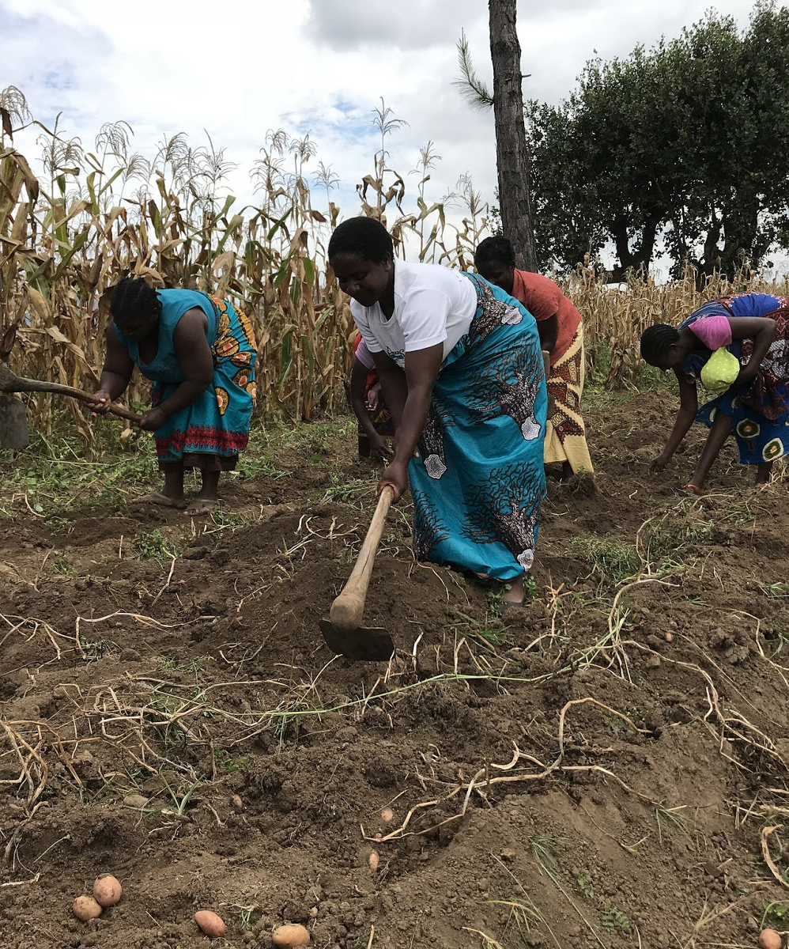
Gender Varietal Characteristics
Both are concerned with:
  Root yields and size
  Disease and pest resistance
  Drought tolerance
Women are more concerned with cooking qualities, taste, dry matter content.
Men are more concerned with market-related characteristics.

Slide 35
What characteristics are more important to women? Men?
Besides gender, what else might affect access to resources?
Notes:
Answers
Age, community status
Women: cooking qualities, taste, dry matter content: Men: market-related characteristics

Slide 36
Key Points
Men and women generally have different roles and privileges in various regions of Sub-Saharan Africa and therefore do not experience sweetpotato farming in the same way.
For example, in Nasarawa State, Nigeria, men own the land and therefore have access to larger sweetpotato plots to work, as women must rely on men to borrow land and access resources.
Factors such as age and community status also affect individuals’ access to resources.

Slide 37
Best Practice for Incorporating Gender in Sweetpotato Programs
Unit 5

Slide 38
Objectives
By the end of this unit, you should be able to:
Describe best practices for studying local gender issues prior to beginning sweetpotato programs.
List the areas of sweetpotato growing that should receive gender analysis.
Describe the power, education, and access differences that may exist between groups in the same community.
Name and describe areas and practices that can be altered to make sweetpotato programs more inclusive for women, young and old people, the poor, and the community as a whole.

Slide 39
Incorporating Gender in Sweetpotato Programs: Startup and Targeting
Sweetpotato program facilitators should carry out a gender situation analysis prior to beginning programming.
Analysis should include:
  Roles and responsibilities in agriculture
  Access to land and other resources
  Role of sweetpotato in food security and family income
  Power in household
  Gender differences in knowledge
Information gathered through group and individual interviews, using participatory tools tailored to rural areas.
Targeting should not exclude women. If appropriate, use gender quotas.

Slide 40
Incorporating Gender into Service Provision and Training
Ensure women have access to resources they need to participate, e.g. by providing credit
Use gender-neutral language and promote program in ways that clarify benefits for both men and women.
Explore communication strategies with all genders, income levels, and age groups.
Setting class times, facilitators should consider women’s childcare needs and all community members’ scheduling needs.
Measures should be taken to ensure young people can also participate.

Slide 41
Gender Issues in Varietal Development and Testing
Understand gender roles and responsibilities to decide which farmers to work with, when developing new varieties and technologies, as different genders prefer different qualities.
Monitor gender roles over time
Use Gender situation analysis; Participatory varietal selection and evaluation involving women and men farmers and traders; Gender mapping based on interviews with key informants.

Slide 42
Gender issues in Vine Multiplication
Understanding the differences between male and female farmers in planting material multiplication practices.
Gender analysis of division of labour, resource allocation, decision-making.
Exploring female and male farmers’ perceptions of qualities of a good sweetpotato vine multiplier and seed system.
Understanding what resources existing women and men multipliers use for vine conservation and multiplication.
Using a mixture of qualitative survey tools such as: checklists/ semi-structured interviews with gender disaggregated farmer focus groups and key informants, observation, calendars, field walks/ transects; and a trans-disciplinary team.

Slide 43
Gender Issues in Crop Management Practices
Understanding how pest and disease control and crop management practices vary amongst different groups.
Understanding who does what when, the challenged faced by different groups and different information pathways.
Understanding ownership, control and access to resources.

Slide 44
Gender Issues in Food Security and Marketing
Understanding who is typically involved in which aspects of the sweetpotato value chain, as well as what these players do, when and how, and what constraints they typically face.
Understanding who makes decisions and who benefits.
Devising approaches that support the production activities of both genders so that women have equal opportunity to engage in commercial production.
Devising approaches to ensure that sufficient quantities of harvested OFSP are set aside for household consumption and that OFSP income is used equitably.

Slide 45
Gender Issues in Nutritional Messaging
Nutritional requirements vary by age, sex and workload
Develop nutritional messages that focus on how OFSP provides vitamin A and reduces deficiency among young children and pregnant and breastfeeding women.
The content of nutrition messaging should be gender and culturally specific.
Nutrition messaging should also target men as they often play an important role in deciding on child feeding practices, purchasing food and use of health care facilities.

Slide 46
Gender Issues in Demand Creation and Promotion
Be aware of gender differences in availability, ability to travel, literacy and access to radio and television.
Use village meetings, religious meetings, and town criers to provide information to the communities.
Use schools to increase awareness about OFSP or new SP varieties among children who will take the message home.
Use “market storms” and market day promotions to increase awareness of both men and women.
Since women tend to be less literate than men, written extension materials are likely to be biased toward men.

Slide 47
Gender Issues in M&E
Timely and systematically collect gender information to inform managers and other stakeholders whether the intervention is benefiting both males and females.
Gender should be integrated throughout the program logic
Evaluate whether and to what extent the intervention:
  increased the participation of women in sweetpotato economic activities
  reduced incidence of vitamin A deficiency
  influenced institutional changes that support the advancement of women
  reduced gender and diversity disparities in the health and agriculture sectors
Do not assume that M&E frameworks are gender neutral

Slide 48
Prior to developing an intervention programme, what gender-related factors should be analysed?
What are some of the factors to be looked at when evaluating the intervention effectiveness from the gender perspective?
Notes:
Answers
Roles and responsibilities in agriculture; Access to land and other resources; Role of sweetpotato in food security and family income; Power in household; Gender differences in knowledge
Increased the participation of women in sweetpotato economic activities; reduced incidence of vitamin A deficiency; influenced institutional changes that support the advancement of women; reduced gender and diversity disparities in the health and agriculture sectors

Slide 49
Key Points
Sweetpotato program facilitators should carry out a gender situation analysis prior to beginning programming.
Program workers can refer to the gender issues sections in each topic in this manual for specific guidelines.
Analyses should include roles and responsibilities in agriculture; access to land and other resources; the role of sweetpotato in food security and family income; power in the household; gender differences in knowledge.
Information can be gathered through group and individual interviews, using participatory tools tailored to rural areas.

Slide 50
Key Points (cont.)
Women’s empowerment in sweetpotato programs can be aided through gender quotas; programs to ensure women have access to resources they need to participate, such as providing credit; using gender-neutral language, and promoting the program in ways that clarify the benefits for both men and women; and exploring communication strategies with all genders, income levels, and age groups.
Development workers should understand who does what and who decides what in every aspect of sweetpotato production.
Decisions about which varietals to work with should incorporate different viewpoints; men and women value different qualities in sweetpotato roots, plants, and vines.

Slide 51
Key Points (cont.)
When setting class times, facilitators should consider women’s childcare needs and all community members’ scheduling needs. Measures should be taken to ensure young people can also participate.
Development workers should consider class and gender when designing seed conservation and vine multiplication systems, as well as plant breeding programs and varietal trials.
Men, women, and other diverse groups in society have different experiences and knowledge about sweetpotato farming.
Nutritional knowledge varies between groups, and nutritional needs vary by sex, age, and workload.
Women are often less well-educated and literate than men in many communities in SSA, and may not benefit from written literature

Slide 52
Gender-Sensitivity Situations
On the flip chart provided, write a few examples of obvious gender-sensitivity situations you have seen.
Brainstorm with the rest of the class on the possible solutions.

