Slide 1
Operationalizing One Health in pastoralist settings

Slide 2
Module 3: Practice of One Health in HEAL sites
HEAL Standard Operation Procedure

Slide 3

Warm up
Getting to know each other
Stand up and move around the room
Meet other participants and share your experience using ‘standard operating procedures’ and why you think it is important for practice of One Health in HEAL sites
10 minutes

Slide 4
Participant expectations
Expectations and intention to apply the learning
Individually, write down 2-3 expectations for the training and 1 intention to apply the learning
At your table, discuss and agree on 2 expectations for the training and intention to apply the learning
In plenary, share your expectations and application intention
10 minutes

Slide 5

Intended learning outcomes
By the end of this training, you will be able to:
guide the set up and running of community-designed OHUs and associated interventions; and
ensure that services and operations are carried out effectively (quality and efficiency), in the same manner (consistency) and sustainably across different sites where HEAL is active

Slide 6
Training content
Over the next 2 days we will cover:
Overview of HEAL
Key concepts and definitions in the SOP
Core interventions (OHU, MSIP, OHTF)
OHU services
Procurement and financing
Other elements (CBON, CRHW)

Slide 7
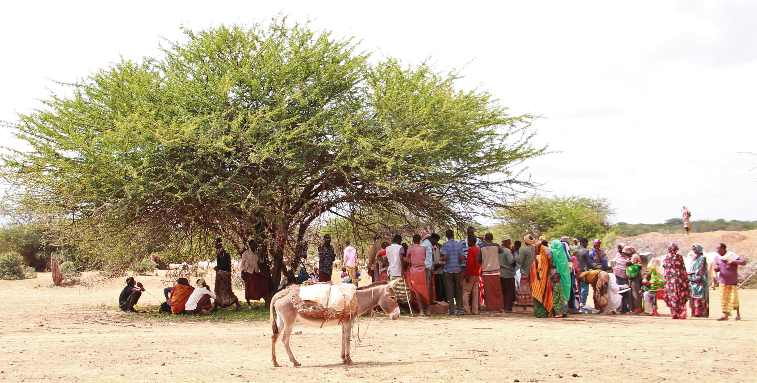
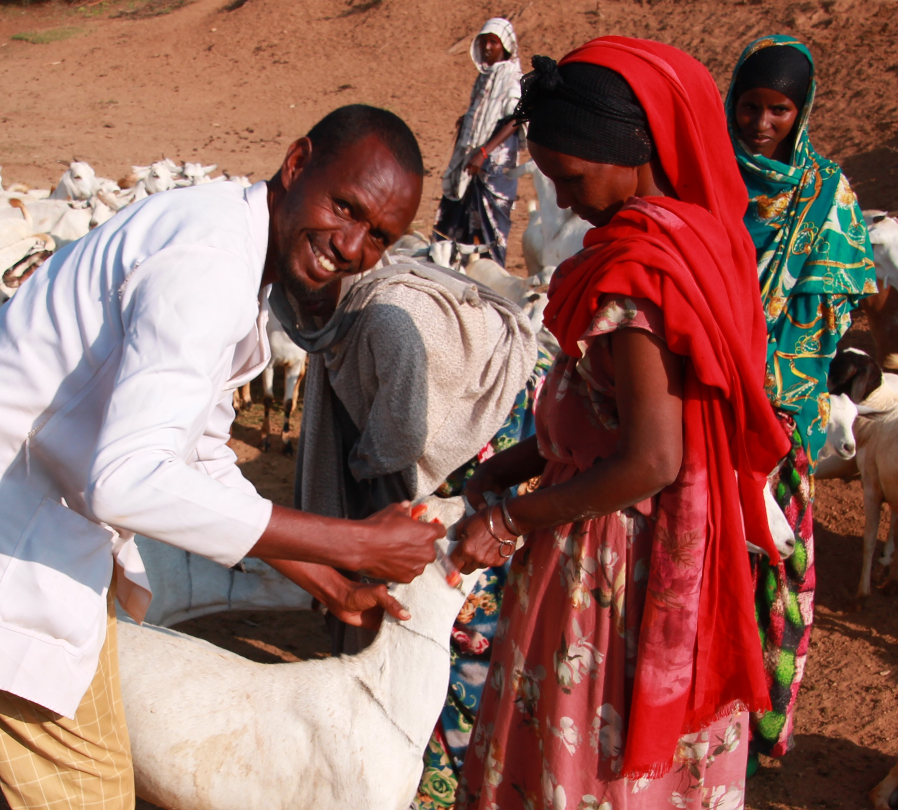
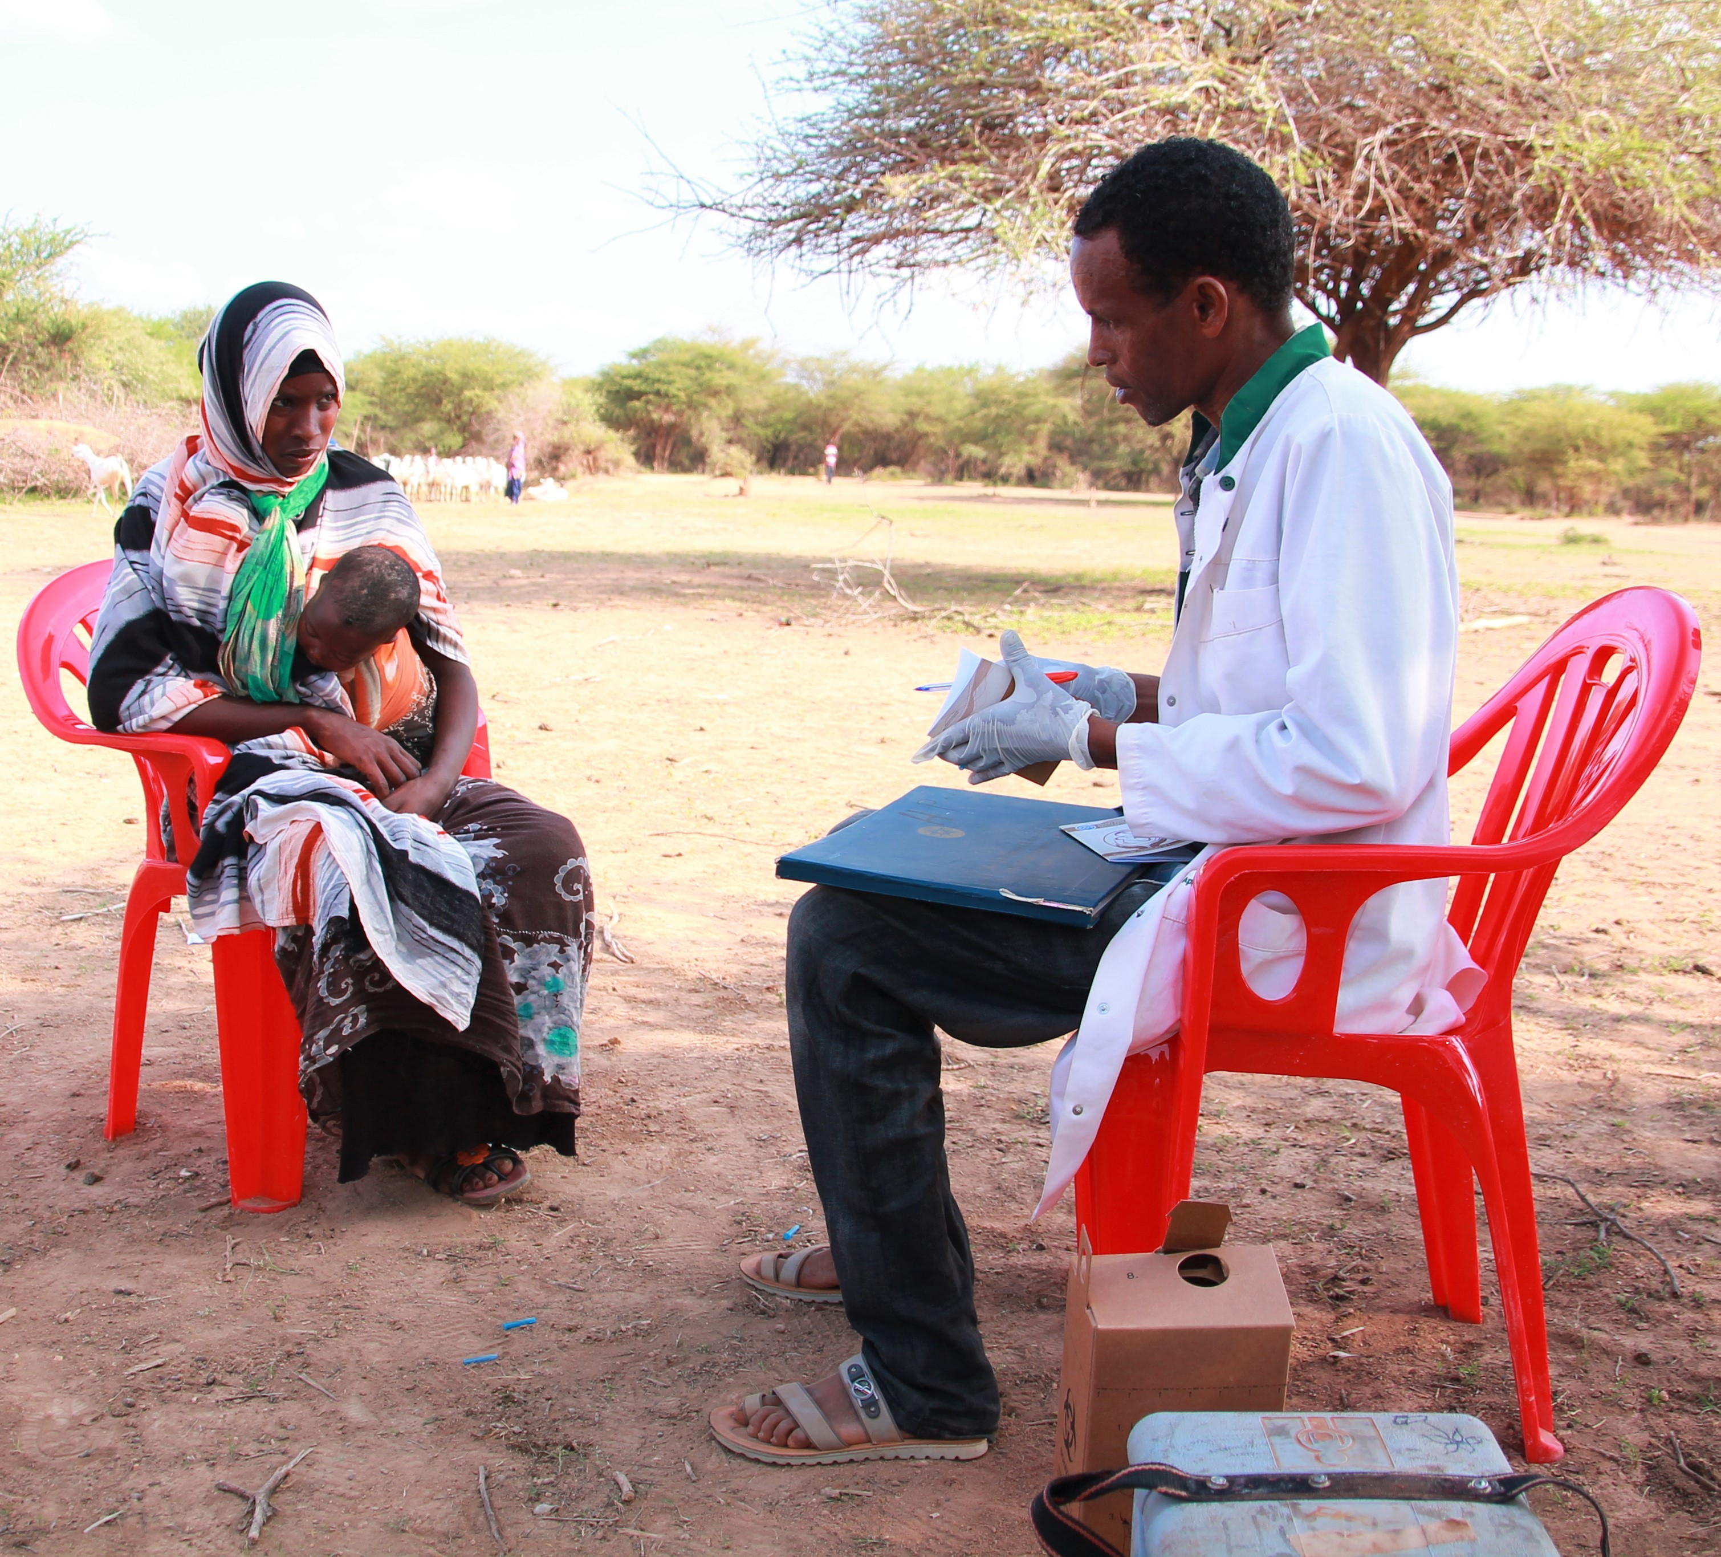
Day 3: Optional field visit
Witness how the OHU is running at the community level
Credit: Andrea Rossetti

Slide 8
Training approach and process
Experiential, reflective, and collaborative learning process
Enriching learning through study circles
Small group work and presentations
Personal reflections and journaling of key lessons and insights

Slide 9
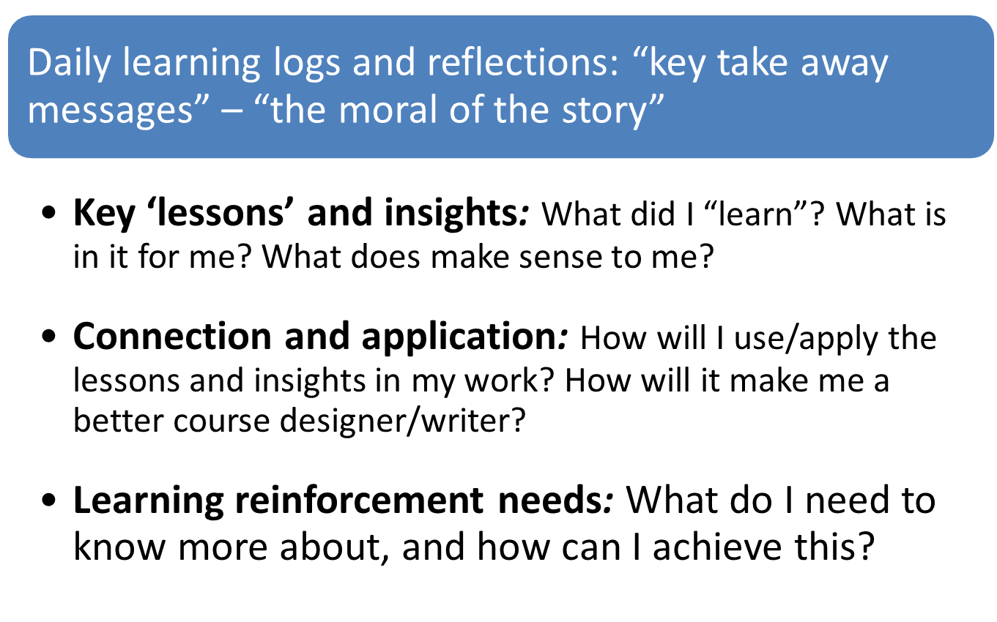
Self-learning management

Slide 10
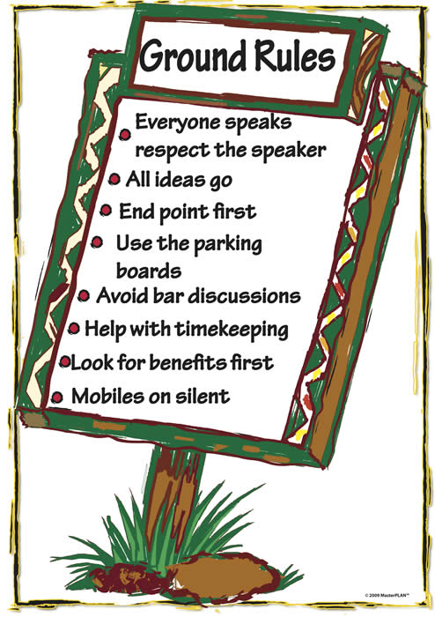
Ground rules
Be punctual
Be prepared
Every idea counts
Phones on silent mode
No side conversations
Active participation
Keep an open mind
Build connections

Slide 11
Feedback teams
Volunteers needed for each day
Purpose:
  Obtain participant feedback on the training content and process
  Energizers
  Time keeping

Slide 12
Evaluation
Your facilitator will distribute the pre-training evaluation form – measures baseline understanding on day 1 of training
Form is anonymous and will be compared with post-training evaluation completed after the training
10 minutes

Slide 13
Overview of HEAL; key concepts and definitions; OHU in depth

Slide 14
Intended learning outcomes
By the end of today, you will be able to:
explain the objectives and implementation approaches used by the HEAL project;
describe the purpose and scope of the HEAL SOP;
explain the guiding principles of HEAL;
identify different frontline service providers and community-based actors and their roles in service delivery;
distinguish between environmental and rangeland health;

Slide 15
Intended learning outcomes (continued)
describe the composition and target users of the OHUs;
describe the difference between mobile, static and mixed OHUs and select the appropriate type with communities;
describe the governance structure of OHUs;
guide the process of establishing and maintaining OHUs in intervention areas

Slide 16
Topics
The following chapters of the SOP are covered in this session:
Chapter 1: Introduction
Chapter 2: Key definitions used in this SOP
Chapter 3: One Health Unit (OHU)

Slide 17
Service delivery models (single sector)
Interactive plenary discussion
What services are available to pastoralists in this area? Which organizations offers these services?
  Human health sector
  Animal health sector
  Environment sector
For each sector, what are the challenges in terms of:
  Accessibility (what is the distance between services and users? transport options?)
  Affordability (can users afford the services? ability to pay?)
  Adequacy (do they meet user expectations? suitable opening hours?)
  Acceptability (do users trust in the services?)
50 minutes

Slide 18
Integrated health services
Interactive plenary discussion
What do you understand by the term ‘integrated health services’?
10 minutes

Slide 19
Integrated health services
According to WHO, integrated health services “respond to the needs of individuals and populations and deliver comprehensive good-quality services throughout the life course through multidisciplinary teams who work together across settings and use evidence and feedback loops to continuously improve performance”

Slide 20
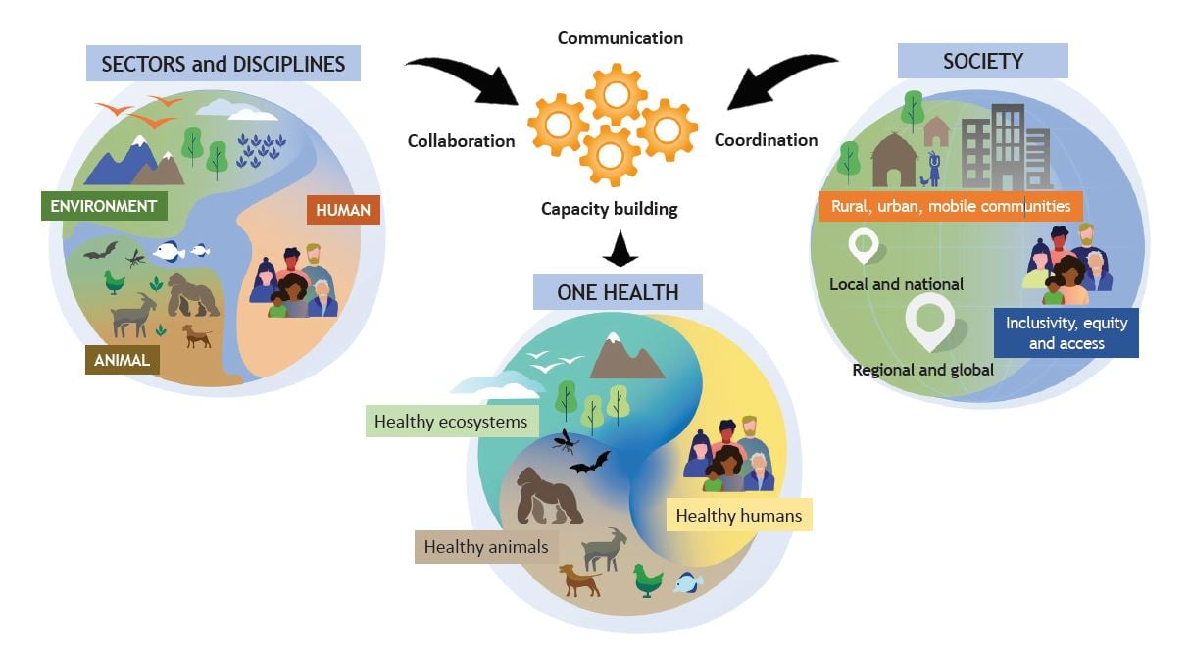
One Health
Notes:
One Health is an “integrated, unifying approach that aims to sustainably balance and optimize the health of people, animals, and ecosystems. It recognizes the health of humans, domestic and wild animals, plants, and the wider environment (including ecosystems) are closely linked and inter-dependent” (OHHLP). Within the framework of HEAL, One Health is operationalised through supporting coordination, collaboration, communication and capacity building between service providers, communities and government stakeholders towards the goal of improving health service delivery and rangeland health in pastoralist areas.

Slide 21
Integrated health services in HEAL
In the framework of HEAL, integrated service delivery involves multidisciplinary teams – including service providers and community-based actors in human, animal, environmental and rangeland health – working together to ensure that, in pastoralist systems, healthy people can derive their livelihoods from healthy livestock, in a sustainably managed environment

Slide 22
HEAL project overview
Interactive plenary discussion
Your facilitator will play a video
As you watch consider:
  What does HEAL project aim to do?
  Who are the project beneficiaries?
  Who are the partners that are implementing the project?
  What is a ‘One Health Units (OHUs)’? What do they do?
  What is an ‘MSIP’? What do they do?
Be prepared to share your answers in plenary
Video 1: Enhancing wellbeing and resilience of pastoralist communities in Ethiopia
https://www.youtube.com/watch?v=yKwieovd9w4&t=6s

Slide 23
HEAL project overview
Mission
To improve access to quality human and veterinary health services and sustainable natural resources management in vulnerable communities in (agro-)pastoralist areas of Ethiopia, Kenya and Somalia

Slide 24
HEAL project overview
Objectives
Engage (agro-)pastoralists in defining sustainable, demand-driven and needs-based “One Health Units”
Implement context-specific and cost-effective service delivery models
Provide evidence to policymakers and investors on “One Health Units” as solutions for service delivery for (agro-)pastoralist communities

Slide 25



HEAL project overview
Partners: Designed and implemented by a consortium of three organizations:
Consortium lead Operates field offices in Ethiopia and Somalia | Formerly known as CCM Operates field offices in Ethiopia and Kenya | Rangeland health, training & research technical lead Research Officers deployed to Ethiopia/Kenya sites via host agreements with partners

Slide 26
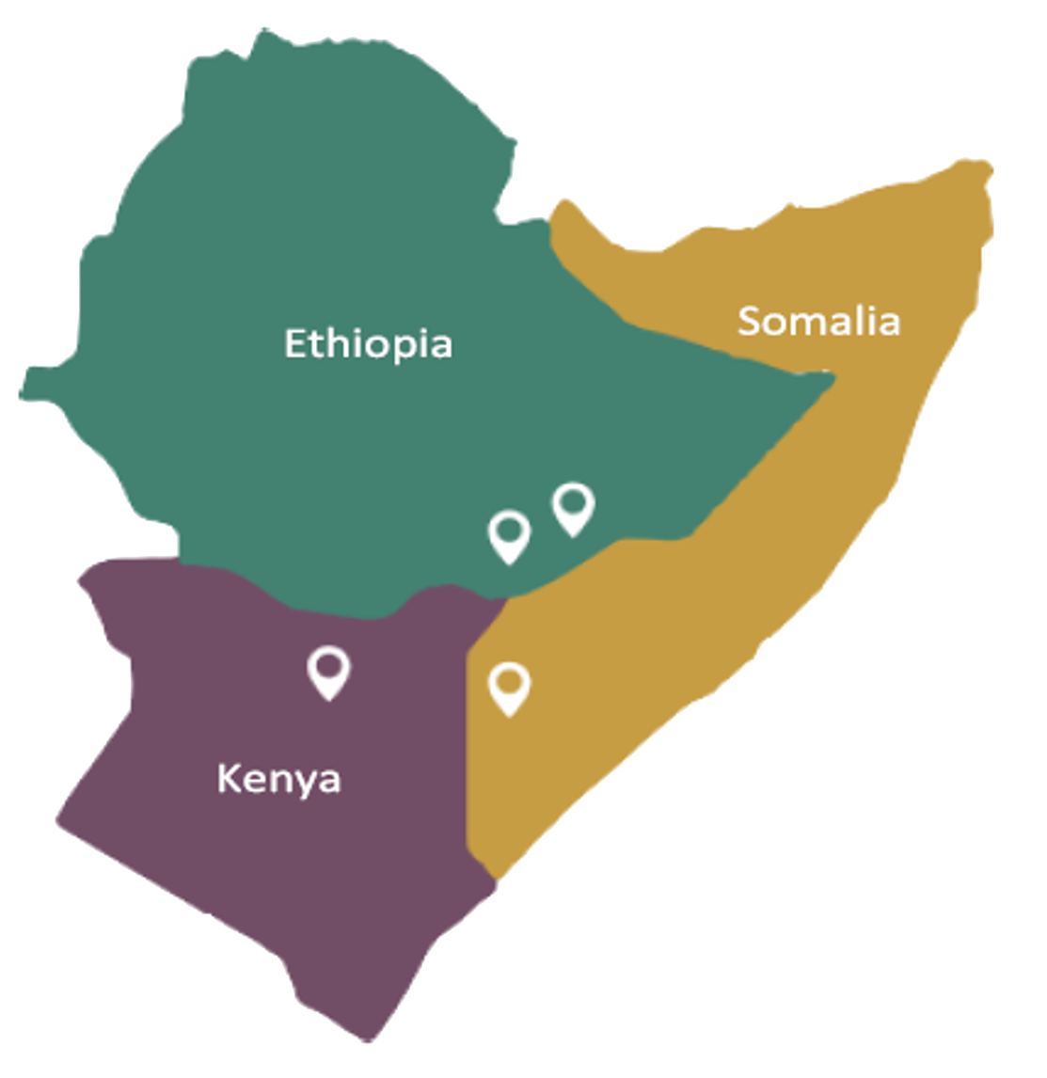
HEAL project overview
Sites: Select pastoralist areas of Ethiopia, Kenya and Somalia that have strong cross-border dynamics
  Ethiopia:
    Moyale and Filtu woredas in Somali region
    Miyo and Moyale woredas in Oromia region
  Kenya:
    North-Horr sub-county of Marsabit county
    Garbatulla and Merti sub-counties of Isiolo county
  Somalia:
    Beled Xaawo and Dollow districts of Gedo region

Slide 27


HEAL model for integrated service delivery
Three multi-sectoral collaboration platforms
One Health
Task Force (OHTF)
One Health Unit (OHU)
Multi-stakeholder
Innovation Platform (MSIP)
OHU
Collaboration platform for
government departments
Collaboration platform for
community members
Collaboration platform for
service providers and
community-based actors

Slide 28
HEAL model for integrated service delivery
Technical and logistical support
OH4HEAL PARTNERS
OTHER PARTNERS
OHTF
MSIP
Communication & dialog
Woreda/county level
Community level
Training
Supervision
Planning
Monitoring
Community
oversight
OHU
HUMAN HEALTH
antenatal care
postnatal care
family planning
growth monitoring
nutrition screening
medical consultations
ANIMAL HEALTH
disease surveillance
vaccination
disease treatment
animal husbandry
animal products
RANGELAND HEALTH
grazing management
rangeland restoration
CROSS-CUTTING SERVICES
WASH
environmental health
capacity building
support for DDDM
outbreak response
Services provided
by OHU
Notes:
The three collaboration platforms (OHU, MSIP, OHTF) work together to establish, run, and maintain a new service delivery model that ensures that pastoralist communities can access and utilise essential health services for their families and their livestock, and implement improved natural resource management. Continuous communication and open dialogue is maintained between the OHTF and the MSIP to ensure the collective governance of the OHU. The OHTF coordinates with the OHU to guarantee services are planned and delivered in line with the local development plans and priorities. The MSIP coordinates with the OHU to ensure the community oversight of services provided.

Slide 29
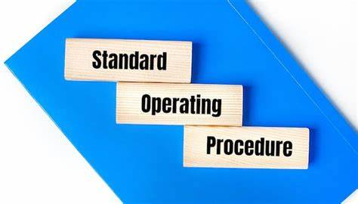
Meaning and purpose of SOP
Interactive plenary discussion
What do these words mean: ‘standard’, ‘operate’, and ‘procedure’?
Putting meanings of these words together, how can you define ‘standard operating procedure’?
What is the purpose of a ‘standard operating procedure’?
15 minutes

Slide 30
Purpose of HEAL SOP
Provides guidance for the setting up and regulation of operations of the OHUs in the HEAL intervention sites
Ensures that services and operations are carried out effectively and appropriately (quality and efficiency), in the same manner (consistency) across different project sites, and sustainably
Helps the OHUs to provide uniform essential health services through an integrated approach

Slide 31
Scope of HEAL SOP
Chapter 1: Introduction
Chapter 2: Key definitions used in this SOP
Chapter 3: OHU
Chapter 4: MSIP
Chapter 5: OHTF
Chapter 6: Operationalising the integrated health service delivery model
Annexes: Other elements of the HEAL project
What is it?
Composition
Establishment
Maintenance
Roles and responsibilities
Relevant MEAL indicators

Slide 32
Key concepts and definitions in the HEAL SOP
Study circle
Your facilitator will:
  Divide you into 3 groups of people from different sectors
  Distribute definitions in the HEAL SOP
In groups:
  Study the topics assigned, enriching them with your HEAL project implementation experience
  Record your understanding/interpretation/experience of the topics on flipcharts
Be ready to teach others what you learned in plenary
60 minutes

Slide 33
Key concepts and definitions in the HEAL SOP
Group 1 | Group 2 | Group 3
Guiding principles | Frontline service providers Community-based actors | Environmental health Rangeland health
Explain the six guiding principles in your own words Identify examples of each guiding principle in practice within the HEAL project in your area | Explain the difference between frontline service providers and community-based actors and their different roles in human/animal/environmental health service delivery Identify the frontline service providers and community-based actors that exist in your area. Clarify whether these are the same or different in other areas of HEAL operation | Explain the difference between ‘rangeland health’ and ‘environmental health’ in your own words Identify examples of ‘rangeland health’ and ‘environmental health’ in your area
60 minutes

Slide 34
Guiding principles
Integration of human and animal health care delivery, rangeland and environmental health services, including natural resources management and weather-related services
Alignment of partners’ activities with those of the national/regional priorities and plans
Partnership between implementing parties across sectors and at all levels, building on existing actors and networks
Enhanced accessibility and utilisation of essential services, with special attention to children, women, elderly, and vulnerable groups in the communities (e.g., returnees and internally displaced people, IDPs)
Contextualisation of the OHUs to the specific needs in each district/country
Collection of evidence and lessons learned from small-scale interventions at the village level, to support data driven decision making (DDDM) on the refinement and scaling of services at the district/county level and to influence the development of policies at the national and regional level

Slide 35
Frontline service providers & community-based actors
Term | Definition
Frontline service provider | Qualified staff engaged in the delivery of health services to humans and animals and in the management of natural resources, e.g. Human domain: health officers and registered nurses Animal domain: animal health technicians Environment domain: natural resource management (NRM) officers and environmental health officers working under the Ministry of Health
Community-based actors | Members of the community who are usually selected by the local administration in collaboration with local communities to receive specific training and carry out certain tasks in their village, e.g. Human domain: health extension workers (HEWs) in Ethiopia; community health volunteers (CHVs) in Kenya; community health workers (CHWs) in Somalia Animal domain: community animal health workers (CAHWs) in Ethiopia and Somalia; community disease reporters (CDRs) in Kenya Environment domain: development agents (DAs; Ethiopia only)

Slide 36
Environmental vs rangeland health
Environmental health
Rangeland health
…is a branch of public health that is concerned with monitoring or mitigating those factors in the environment that affect human health and disease (Oxford Dictionary). Within the framework of HEAL, this definition is expanded to include the effects of the environment on animal health and disease
e.g. weather/climate sensitive diseases; management of waste, including (human) sewage and (animal) manure, solid waste and plastic
…the degree to which the integrity of the soil, vegetation, water and air as well as the ecological processes of the rangeland ecosystem are balanced and sustained…
In pastoralist rangelands…includes the ability of a rangeland to provide the feed base needed to sustain healthy and productive livestock, and to provide ecosystem services to greater society, on a long-term sustainable basis

Slide 37
One Health Unit (OHU) in depth
Study circle
Your facilitator will:
  Divide you into 4 groups of people from different sectors
  Distribute definitions in the HEAL SOP
In groups:
  Study the topics assigned, enriching them with your HEAL project implementation experience
  Record your understanding/interpretation/experience of the topics on flipcharts
Be ready to teach others what you learned in plenary
60 minutes

Slide 38
One Health Unit (OHU) in depth
Group 1 | Group 2 | Group 3 | Group 4
Composition (3.2) Target users (3.1.2) Role of HEAL partners (3.5) | Mobile, static, and mixed model (3.1.1) Selection (3.3.1) | Establishment/ step-by-step implementation (3.3) | Governance (3.4.1) Day-to-day management (3.4.2)
What is the composition and role of the different actors that form the OHU? Who are the target users of the OHU services? What are the constraints and needs of these target users in your area? What is the role of HEAL partners with respect to the OHU? | What is the difference between mobile, static and mixed OHUs? How are the mobile, static, or mixed delivery models selected? What model might be more suitable in your area and why? What are the benefits and challenges of mobile, static, or mixed delivery models? | How are OHUs established? What steps are followed? What challenges could be faced in the establishment of a OHU in your area? How could these challenges be addressed? | Who are the main actors involved in the governance and day to day running of the OHU and what are their roles and responsibilities? What challenges could be faced in the maintenance of OHUs in your area? How could these challenges be addressed?
60 minutes

Slide 39

Summary of main learning points
One Health Unit is a new health service delivery model that promotes integration of human, animal and environmental health services
Flexible set-up:
  mobile OHU (frontline service providers move along livestock routes together according to agreed schedule)
  static OHU (frontline service providers work from a common facility/site e.g., water point)
  mixed
OHU
MULTISECTORAL TEAM comprising:
Frontline service providers (FSPs)
Community-based actors
HUMAN
health officers
registered nurses
HEW/CHW
ANIMAL
animal health technicians
CAHW
ENVIRONMENT
NRM officers
environmental health officers
development agents

Slide 40
Summary of main learning points
OHU aims to improve the availability, accessibility, affordability, adequacy, and acceptability of essential health services among pastoralist communities
SOP guides the setting-up and regularly recurring operations of the OHUs
SOP ensures that OHU services and operations are carried out correctly (quality and efficiency) and in the same manner (consistency) across different project countries and sites
SOP makes use of key concepts and terminologies that are essential to understand and apply consistently

Slide 41
MSIP and OHTF in depth; OHU services, procurement and financing; and other elements
Tomorrow:

