Slide 1



Webinar series on:
Land and Natural Resource Governance, Planning and Management
Research investments in institutional innovations: the case of rangeland governance in Tunisia:
2 – Ongoing rangeland research and outcomes of IFAD-ICARDA-NARS
July 2020.
Team: Aymen Frija, Mongi Sghaier, Mariem Sghaier, Mondher Fetoui, and Boubaker Dhehibi.

Slide 2
Ongoing projects and research for development programs
Consortium Research Program (CRP) on « Policies, Institutions, and markets » - Natural resources governance flagship,
  “Impact assessment (in terms of governance) of rangeland management institutions”
  Support ongoing national initiatives aiming at critically reviewing and analyzing the technical and institutional experience of Tunisia in rangeland management.
CRP Livestock – Livestock and the Environment Flagship.
  Back up technical research aiming at identifying innovative grazing management practices and ensure their acceptance by farmers.
  Provide guidance for large scale adoption of fencing practices in general.

Slide 3
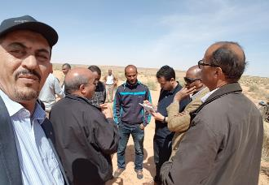
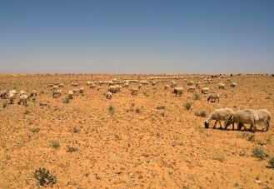
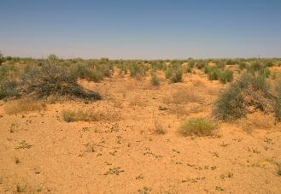
Main research questions tackled
Identification of pathways for enhancing rangeland governance under constraining land tenure systems?
Comparative assessment of rangeland GDA performances based on a set of developed indicators (why some GDA are performing better than others? And which effect of tenure systems in place?)
Characterization of social networks and property right systems in Rangelands of Tataouine
Assessment of the effect of land tenure and stakeholders perceptions for rangeland restoration.
Inputs to Pastoral code.

Slide 4
Some current results and how they link to ongoing IFAD programs
Need for institutional empowerment of GDA (why some of them are less performing then others)
Which land tenure system is the most constraining and needs the most of attention. How can we improve rangeland governance under these tenure systems?
Pathways for better dialogue between stakeholders for rangeland restoration in collective rangelands ….
Overall governance failures and how can we deal with them through future regulatory and policy dialogues

Slide 5
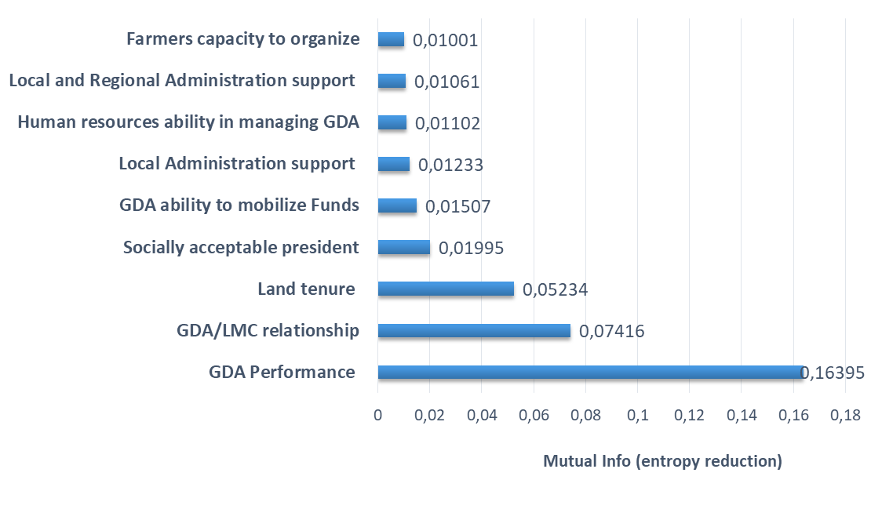
Some results –Pathways for enhancing rangeland governance under constraining land tenure systems
List and weight of factors having strong effect on rangeland governane
Rangelands where private tenure is embedded into collective tenure systems are the most constraining for good rangeland governance.
overall improvement of rangeland governance in the study area is highly related to the type of tenure system.
Even under restrictive tenure systems, the improvement of a set of local institutional attributes can lead to better governance.
Diversification of local economic activities can lead to lower pressure and better rangeland governance.
Negative impacts of PRODESUD I on governance identified in some cases.
Recommended actions under different land tenure systems

Slide 6
Some results – Comparative assessment of GDA performances
Work elaborated in the framework of the PRODEFIL project (supported by ICARDA internship)
Scoring method based on three criterions: governance, management and service to identify the most performant GDAs
Two factors of seggregation of the existent GDAs :
  governance and financial management (Control, documentation, meetings, coordination)
  Partnership and additional services for members (Networking capacity of the GDA)
Dhaher GDA example within collective rangelands and how its good performance helped the application of the resting technique
Ranking GDAs based on a multicriteria assessment/score.
PCA and typology
Source: Mariem Sghaier, 2019 (PRODEFIL)

Slide 7
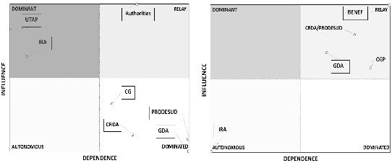
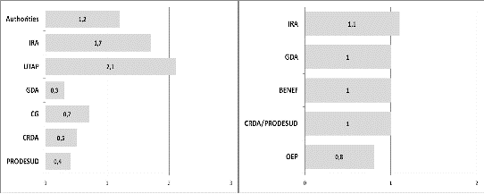
Some results – Strategies and alliances for private and collective rangeland restoration
In private rangelands, equal levels of stakeholder influence and power lead to a much more stable and flexible rangeland restoration process.
In collective rangelands: the majority of stakeholders have weak influence in terms of management decisions, with less alliances and more conflictual objectives among Stakeholders.
Heavy presence of the administration (CRDA) in collective rangelands which creates a strong dependency of local actors.

Slide 8
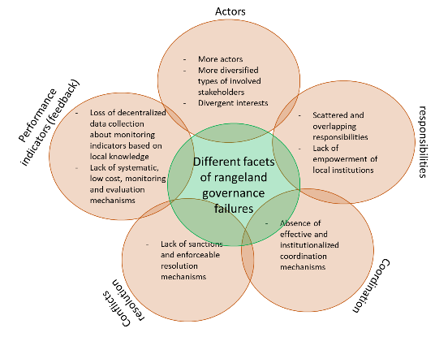
Some results – Potential inputs and arguments (regarding major rangeland governance failures) for the adoption of the new pastoral code of Tunisia
Institutional analysis of different facets of rangeland governance failures at different levels.
Provide evidence-based inputs and argument for the adoption of the new pastoral code/law in Tunisia, particularly:
  Scattered responsibilities
  Need for coordinating institutions.
  Nested (multi-level) governance frameworks,
  Etc.

Slide 9
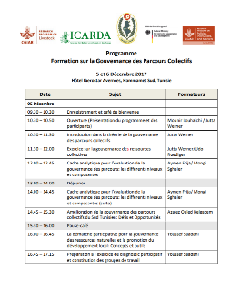
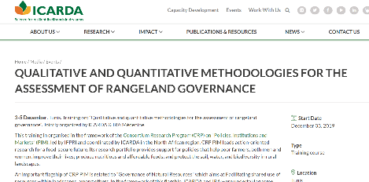
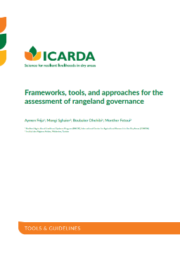
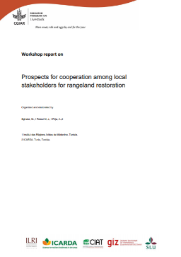
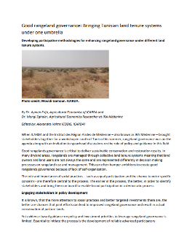
Trainings, manuals, guidelines, toolboxes for good rangeland governance,

Slide 10
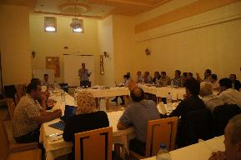
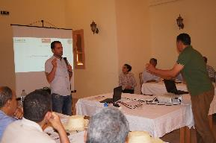
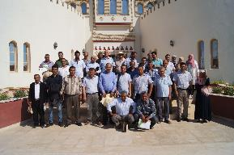
Implementation of research activities: validation with development partners
Trainings on every major research achievements,
Results validation workshops are constantly held with partners and other concerned stakeholders.
Ex. workshop presenting research results concerning the evaluation of the level of rangeland governance under different land tenure contexts
  Joint elaboration of scenarios identified to enhance rangeland governance,
  Live simulations to show the impact of these scenarios on the rangeland governance (perceptions).
  Joint elaboration of recommendations.

Slide 11
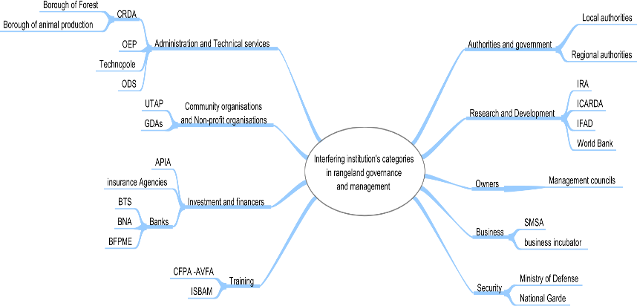
Ways forword – developing a toolbox for enhanced implementation of pastoral investment projects
Economic Territorial Intelligence : Towards a sustainable development of territories
Four levers : the development of job-creating projects, the anticipation of economic changes, disruptions and risks, the promotion of the attractiveness of territories and the animation of the territorial development and social networks,
Starting point to develop a TI plan is the identification of the network of actors,

Slide 12
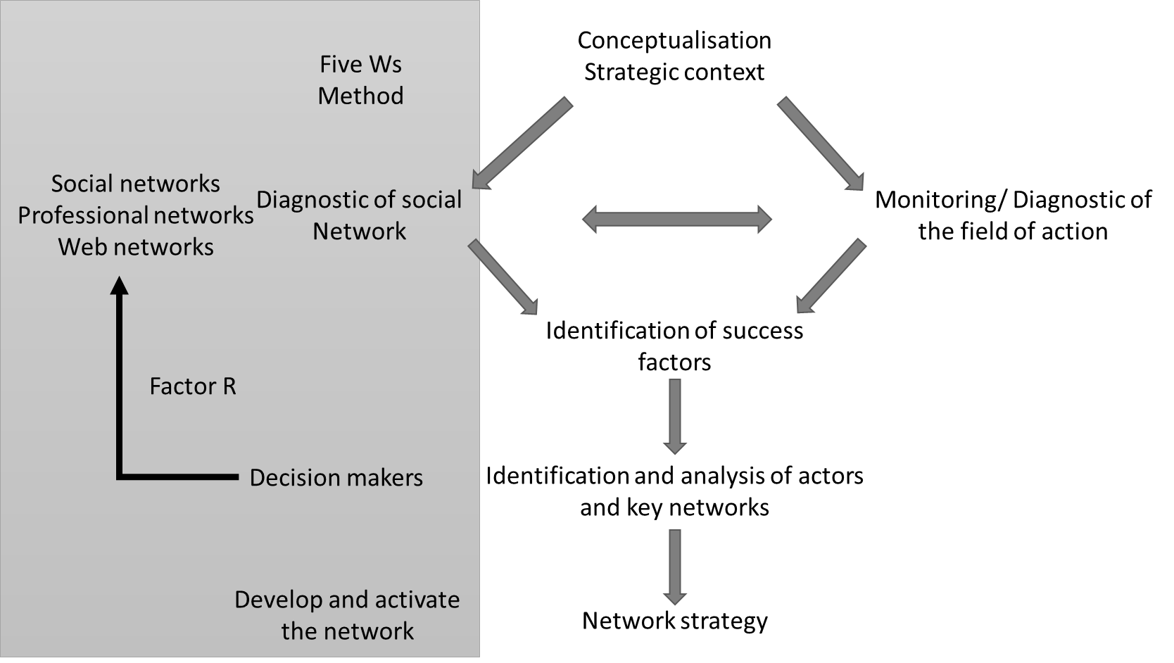
Ways forword – developing a toolbox for enhanced implementation of pastoral investment projects
Operate as a network!
Activate and manage the existent network ➔ better coordination between actors and create cooperation opportunities
How land tenure is tackled in this perspective?
Different Land tenure systems

Slide 13
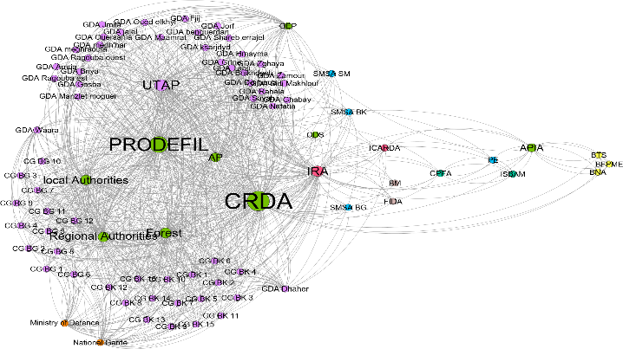
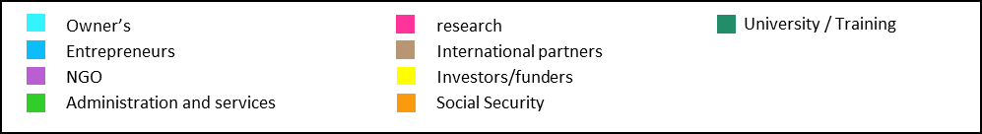
Ways forword – developing a toolbox for enhanced implementation of pastoral investment projects
GDA’S are located on the periphery of local development network while their role should be more central in landscape and ressource governance.
Strengthenning the performance and ability of the community-based organizations to create opportunities and partnerships
Creating a platform for a socio-digital communication can help operating as a network for more effective rangeland management and pastoral development.

Slide 14
Concluding remarks
A lot has been achieved.
New challenges and need for new approaches.
Perspectives of using social networks and related ETI approaches.
Need for effective toolboxes for assistance with governance oriented invetsment projects.

Slide 15
Thank you!

