Slide 1
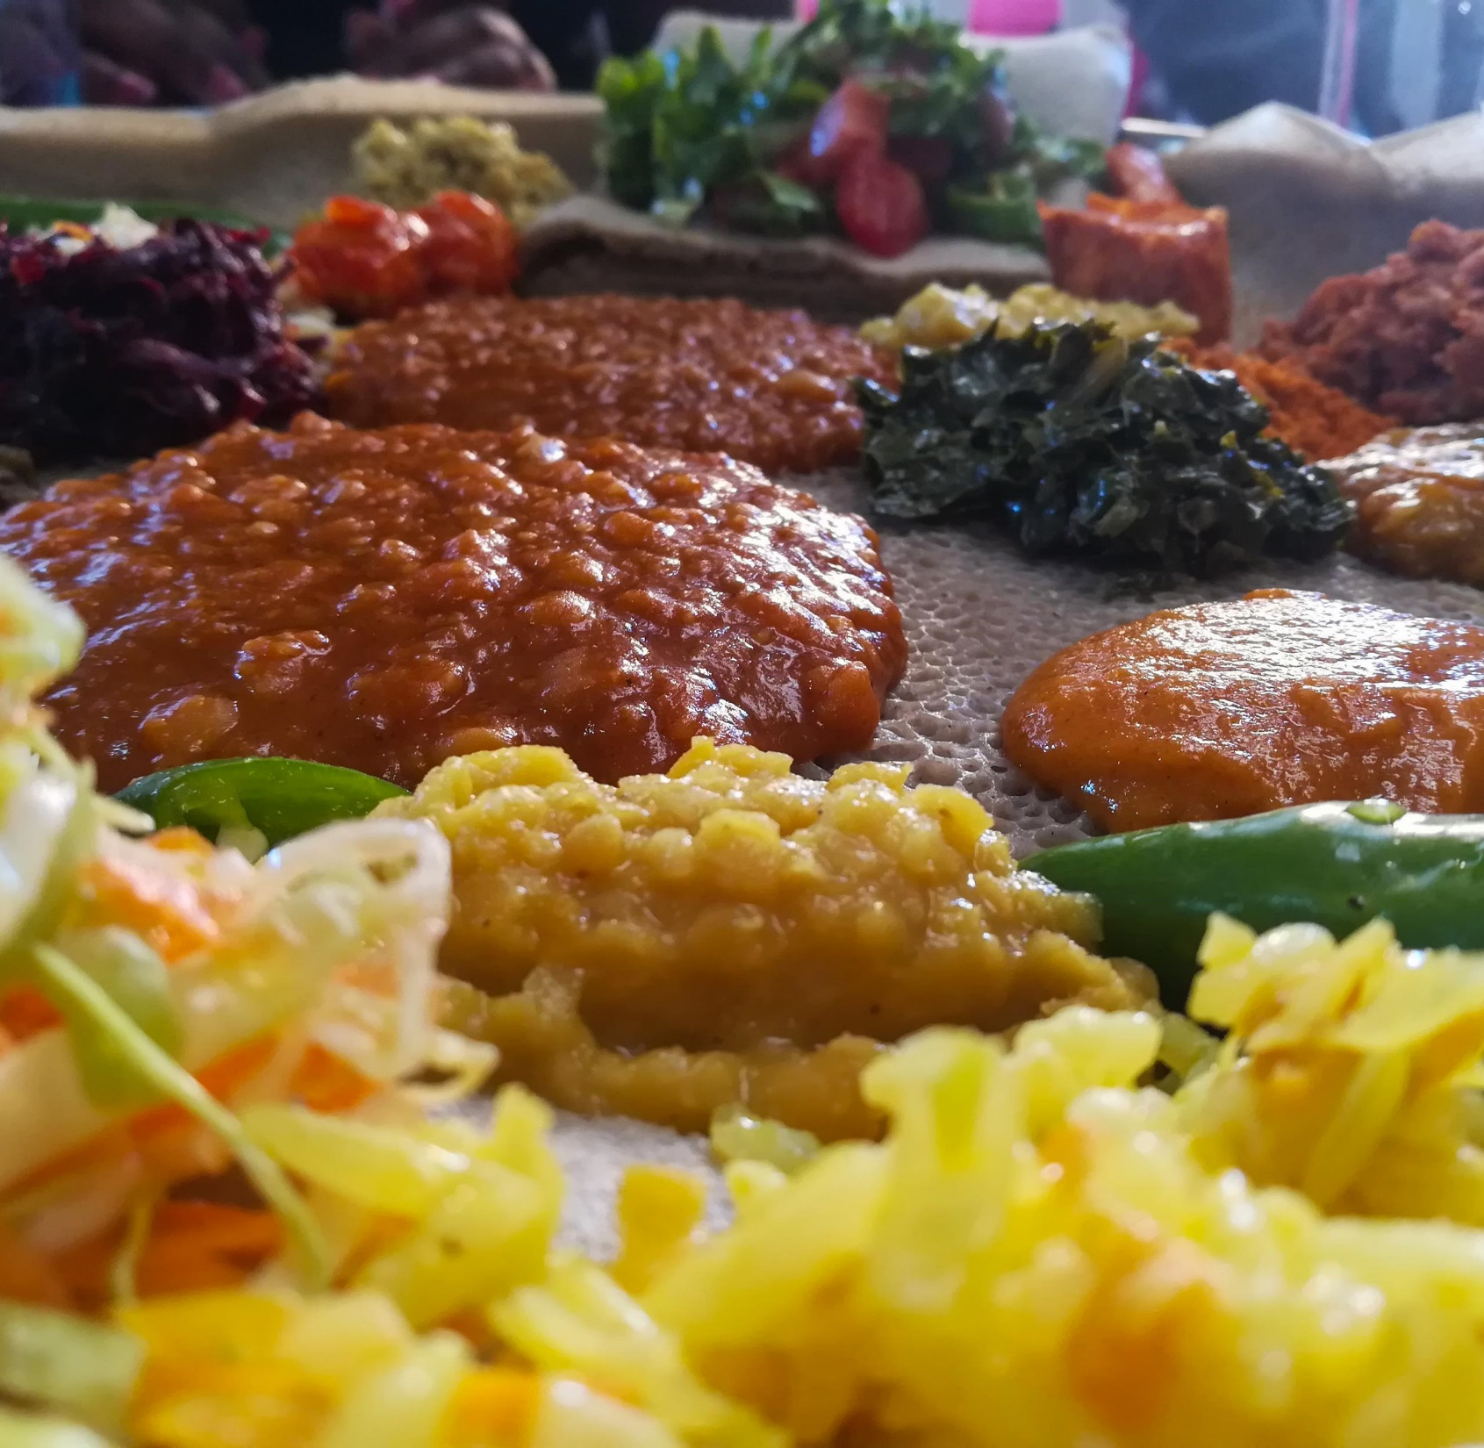
CGIAR Research Initiatives: One Health and Resilient Cities
Food safety intervention consultation meeting
Kebede Amenu, Silvia Alonso
19 May 2022, ILRI Campus, Addis Ababa

Slide 2
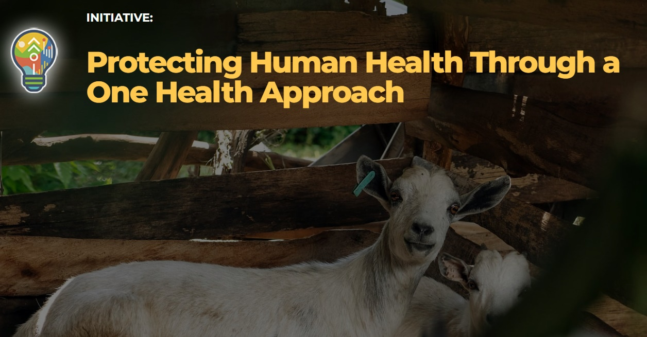
Food safety intervention consultation meeting
19 May 2022, ILRI Campus, Addis Ababa
Objectives
Understanding the current food safety research projects in Ethiopia
Agree on the commodities and intervention type to implement in One Health and Resilient Cities initiatives
Define opportunities for collaboration with other food safety projects and partners to implement the research activities

Slide 3
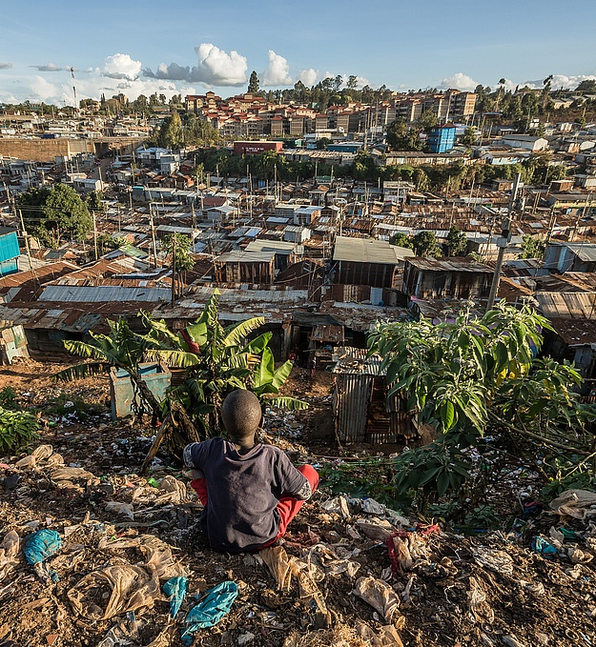
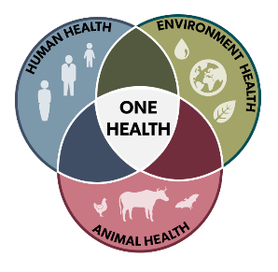
Two main initiatives
Protecting human health through a One Health approach
Credit: Brian Otieno, FES
Resilient Cities Through Sustainable Urban and Peri-urban Agrifood Systems

Slide 4
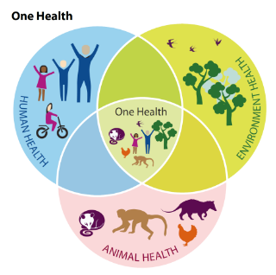
Protecting human health through a One Health approach
Hung Nguyen
ILRI Animal and Human Health program co-lead and One Health Initiative lead
Food safety intervention consultation meeting
19 May 2022, ILRI Campus, Addis Ababa

Slide 5
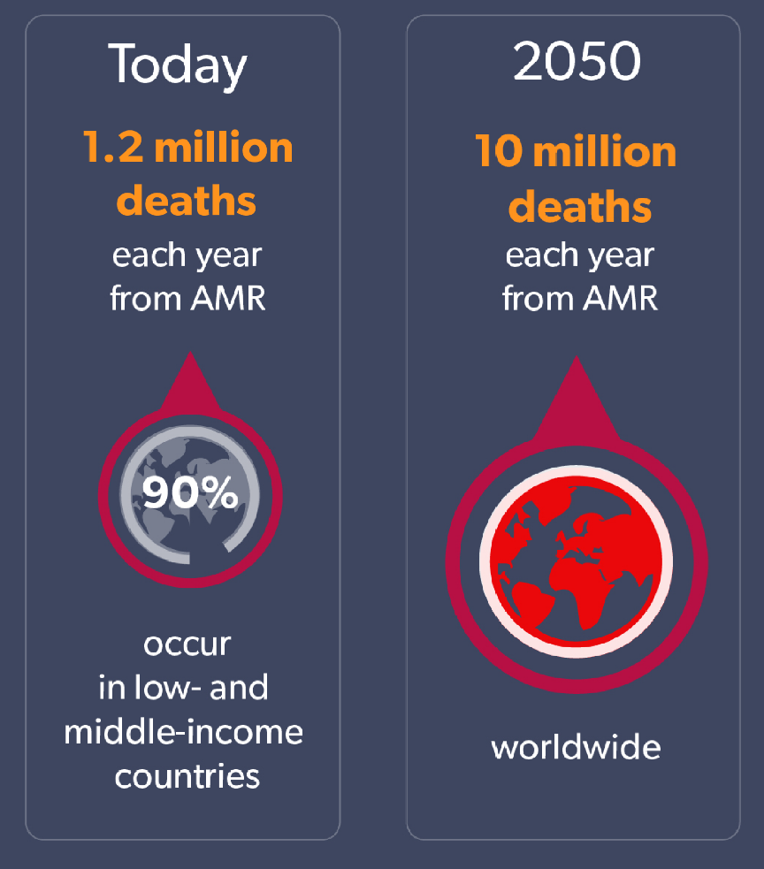
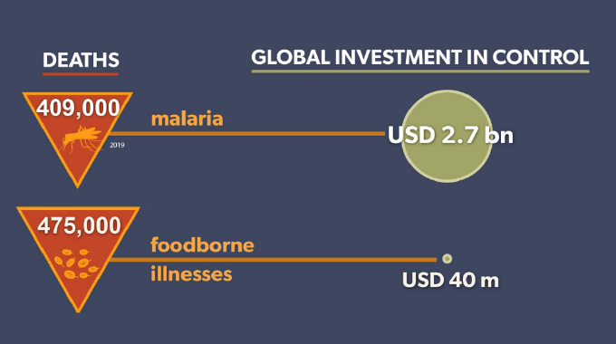
The challenges
Food safety: large burden comparable to tuberculosis, malaria, and HIV/AIDS, but small investment
Antimicrobial Resistance (AMR) is a growing problem

Slide 6
A One Health Approach
Solving these challenges requires a One Health approach – the takes a systems approach to looking at intersections between animal, human and environmental health
Leverages unique CGIAR capacity on One Health in food systems
Objective is to protect human health by improving detection, prevention, and control of zoonoses, foodborne diseases and AMR in LMICs

Slide 7
Structure of the initiative (2022-2024)
WP4: Environment (Water)
improve water management to reduce infectious disease risks
WP1: Zoonoses
reduce disease emergence and transmission at wildlife-livestock-human interfaces
WP2: Food Safety
reduce foodborne disease through capacity building of market actors and incentives for compliance
WP3: AMR
reduce emergence and spread of antimicrobial-resistant
zoonotic pathogens
WP5: Economics, governance, and behavior
understand incentives for & constraints to behaviors affecting One Health
Notes:
What we will do :
Generate evidence on gender-mediated risk exposure, public and private returns to action
Evaluate impacts of technologies, tools, and approaches on health risks and economic outcomes
Integrating innovations into policies and programs

Slide 8
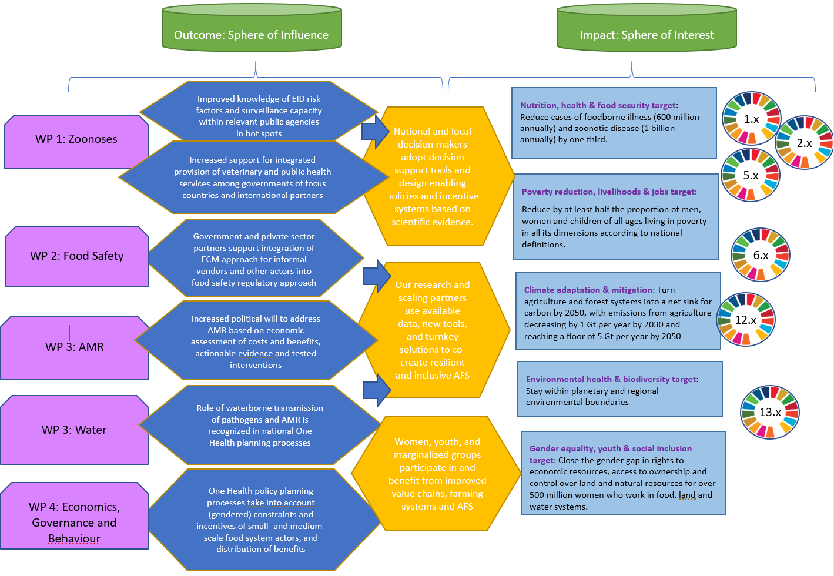
One Health initiative Theory of Change

Slide 9



Where we will work
    Research contexts:
      Intensifying food systems
      Informal food systems
      Wildlife-livestock interactions
8

Slide 10
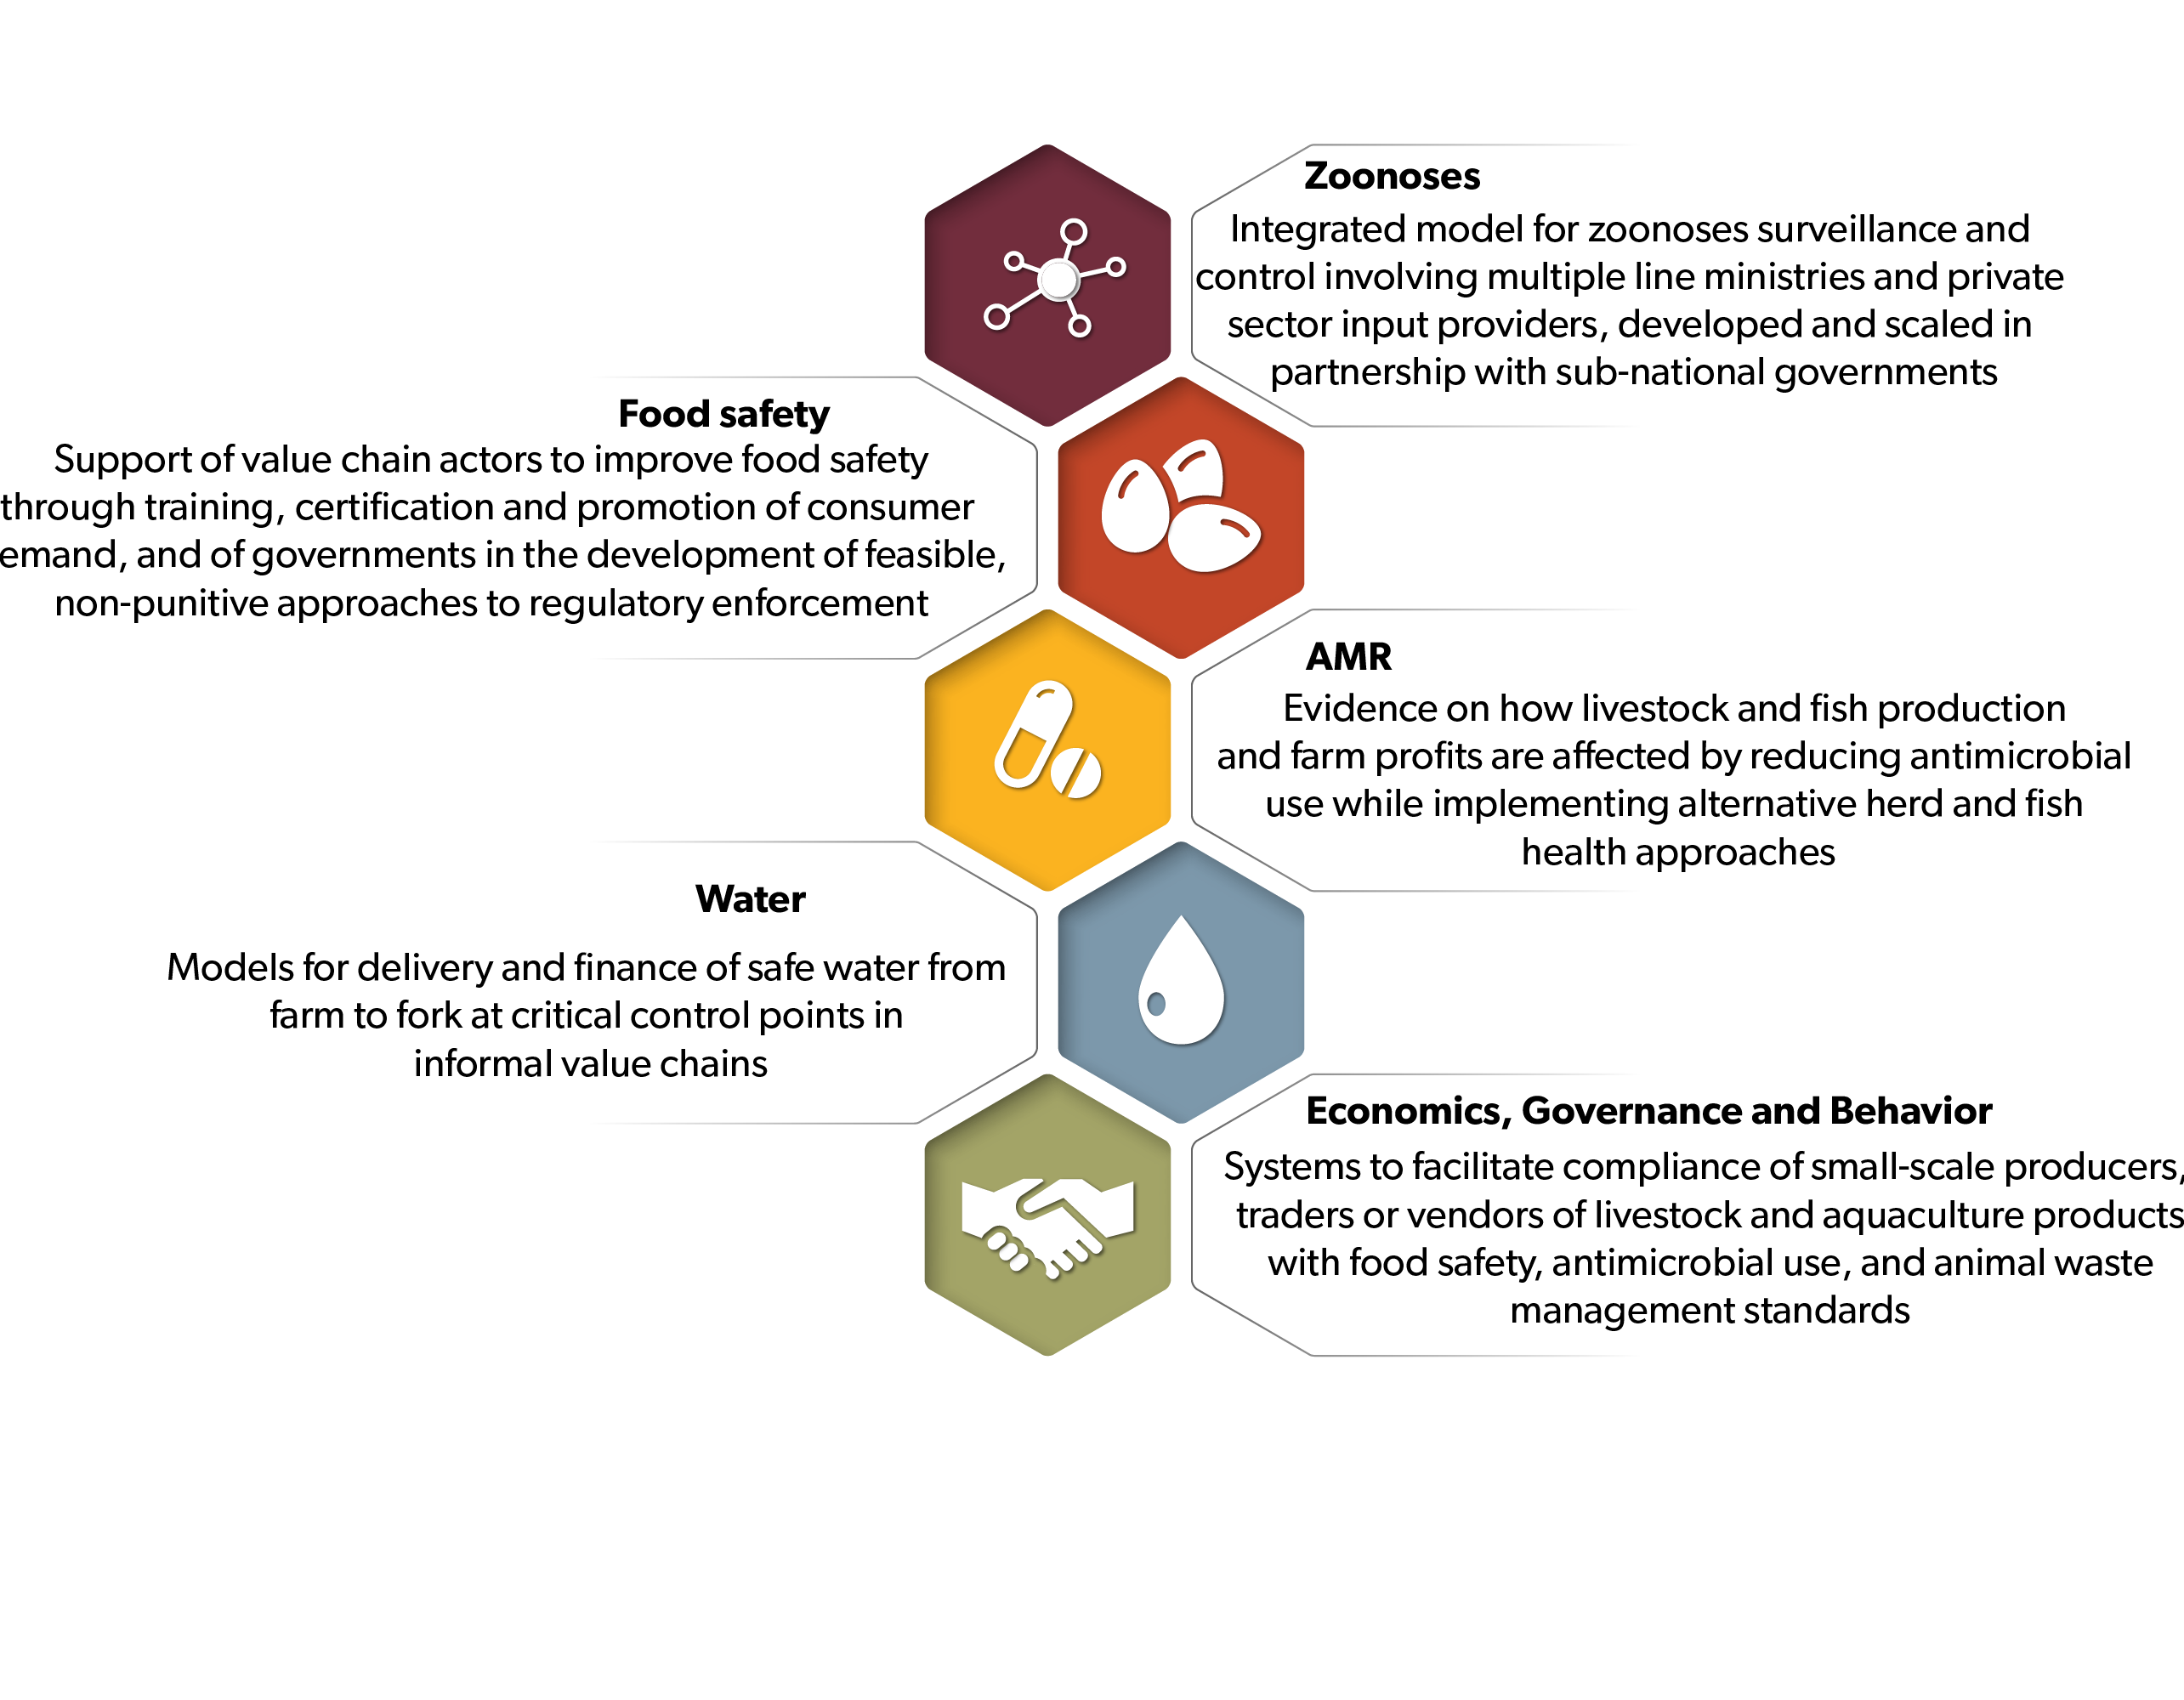
Selected Innovations

Slide 11
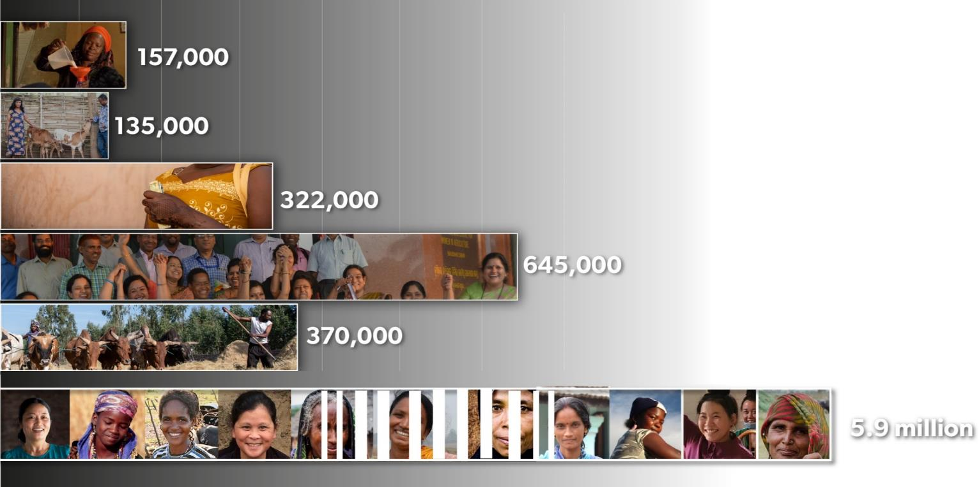
Impact Forecast
Medium to high certainty impacts by 2030
Female food vendors
served by innovations
People with 10-50% of
annual income benefit
Women prevented
from entering poverty
People prevented
from entering poverty
DALYS saved
Women benefiting from
better zoonoses control

Slide 12
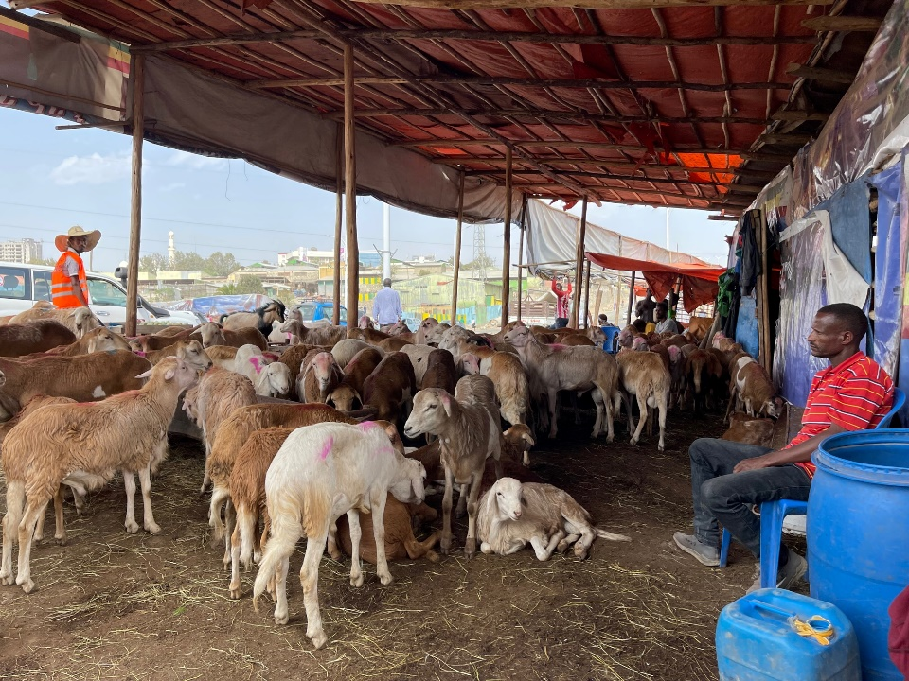
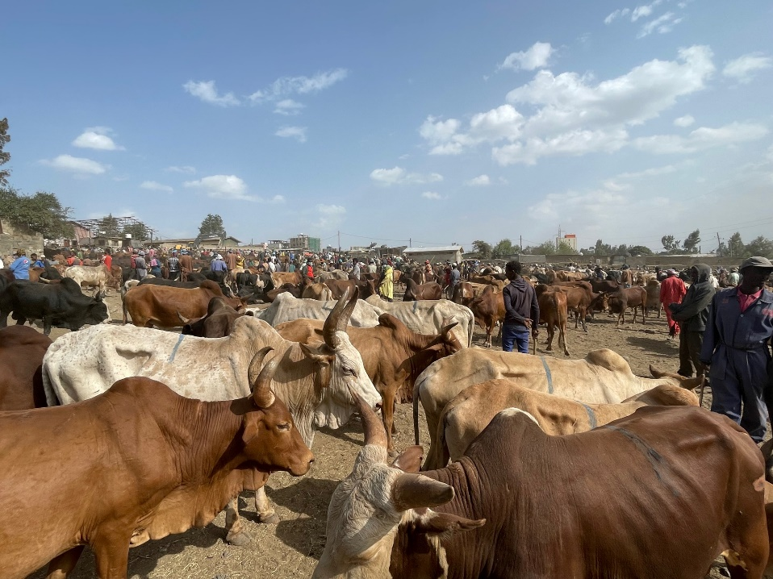
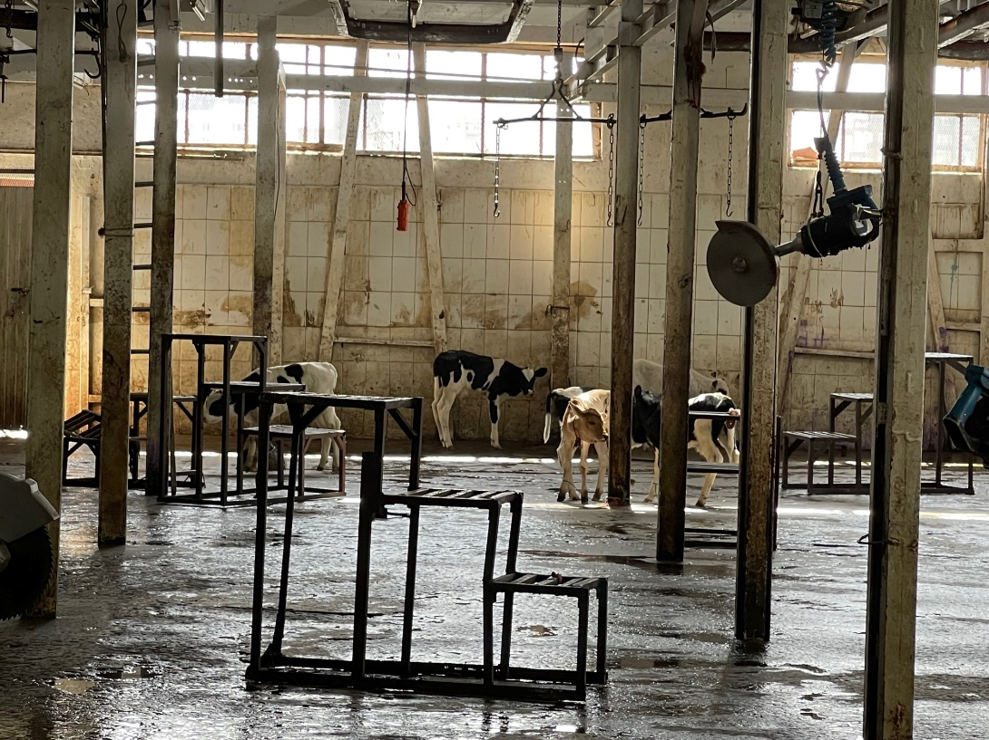
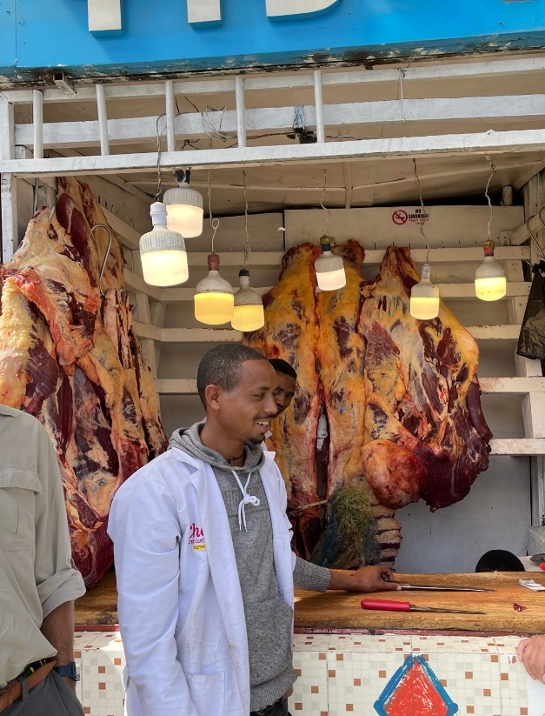
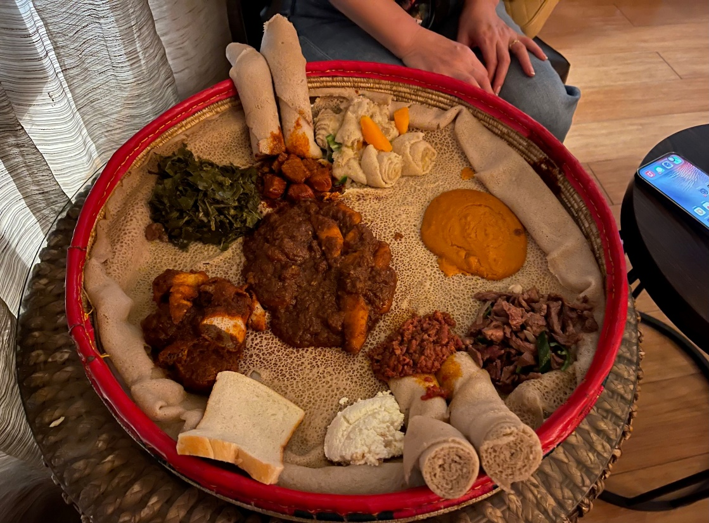
WP 2: Food Safety

Slide 13
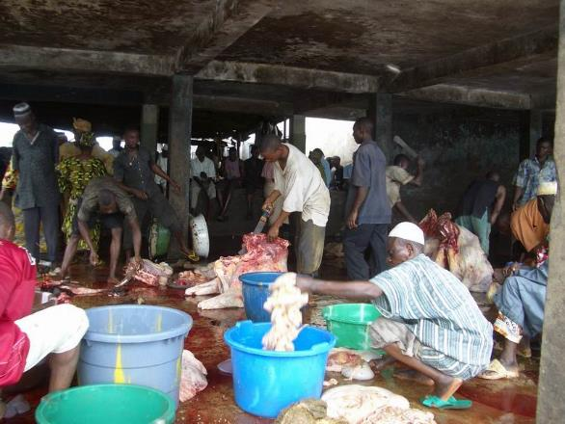
WP 2: Food Safety
Reduce the burden of foodborne disease with a focus on animal-source foods, including in informal and traditional food systems, through simple technologies and non-punitive governance approaches implemented along food value chains from production to consumption.

Slide 14

WP2 Food Safety Theory of Change
WP4: Water management, clean water improvision, relative contribution to disease burden
Evidence on foodborne disease burden and intervention priorities
1
Improved food safety practices of value chain actors
7
3
ECM: Training and simple technologies, certification and enabling environment/ non-punitive enforcement intervention package
Producers, SH, market vendors
WP1: farm interventions
Government and private sector partners support integration of ECM approach for informal vendors and other actors to food safety regulatory approach
4
8
Reduction in foodborne disease in informal and traditional food value chains
Establishment of national food safety working group
5
2
Producers, SH, market vendors, consumers
Capacity building
Government, private sectors, consumers
6
9
Enabled policy of food safety
Pathway 1: Food safety improvement in traditional markets
Government
Pathway 2: Policy and capacity improvement for food safety

Slide 15
Innovations
Evidence on multiple foodborne disease burdens (including risk assessment), risk factors and intervention priorities (risk ranking)
ECM (enabling, capacitating, incentivizing) informal markets: Support value chain actors (from farm to fork) to reduce burdens of foodborne disease through supporting: a) an enabling environment, b) technologies and training, c) incentives for behaviour change. For example, non-punitive co-regulation, color-coded containers for raw and cooked foods, food safety culture.
Establishing and strengthening national food safety working group to generate foodborne disease evidence and support regulatory approaches to food safety

Slide 16
Partnership
Evidence on risk analyses including testing appropriate technologies and behavioural change mechanisms and evaluating their scalability. Partners will include (Ethiopian TBC).
At the regional level, we will collaborate with other One Health programs (OHRECA, COHESA) to work with FAO, WHO, OIE on traditional market communication and advocacy, and support the regional economic communities on food safety strategy and curriculum.
Regional platforms AFROHUN to scale up the risk-based approach to food safety through trainings
Government programs: NOHCS, other directorates, AHI.
SAPLING, Resilient Cities, HER+ initiatives.

Slide 17
Resilient Cities
Through Sustainable Urban and Peri-urban Agrifood Systems
A CGIAR Research & Innovation Initiative
May 2022

Slide 18
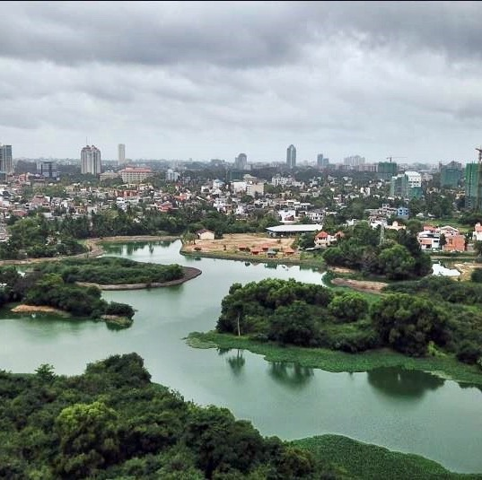
Why this Initiative?
Our urbanizing world
By 2050, more than 2 out of 3 people will live in urban environments
Including more than 5.5bn in LMICs
More than 80% of food will be consumed in urban environments
Engage urbanization is a driver of food system transformation
Scientific research to understand and support this global transition
Key role for CGIAR science partnerships in the Global South

Slide 19

OneCGIAR Research and Innovation
Applying CGIAR science to urban challenges
  Combining social and biophysical sciences
  Engaging new sets of urban stakeholders and research partners
  Developing new multi-sectoral approaches (agrifood within urban systems)
Focus on Resilience outcomes
  Equitable access to healthy diets
  Decent employment for women & youth
  Climate-smart, circular bioeconomy

Slide 20
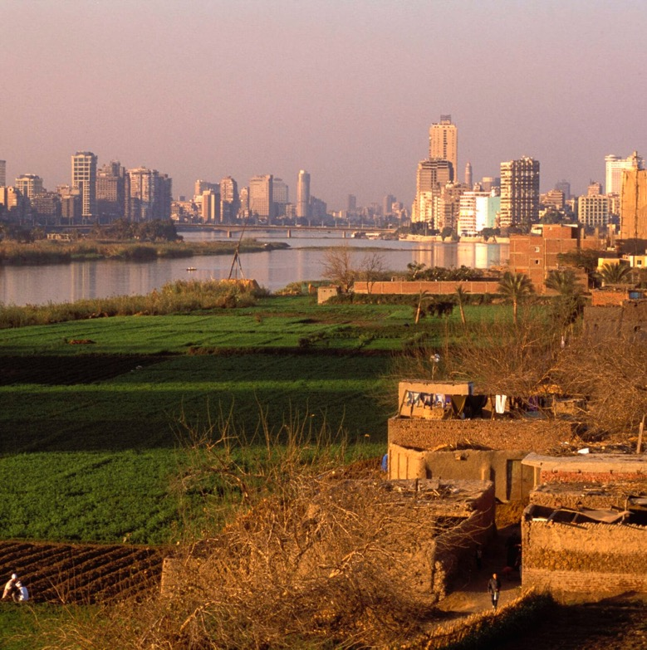
Urban and peri-urban food production
What technologies and business models can provide fresh, safe and nutritious food for low-income consumers in the city?
Focus on peri-urban production zones for vegetables, fruits, livestock, fish
Efficient and safe year-round production systems
Biofertilizer & biocontrol technologies
Evidence for planning, policies and regulations (land/water access, pollution, services etc.)
Credit: CGIAR

Slide 21
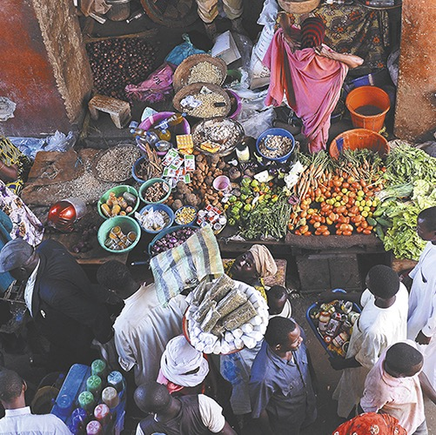
Informal urban food markets
How can we make and keep informal urban food markets inclusive, safe and profitable?
Low-cost technologies for food safeguarding
  More efficient marketing through ICTs
  Low-investment food processing
  Simple storage with solar power
Skills and evidence for market development
  Women & youth-focused food business development
  Evidence & design for market upgrading/regulations/ diversification
Credit: CGIAR

Slide 22
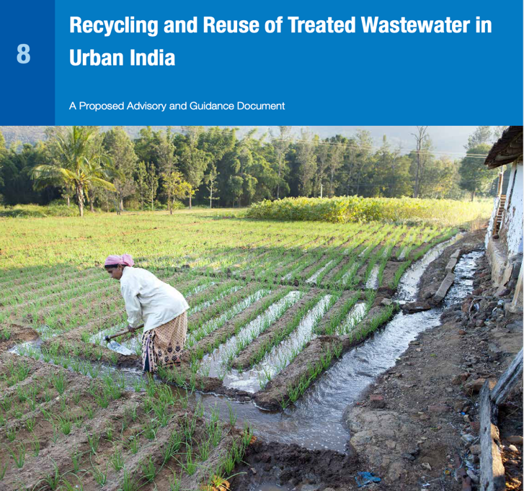
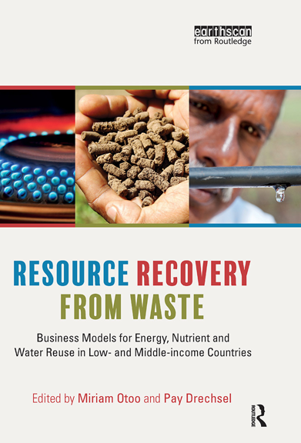
Circular bio-economy
What technologies and business models can most effectively close nutrient and water loops?
Resource Recovery and Reuse turning agro-industrial and municipal waste into safe organic fertilizers and feed
Recycle wastewater for safe food production at scale in and around water-scarce cities
Research & monitoring tools for circular urban-rural planning and policy

Slide 23
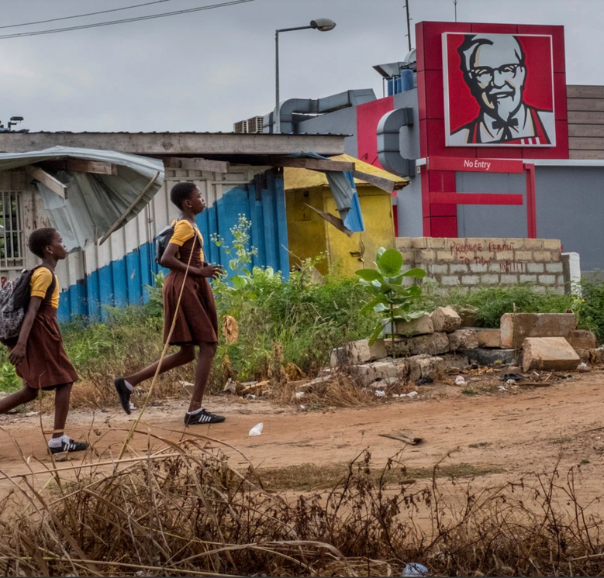
Food Environment & Consumer Behaviour
What interventions can most effectively improve urban food consumption?
Programming and investment tools:
Options for an alternative, healthier urban food environment
  Focus on adolescents
Global evidence base and guidelines for urban food investments
  Including private sector action on healthy food
Consumer education and demand creation modules
Credit: A. Gilbertson, NYT

Slide 24
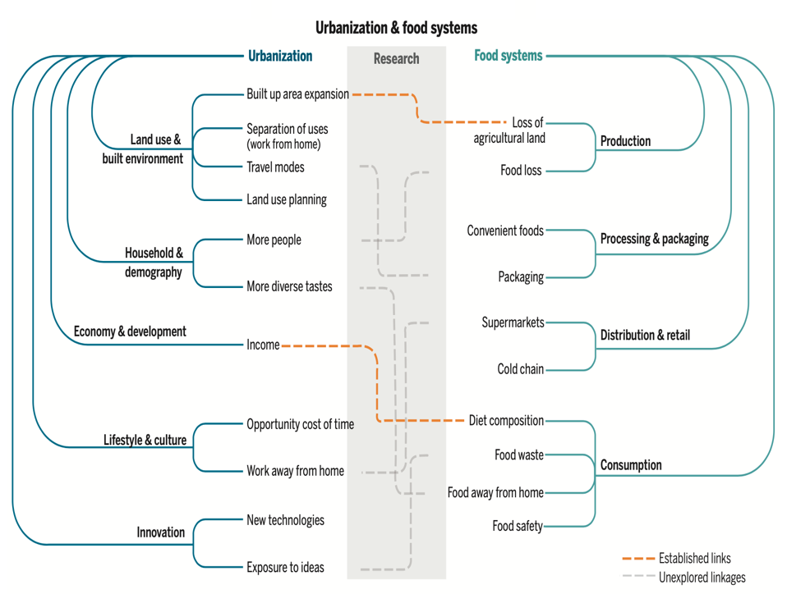
Evidence base, governance, and research & innovation capacities
How can we assess the resilience of urban food systems and harness urban innovation capacities?
Urban Food System Profiles of participating cities
  Integrated assessment across urban sectors
  Current Resilience Status determined
  Identification of investment options
Improved metrics, data tools and efficient methods for research and monitoring
Train young agrifood scientist-entrepreneurs from local universities through Lean Launchpad facilities
Seto & Ramankutty, Science 2016

Slide 25
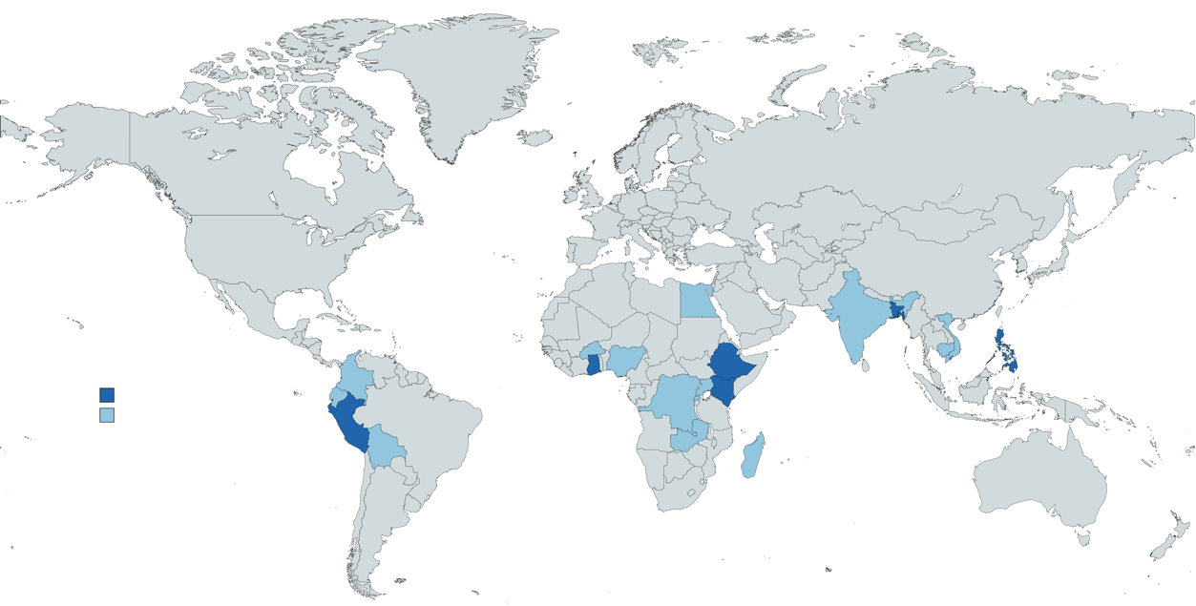

Where we work (2022-25)
Roles | Partners
Research & innovation | Dhaka U, icddr,b, Bangladesh Agric U, Institute of Public Health
Delivery at scale | Producer organizations, Informal Vendor Associations, City Corporations (Dhaka North, Dhaka South), SUN Business Network
Policy change | Food Policy Platforms, City Corporations (Dhaka North, Dhaka South), National Ministries (Food, Urban Dev, Agric, Health)
Capacity development | FAO Dhaka Food System Project, RUAF, GAIN
CGIAR collaboration: TAFSSA, SHiFT, HER+, Aquatic Foods
Focus countries in 2022/23
Bangladesh, Ethiopia, Ghana, Kenya, Peru, Philippines

Slide 26

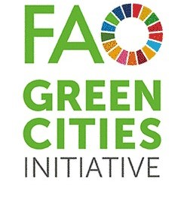



Delivering Through Partnerships
Cities and Municipalities
Private sector (formal and informal)
Civil society groups
Research and innovation partners
Global city networks (> 2,000 cities)

Slide 27

Thank You!
This presentation is licensed for use under the Creative Commons Attribution 4.0 International Licence. May 2022

