Slide 1
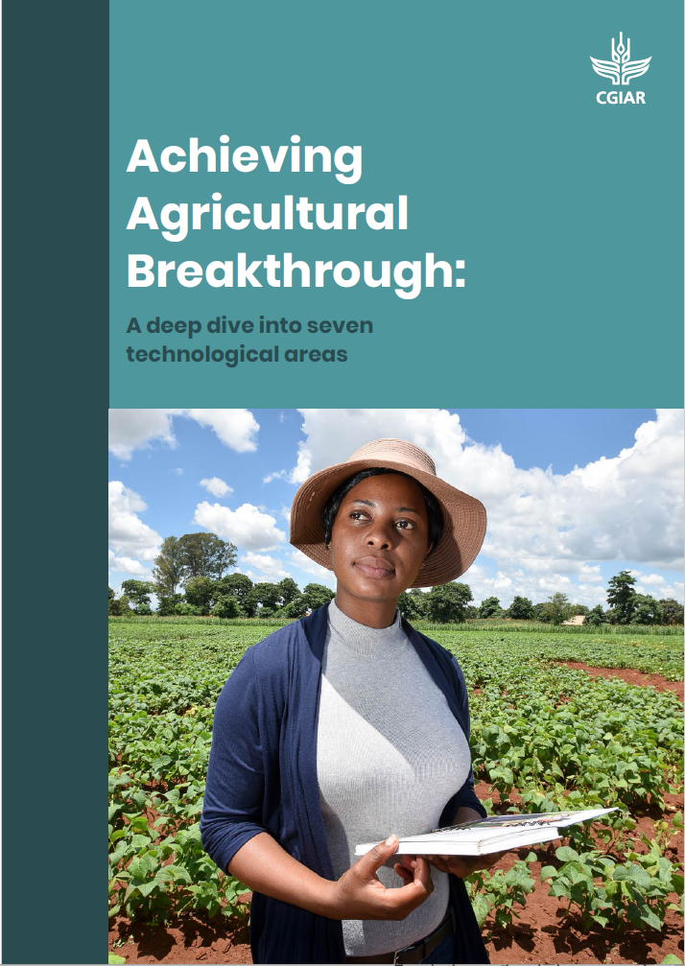
Breakthrough Agenda in Agriculture: Areas to drive food systems transformations
26th September, 2023
Feeding Resilience: Climate Change and The Security Case for Agricultural Adaptation Investment
Dr. Aditi Mukherji
Director, CGIAR Climate Change Impact Platform
https://www.cgiar.org/research/publication/agricultural-breakthrough/

Slide 2

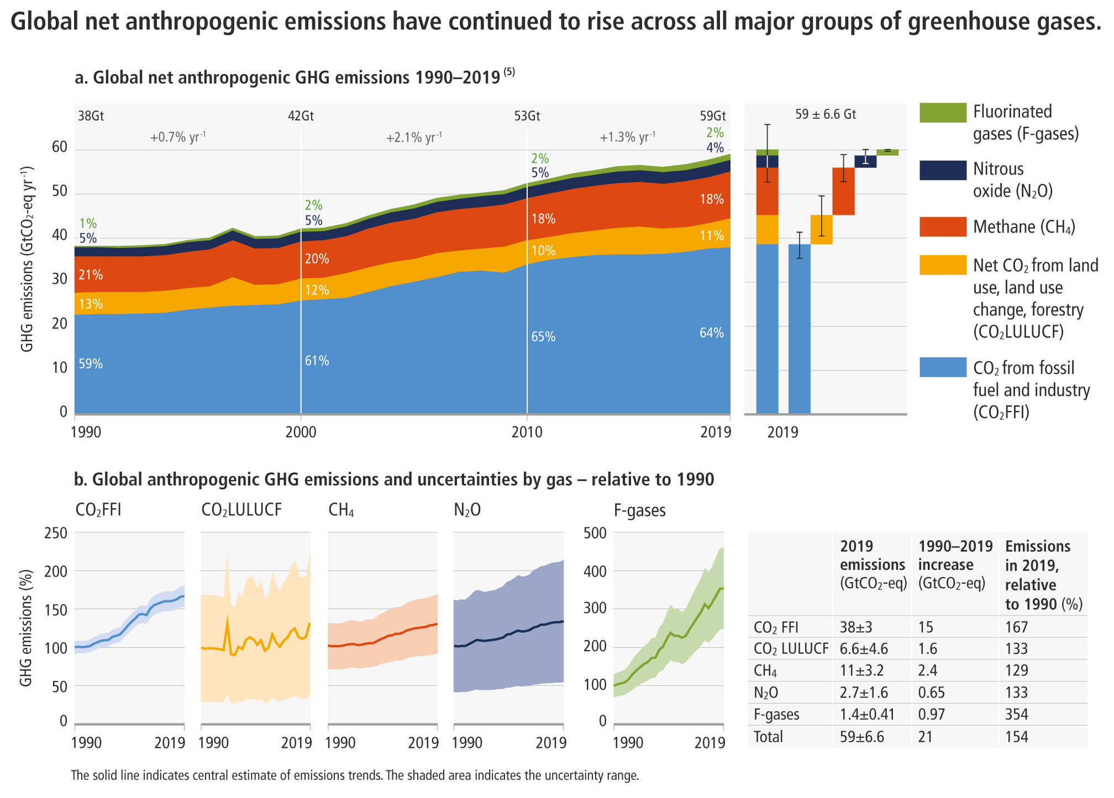
Emissions are at their highest level in human history
Agri-food sector
~30% of global
GHG emissions
[IPCC WGIII Figure SPM.1; Chapter 2, Figure 2.4; Chapter 12.4]
Notes:
In the next 20 minutes we will set out our key findings, showing where we are in terms of greenhouse gas emissions, where we are headed, and what action we can take to limit global warming.
[CLICK]
The reality is that greenhouse gas emissions, which are causing global warming, are at their highest levels in human history.
[NEXT SLIDE]

Slide 3
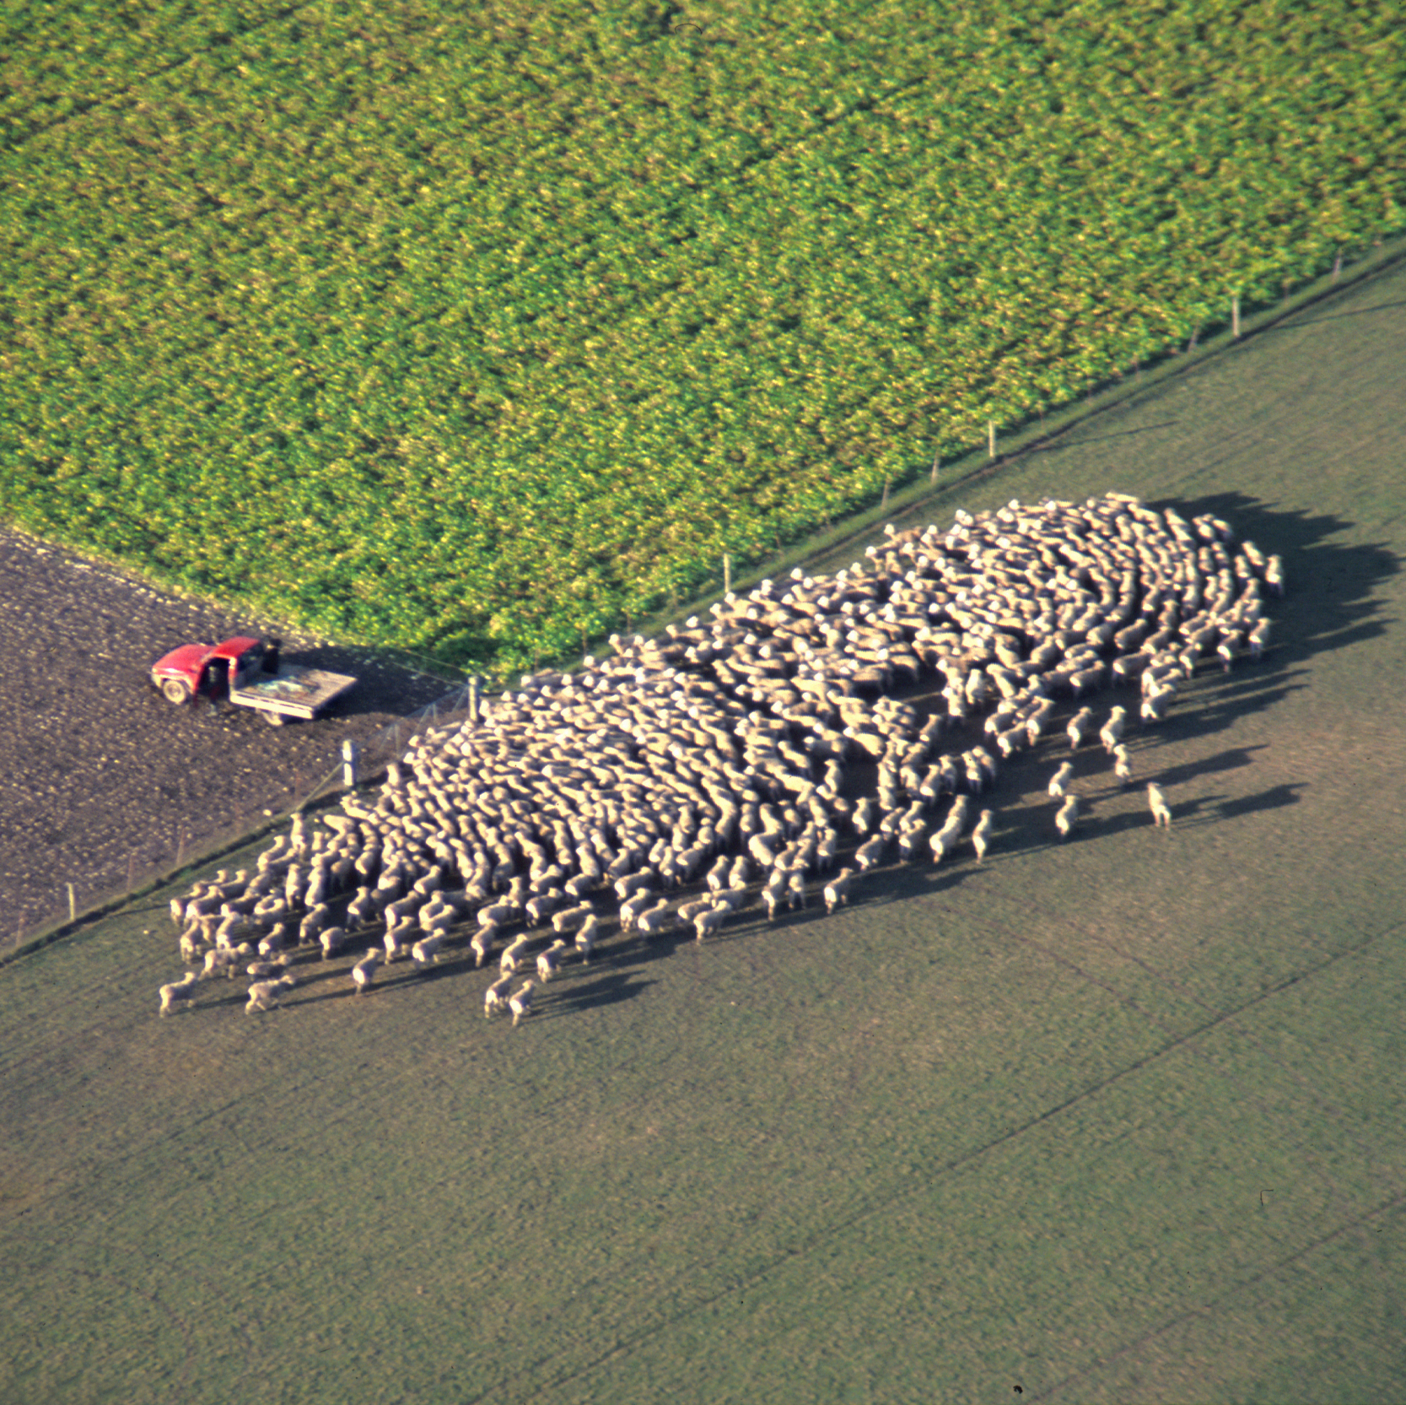

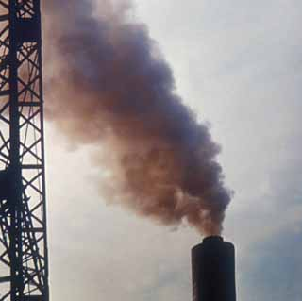
Agri-food system emission sources
Production, processing, distribution, consumption of food and management of food system residues; estimated 23-42% of all global GHG emissions
  Agriculture
Direct emissions from livestock and crop production systems; 6.3 Gt CO₂-eq
  Land-use change
Land use, land-use change and forestry, including peatland drainage; 4.0 Gt CO₂-eq
  Energy, industry, waste
Processing, transport, storage, preparation, food waste;
6.5 Gt CO₂-eq
The share of energy, industrial process and waste emissions occurring as part of the food system has grown from ~28% in 1990 to ~38% in 2018
WGIII Chapter 12.4

Slide 4
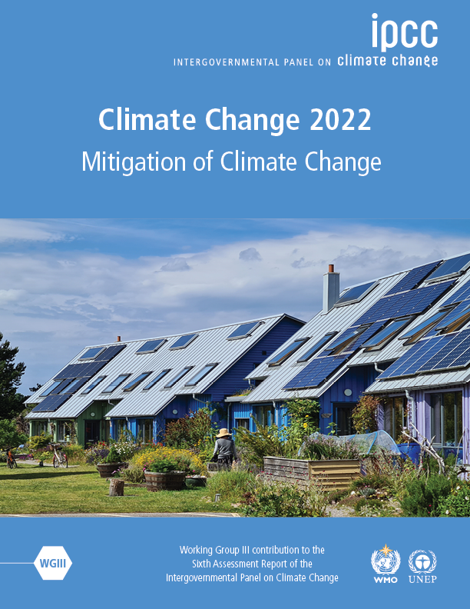
Unless there are immediate and deep emissions reductions across all sectors (including agri-food systems), 1.5°C is beyond reach.
[Matt Bridgestock, Director and Architect at John Gilbert Architects]
Notes:
In the next 20 minutes we will set out our key findings, showing where we are in terms of greenhouse gas emissions, where we are headed, and what action we can take to limit global warming.
[CLICK]
The reality is that greenhouse gas emissions, which are causing global warming, are at their highest levels in human history.
[NEXT SLIDE]

Slide 5
However, stringent mitigation to keep within 1.5-2°C may lead to severe food insecurity in Sub Saharan Africa and South Asia
Robust finding is that by 2050, stringent climate mitigation
policy, if implemented evenly across all sectors and regions,
would have a greater negative impact on global hunger and
food consumption than the direct impacts of climate change
Hasewaga et al. Nature Climate Change, 2018
https://www.nature.com/articles/s41558-018-0230-x#citeas
Land based mitigation actions like energy crop expansion,
non-CO2 emissions reduction in agricultural sector and
afforestation lead to lowered availability of calories,
increase in population at risk of hunger,
higher agricultural commodity prices
Fujimori et al. 2023, Nature Food
https://www.nature.com/articles/s43016-022-00464-4#citeas

Slide 6
We have a catch-22 situation here
Mitigate we must to keep global warming levels within Paris agreed goals of 1.5 to 2ºC to keep the climate impacts at its minimum
But mitigation at needed scale may lead to hunger and food insecurity for people in the Global South unless it is done carefully and by understanding the trade-offs and synergies well
All of us need to play an important role in ensuring:
“That technological and policy breakthroughs lead to just transitions in agri-food sector”

Slide 7
Principles and pathways for agricultural breakthrough
Four Principles of Agriculture Breakthrough
Sustainable increases in agricultural productivity and incomes, particularly in LMIC contexts
Reduced GHG emissions from agrifood sector
Improved soil, water resources, and natural ecosystems
Improved adaptation and resilience to climate change particularly for vulnerable smallholder producers

Slide 8
Five Pathways for Achieving Agriculture Breakthrough

Slide 9
Recommendations
Supported by international collaborative actions on
Climate finance
Policies, regulations and innovations
Metrics, indicators and standards
RD&D
Private sector markets and trade
Climate finance for deployment of agricultural technologies and approaches for which science has generated evidence on effectiveness, including agroecology, reducing food loss and wate, reducing livestock methane emissions, reducing emissions from fertilisers, and crop and livestock breeding.
Test, develop evidence, and share learning on policy and implementation. Prioritise the redirecting of policies and support for agriculture towards sustainability and climate resilience, and the facilitation of faster uptake of proven technologies in the sector.
Governments, international organisations and research institutes should develop common metrics and indicators to track the adoption of key sustainable agriculture solutions as well as to monitor the state of natural resources on which agriculture depends.
Higher levels of investment in agricultural research, development and demonstration, to be maintained over the course of this decade.
Governments should begin strategic dialogues on how to ensure international trade facilitates, and does not obstruct, the transition to sustainable agriculture.

Slide 10
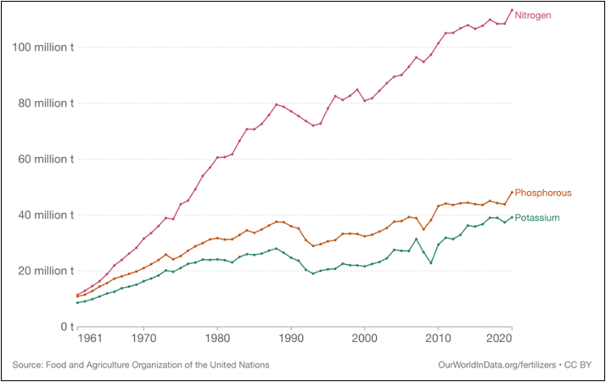
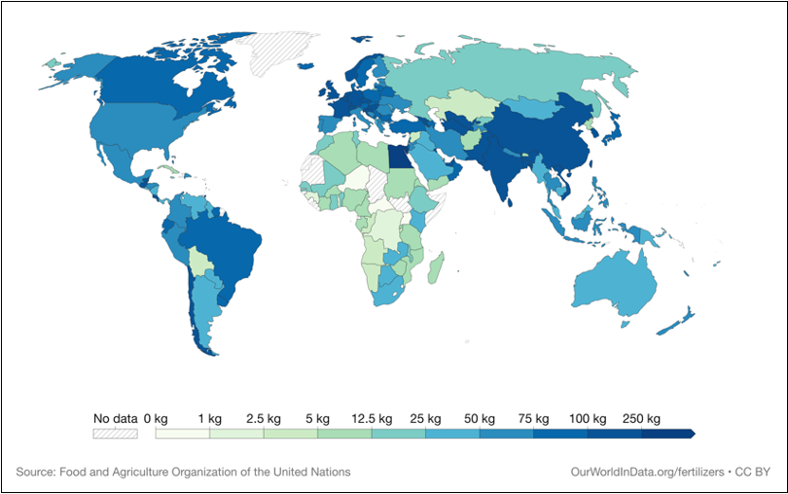
Reducing emissions from fertilisers : Importance
Fertilizer use increased since 1960s, with commensurate food security benefits
Fertilizer use unequal across regions
Higher global warming potential of N₂O than CO₂
More efficient use of fertilizers in high-use regions will allow for optimum use in low-use areas

Slide 11
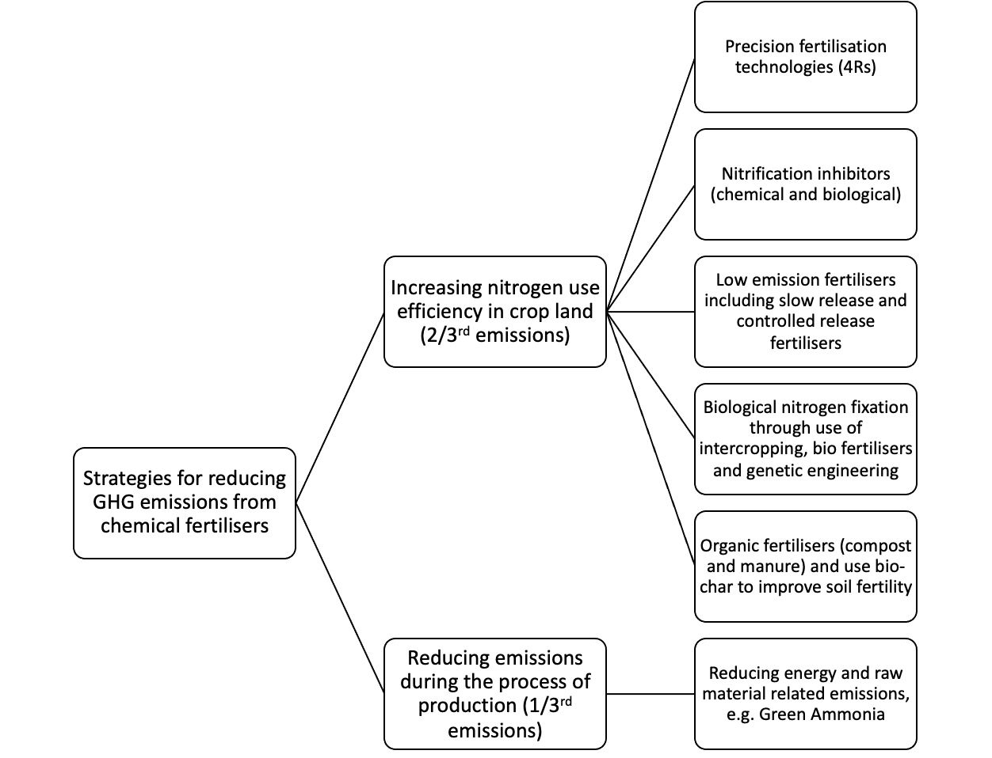
Reducing emissions from fertilisers: State of science
Production of mineral based fertilizers = 1/3 of fertilizer-based emissions
Use : improving nitrogen efficiency essential part of strategy, through precision fertilization, low emissions fertilizers, etc.

Slide 12
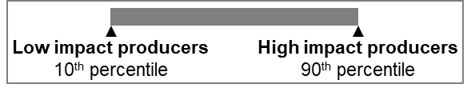
Alternative proteins: Importance
Animal-source foods (ASF) are an important component of diverse diets
However, huge global inequities in consumption ranging from ~140 kg/capita in US and less than ~10 kg/capita in many Africa countries, with health consequences
High GHG emissions, with livestock and fisheries estimated to account for 53% of food emissions, also beef production is a leading cause of deforestation
Alternative proteins can help reduce ASF consumption where it is unsustainably high
Greenhouse gas emissions of selected traditional protein foods
(Source: Adapted from Poore & Nemecek, 2018)

Slide 13
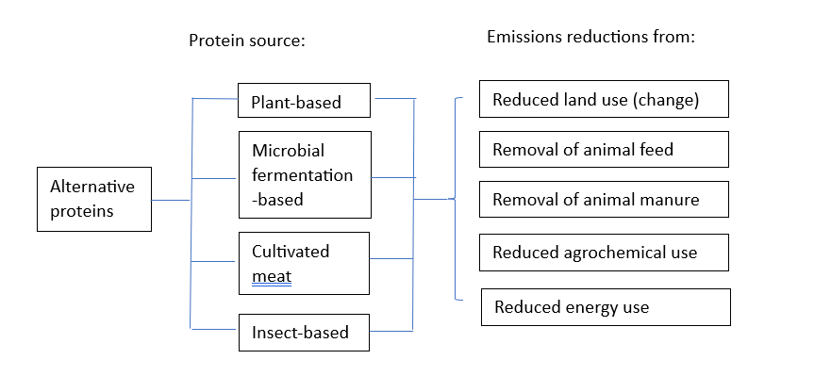
Alternative proteins: State of science

Slide 14
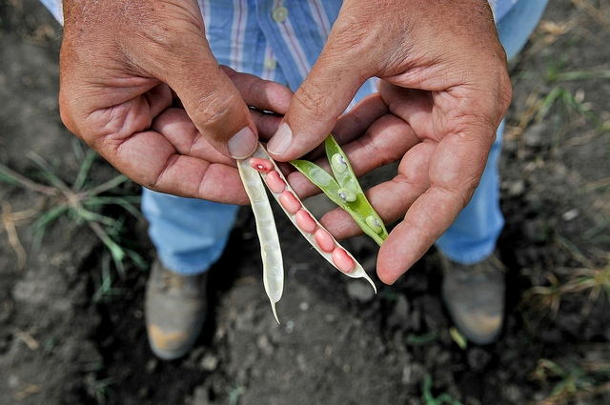
Breeding crop and livestock for climate resilience: Importance
Climate change has slowed down the growth in crop yields, reduced livestock productivity and affected the nutritional content of food as well as farm profitability.
The rate of genetic improvement must be doubled to meet the future demands.
Therefore, accelerated breeding programmes are essential in the production of crops and livestock that can withstand the impacts of climate change

Slide 15
Breeding crop and livestock for climate resilience: State of science
* Breeding that focuses on reducing emissions also has co-benefits for climate adaptation

Slide 16

Thank you on behalf of CGIAR Author team
Aditi Mukherji (CGIAR), Claudia Arndt (ILRI), Jacobo Arango (Alliance for Bioversity and CIAT), Fiona Flintan (ILRI), John Derera (CGIAR), Wendy Francesconi (Alliance for Bioversity and CIAT), Sarah Jones (Alliance for Bioversity and CIAT), Ana Maria Loboguerrero (Alliance for Bioversity and CIAT), Douglas Merrey (Consultant), Jonathan Mockshell (Alliance for Bioversity and CIAT), Oscar Ortiz (CGIAR) Marcela Quintero (Alliance for Bioversity and CIAT), Daniel Girma Mulat (ILRI), Claudia Ringler (IFPRI), Loraine Ronchi (CGIAR), Manuel Ernesto Narjes Sanchez (Alliance for Bioversity and CIAT), Tek Sapkota (CIMMYT), Shakuntala Thilsted (CGIAR)
Acknowledgment: Agriculture Chapter Steering Committee
FAO Chief Scientist Ismahane Elouafi
UN Climate Change High Level Champion: Rebecca Brooks
CGIAR Managing Director: Johan Swinnen
Acknowledgment: Funding support
FCDO
Full report available at:
https://www.cgiar.org/research/publication/agricultural-breakthrough/

