Slide 1
Research and learning for sustainable intensification of smallholder livestock value chains in Burkina Faso, Ethiopia and Tanzania
Dawit Woubishet
Ethiopian Development Research Institute
SAIRLA Second National Learning Alliance Workshop
ILRI, Addis Ababa, 23 November 2017

Slide 2
Background
One of the four SAIRLA projects funded by DFID
Generate new evidence and design tools
- to enable government, investors and other key actors to deliver more effective policies and investments in sustainable agricultural intensification (SAI)

Slide 3
Partners

Slide 4
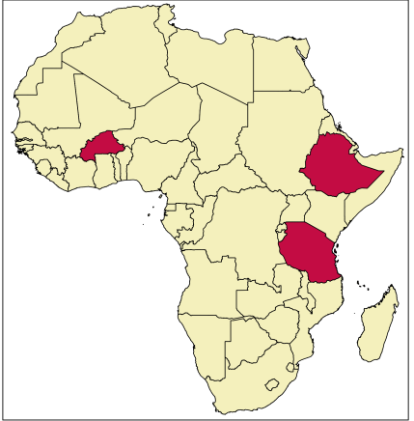
How are we doing it?
Multi-disciplinary, multi-country team
Three case-study locations
- Burkina Faso, Ethiopia &
Tanzania
Action research approach
- rapid environmental assessment and participatory economics
- in a social learning process

Slide 5
Why is the project essential?
Environment: Rapid development of livestock production is resource intensive. It has multiple environmental consequences
  Equity: Understand history and ensure representation of stakeholders
  Fair and just distributions of risk, costs and benefits
Economy: Participatory economics approach. Two core concepts
  Shared economic qualitative and quantitative indicators
  Shared process for co-evaluation of economic indicators

Slide 6
Ethiopia: Project site, Workshop and Outputs
Project site in Ethiopia: Atsbi Woreda
Assessment of household (expert interview of households in Atsbi in December 2016)
Reconnaissance tour: February 2017
Workshop June 26-30 in Wukro: Participatory stake-holder mapping workshop
Outputs: (1) Validated data and information; (2) Consolidated report; and (3) Policy brief
Tanzania and Burkina Faso: proceeding similarly…

Slide 7
Ethiopia: Project site Atsbi: the issues
Atbi Topography: suitable for livestock, dominated by sheep; but, the production system is traditional.
Constraints: Feed shortage, poor veterinary service, poor management and awareness: affects the Q & Q of livestock
Sustaining production
Deteriorating environmental condition
Challenges to Atsbi Communities
To understand the constraints, information is limited
Here comes CLEANED Model
Timely to focus and contribute in improving livelihoods of the smallholder farmers.

Slide 8
Ethiopia: ….
The workshop in Wukro/Atsbi: inclusive participatory processes to integrate environmental, economic & equity considerations into policy & implementation
The workshop had two-fold objective:
Data validation, study area delineation, and brief and detail description of the livestock keeping systems to parameterize the CLEANED tool
(2) To create a baseline for the equity & economy components.

Slide 9
Ethiopia...
Methods used
Participatory mapping for characterisation of livestock systems
Snowballing negotiation
Letter to the future generation and journalist interview: describing how they wish to keep livestock in 10 years from now and share their vision in smaller group.

Slide 10
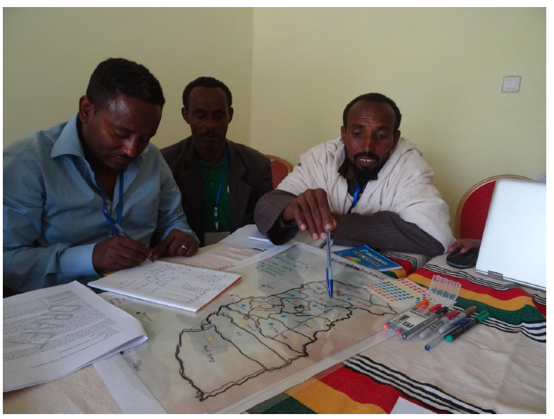
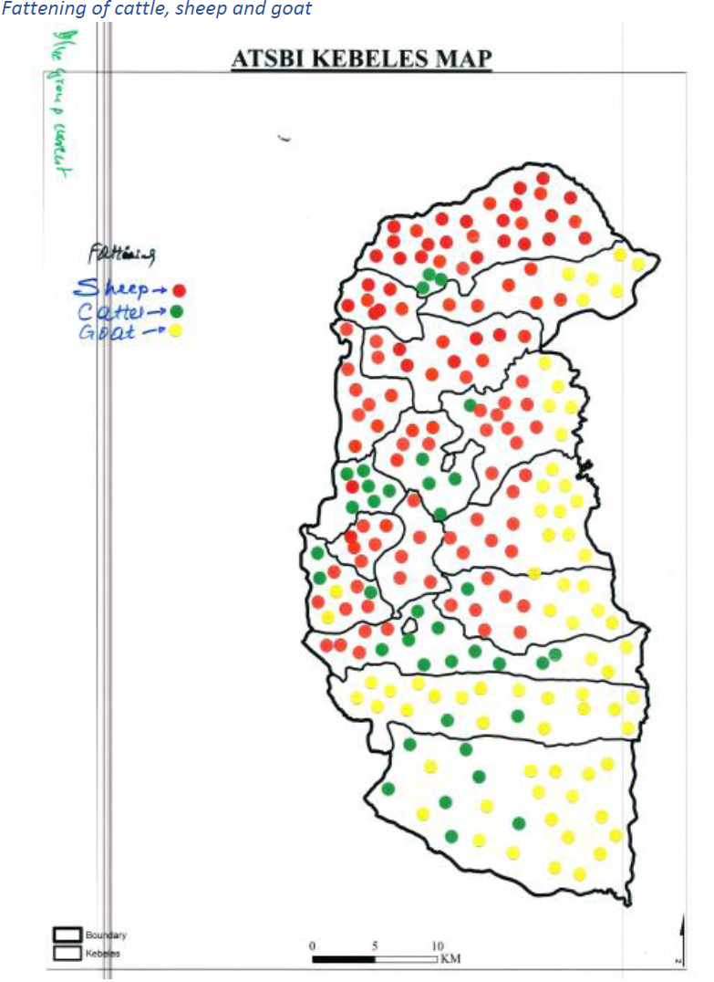
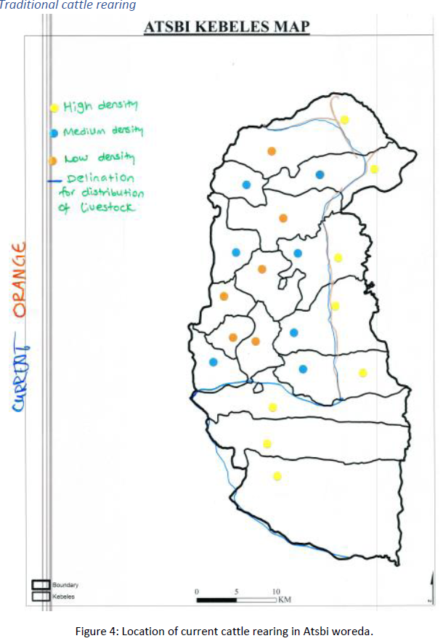

Slide 11
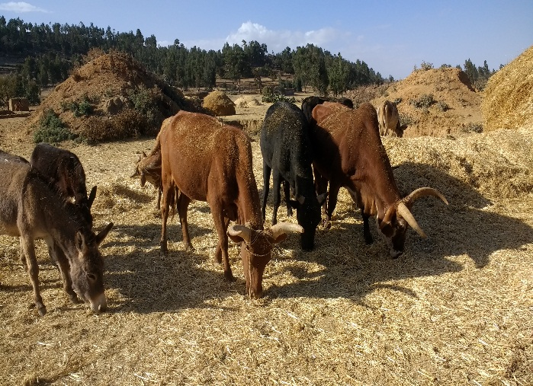
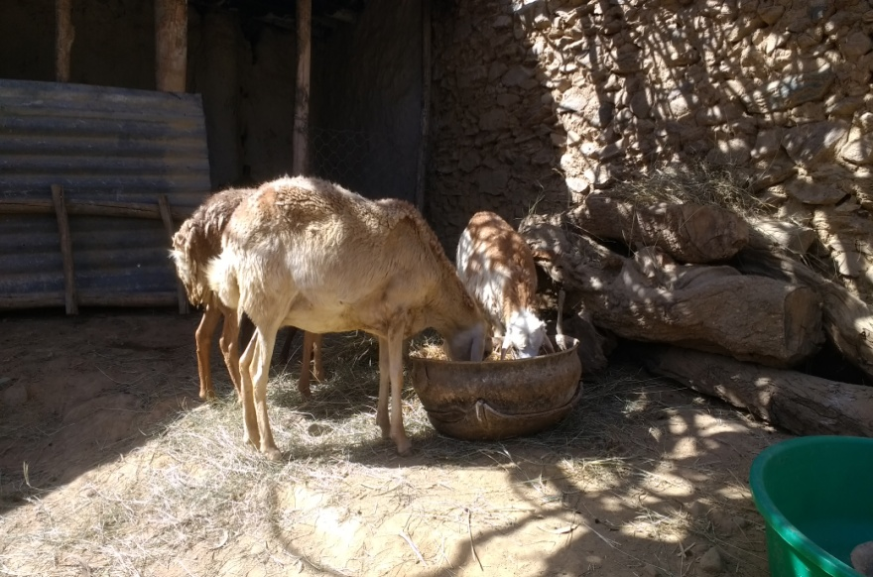
Ethiopia... The current...
E.g. Atsbi current system
for traditional cattle rearing
(1)Improved Dairy production; (2) Dual purpose cattle (traditional that includes Oxen keeping for ploughing, cattle fattening and cattle rearing; (3) Sheep fattening; (4) Sheep rearing
Participants defined the # and characteristics of animals, feed basket per season, manure mgt, equipment & facilities.
E.g. Atsbi current system
Of sheep fattening

Slide 12
CLEANED Model
CLEANED : Comprehensive Livestock Environmental Assessment for improved Nutrition, a secured Environment & sustainable Development CLEANED)
The CLEANED Model for Ethiopia is expected during August-October, 2018
The CLEANED Model for Tanzania can be expected between May-July, 2018
Currently, the research team has drafted the parameterized CLEANED Model for Burkina Faso.

Slide 13

The RestLess learning space: Burkina Faso : objective of CLEANED approach
Interaction between stakeholder and the CLEANED environmental simulation tool :
To understand environmental dynamics
Raise awareness about spatial planning
Engage a multi-stakeholder dialogue
Provide a neutral base to negotiate trade-offs
Develop inclusive intensification plans

Slide 14
Integration through a production game: Burkina Faso
Elements of the game
1. Livestock production in 5 production categories (pastoral transhumant animals, pastoral dairy animals, specialized dairy, fattening and draft)
2. Vignettes that represent current and new ways of livestock keeping methods for each category
3. Lego bricks represent the amount of animals in each category
Objective: develop a scenario that maximize benefit along socio-economic indicator are commonly defined and agreed by the stakeholders

Slide 15
Iteration and negotiation
Based on an environmental score card derived from CLEANED tool and a socio-economic score card, participants negotiated trade-off and proposed improved/negotiated scenarios.

Slide 16
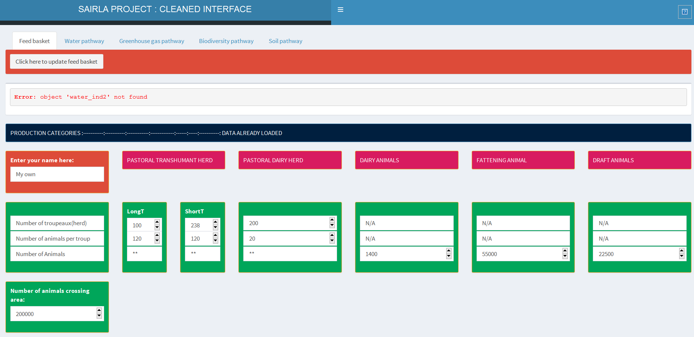
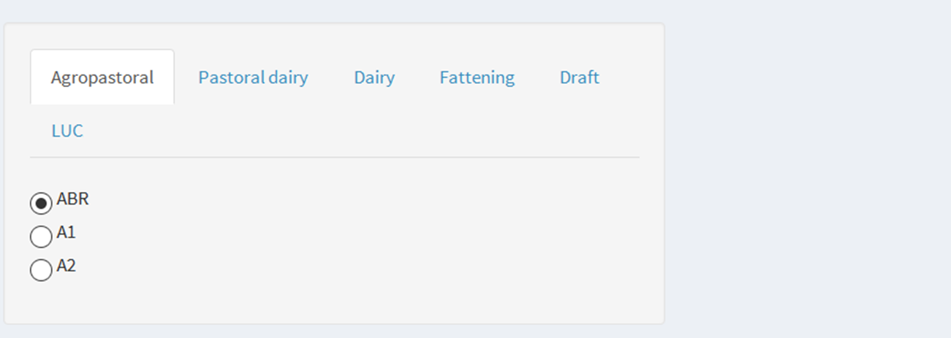
The CLEANED tool interface
Allows to enter the same information than in the game, namely number of animals and vignettes

Slide 17
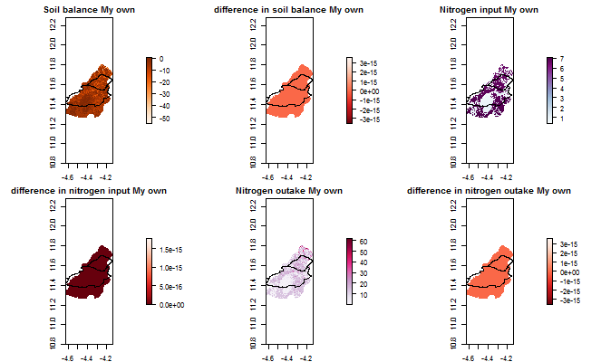
CLEANED … Soil pathway for project site in Burkina Faso …
Source- SAIRLA PROJECT: CLEANED INTERFACE for Burkina Faso

Slide 18
Ethiopia... Equity
II. Equity through workshop design: delivers three central components:
The equity research questions focus on knowledge and under-standing (based on what was said in the workshop):
1) Ensuring all voices are heard;
2) exposing differences in perspective on problems
3) Building toward each stakeholder group appreciating the validity of the others’ perspective
- To what extent is appreciation of others’ perspective?
- Were changes in views evident in the workshop?
- What different understandings of the problem or ‘issue’ under discussion were expressed?

Slide 19
Findings...Equity...
At the end of the workshop, participants stated that they had learnt:
Improved livestock practices are preferred;
How they can improve livestock production and therefore their livelihoods.
The workshop had created an enabling environment where participants, facilitators and also researchers engaged in open discussions and activities;

Slide 20
Conclusions
The participatory information collected at several levels are inputs for CLEANED Model for Ethiopia
Learning and Research was by and large successful in generating the required data
The Livestock production system in Atsbi is categorized for the model
The CLEANED Model for Ethiopia can be finalized from between August-October, 2018
Standard methods of generating Economic and Equity Indictors
Reports and policy briefs summarize the learning and research progress of the team

Slide 21
