Slide 1
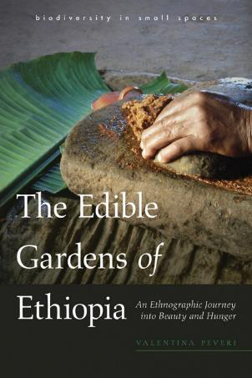
TH2.1: Multispecies Perspectives for Cultivating Diversity and Equality:
Reflections on ‘Species Inclusivity’ in Gender Research in Agriculture
Valentina Peveri
Cultivating Equality: Advancing Gender Research in Agriculture and Food Systems | October 12–15, 2021

Slide 2
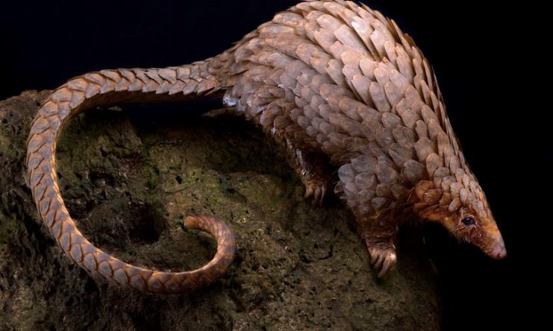
Life in the garden is like life at large:
the creature who remains alone, and does not commingle,
is doomed to pass away unrecorded.
—Hadiyya woman farmer, March 2014

Slide 4
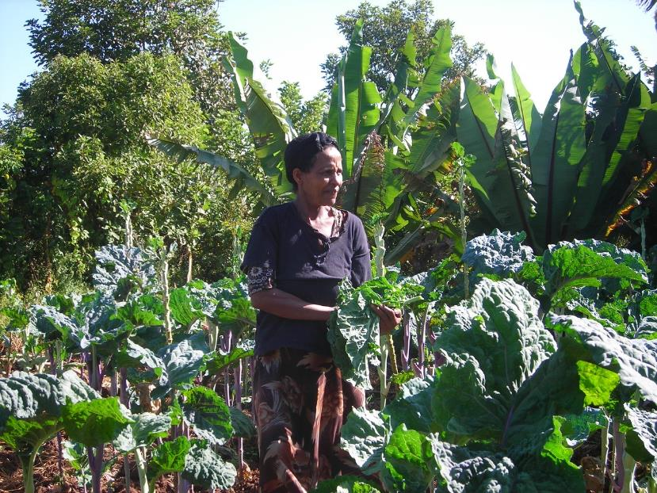

Slide 5
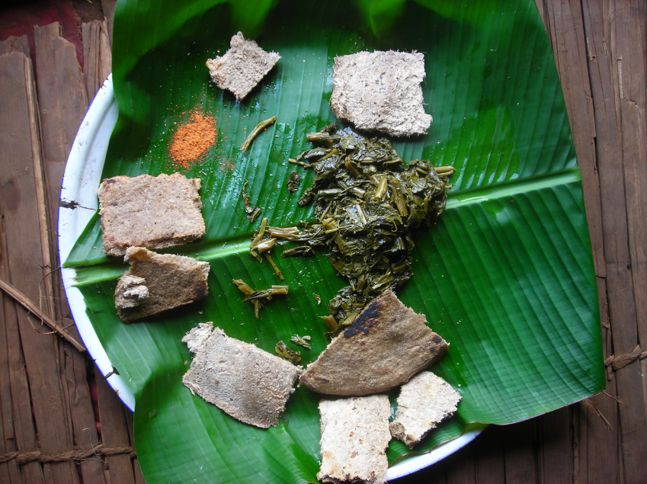

Slide 6
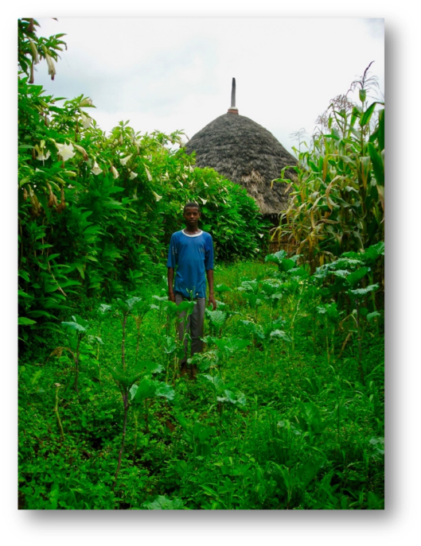
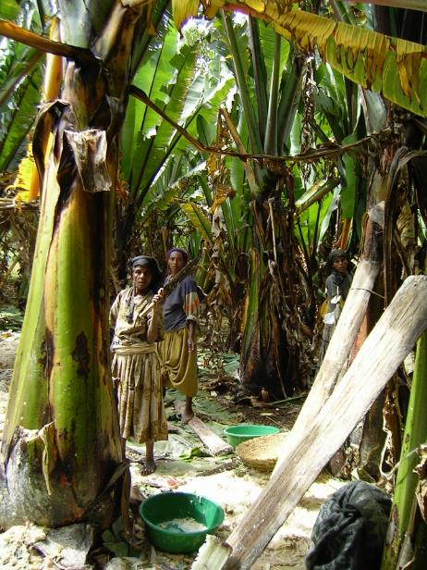

Slide 7
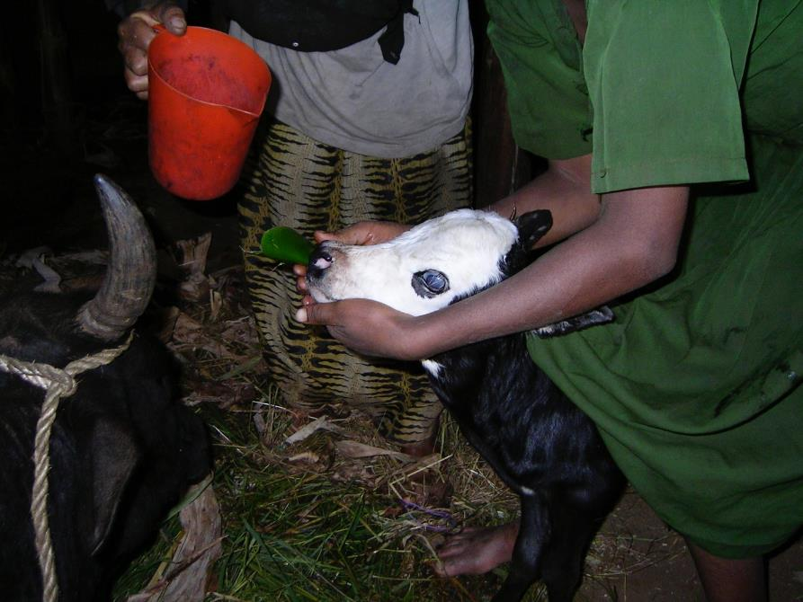

Slide 8
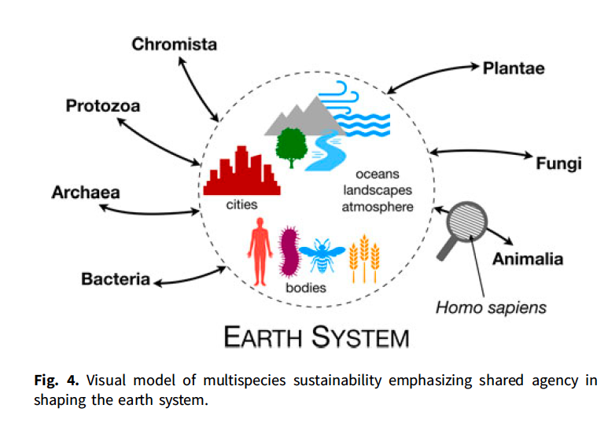

Slide 9
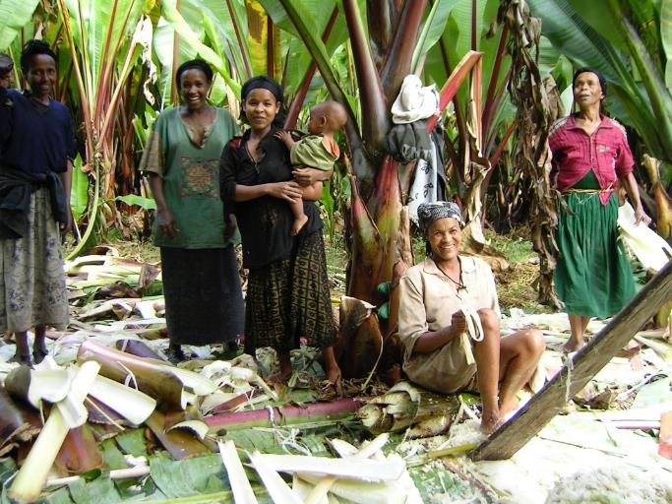
“Collaboration means working across difference, which leads to contamination. Without collaborations we all die.”
—Anna Tsing, The Mushroom at the End of the World (2015)

