Slide 1
Operationalizing One Health in pastoralist settings

Slide 2

Participant introductions
Getting to know each other
Go around and meet a participant whom you do not know
Introduce yourself. Share your experience as a One Health practitioner
In plenary, share what you have learned about your partner
15 minutes

Slide 3
Participant expectations
Expectations and intention to apply the learning
Individually, write down 2-3 expectations for the training and 1 intention to apply the learning
At your table, discuss and agree on 2 expectations for the training and intention to apply the learning
In plenary, share your expectations and application intention
15 minutes

Slide 4

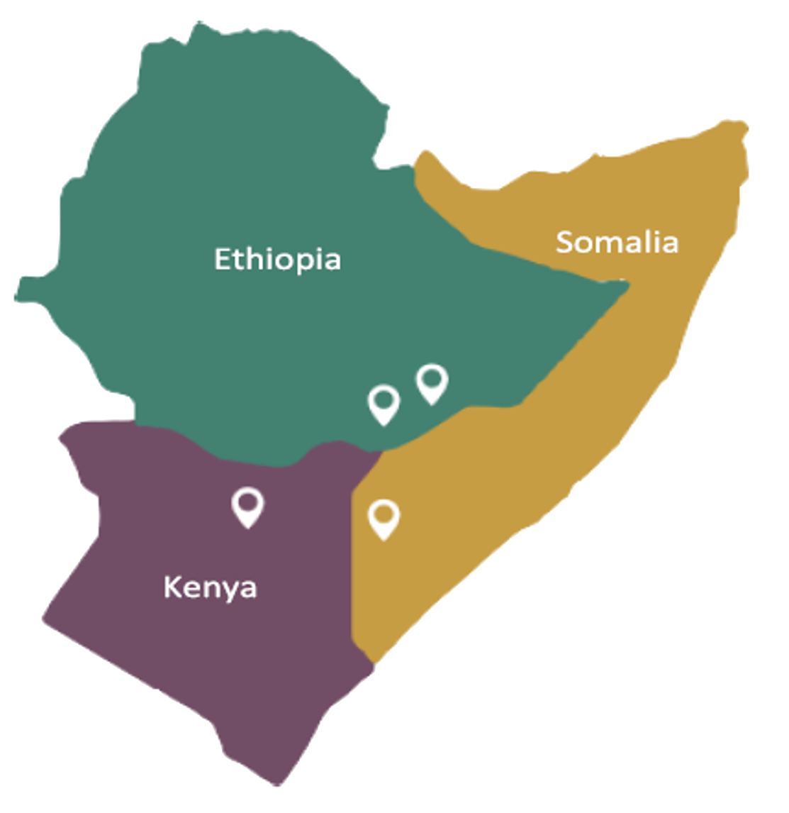
About OH4HEAL
Mission:
  To improve access to quality human and veterinary health services and sustainable natural resources management in vulnerable communities in (agro-)pastoralist areas of Ethiopia, Kenya and Somalia
Consortium partners:
  Vétérinaires Sans Frontières Suisse (VSF-Suisse; Lead)
  Amref Health Africa
  International Livestock Research Institute (ILRI)

Slide 5
About the OH4HEAL training package
Module 1: Principles and applications of One Health (5 days)
Module 2: Gender, culture and One Health (3 days)
Module 2: Practice of One Health in HEAL sites (2-3 days)
* Your facilitator will tell you about plans for future trainings

Slide 6
Module 1: Principles and applications of One Health

Slide 7
Intended learning outcomes
By the end of this training, you will be able to:
use the principles and approaches of One Health to address issues affecting human health and livelihoods, animal health and welfare, and rangeland and environmental health in pastoralist settings;
apply systems thinking to better understand problems at the ‘human-animal-environment interface’;
collect, analyze, and disseminate information to a diverse range of stakeholders engaged in One Health for effective, data-driven decision making;

Slide 8
Intended learning outcomes (continued)
apply effective practices to collaborate and coordinate with different sectors; and
engage communities in identifying challenges related to the interdependency between human, animal and environmental health in pastoralist areas and develop strategies for addressing them

Slide 9
Training content
Over the next 5 days we will cover:
Overview of One Health principles
Systems thinking in One Health
Data-driven decision making in One Health
Multi-sectoral collaboration and coordination in One Health
Participatory community engagement in One Health

Slide 10
Training approach and process
Experiential, reflective and collaborative learning process
Enriching learning through case study analysis, videos, and role-plays
Small group work and presentations
Personal reflections and journaling of key lessons and insights

Slide 11
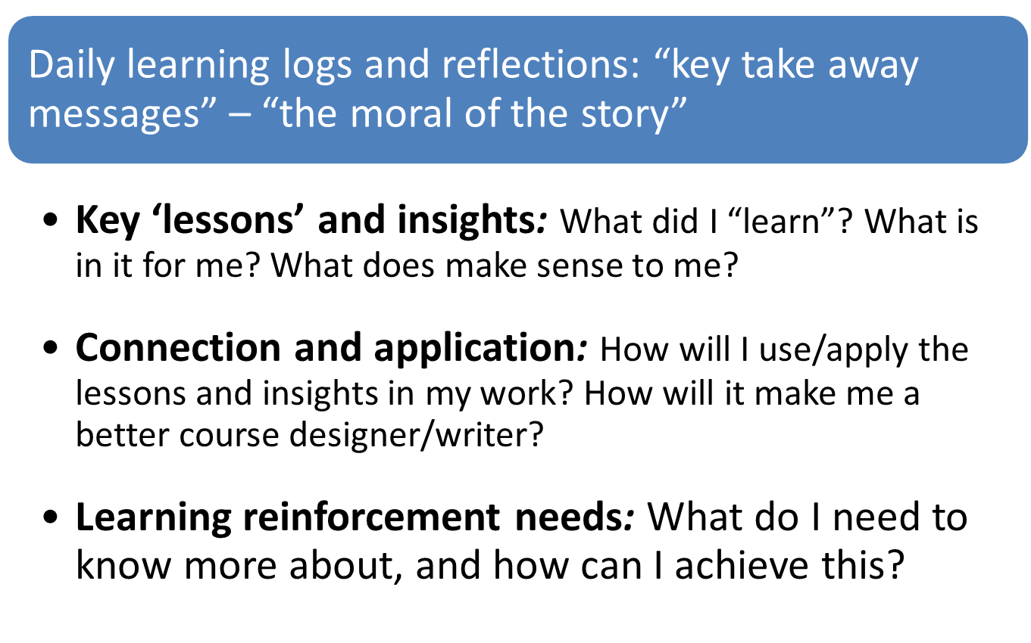
Self-learning management

Slide 12
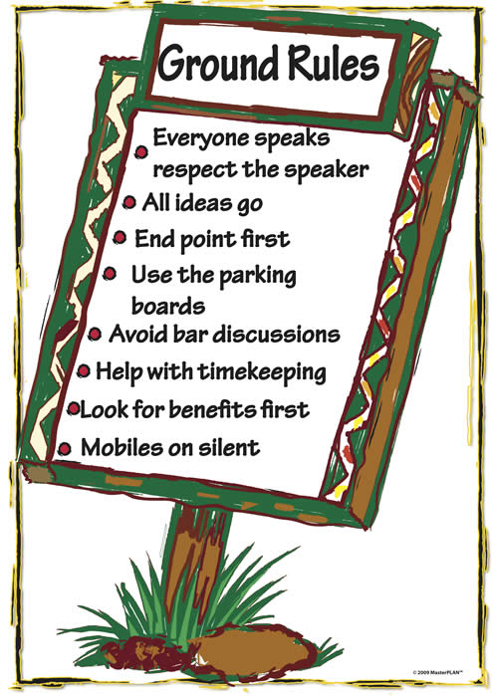
Ground rules
Be punctual
Be prepared
Every idea counts
Phones on silent mode
No side conversations
Active participation
Keep an open mind
Build connections

Slide 13
Feedback teams
Volunteers needed for each day
Purpose:
  Obtain participant feedback on the training content and process
  Energizers
  Time keeping

Slide 14
Evaluation
Your facilitator will distribute the pre-training evaluation form – measures baseline understanding on day 1 of training
Form is anonymous and will be compared with post-training evaluation completed on day 5
5 minutes

Slide 15
Overview of One Health principles

Slide 16
Intended learning outcomes
By the end of today, you will be able to:
define One Health and identity its key principles;
identify the sectors and disciplines which contribute to One Health;
recognize the importance of the 4 C’s in operationalizing One Health; and
describe the benefits of and challenges arising from the connectedness between human, animal, and environmental health, and provide relevant examples.

Slide 17
Topics
Meaning of ‘health’ in different contexts
Definition of ‘One Health’
Important One Health issues in pastoralist settings

Slide 18
The meaning of ‘health’ in different contexts
Interactive plenary discussion
Does ‘health’ mean the same thing when applied to humans, animals, and the environment?
What are the common characteristics of a healthy person/animal? What are some examples of an unhealthy person/animal in your woreda/district?
What does a healthy/unhealthy environment look like?
15 minutes

Slide 19
Human health
According to WHO:
‘Health is a state of complete physical, mental and social wellbeing and not merely the absence of disease or infirmity’ (WHO, 1948)

Slide 20
Animal health
Similar to human health but encompasses concepts related to productivity and welfare
‘Animal welfare’ is defined as the ‘the physical and mental state of animals in relation to the conditions in which they live’ (WOAH, 2022). Encompasses the ‘5 freedoms’:
  freedom from hunger, malnutrition, thirst;
  freedom from fear and distress;
  freedom from heat stress or physical discomfort;
  freedom from pain, injury and disease; and
  freedom to express normal patterns of behavior.

Slide 21
Health in relation to the environment
Different in different disciplines, e.g.
  Public health practitioner uses ‘environmental health’ to refer to policies and programs to reduce chemical and other environmental exposures in air, water, soil, and food to protect people and to provide communities with healthier environments
  Ecologist uses ‘ecosystem health’ to refer to ecosystems which are productive, have strong organizational structures, and are resilient under stress
Humans
Environmental health
(what environment
does to humans)
Ecosystem health
(what humans do
to the environment)
Environment

Slide 22
Meaning of One Health
Interactive plenary discussion
What key words come to mind when you hear the term ‘One Health’
10 minutes

Slide 23
Meaning of One Health
Small group activity (brainstorming)
Facilitator will show an image (next slide)
At your table, discuss how the image enhances your understanding of the meaning of ‘One Health’
20 minutes

Slide 24
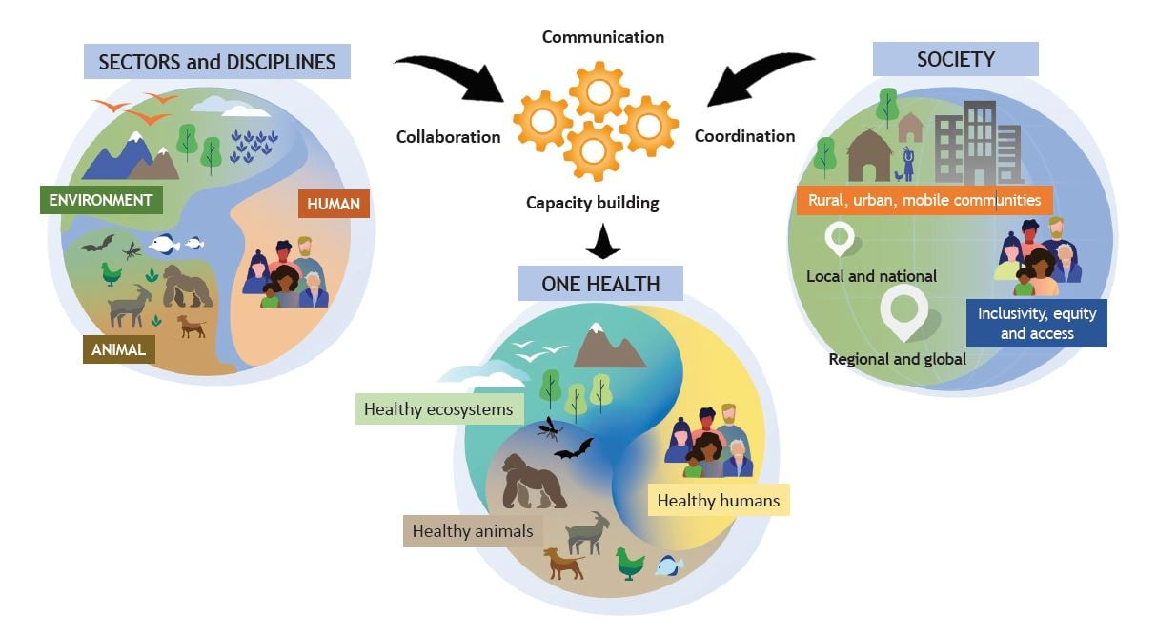

Slide 25
Definition of One Health
According to the One Health High-Level Expert Panel established by the ‘Quadripartite Alliance for One Health’ (comprising WHO, WOAH, FAO and UNEP):
‘One Health is an integrated, unifying approach that aims to sustainably balance and optimize the health of people, animals, and ecosystems. It recognizes the health of humans, domestic and wild animals, plants, and the wider environment (including ecosystems) are closely linked and interdependent’ (OHHLEP, 2022)

Slide 26
Definition of One Health
According to the One Health High-Level Expert Panel established by the ‘Quadripartite Alliance for One Health’ (comprising WHO, WOAH, FAO and UNEP):
‘The approach mobilizes multiple sectors, disciplines and communities at varying levels of society to work together to foster well-being and tackle threats to health and ecosystems, while addressing the collective need for clean water, energy and air, safe and nutritious food, taking action on climate change, and contributing to sustainable development’ (OHHLEP, 2022)

Slide 27

4 C’s of One Health
One Health is operationalized by enhancing collaboration, communication, coordination and capacity building between sectors, disciplines, and different groups in the society (communities, policymakers, and researchers)

Slide 28
Sectors and disciplines - examples
Practitioners
Rangeland health technicians
Development agents
NRM agents
Practitioners
Doctors
Nurses
HEWs
Academic disciplines
Climate science
Plant science
Soil science
Academic disciplines
Public health
Human medicine
Social science
Economics
Academic disciplines
Veterinary medicine
Animal science
Wildlife biology
Practitioners
Veterinarians
Livestock officers
CAHWs
Park rangers

Slide 29
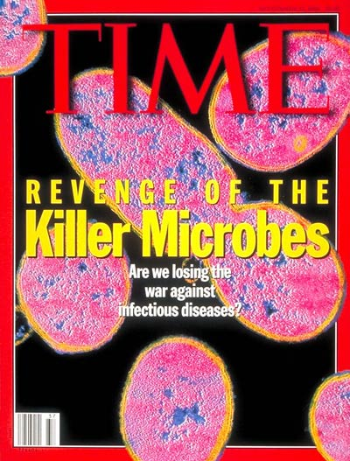
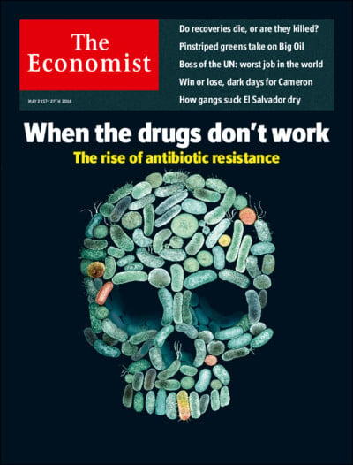
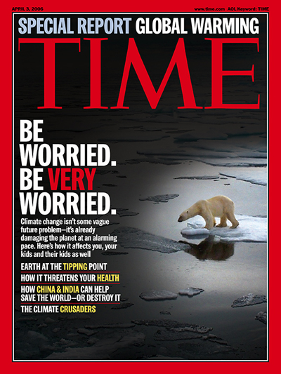
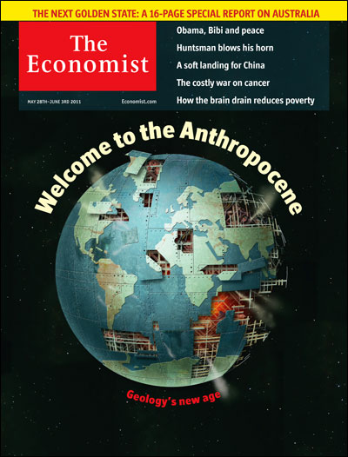
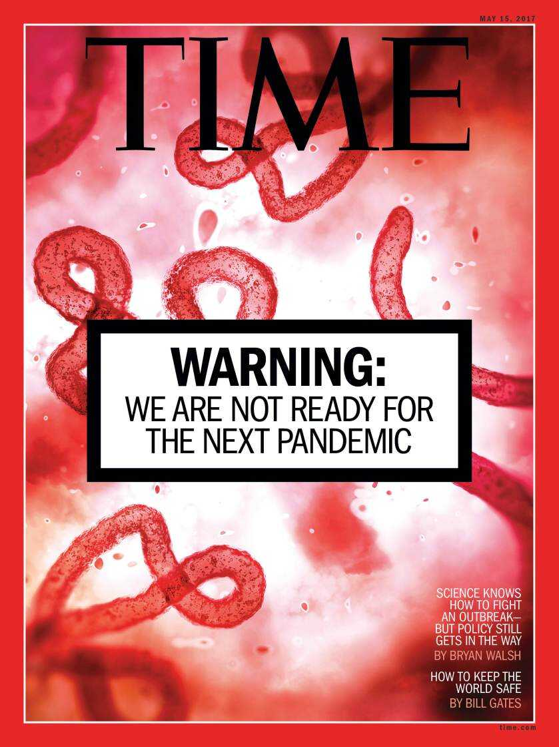
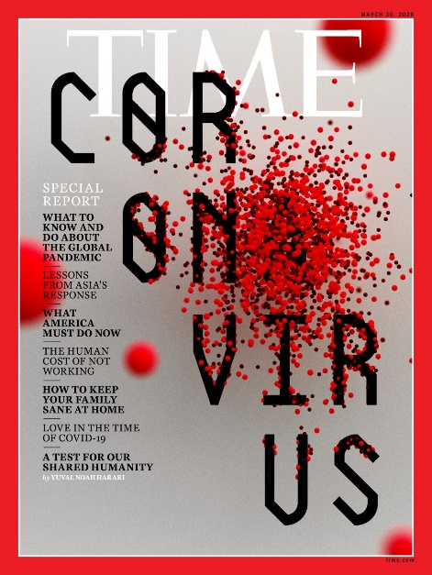
Relevance of One Health in 21st century
One Health is not a new concept, but it has become more relevant as societies deal with complex problems like antimicrobial resistance, climate change and newly emerged infectious diseases (e.g. COVID-19)
1994
2006
2006
2011
2017
2020

Slide 30
Trade-offs of human-animal-environment interaction
Small group activity (photo analysis)
Facilitator will distribute photos to each table
In small groups, reflect on the following questions:
  What do you see in the photo?
  What benefits can come out of the interaction seen in the photo?
  What potential risks/dangers can result from this interaction?
Be ready to present your findings in plenary
30 minutes

Slide 31
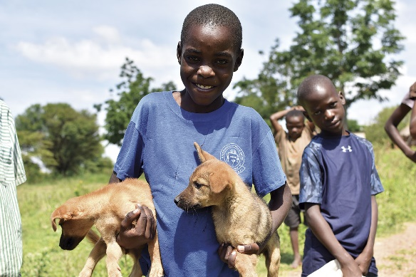
Credit: Guy Palmer/ WSU

Slide 32
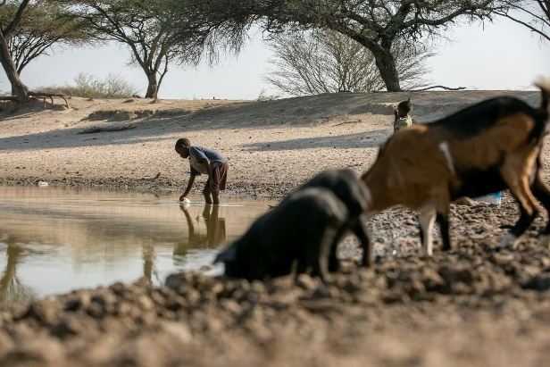
Credit: Carlos Cesar/UNICEF

Slide 33
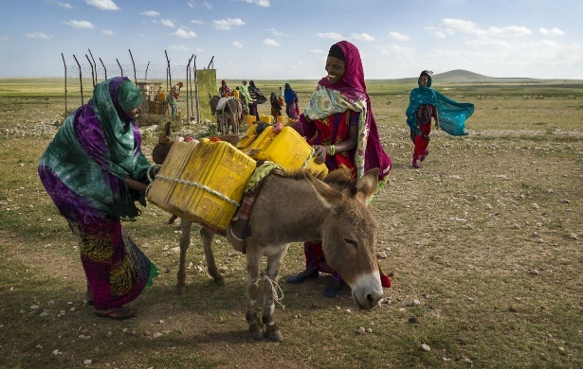
Credit: Kelley Lynch

Slide 34
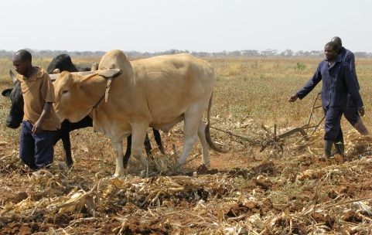
Credit: Barbara Adolph/IIED

Slide 35
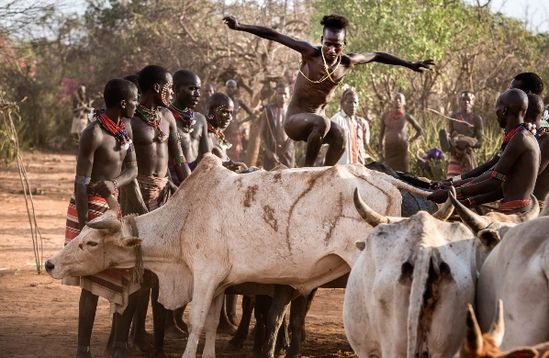
Credit: Dr Gilad Fiskus

Slide 36
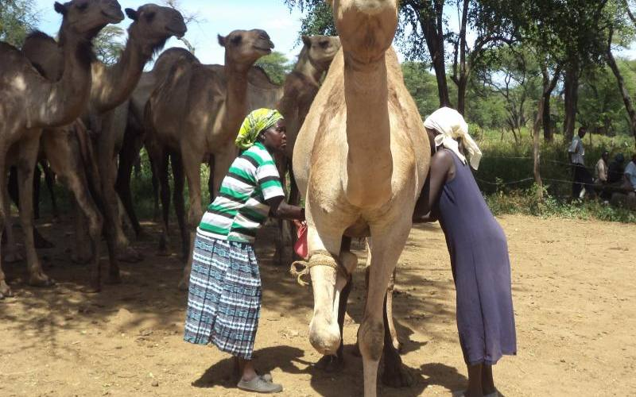
Credit: Antony Gitonga

Slide 37
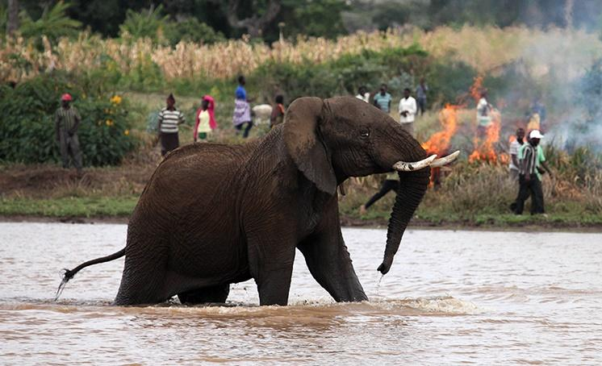
Credit: Baraka FM

Slide 38
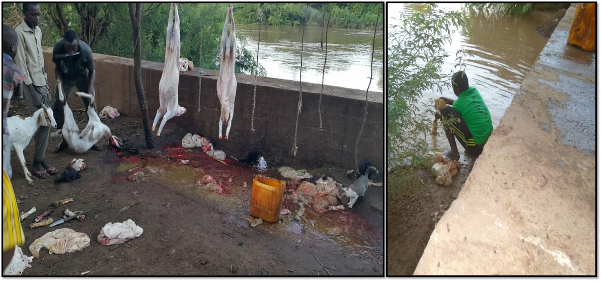
Credit: Dr Ahmed Kadle

Slide 39


Humans and animals share the same resources
Humans and animals are both affected by poor quality environments
Humans and animals are both affected by resource scarcity (which is compounded by global climate change)

Slide 40
Human interaction with animals has benefits and risks
Benefits
Risks
Food (milk, meat, eggs)
Hides and fiber for clothing
Transportation and draught power
Social status
Social support
Zoonoses
Injuries

Slide 41
Benefits and risks are not the same across society
Men/boys and women/girls have different roles within the household which affect how they interact with and benefit from animals
Children often keep pets (or are attracted to free-roaming animals) and hence are also in close contact with animals

Slide 42
Zoonoses
Interactive plenary discussion
What diseases come to mind when you hear the ‘zoonoses’?
Do you think zoonoses are a big problem in your woreda/district?
5 minutes

Slide 43
Zoonoses
Small group activity (street theatre)
Facilitator will divide you into 4 groups: (1) rabies, (2) Rift Valley fever, (3) brucellosis, (4) anthrax
In small groups, develop a short ‘street theatre’ performance to educate community members on key features of the disease including:
  Clinical signs in people and animals
  Method(s) of transmission from animals to people
  Methods of prevention and control
Present street theatre in plenary
Be ready to identify key features/any missing details in performances by other groups
20 minutes prep
+
5 mins performance
per group

Slide 44
Zoonoses
Important One Health issue because:
  Zoonoses are diseases that spread from animals to humans
  Zoonoses have dual impact on pastoralist populations:
    Impact on human health
    Impact on animal health → human livelihoods
  Control requires interventions in animals and humans and thus coordination/collaboration across sectors
  Transmission is sometimes influenced by environmental factors
  Control measures can sometimes have an impact on the environment

Slide 45
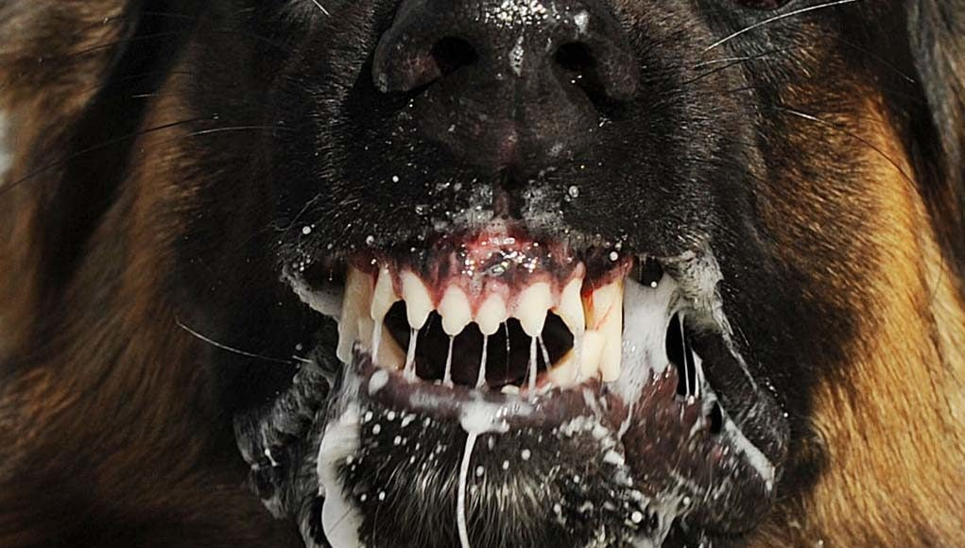
Rabies – caused by rabies virus
Clinical signs – humans Flu-like symptoms → confusion, abnormal behaviour, hydrophobia → death | Transmission Saliva of infected animals e.g. bite wound, open cuts in skin
Clinical signs – animals* Non-specific (e.g. lethargy, loss of appetite) → behavioural changes (e.g. aggression), excessive salivation, paralysis → death * dogs, cattle, sheep, goats, camels, horses, and donkeys | Prevention and control Vaccination of dogs Wash bite wound with soap and lots of water for at least 15 minutes (and ideally disinfect with sanitizer) Seek medical help for post-exposure prophylaxis of humans (before symptoms develop)

Slide 46
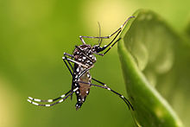
Rift Valley fever – caused by Rift Valley fever virus
Clinical signs – humans No symptoms Common: flu-like symptoms (e.g. headache, fever, muscle pain, loss of appetite) Rare: encephalitis, fatal hemorrhaging, or visual impairment | Transmission Bites of infected mosquitoes Contact with blood, body fluids or tissues of infected animals Outbreaks often follow abnormally high rainfall and flooding
Clinical signs – animals Young animals: fever, loss of appetite, weakness, diarrhea, death in 2-3 days Mature animals: fever, nasal discharge, diarrhea, decreased milk production, abortion (loss of pregnancy) | Prevention and control Avoid mosquito bites Use protection when handling blood, body fluids or tissues of suspect animals Vaccination of livestock

Slide 47
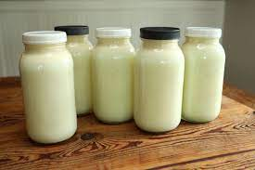
Brucellosis – caused by Brucella (bacteria)
Clinical signs – humans Flu-like symptoms (e.g. fever, chills, and body aches) Chronic: inflammation of the joints (arthritis), testes (orchitis) and heart (endocarditis) | Transmission Drinking raw/unpasteurized milk or body fluids of infected animals Breathing in the bacteria Broken skin contact with animals or excretions e.g. slaughterhouse workers
Clinical signs – animals* Reproductive problems (e.g. loss of pregnancy, neonatal death, birth of weak offspring, infertility) Reduced milk yield due to mastitis * goats, sheep, cattle, and camels | Prevention and control Pasteurization of milk Vaccination of livestock

Slide 48
Anthrax – caused by Bacillus anthracis (bacteria)
Clinical signs – humans Cutaneous: black ‘eschar’ (right) Gastrointestinal: bloody vomiting and diarrhea, stomach pain, death Inhalational: systemic disease, death | Transmission Skin contact with meat or hide of infected animals (most common) Ingestion of bacteria in raw/uncooked meat from infected animals Inhalation of bacteria in air e.g. slaughterhouse
Clinical signs – animals* Sudden death with bleeding from body orifices Spores released in blood of dead animals contaminate environment * most domestic and wild animals | Prevention and control Avoid eating meat from animals suspected to have died from anthrax Vaccination of animals Proper disposal of dead animals (e.g. burial, decontamination)

Slide 49
Zoonoses – general points
Flu-like symptoms are common first sign of many zoonoses
  Not easily distinguished from other diseases
  Not easily diagnosed
Human behaviours are the main reason why people get infected with zoonoses
  Modifying these behaviours can help achieve control and prevention
Men/boys and women/girls may have different exposure pathways given different roles:
  Livestock management e.g. herding, slaughter
  Animal source foods

Slide 50
Anti-microbial resistance (AMR)
Interactive plenary discussion
Have you heard of ‘anti-microbial resistance’?
What do you understand by the term?
10 minutes

Slide 51
Anti-microbial resistance (AMR)
Small group discussion (image analysis)
Facilitator will show an image (next slide)
Discussion questions:
  What did you learn from the image?
  How does the image help you understand AMR?
  What is the implication for antibiotic use in pastoralist areas?
Be prepared to share your discussion in plenary
20 minutes

Slide 52
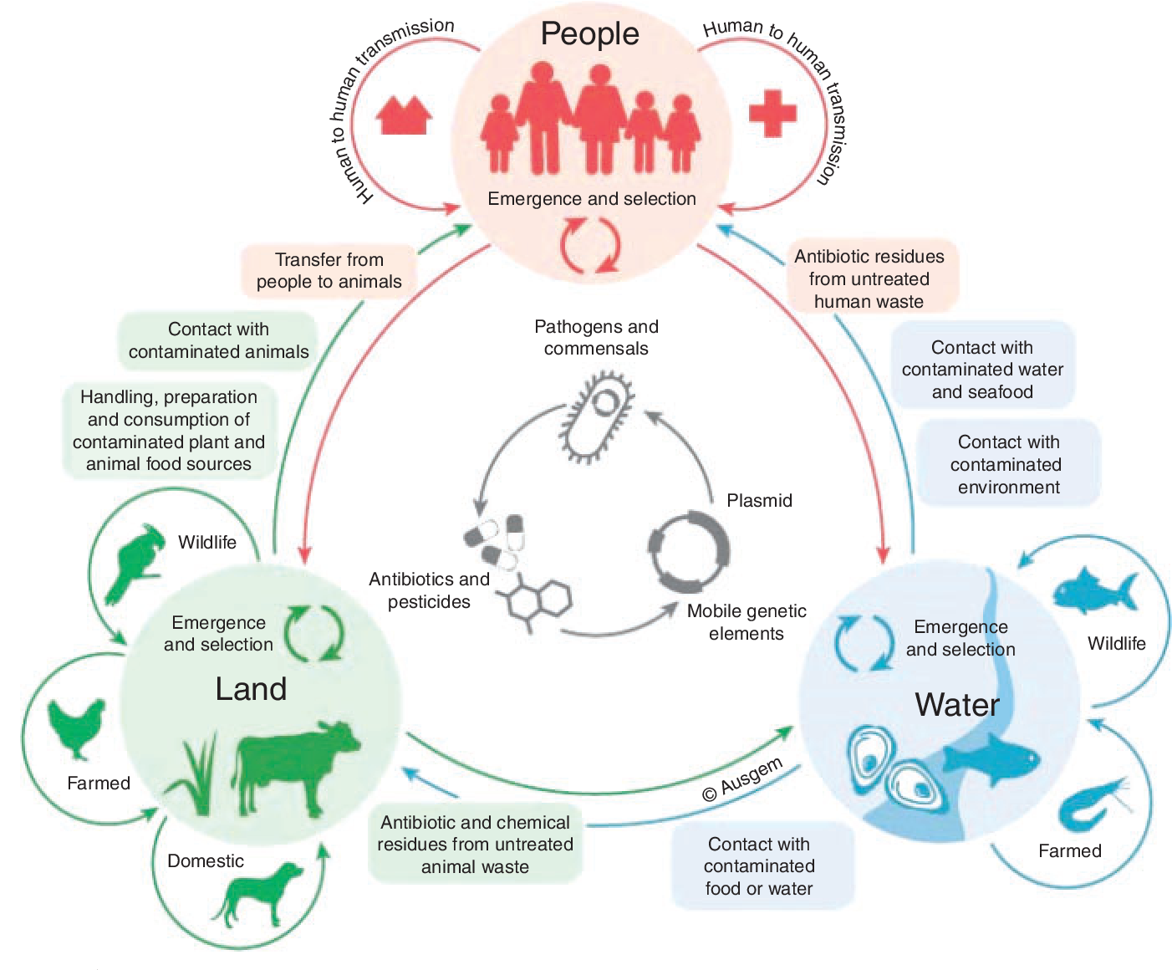

Slide 53
Anti-microbial resistance (AMR)
Process which happens naturally over time in all microbes that are exposed to antimicrobial agents
  bacteria exposed to antibiotics
  parasites exposed to anti-parasitic drugs
  viruses exposed to anti-viral agents
Relates to:
  overuse (e.g. using antibiotics when not indicated)
  misuse (e.g. using wrong antibiotic, over-/under-dosing)
  improper disposal of antimicrobial agents
  counterfeiting of antimicrobial agents

Slide 54
Anti-microbial resistance (AMR)
Important One Health issue because:
  it is a problem in human health settings (e.g. hospital)
  it is a problem in animal health (e.g. veterinary clinic, farm)
  resistant organisms and genes can be spread from humans and animals through the environment, including in water, soil, and air

Slide 55
Environmental and rangeland health
Small group discussion
Summarize your discussion on a flipchart using diagrams and pictures where possible
Be ready to share your discussions in plenary
Discussion questions (Group 1) | Discussion questions (Group 2)
What is the water situation like in your woreda/district? How do humans and livestock impact on the quality of water? In what ways does water scarcity contribute to health and nutrition problems in humans and humans (are the problems the same or different?) | What is the condition of the grazing lands in your woreda/district? How do humans and livestock impact on the condition of the grazing lands? How does the condition of the grazing land impact the health and nutrition of humans and humans?
20 minutes

Slide 56
Water scarcity and overgrazing
Important One Health issue because:
  Water is a necessity for life of humans, animals and plants
  Shared use of (unsafe) water points
    Congregation of animals → animal disease
    Contamination with animal manure → diarrheal disease in humans
    Contamination with chemicals → health problems in humans
  Migration of humans and animals over longer distances
    Decreased availability of animal milk→ malnutrition in humans
    Inter-communal conflict over resources
  Contributes to environmental degradation
    Invasive species
    Poisonous plants → health problems in animals

Slide 57
Wrap-up Day 1
Interactive plenary discussion (video analysis)
Your facilitator will play a video
As you watch consider:
  What were the main learning points and messages from Day 1 that were reinforced in the video?
  Were any principles from Day 1 overlooked in the video?
Video 1: What is One Health? From concept to action
https://www.youtube.com/watch?v=Ndfi9QbdXVY
15 minutes

Slide 58
Summary of key learning points from Day 1
One Health is an approach to health problems that recognises that human, animal and environmental health are closely linked
  Zoonoses, AMR, water scarcity and overgrazing are relevant examples of this interconnection in pastoralist areas
One Health is operationalised by improving collaboration, coordination, communication and capacity building between sectors and disciplines
Main sectors/disciplines involved are those working in human, animal and environmental health

Slide 59
Systems thinking in One Health
Coming up:

