Slide 1






Farmvetcare mobile application
Improving human health through sustainable value chains in human-animal-environmental interactions using ICT in Vietnam (ICT4Health)
Thang Nguyen¹, Hu Suk Lee² and Hung Nguyen-Viet¹
¹ILRI Vietnam; ²Chungnam National University, Korea
Technical consultation: Integration of data and information for epidemic intelligence and decision-support in disease surveillance
FAO Headquarters, Rome, Italy | Ethiopia room (C 289) | 16-18 April 2024

Slide 2


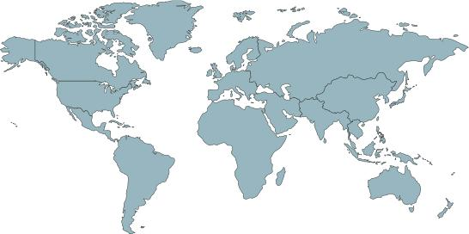




CGIAR
CGIAR System Organization
Montpellier
Alliance Bioversity International-CIAT
Rome
IFPRI
Washington, D.C.
ICARDA
Beirut
IWMI
Colombo
IRRI
Los Baños
ICRISAT
Hyderabad
Cali
WorldFish
Penang
CIMMYT
Mexico City
CIP
Lima
AfricaRice
Bouaké
ILRI
Nairobi
Addis Ababa
IITA
Ibadan

Slide 3
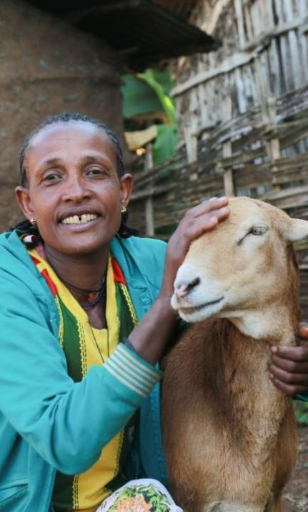

ILRI’S MISSION: Peoples' lives in the Global South are improved through livestock science that delivers equitable and resilient livestock systems contributing to food systems transformation with climate and environmental benefits.

Slide 4
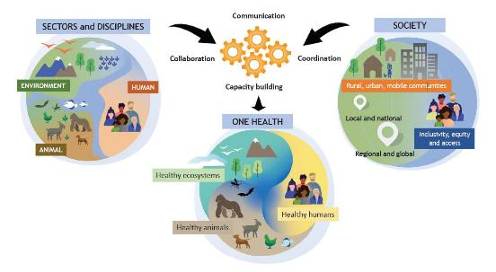
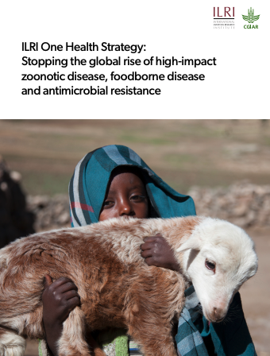
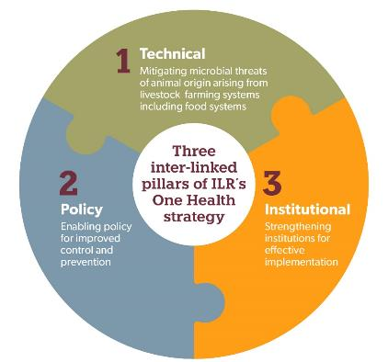
ILRI One Health strategy
A holistic approach to preventing pandemics/epidemics and other microbial threats from animals/environment
Vision
  To improve the lives, livelihoods and well-being of people in the global south by building healthy, sustainable and resilient systems at the intersection of humans, animals and the environment.
Key thematic areas
  Epidemics and pandemics & Endemic zoonoses
  Food-borne diseases
  Antimicrobial Resistance
OHHLEP One Health, 2021
wildlife
More on One Health @ILRI: ilri.org/one-health
Notes:
ILRI One Health strategy to position our works on the global OH landscape

Slide 5

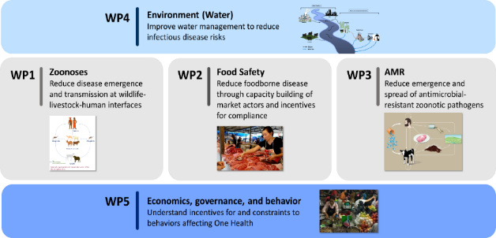




Major projects: One Health science, capacity building and operationalization
ICT4Health Vietnam, Korea MAFRA
Co-Infection, DTRA
Covid-19 genomic surveillance, RF
MoreMilk BMGF
SafePORK, ACIAR, Vietnam
APART, WorldBank, India
AMR, Fleming Fund
JPI AMR: “SEFASI” funded,
POLOH Poulty &One Health, LSIL
And others…
More on One Health @ILRI: ilri.org/one-health

Slide 6
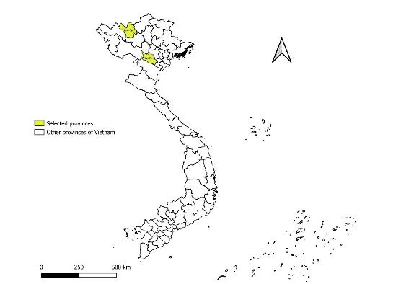
Project introduction
      Period: 2023-2026
      Target area: Hoa Binh and Lao Cai provinces
      Budget: ~USD 2.8 million
      Donor: Ministry of Agriculture, Food and Rural Affairs (MAFRA) in South Korea

Slide 7







Objective and Key components
To improve human health through strengthen the capacity of the government and community to prevent, control or eliminates risks of TAEZDs under a One Health approach and using ICT
Component 1:
To conduct gap analysis on TAEZDs
Component 2:
To establish surveillance working groups
Component 3:
To conduct a pilot study for e- surveillance & training
Component 4:
To develop method tools for improving health along the VC
Component 5:
To implement community-based interventions
- TAEZDs prioritization through participatory approach
- Communication and information sharing
- Institutional capacity
- Integrated surveillance and diagnosis along the VC
- Assessment of cost-effective control & prevention strategies
- Developing mobile application and systems
- Training workshops for e- surveillance system
- Developing risk map and transmission models
- Risk assessment and preparedness tools
- Cost-effective strategies
- Low-cost interventions (e.g., livestock management and biosecurity)
- Capacity building (e.g., outbreak investigation, vaccines and drug use)
Cross cutting aspects: ICT, E-training, Gender & equity, Climate change, and Animal welfare
Link to the SDGs:
TAEZDs: Transboundary Animal and Emerging Zoonotic Diseases

Slide 8

Mobile application developed by AIDKOREA
Users
01
Farm owner
02
Vet /
Animal Health Workers
03
Sub – DAH /
Local authority
Ask a vet & Call
Call each other
Answer & Call
Flow
&
Main
Features
The farm owner
(Farmhouse)
Vet/AHWs
Sub-DAH
Local authority
Answer & Call
Ask a Vet (describe symptoms and share images)
Call to Vet/sub-DAH (only after receiving the answer)
Manage all inquires from dedicated farmers
Provide Q&A answers
Call farmers only after registering their inquiries
Call sub-DAH (default)
View all inquiries from dedicated vets
Provide Q&A answers (support vet)
Call to farmers (only after registering the inquiry
Call to vets (default)

Slide 9
Core Values
01
Establish better/advanced disease surveillance systems
02
Provide improved high-quality professional veterinary services in the community through the mobile application
03
Timely proactive communication and cost-effective control measures in the community
04
Enable data-driven livestock health care and improve farm productivity

Slide 10
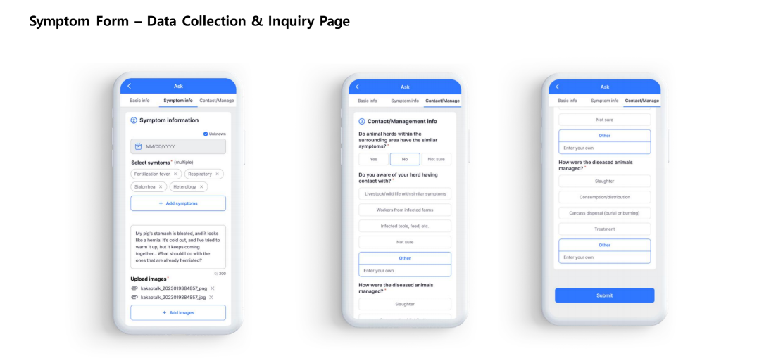
Mobile application developed by AIDKOREA

Slide 11
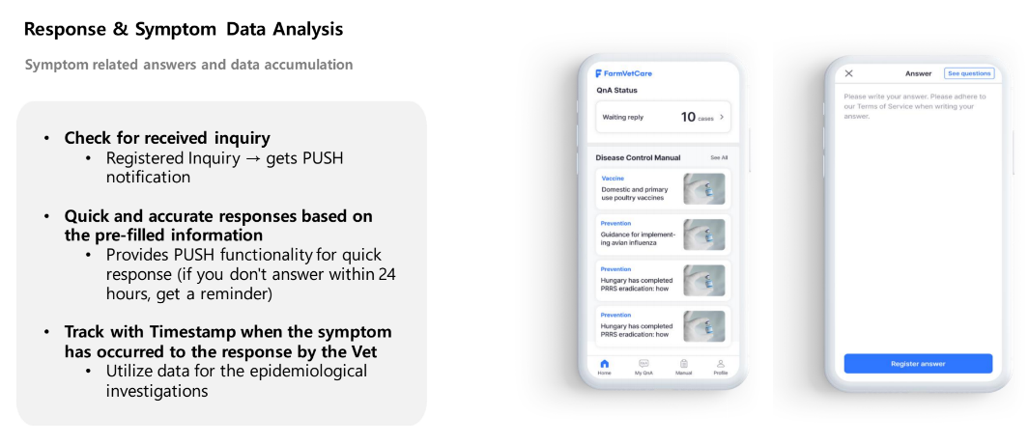
Mobile application developed by AIDKOREA

Slide 12
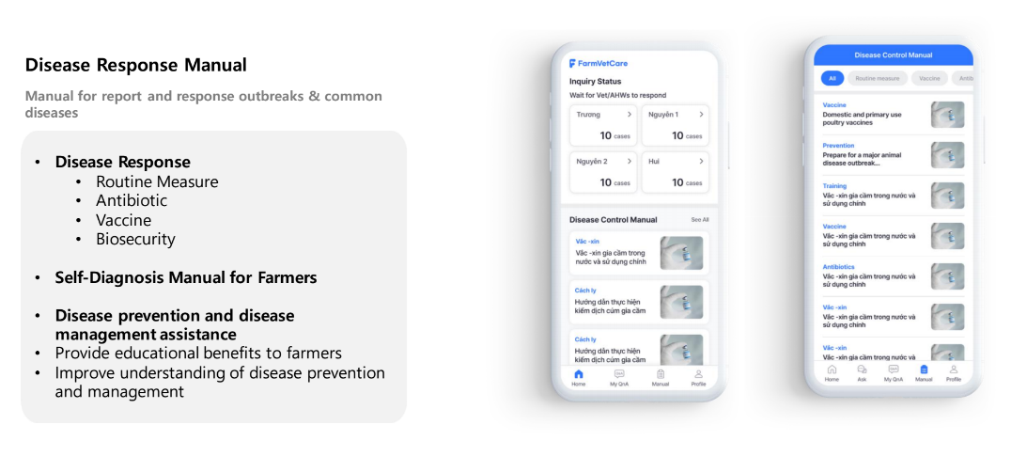
Mobile application developed by AIDKOREA

Slide 13
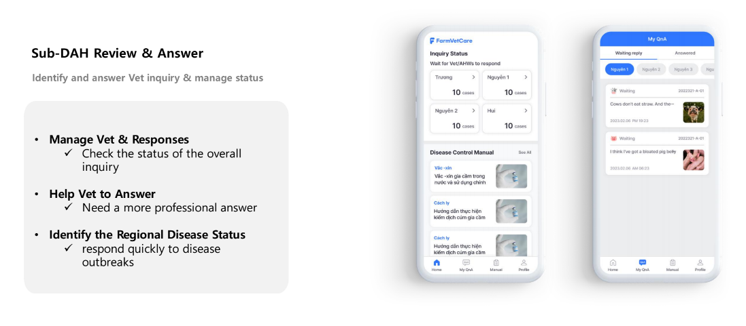
Mobile application developed by AIDKOREA

Slide 14
Other projects at ILRI using ICT for health surveillance
Using mobile syndromic surveillance at slaughter to understand the incidence and distribution of important animal and zoonotic diseases in Kenya and Uganda
Elizabeth Cook, Denis Mugizi, Innocent Obilil, Kristina Roesel, Bernard Bett
A web-based decision-support tool for prevention and control of Rift Valley fever outbreaks in Kenya
B. Bett, V. Kondi, R. Dhulipala
Possibilities of using ICT to support monitoring and control of antimicrobial use in smallholder poultry systems, Kenya
Florence Mutua, Joshua Onono, Sofia Boqvist, Lawrence Mugisha, Susanna Sternberg Lewerin

Slide 15
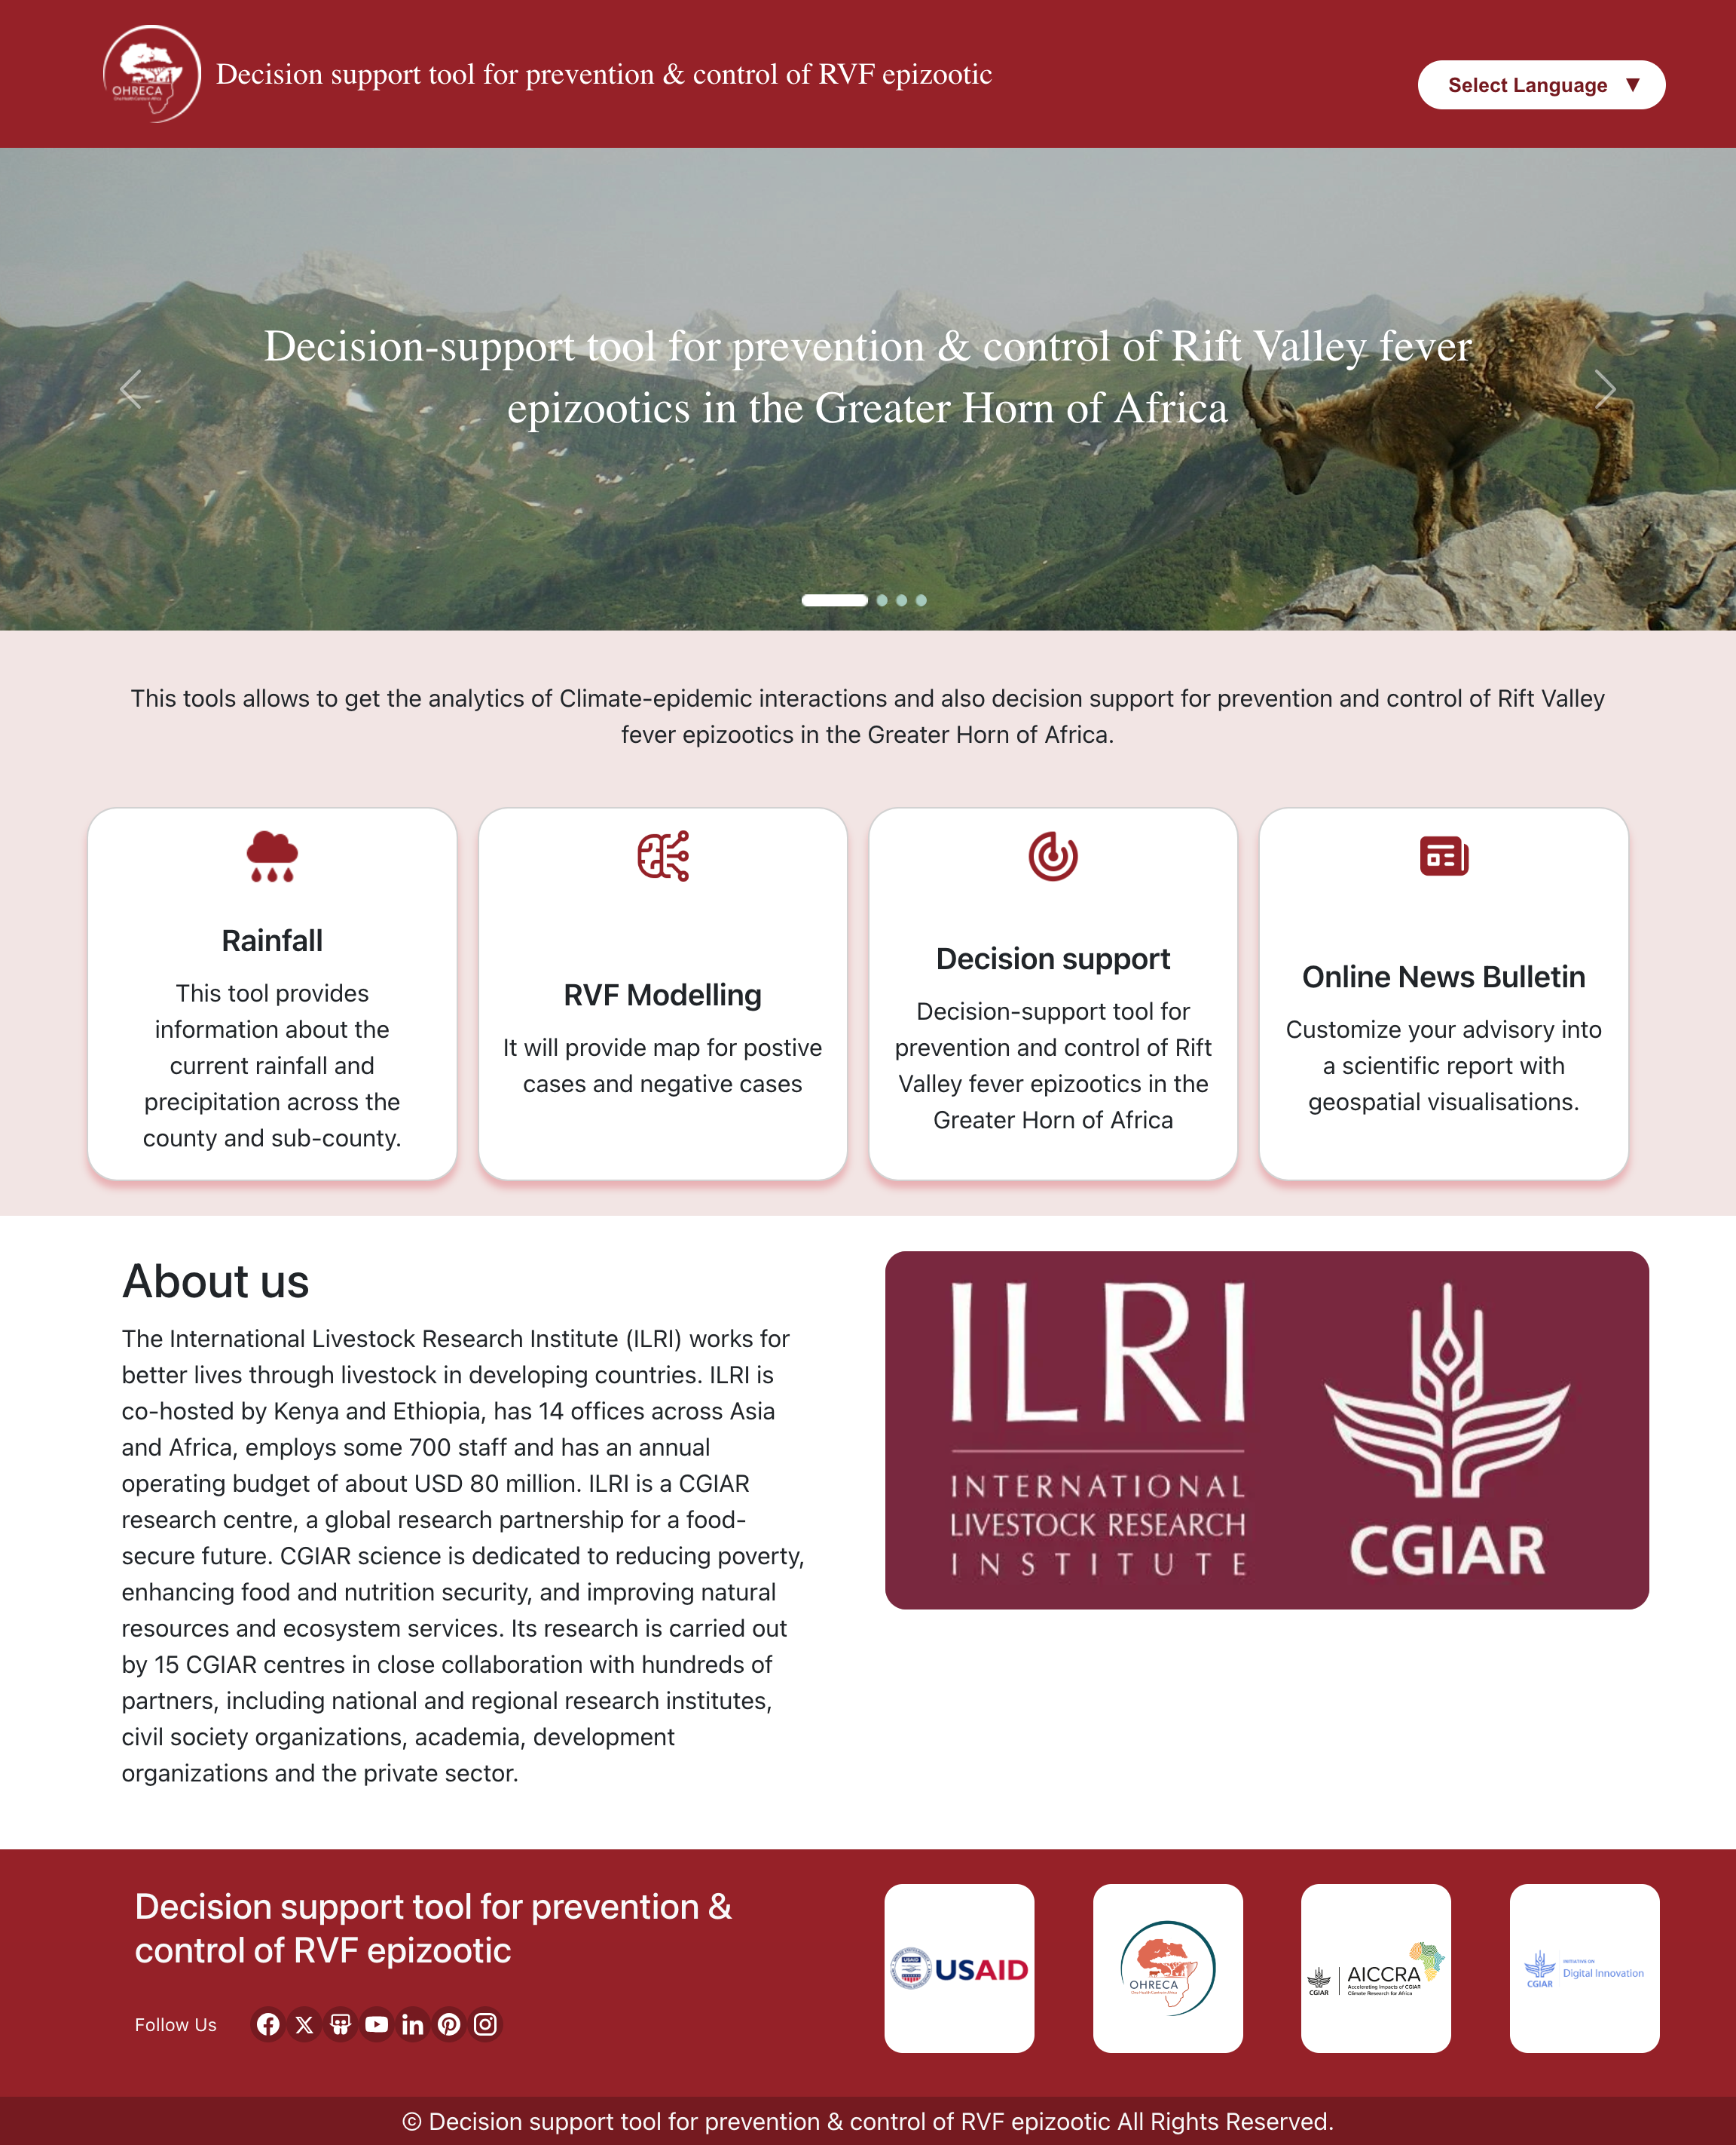
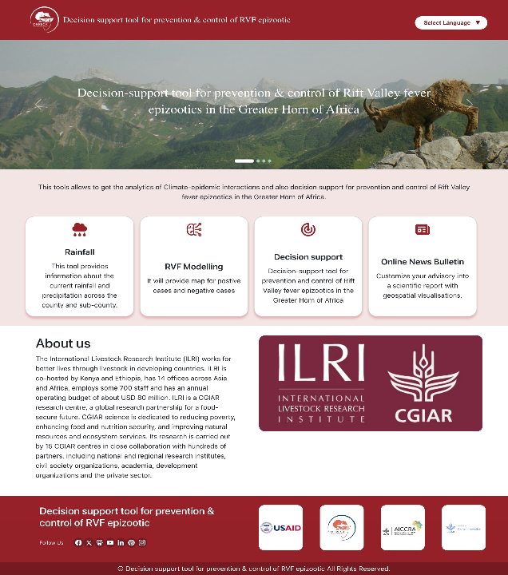
Web-based RVF decision support tool
(Bernard Bett)

Slide 16



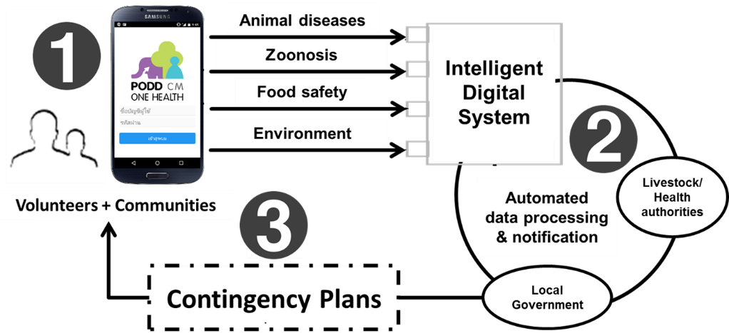
The PODD functional structure
Volunteers + General Public
Reporter
P
O
D
D
articipatory ne–health isease etection

Slide 17
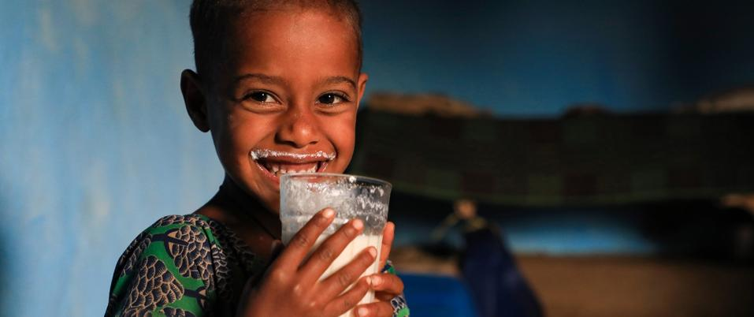
THANK YOU

