Slide 1

Improving collaboration between research and the private sector to accelerate livestock innovation for sustainability into use
Samuel Thevasagayam, BMGF
Lightning presentation at a parallel session, 9th Multi-Stakeholder Partnership Meeting of the Global Agenda for Sustainable Livestock, Manhattan, Kansas, 9-12 September 2019

Slide 2
Introducing me!
Responsible for the livestock portfolio of investments
At the Bill & Melinda Gates Foundation
Overall goal: Inclusive Agriculture Transformation and Economic growth of poor people depending on Animal Agriculture.
  Partner and invest in both public and private sectors - solutions needed by poor livestock owners realize the potential of their livestock assets ....through a government enabled, private sector led market oriented approach
  Believe public sector critical for research that cannot be fully justified based on ROI; private sector is best suited to address customer facing aspects and deliver solutions
  Connect and align the objectives of the producer, private sector and public sector for sustainability
#LivestockAgenda

Slide 3
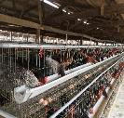

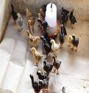
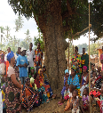

My example that worked: African Poultry Multiplication Initiative
Purpose: to enhance productivity, household income, improve household nutrition and empower women.
  Why?
        Critical factor 1: Incentives aligned across all stakeholders
        Critical factor 2: Brought together ‘best’ or ‘most suitable’ partners for each of the components
The model delivers sustainable value for all stakeholders
Amo: parent stock rearing
Amo: Incubation/ Hatching
Brooding & Vaccination
Farmer Training
Noilers in NG
Ethiochicken – independent evaluation:
>85 % household producers are women
DPP >2x productive vs indigenous chicken in eggs: 30-50% sold, rest consumed
Eggs = 20% higher price, 3.5x household income;
Chicken = 30% higher price, >2x household income
#LivestockAgenda

Slide 4


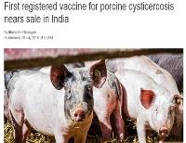
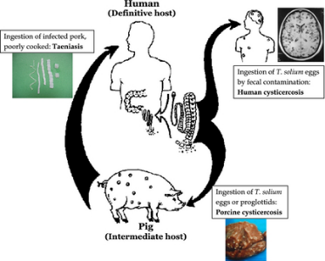
My example that hasn’t worked so well yet: Adoption of solution at scale for control of porcine cysticercosis
Cysticercosis - a public health issue
University of Melbourne (Prof Lightowlers)
Exceptionally effective vaccine
99.5% and 100% (Mexico)
100% (Cameroon)
99.5% (Peru)
99.3% (Honduras)
94 to 100% (China and Peru)
In 1993 it was identified as one of six potentially eradicable diseases
Joint FAO/ WHO Expert Meeting 2012: #1 of 24 food borne parasitic disease of global importance
Why?
  Critical factor 1: Didn’t fully anticipate market realities: who pays? who gains?
  Critical factor 2: Perhaps didn’t start with the end in mind and line up critical stakeholders to avoid delays in adoption at scale?
#LivestockAgenda

Slide 5
My advice for public research and private sector based innovations
For investors
  Be clear about Development efforts vs Humanitarian efforts (Solve vs Help)
  Ensure the partner who is critical to sustain the desired outcome is in the driver’s seat
For implementors
  Start with the end in mind
  Don’t try to do everything. Stick to your expertise, bring the best of you and connect with others who are best at what is needed.
#LivestockAgenda

