Slide 1
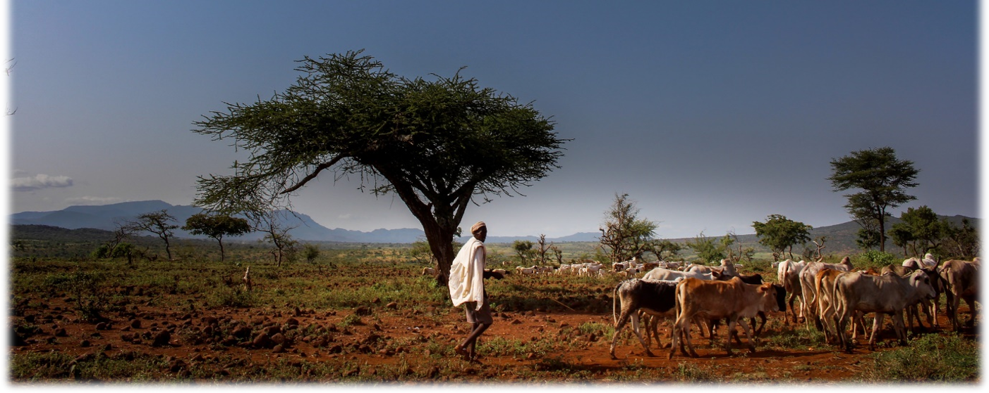
Programme for climate-smart livestock systems
Charlotte Haeusler Vargas, GIZ
13.09.2022

Slide 2
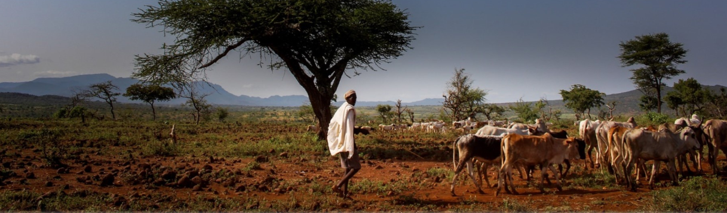
Programme for Climate-Smart Livestock systems (PCSL)
Duration: 01/2018 -12/2022
Implemented by: GIZ, International Livestock Research Institute (ILRI) and Worldbank
Funded by: German Federal Ministry for Economic Cooperation and Development (BMZ),
Part of the special initiative „One World- No Hunger" (SEWoH)
Mauritania
Mali
Senegal
Niger
Chad
Burkina
Faso
Ethiopia
Cameroon
Uganda
Kenya
Focus countries
Scaling countries
Regional activities
Focus and scaling countries
© ILRI/Camille Hanotte

Slide 3
Project partners and their roles
Research, training and policy advice on adaptation and mitigation
ILRI
Taking impact to scale
World Bank
Steering and dis-semination GIZ
  Objective:
  Key actors increasingly direct
  livestock practices
  sector strategies/ policies
  and investments
  towards
  climate-smart livestock systems

Slide 4

Programme for Climate-Smart Livestock Systems - Results
  Research&Training:
    Practices that lead to more adaptation and mitigation (co-benefits) identified and validated
    Digital training strategy implemented
  Policies:
    Participatory scenario planning processes with multi-stakeholder platforms conducted
    National governments and regional actors have oriented livestock-related policies and strategies towards climate-smart strategies
  NDC-reporting:
    Basis for Tier-2 based Monitoring, Reporting and Verification (MRV) in the livestock sector improved
    Protocols that enable countries to make statements about adaptation developed
  Scaling:
    Climate-smart approaches integrated into investment programmes of the World Bank
    Advice given to formulation of IGAD regional strategy
  Dissemination:
    Approach of climate-smart livestock systems promoted in events & publications
    Study on digitalization in the african livestock sector
Notes:
Countries contributions to climate change adaptation and mitigation in the context of UN framework convention on climate change

Slide 5
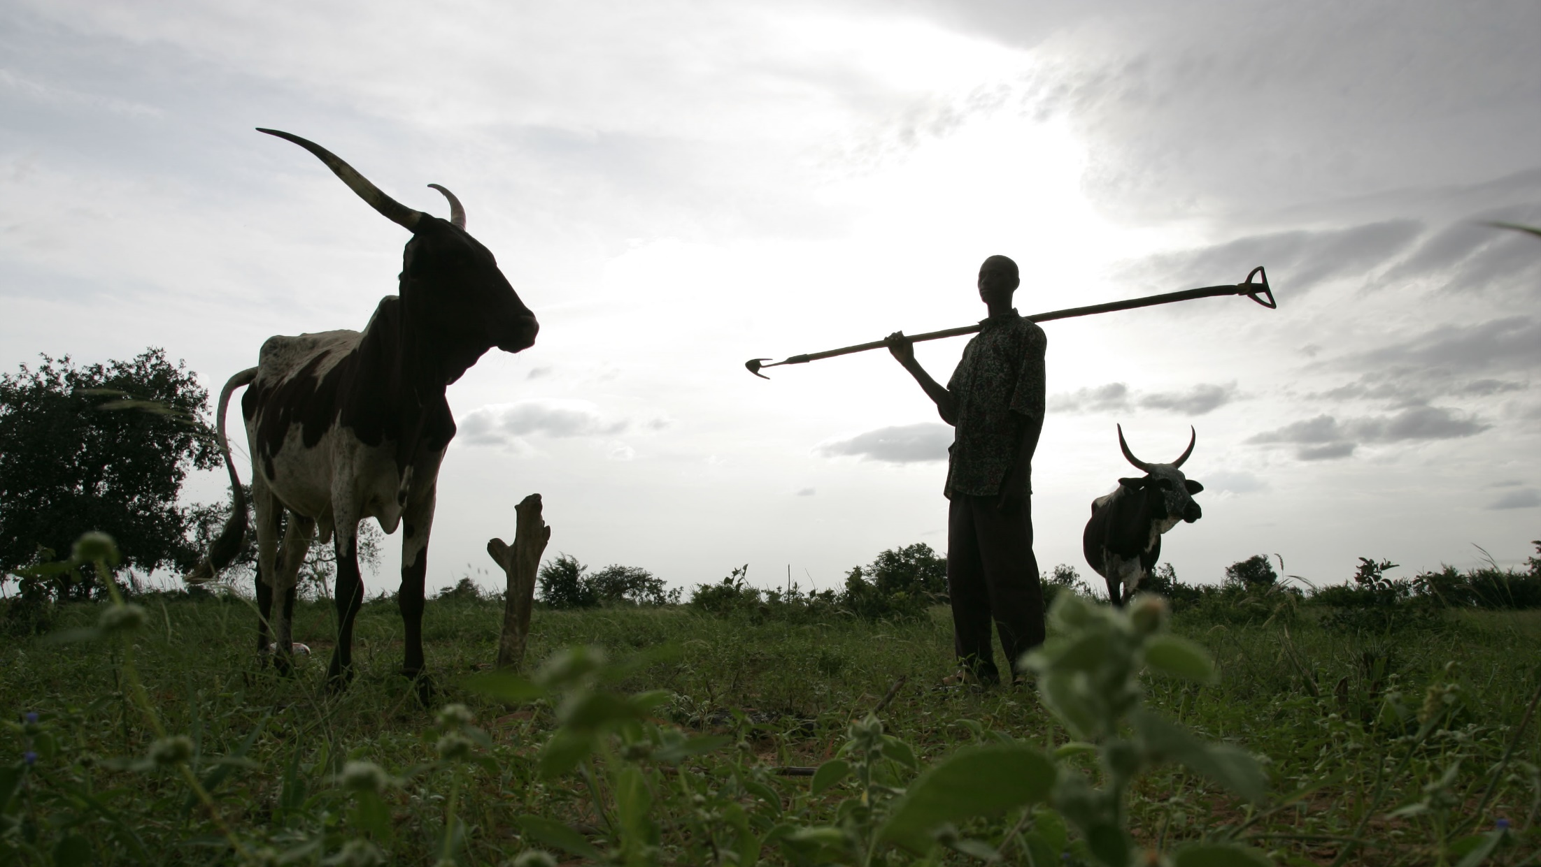
Thank you!
© ILRI/Stevie Mann

Slide 6
Author:
Programme for Climate-Smart Livestock Systems, Bonn, Germany
URL links:
Responsibility for the content of external websites linked in this publication always lies with their respective publishers. GIZ expressly dissociates itself from such content.
GIZ is responsible for the content of this publication.
Address
Postcode and town, country
T +49 61 96 79-0
F +49 61 96 79-11 15
E info@giz.de
I www.giz.de

