Slide 1
Communications update on Africa RISING in Ethiopian Highlands
Haimanot Seifu
ILRI, Ethiopia
29 June 2022 CKM meeting

Slide 2
What's happing in Africa RISING Ethiopian highlands
As most of you know Africa RISING will be ending towards the end of this year.
However, we do have lists of tasks that have started to be implemented until the end of the year.
Some of the key activities includes :
legacy products
  Extension manual
  Policy briefs
  Special issue
  Photo Book
  Africa RISING end-of-program report
Surveys and evidence generation:
  • Gender
  • RHoMIS
  • Spillover
  • Scaling
  • SIAF

Slide 3
Africa RISING and AICCRA
Africa RISING is also partnering with the Accelerating Impacts of CGIAR Climate Research for Africa (AICCRA)
Under this project some of the comms activities include:
Workshop and survey
Online questionnaire survey on climate smartness and social inclusiveness
Workshop on climate smartness and social inclusiveness of the forage technologies
Training module and capacity development
Training: extension, media, forage seed producers
Broadcasting feed and forage technologies
Weekly radio programs in three languages stated with Debre Birhan Fana FM, Shashemene Fana, Bale OBN FM and Hosaena FM local radio stations

Slide 4
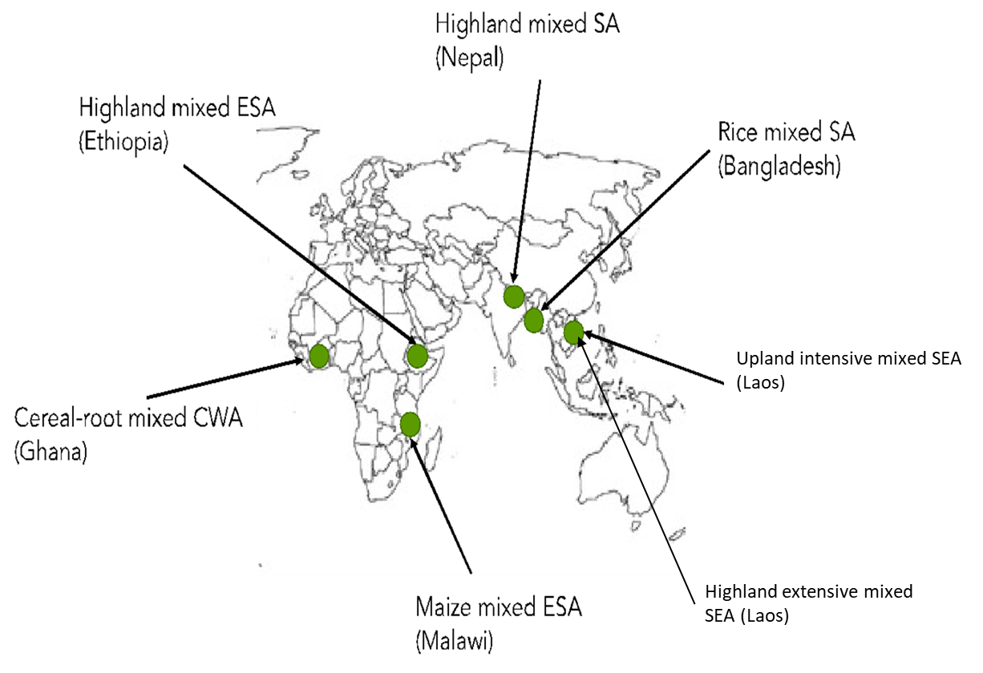
Sustainable Intensification of Mixed Farming Systems (SI-MFS) initiatives
One of the 30 new initiative
Launched in May ILRI Addis campus
5 regions, 6 countries in different MFS (Ethiopia, Malawi, Ghana, Bangladesh, Nepal, Laos)
7 Mixed Farming Systems
Duration of the SI-MFS : Initially for 3 years (2022-2024)

Slide 5
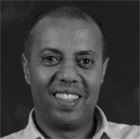

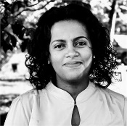
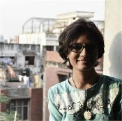
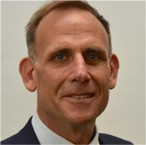
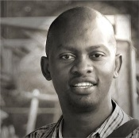
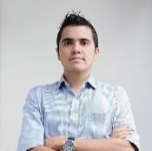
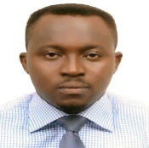
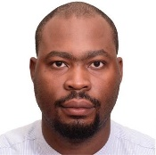
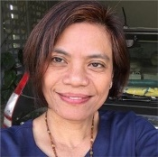
ILRI, Addis Ababa, Ethiopia
CIMMYT, Dhaka, Bangladesh
Apollo Habtamu
Tsehay Gashaw
Haimanot Seifu
Mahajabin Nur-Khan
Lao PDR
ILRI HQ, Nairobi, Kenya
Bangladesh
Ghana
Nepal
Ethiopia
Michael Victor
Malawi
ABC, Cali, Colombia
Paul Karaimu
IITA HQ, Ibadan, Nigeria
José Benitez
Yinka Fakunle
Jonathan Odhong
Kathy Lopez

Slide 6
CKM support needed
Editing and layout design support for the legacy product.
Facilitations support for the Ethiopian SI-MFS launch
tentatively scheduled in August.
Finally, as usual for ongoing activities such as editing blogs, report, CGSpace approval support needed from CKM.

Slide 7
Thank You

