Slide 1
Poultry losses and One Health:
Reducing losses and zoonotic risks along the poultry value chain through a One Health approach
Presented by Michel Dione, Senior Scientist, at the International Livestock Research Institute, Dakar, Senegal
Innovation Platform Meeting of the Feed the Future Innovation Lab for Livestock Systems
Hôtel Sopatel Silmande, 9FRX+P43, N3, Ouagadougou, Burkina Faso
24–27 May 2022
May 27, 2022
Notes:
Photo credits: all photos shared in the presentation were provided by Bhola Shrestha, HPI in April 2022

Slide 2
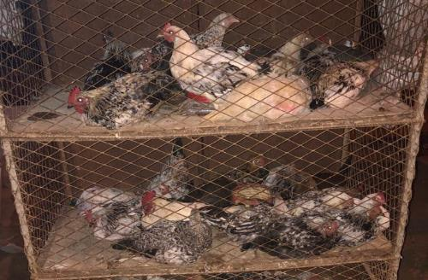

Poultry losses and One Health (POLOH): Reducing losses and zoonotic risks along the poultry value chain through a One Health approach
Principal investigator
Michel Dione, International Livestock Research Institute (ILRI)
Co-PIs
Kagambèga Assèta, University Joseph Ki-Zerbo, Ouagadougou, Burkina Faso
Claudia Ganser, University of Florida, USA
Objectives
Assessing knowledge, attitudes, and practices (KAP) of smallholder poultry producers and other connected value chain actors
Assessing the distribution and characterizing of zoonotic pathogens, assessing intervention effects and gendered impacts of farm and market-level practices on productivity, food safety, and animal welfare
Developing and testing appropriate One Health (OH) Integrated Educational and Training packages
Identifying and testing likely gender-sensitive business models for enhancing value linkages
Building the capacity of next-generation youth national researchers
Notes:
Objectives
Assessing knowledge, attitudes, and practices of smallholder poultry producers and other connected value chain actors
Assessing the distribution and characterizing the key chicken associated zoonotic pathogens (Salmonella spp. and Campylobacter spp) and assessing intervention effects and gendered impacts of farm and market-level practices on productivity, food safety, and animal welfare through modeling approaches, laboratory surveys, and field evaluation
Developing and testing appropriate Integrated Educational and Training packages using a holistic approach
Identifying and testing likely gender-sensitive business models for enhancing value linkages, including inputs, delivery of veterinary products (such as deworming, effective vaccination and training), and advisory services through public-private partnerships and including community vaccinators
Building the capacity of next-generation youth national researchers on poultry health and food safety research using a One Health approach and improve networking and collaboration among value chain stakeholders.

Slide 3
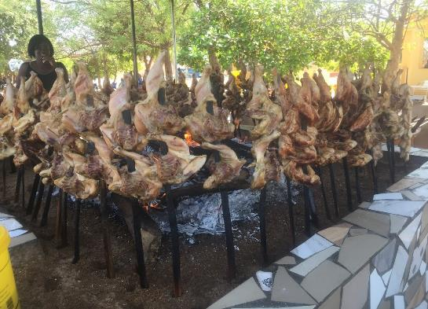
Innovate – Our Theory of Change
Poultry disease in Burkina Faso can negatively affect human health and constrains the productivity of the poultry market.
By developing interventions that improve farm and market practices, provide education and training, and test business models that can enhance value chain linkages, the poultry sector can become safer and more productive.

Slide 4
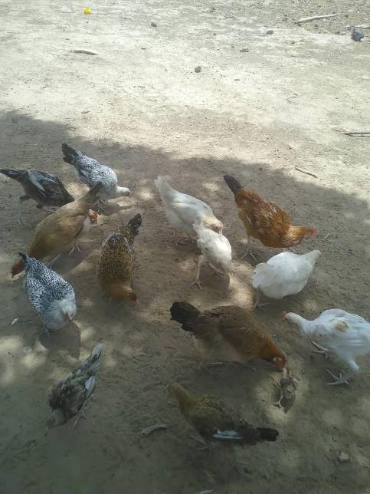
Overarching goal
The overarching goal of this proposal is to enhance household food security and safety and improve the livelihoods of poultry smallholder producers by reducing economic losses and zoonotic risks along the value chain, by developing culturally and economically appropriate, gender-sensitive One Health interventions at the producer level, resulting in reduced flock mortality, pathogen occurrence, and human health risks.
Notes:
LSIL supports Research for Development projects. So, research (“investigation”) is a key tool to achieving the overarching goal.

Slide 5
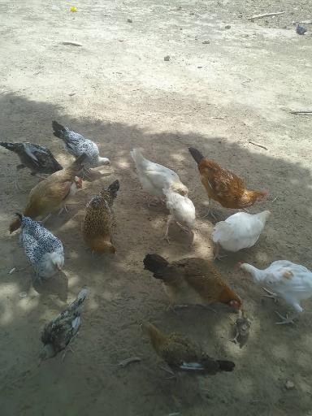
Investigate – Why it matters
Poultry keeping among rural households represents an important component of livelihood (source of income, nutrition, and as gifts to strengthen social ties)
Traditional smallholder sector contributes 98% and 86% of poultry meat and eggs produced for home consumption and sale, respectively
Village poultry are often essential elements of female-headed households to the empowerment of women.
The cost-benefit ratio is usually favorable due to minimal input costs
Notes:
Poultry keeping among rural households in low-income countries such as Burkina Faso represents an important component of livelihood as a source of income, nutrition, and as gifts to strengthen social ties. The landlocked status of the country coupled with increasing demand for poultry-source proteins implies an opportunity for the significant growth of low- to middle-income households that contribute to the smallholder production sector.

Slide 6
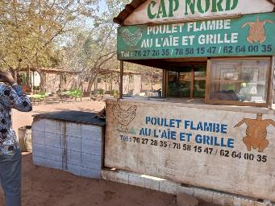
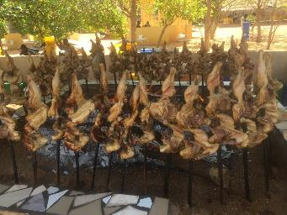
Investigate – Why it matters
Significant increase in demand for local poultry of both urban and exports
Village poultry meat is preferred by a large part of the population
Family slaughter events, out-of-home consumption
Low access to proteins by children and bioavailable micronutrients (25 % of children under 5 years of age are stunted) - Northern region (43%) vs Centre (3 %)
Current poultry keeping systems exposures household members to foodborne pathogens
Traditional production systems present potential health and nutrition risks (may increase children's exposure to livestock‐related pathogens)
Notes:
Poultry keeping among rural households in low-income countries such as Burkina Faso represents an important component of livelihood as a source of income, nutrition, and as gifts to strengthen social ties. The landlocked status of the country coupled with increasing demand for poultry-source proteins implies an opportunity for the significant growth of low- to middle-income households that contribute to the smallholder production sector.

Slide 7
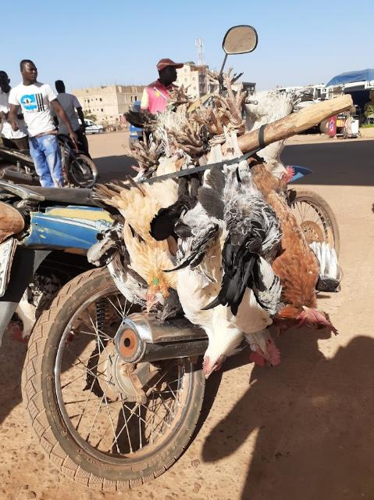
Investigate – Why it matters
Transformation of the production system required - issues still remain - limited access to farm inputs (feeds and veterinary services), poor transportation and limited access to market
Cost-efficient improvements in poultry management, husbandry, and hygiene practices will reduce mortality rates and decrease exposure of women and children and other household members to foodborne pathogens
The OH approach may offer insights into how gender dynamics may affect women and girls in poultry keeping across human, animal, and environmental health and help shape a gender-responsive system.
Notes:
Poultry keeping among rural households in low-income countries such as Burkina Faso represents an important component of livelihood as a source of income, nutrition, and as gifts to strengthen social ties. The landlocked status of the country coupled with increasing demand for poultry-source proteins implies an opportunity for the significant growth of low- to middle-income households that contribute to the smallholder production sector.

Slide 8
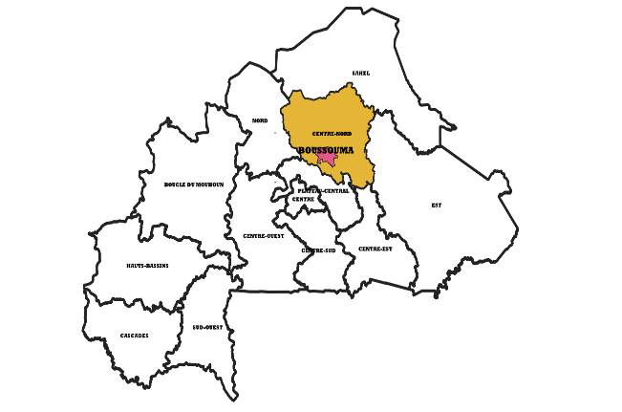
Investigate – What we will do
Study site: region (Centre-Nord) and commune (Boussouma)
Criteria of study site:
Security situation
Development organization and programs based in this region
Less displaced people
Notes:
Approach/Methodology
We will use a gendered mixed method to gain insights on food security and safety of smallholder households. We will assess the shedding of microbiological hazards such as Campylobacter and Salmonella within the farm environment and at live poultry markets. An integrated intervention package, targeting smallholder poultry producers and connected value chain actors, extension workers, and animal professionals to increase poultry production and reduce zoonotic microbial shedding, will be assessed through a randomized control trial. Data generated from the baseline and intervention surveys will be used to develop Bayesian Belief Network models to complement results from the intervention study on farm-level pathogen shedding. Knowledge gained from pre-intervention surveys and Bayesian Belief Network models will be used to identify and develop sustainable approaches to improve knowledge and accessibility of poultry management, husbandry, and hygiene practices that build on existing community-based strategies with a strong One Health component.

Slide 9
Investigate – What we will do
Objective 1: Assess knowledge, attitude, and practices (KAP) of smallholder poultry producers and other connected value chain (VC) actors.
FGD with poultry farmers, with women caregivers; KII with VC stakeholders; Smallholder producer surveys
Develop Bayesian Belief Network (BBN) models to inform interventions
Objective 2: Assess the distribution and characterize the key chicken associated zoonotic pathogens and assess intervention effect on productivity, food safety, and animal welfare
Microbiological assessment (Salmonella spp. and Campylobacter spp.)
Risk factor analysis
Farm-level intervention assessment on production indicators and pathogen shedding
Transport and market survey
Objective 3: Develop and test innovative Integrated Educational and Training (IET) packages using a holistic approach that promotes hygiene practices, biosecurity, improved management, poultry health and welfare, and production of high-quality poultry products
Objective 4: Identify and test likely gender-sensitive business models for enhancing VC linkages including inputs, delivery of veterinary products (such as deworming, effective vaccination against ND and training), and advisory services through PPP including community vaccinators
Objective 5: Build capacity of next generation national researchers and academia on poultry health and food safety research using a OH approach and improve networking and collaboration among stakeholders of the VC.
Notes:
Approach/Methodology
We will use a gendered mixed method to gain insights on food security and safety of smallholder households. We will assess the shedding of microbiological hazards such as Campylobacter and Salmonella within the farm environment and at live poultry markets. An integrated intervention package, targeting smallholder poultry producers and connected value chain actors, extension workers, and animal professionals to increase poultry production and reduce zoonotic microbial shedding, will be assessed through a randomized control trial. Data generated from the baseline and intervention surveys will be used to develop Bayesian Belief Network models to complement results from the intervention study on farm-level pathogen shedding. Knowledge gained from pre-intervention surveys and Bayesian Belief Network models will be used to identify and develop sustainable approaches to improve knowledge and accessibility of poultry management, husbandry, and hygiene practices that build on existing community-based strategies with a strong One Health component.

Slide 10









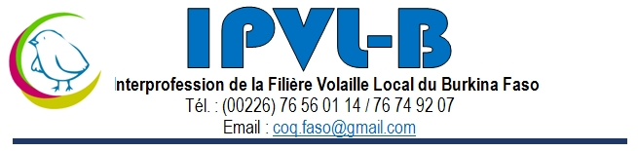
collaborate
Collaborators
Ziynet Boz, University of Florida
Robyn Alders, Kyeema Foundation, Brisbane, Australia
Theodore Knight–Jones, ILRI, Addis Ababa, Ethiopia
Sidonie Ima-Ouoba, Institut de l'Environnement et de Recherches Agricoles / Environmental and Agricultural Research Institute (INERA), Koudougou, Burkina Faso
Adama Maiga, Veterinary Services, Ministry of Animal and Fisheries Resources, Ouagadougou, Burkina Faso
Alessandra Galiè, ILRI, Nairobi, Kenya
Murat Sartas, ILRI, Addis Ababa, Ethiopia

Slide 11

PARTNER
Directeur Générale des Services Vétérinaires (DGSV)
Direction Régionale des Ressources Animales et Halieutiques du Centre-Nord (DRRAH-CN)
Centre de Promotion de l’Aviculture Villageoise (CPAVI)
Interprofession de la Filière Volaille Locale du Burkina Faso (IPFVL/BF)
Autres

Slide 12
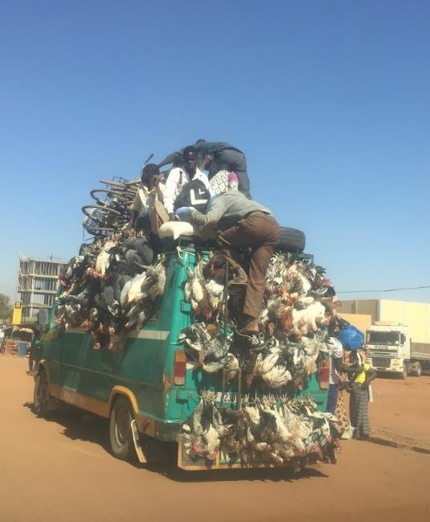
InnovatION 1
Training of Trainers (ToT) – Integrated Educational and Training (IET) packages using a One Health approach
For whom are these innovations relevant?
Female poultry farmers
Extension services
Other projects (ex. SELEVER)
Development Organizations
Which organizations are well positioned to scale them out?
«Centre de Promotion de l ’Aviculture Villageoise/Centre of Promotion of Village Poultry» (CPAVI)
«Direction Générale des Services Vétérinaires/General Directorate of Veterinary Services» (DGSV)
«Interprofession de la Volaille Locale du Burkina Faso» (IPVL/BF)
What opportunities do these innovations present specifically for the private for-profit sector?
Update existing training curriculum to incorporate new OH concepts
Enhance capacity of end users (farmers)
Potential to increase productivity, ensure food safety and reduce contamination at the household (three in one).

Slide 13
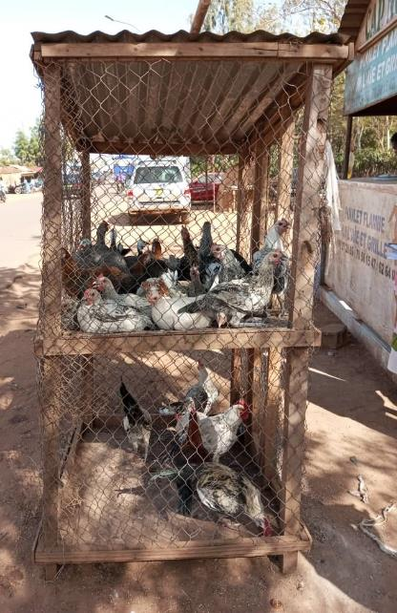
InnovatION 2
Gender-sensitive business models through public-private partnership (PPP) to improve productivity and safeguarded human health
For whom are these innovations relevant?
Poultry farmers
Extension services
Development organizations
Which organizations are well positioned to scale them out?
CPAVI
IPVL/BF
«Vulgarisateurs Volontaires Villageois» (VVV)
What opportunities do these innovations present specifically for the private for-profit sector?
Improve access of poultry farmers to veterinary products and advisory services
Enhance capacity of end users (farmers)
Improve farm production and animal welfare

Slide 14
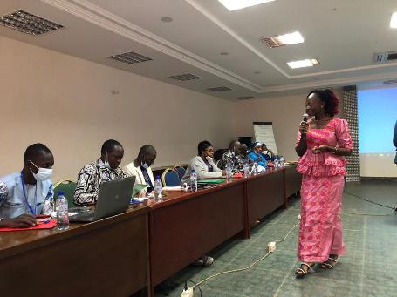
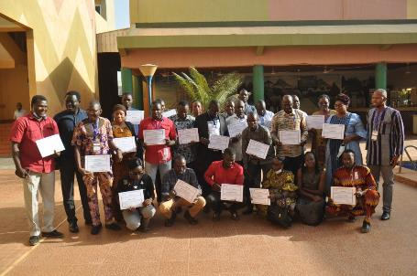
InnovatION 3
Build capacity of next generation national researchers and academia on poultry health and food safety research using a OH approach.
For whom are these innovations relevant?
Universities
Professional livestock schools
Local research
Which organizations are well positioned to scale them out?
«University Joseph Ki-Zerbo» (UJKZ)
«Institut de l'Environnement et de Recherches Agricoles» (INERA)
What opportunities do these innovations present specifically for the private for-profit sector?
Build local capacity

Slide 15
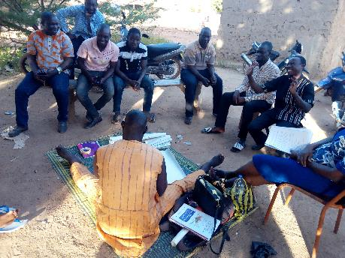
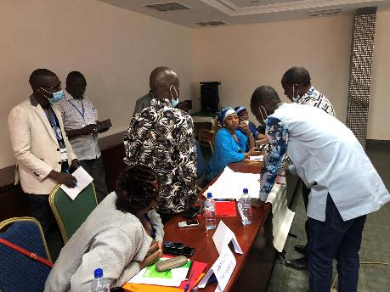
InnovatION 4
Poultry Multi-Stakeholder Platform (PMSP)
For whom are these innovations relevant?
All stakeholders of the poultry value chain
  Poultry farmers
  Traders
  Consumers
  Extension services
  Related research (SELEVER, Pull Push) and development programs
  IPVL/BF
Which organizations are well positioned to scale them out?
«Directeur Régional Ressources Animales et Halieutiques du Centre-Nord» (DRRAH-CN)
IPVL/BF
What opportunities do these innovations present specifically for the private for-profit sector?
Improve networking and collaboration among stakeholders of the VC
Create a conducive policy environment

Slide 16
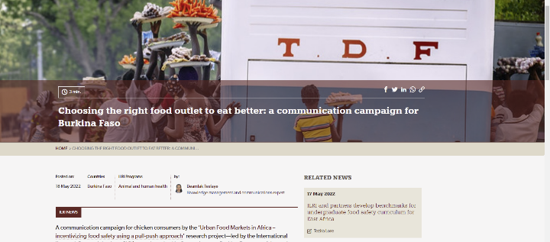
communicate
How will you discuss findings?
PMSP meetings
Workshops
National and international conferences
Project meetings
Who needs to know about your work?
Private sector (poultry value chain actors and others)
Policymakers (Ministry of Livestock)
Academic institutions
Development organizations
Regional and international researchers
How will you engage with them?
Project meetings
PMSP meetings
Policy briefs
Peer reviewed publications
Project reports
Blog stories

Slide 17
Disclaimer
This work was funded in whole or part by the United States Agency for International Development (USAID) Bureau for Food Security under Agreement # AID-OAA-L-15-00003 as part of Feed the Future Innovation Lab for Livestock Systems. Any opinions, findings, conclusions, or recommendations expressed here are those of the authors alone.
Feed the Future Innovation Lab for Livestock Systems
University of Florida - Gainesville, FL 32611, USA
livestock-lab@ufl.edu | http://livestocklab.ifas.ufl.edu

Slide 18

This presentation is licensed for use under the Creative Commons Attribution 4.0 International Licence.

