Slide 1
Update on RHoMIS Survey
carried out in April 2018
Jim Hammond, ILRI
Africa RISING Ethiopian Highlands Project Review and Planning Meeting
Addis Ababa, 21–22 May 2019

Slide 2
Background
A household survey was carried out after completion of the first phase of Africa RISING activities.
Survey was in April 2018 – the data is available for use
The objectives were:
  To evaluate what interventions were adopted more highly, and if particular combinations of interventions were adopted.
  To evaluate any changes to farm productivity, human welfare, or sustainability criteria could be observed, due to adoption of interventions

Slide 3
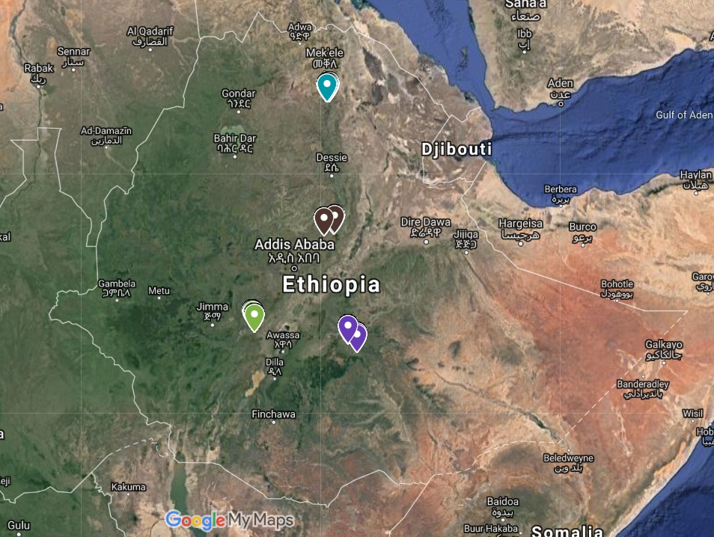
Sample Summary
Region | No. of Responses
Amhara | 148
Oromia | 164
SNNPR | 254
Tigray | 213
Sum | 779

Slide 4
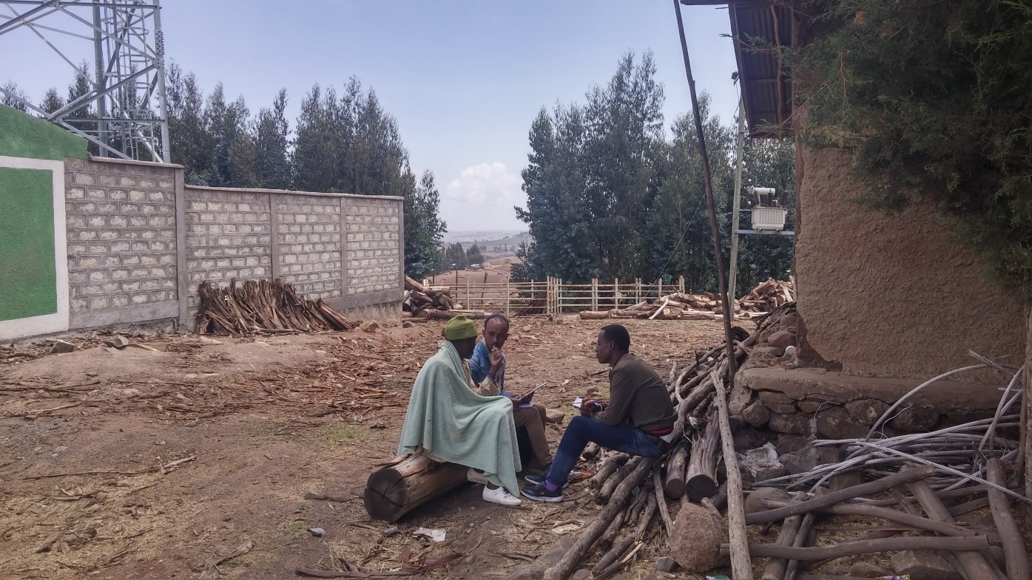
Part 1: Farm System Descriptions

Slide 5
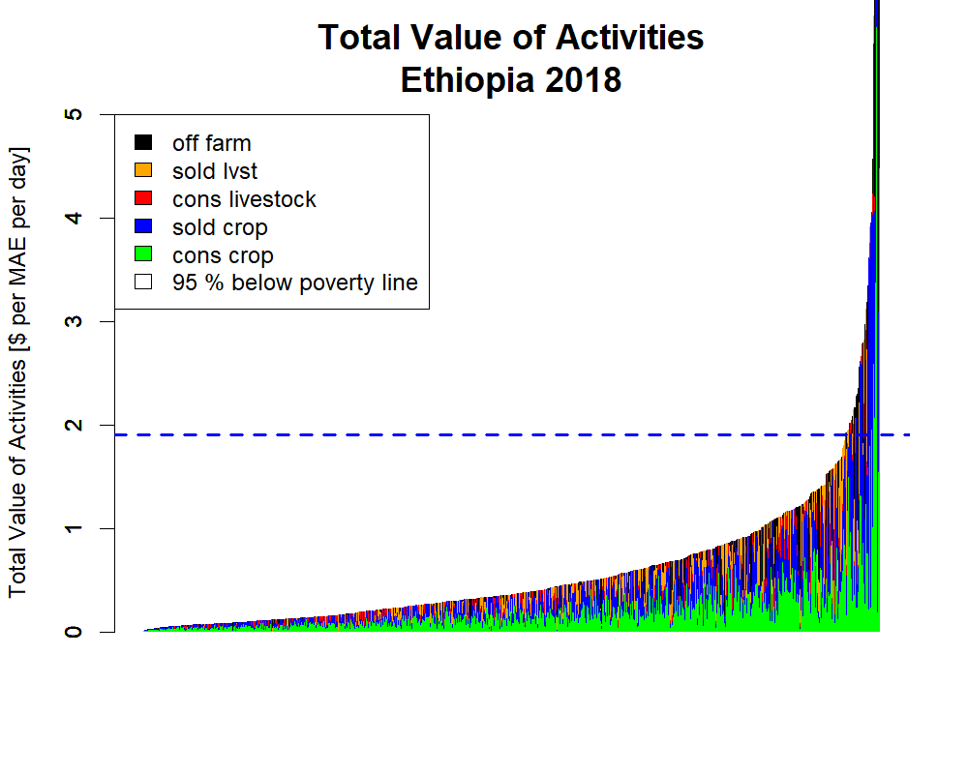
Farm System Summaries: Livelihoods
Low Total Incomes
95% of households below $1.90 per person per day poverty line
75% of household below $1 per person per day
Cropping accounts for majority of production, but mixed farms are the norm, with Livestock kept by all levels of wealth.
Off farm incomes are low and uncommon

Slide 6
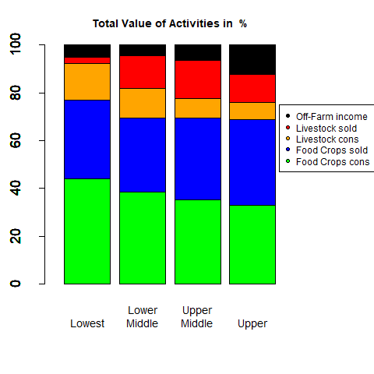
Farm System Summaries: Livelihoods
Households are here divided into wealth quartiles. The average proportion of income & value of production is shown per wealth quartile
All quartiles all rely primarily on crops, and are fairly similar in the balance of activities.
The poorest quartile do not sell livestock.
The wealthiest quartile accessed more off-farm income.

Slide 7
Farm Systems – per Wealth Quartile
Wealth Quartile | Family Size (MAE) | Land Cultivated (ha) | Livestock Holdings (TLU) | Crop Value ($/yr) | Crop Diversity | Lstk Value ($/yr) | Lstk Diversity | Off Farm Income ($/yr) | Produce Sold (%)
Lowest | 5.2 | 1.1 | 0.8 | 100 | 9.5 | 0 | 1.9 | 0 | 0.15
Lower Middle | 4.7 | 1.2 | 1.1 | 300 | 8.1 | 100 | 2.5 | 0 | 0.28
Upper Middle | 4.7 | 1.6 | 1.1 | 600 | 6.9 | 200 | 2.4 | 0 | 0.34
Upper | 4.3 | 2.3 | 1.3 | 1500 | 6.7 | 300 | 2.5 | 200 | 0.37
Looks like land size drives crop income, which is the main driver of wealth. This also links to lower crop diversity and higher market engagement for wealthier households. There appears to be a step change in livestock between the poorest and other quartiles.

Slide 8
Farm Systems – per Region
Region | Family Size (MAE) | Land Cultivated (ha) | Livestock Holdings (TLU) | Crop Value ($/yr) | Crop Diversity | Lstk Value ($/yr) | Lstk Diversity | Off Farm Income ($/yr) | Produce Sold (%)
Amhara | 3.4 | 1.2 | 1.8 | 300 | 6.4 | 200 | 3.5 | 100 | 27
Oromia | 5.6 | 3.5 | 0.9 | 1400 | 5.1 | 300 | 1.6 | 0 | 28
SNNPR | 5.4 | 1.3 | 0.8 | 300 | 12.2 | 100 | 1.7 | 0 | 22
Tigray | 4.4 | 0.7 | 1.2 | 500 | 6.1 | 100 | 2.8 | 100 | 37
The differences are more marked per region.
It would make sense to conduct further analyses on a region-by-region basis.

Slide 9
Welfare & Food Security – per Region
Region | Months Food Insecure | Experience of Hunger (4 = no hunger) | Household Diet Diversity (0-10) | kCal Availability | Count of Income Sources | Cash Income $/prsn/day
Amhara | 0 | 3.3 | 5.2 | 4000 | 5.3 | 0.3
Oromia | 0 | 3.6 | 5.4 | 8000 | 3.2 | 0.5
SNNPR | 0 | 3.3 | 5.4 | 1700 | 2.7 | 0.1
Tigray | 0 | 3.4 | 5.2 | 3400 | 5.3 | 0.3
Food Security looks actually pretty good in each region, despite the low cash incomes. There appears to be sufficient quantity of food, and the dietary diversity score is just about OK (5 or above is considered adequate).
There are however disparities between the locations in terms of total agricultural production (as measures in calories), cash incomes, and the diversity of income sources.

Slide 10
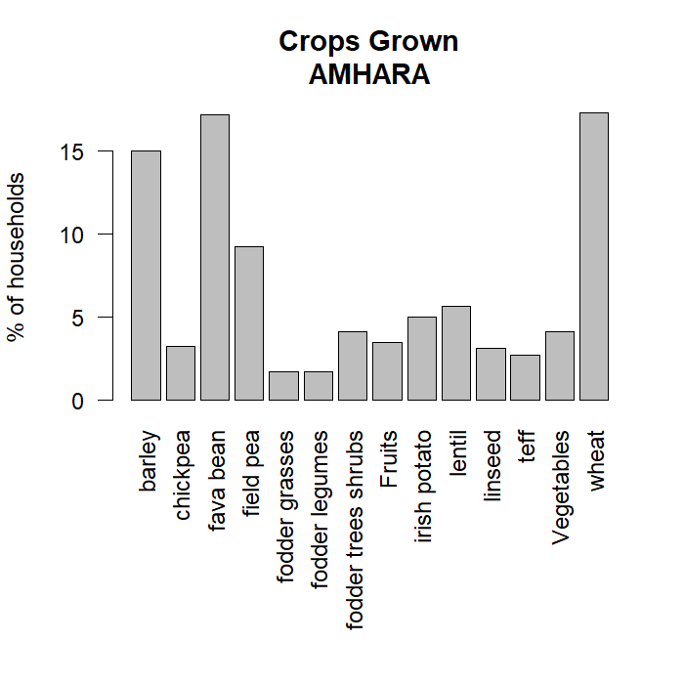
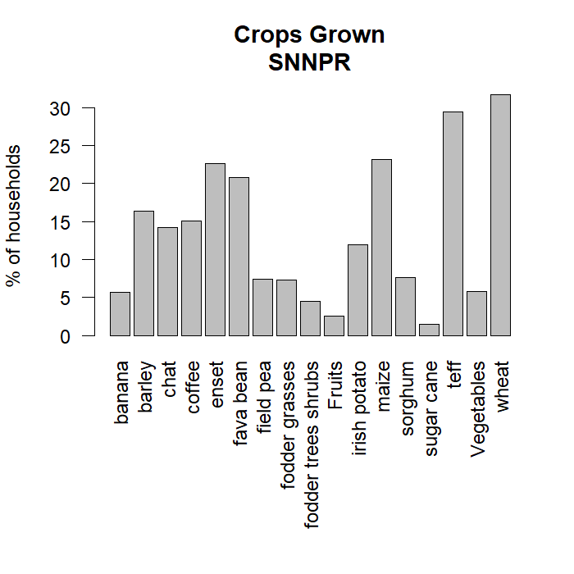
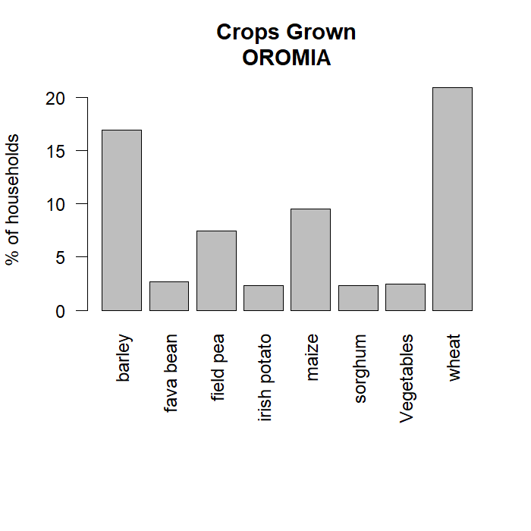
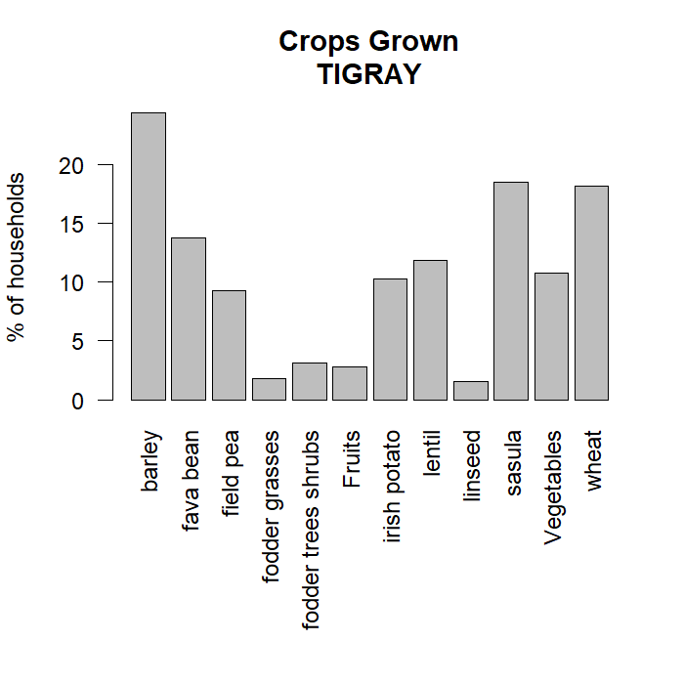
Crops Grown
Region | Land (ha) | Crop Value ($/yr) | Crop Div
Amhara | 1.2 | 300 | 6.4
Oromia | 3.5 | 1400 | 5.1
SNNPR | 1.3 | 300 | 12.2
Tigray | 0.7 | 500 | 6.1

Slide 11
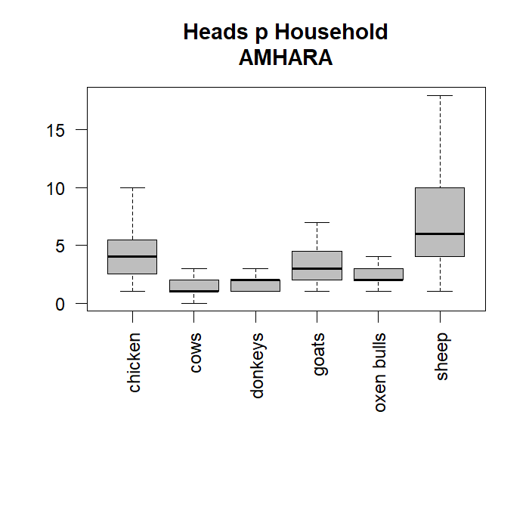
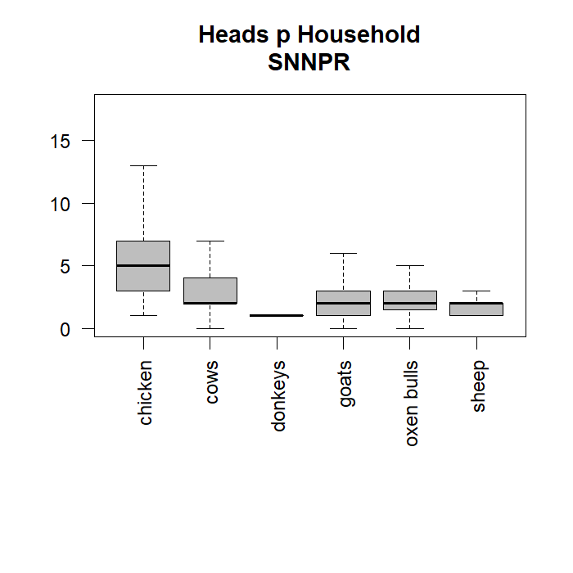
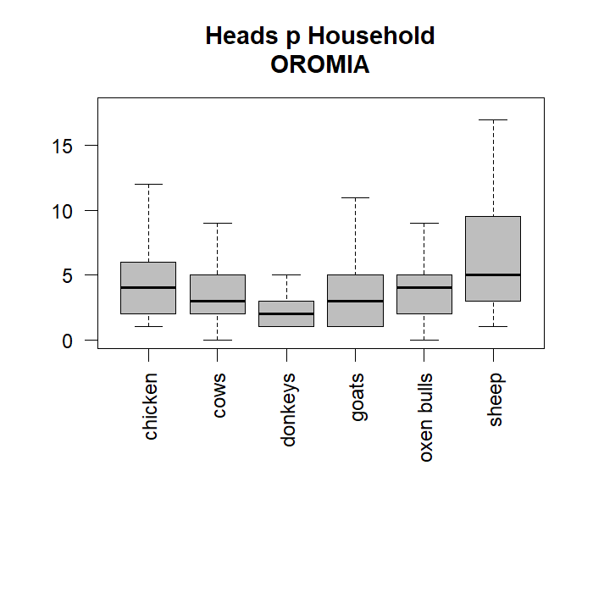
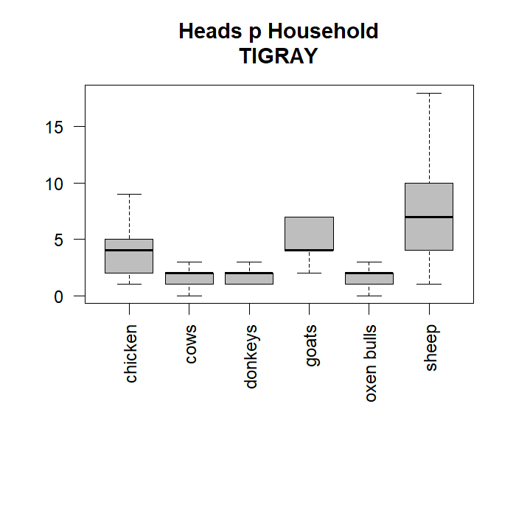
Livestock Kept
Region | Lstk (TLU) | Lstk Value ($/yr) | Lstk Div
Amhara | 1.8 | 200 | 3.5
Oromia | 0.9 | 300 | 1.6
SNNPR | 0.8 | 100 | 1.7
Tigray | 1.2 | 100 | 2.8

Slide 12
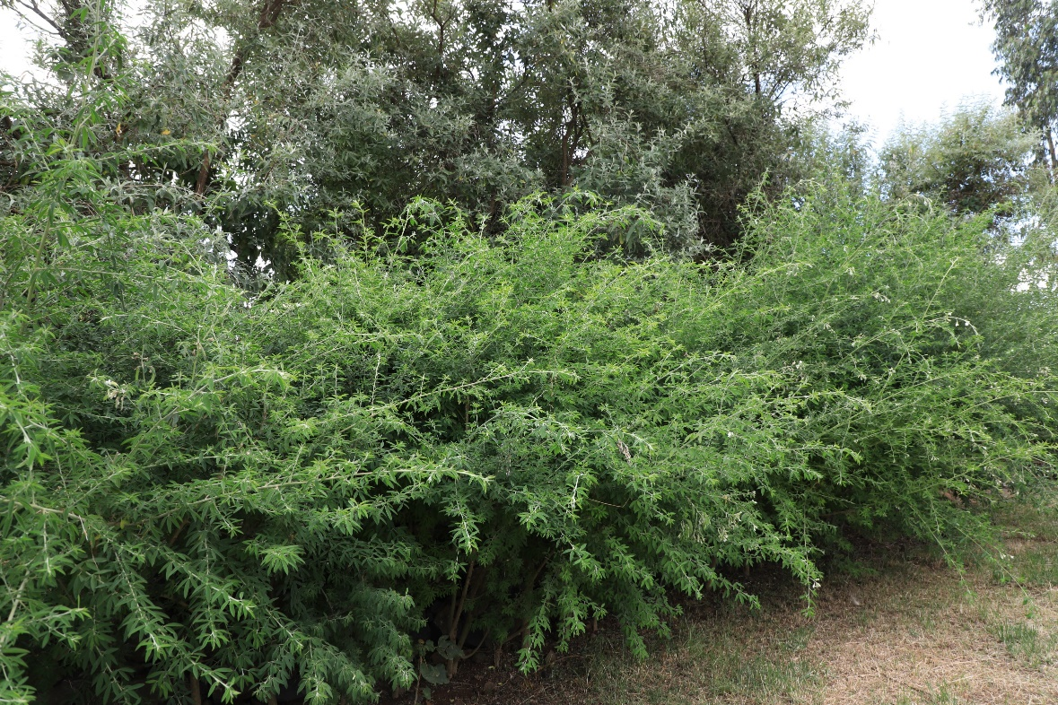
Part 2: Uptake of Africa Rising Interventions

Slide 13
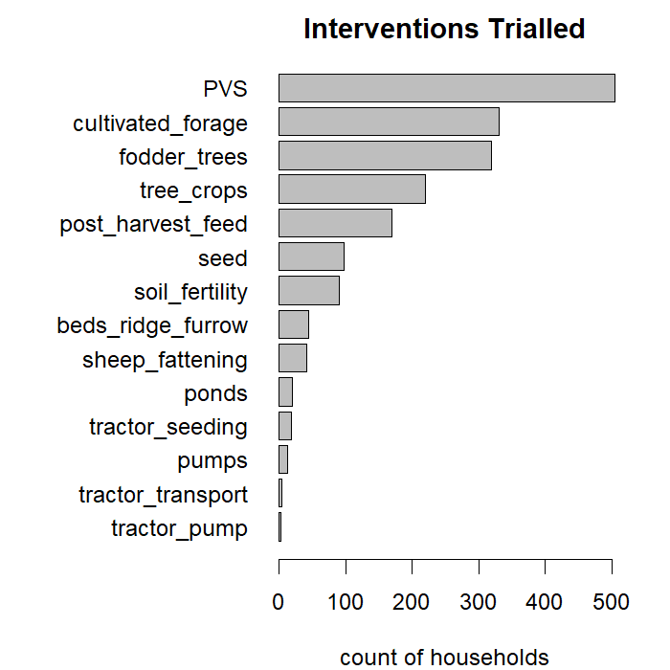
Which Interventions were trialled the most?
Grey = number of households who trialled a technology

Slide 14
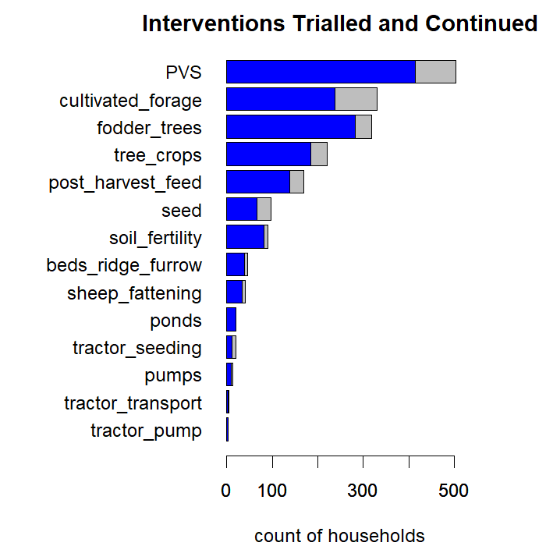
Which Interventions were most popular?
Grey = number of households who trialled a technology
Blue = number of households who decided to keep using that technology
The continuation rate is very high.

Slide 15
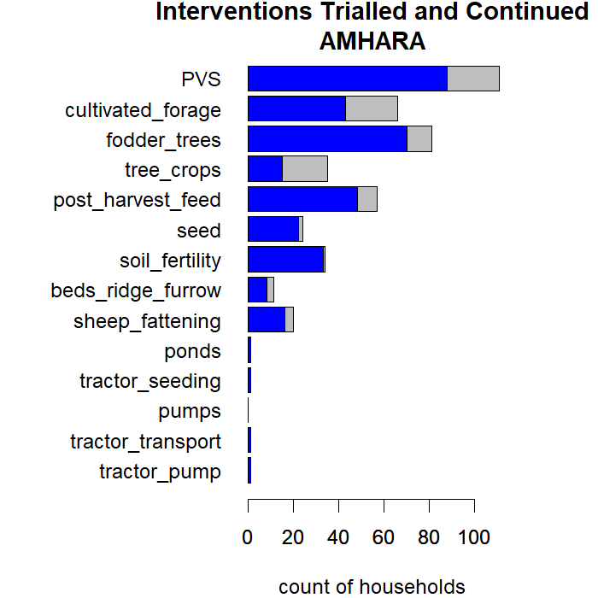
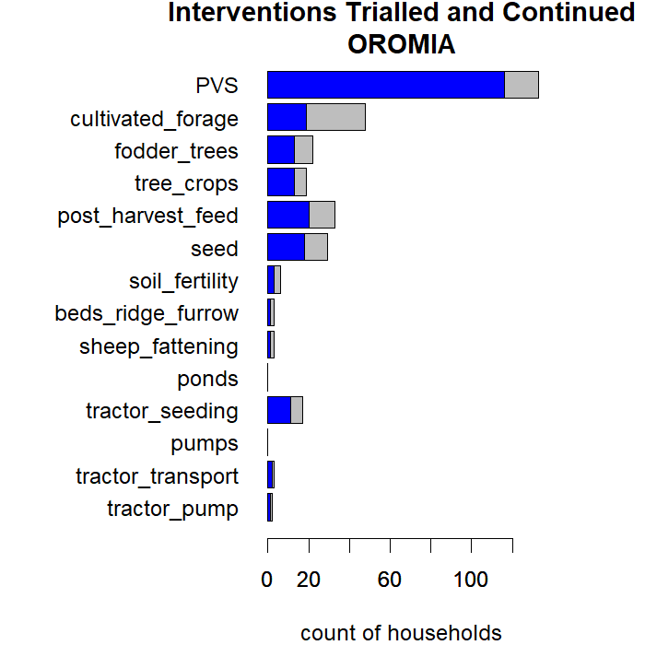
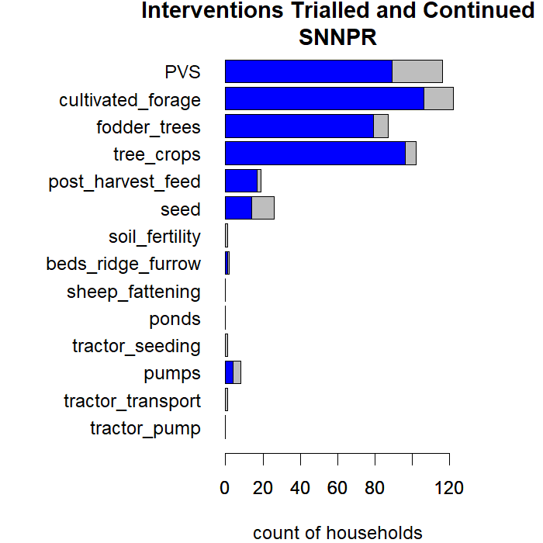
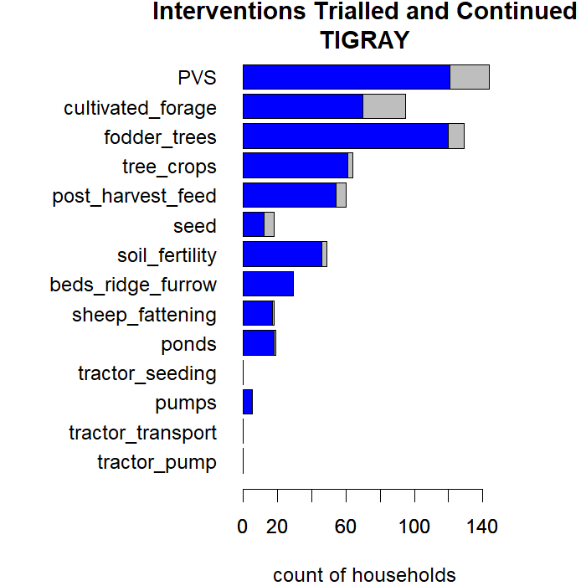
Uptake per Region

Slide 16
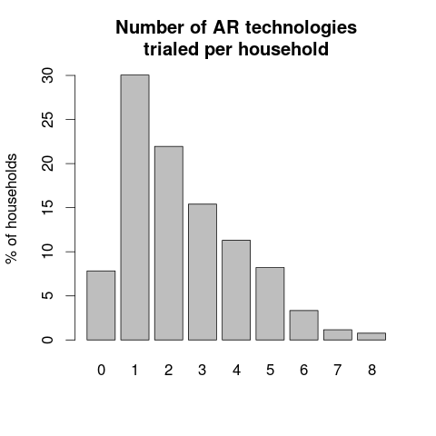
Many households trialled multiple interventions

Slide 17
Most Popular Combinations of Technologies
Technologies | Count | # techs
PVS | 122 | 1
cultivated forage | 39 | 1
PVS & cultivated forage | 32 | 2
PVS & cultivated forage & fodder trees | 32 | 3
PVS & fodder trees | 30 | 2
fodder trees | 25 | 1
PVS & tree crops & cultivated forage & fodder trees | 24 | 4
PVS & tree crops | 23 | 2
tree crops | 17 | 1
cultivated forage & fodder trees | 16 | 2
PVS & tree crops & cultivated forage & post harvest feed & fodder trees | 15 | 5
PVS & tree crops & cultivated forage | 12 | 3
seed | 11 | 1

Slide 18
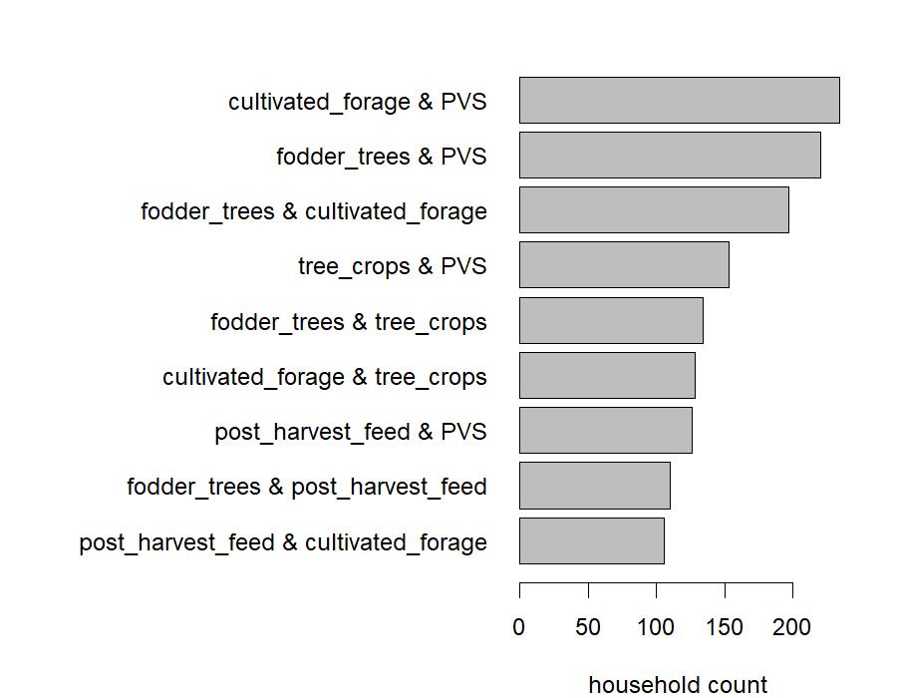
What Pairs of Technologies were commonly together?
Popular Pairwise-Combinations of Techs

Slide 19
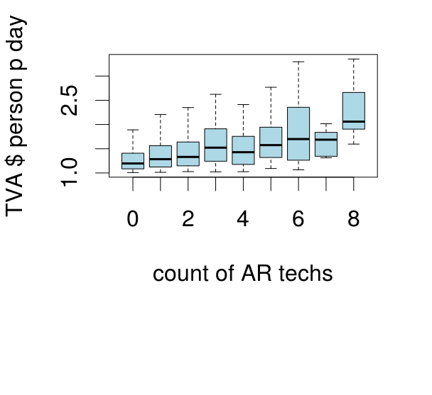
What can we say about types of farms adopting types of interventions packages?
Wealthier households trialled more technologies
But did they get wealthier because they used more technologies?
Or were they able to trial more technologies because they were wealthier?
Need to unpack this further

Slide 20
Who was taking up specific technology combinations?
Asset Grouping of the Household
Livestock and Crop combinations were the most popular for all but the wealthiest households
Followed by crop interventions
Followed by livestock interventions
Poorest households were the most interested in livestock interventions
 | LoLnd-LoLsk | HiLnd-LoLsk | LoLnd-HiLsk | HiLnd-HiLsk
L+C+N | 11 | 6 | 15 | 16
L+C | 32 | 43 | 51 | 33
C+N | 6 | 3 | 7 | 5
C | 23 | 29 | 14 | 39
L | 16 | 12 | 10 | 5
None | 12 | 6 | 3 | 1
Sum (%) | 100 | 100 | 100 | 100
Type of technologies trialled:
L = Lvstk
C = Crop
N = NRM

Slide 21
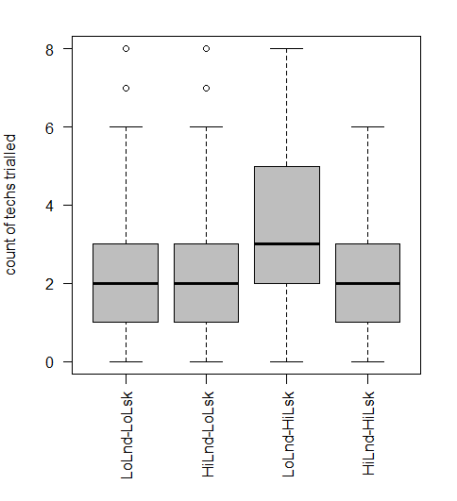
Prosperous but land constrained households were the biggest adopters
The Low Land – High Livestock households trialled more technologies than other asset groups.
They also tested crop-livestock technology combinations most often (see previous slide)
Perhaps they are the most keen to intensify, as they have some wealth (indicated by livestock) but are land constrained.

Slide 22
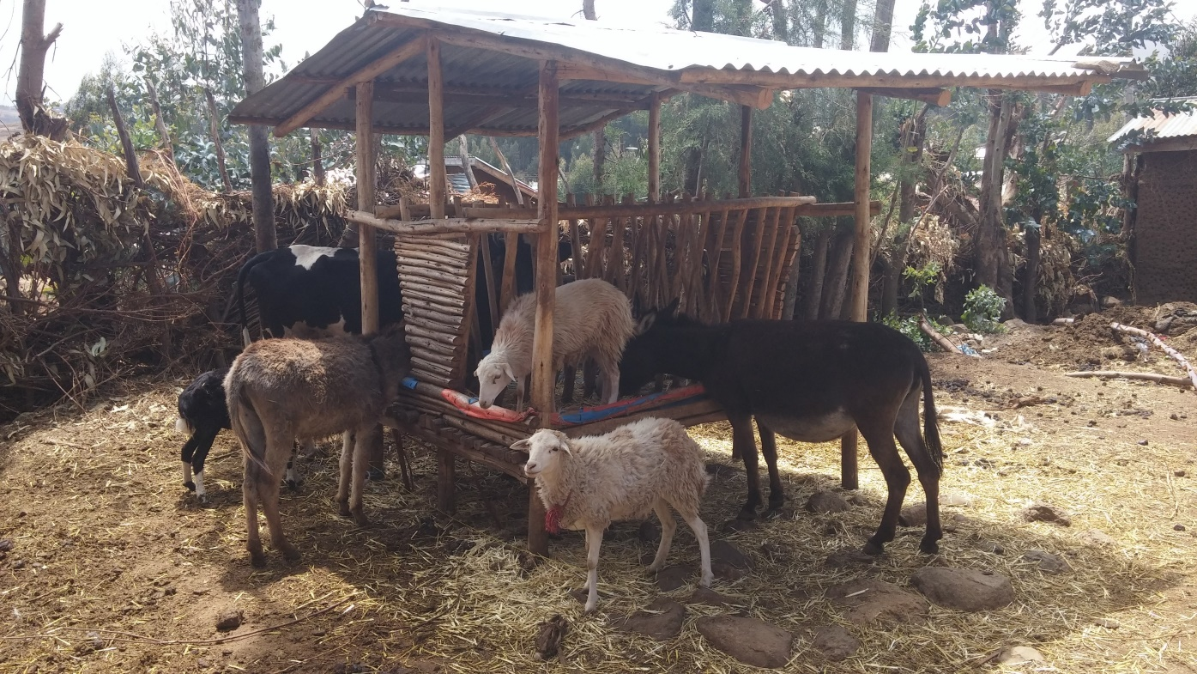
Part 3: Deeper Analysis into a specific technology combination: Cultivated Forage and Post-Harvest Feed Management

Slide 23
The combination of cultivated forages & post-harvest feed interventions
Technologies | n | Amhara | Oromia | SNNPR | Tigray | Sum (%)
Cultivated Forage only | 319 | 12 | 12 | 44 | 32 | 100
Forage plus post-harvest | 134 | 37 | 15 | 10 | 39 | 100
No forage no post-harvest | 291 | 18 | 32 | 32 | 18 | 100
Note: 34 households trialled post-harvest interventions with no cultivated forage, but they are excluded from this analysis as the number is too few

Slide 24
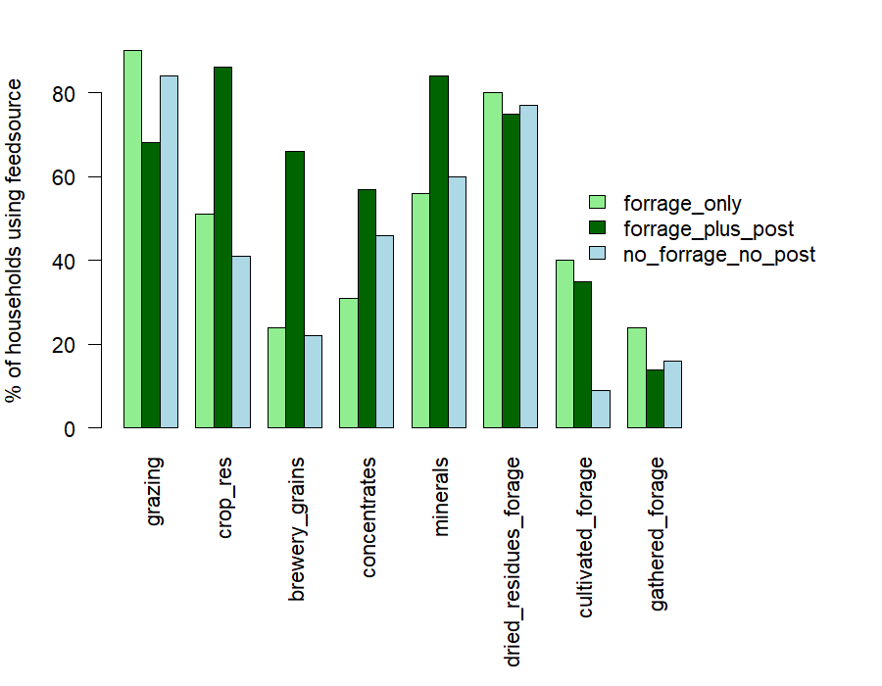
Changes in animal feeding practices due to technology adoption?
It looks like cultivated forage PLUS post-harvest feed management is associated with:
Reduced grazing pressure
Increased crop residue use as feed
Increased use of purchased feeds such as concentrates and minerals

Slide 25
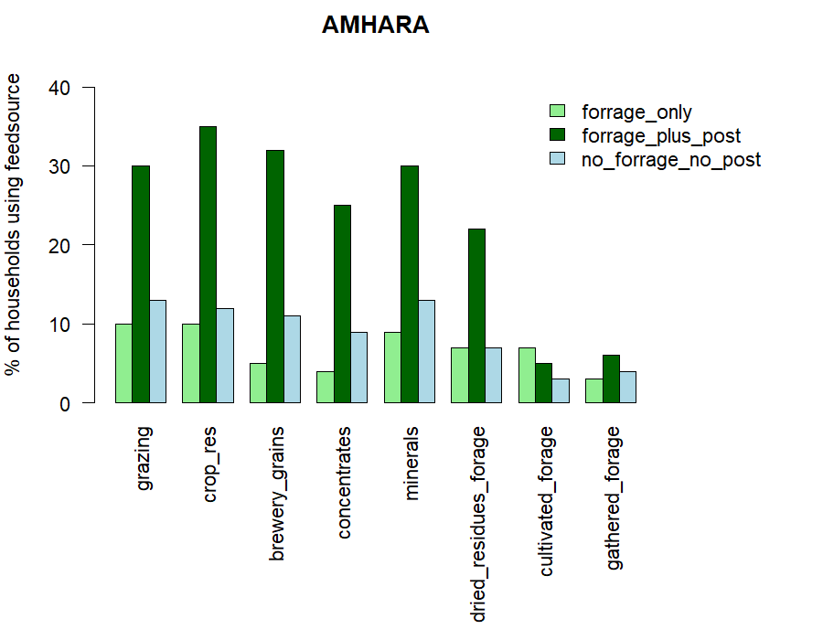
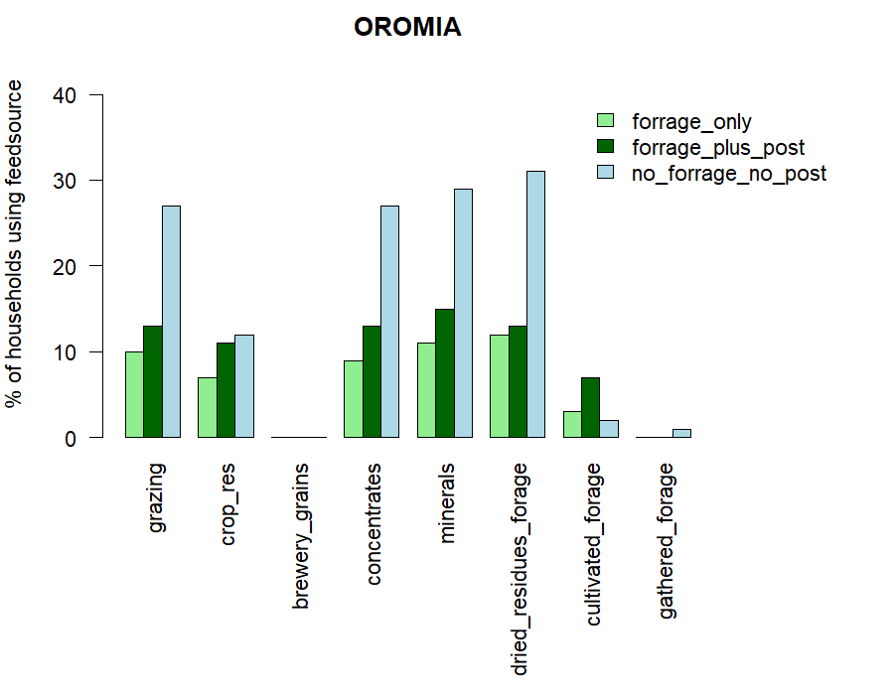
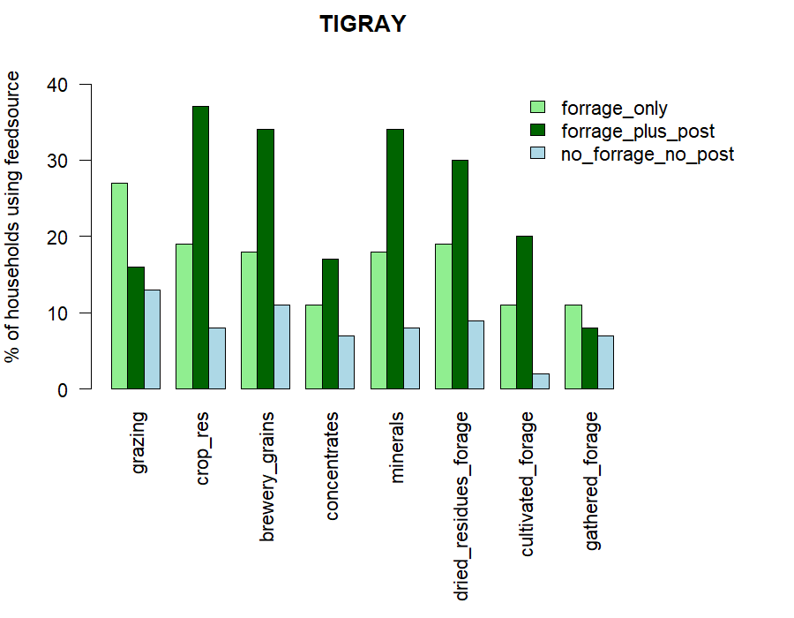
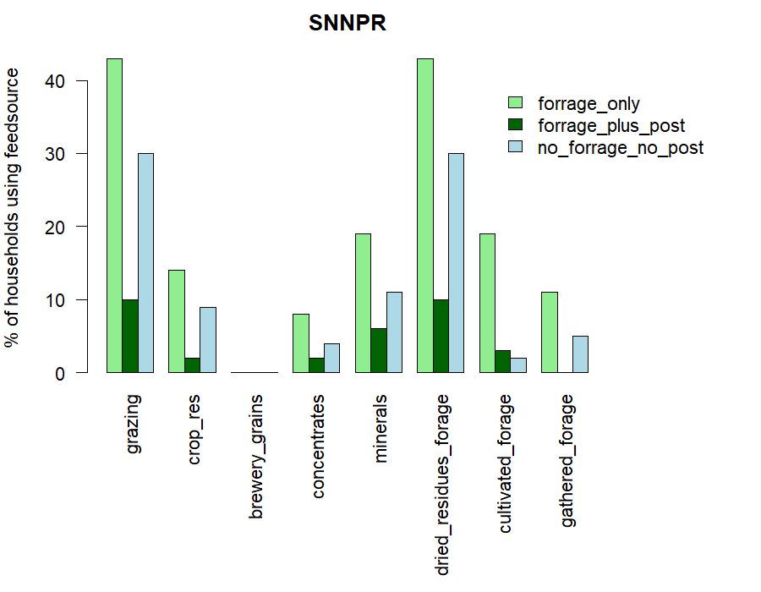
Feeding Techs - Per Region
The biggest effects are seen in Amhara and Tigray, where uptake of post-harvest technologies in combination with cultivated forages was highest.
This does seem to indicate some synergistic effects, although regional outcomes are very different.

Slide 26
Deeper Analysis: Discussion
Question to the group – is this type of deeper analysis helpful?
If so, I will need some guidance from the local experts. Can we develop some hypotheses for specific technology combinations, and what effects they might have in the specific regions?
It might be difficult to make the findings firm, as we would need to subset observations by location, asset base, and technology combination

Slide 27
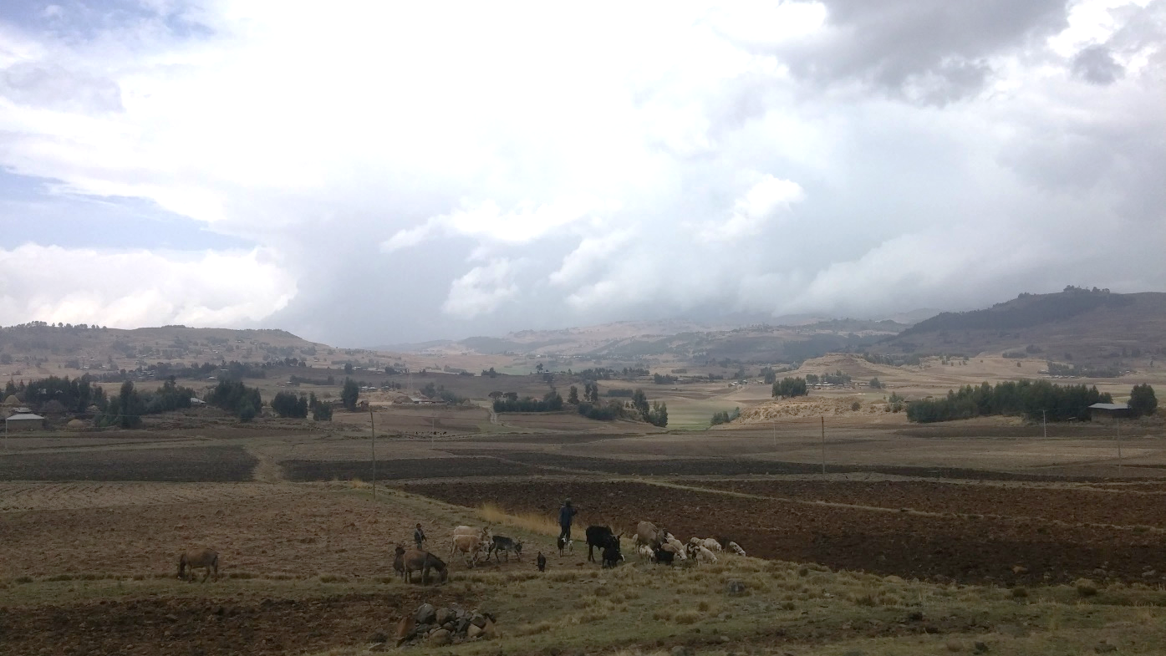
Part 4: Sustainability Assessment

Slide 28
Sustainable Intensification Assessment Framework (SIAF)
Is a framework containing many indicators to measure Sustainable Intensification
About 30 these indicators were gathered in the RHoMIS survey
The indicators were normalised according to user-defined thresholds
And plotted to give landscape-level summaries

Slide 29
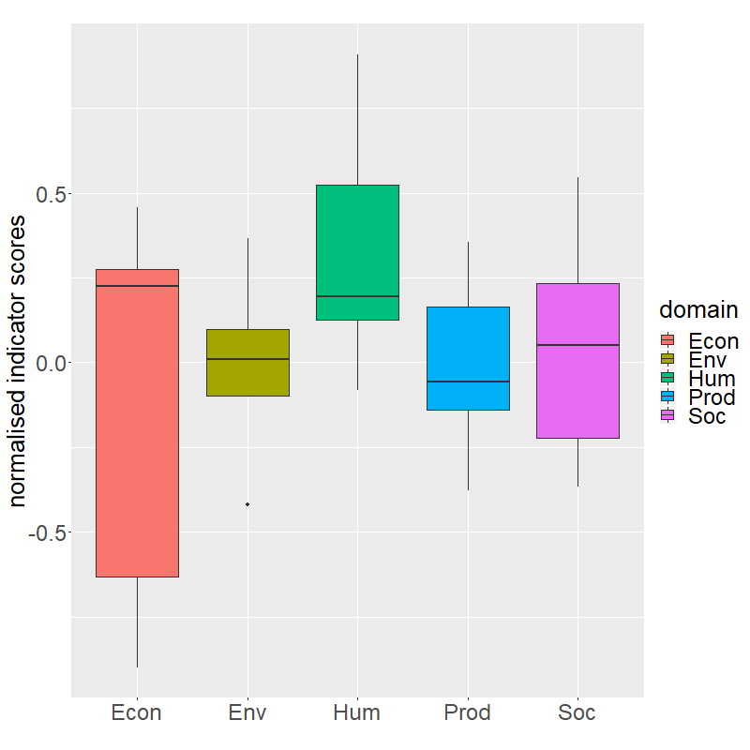
SIAF Results overall
Domain | Indicator | Traffic light | Mean.Score | Unit
Prod | most imp crop yield | Yellow | 2386 | kg/ha.yr
Prod | crop value efficiency | Yellow | 537 | USD/ha.yr
Prod | crop diversity | Green | 8 | count of species
Prod | avg milk yield.animal.day | Yellow | 0.9 | l/animal.day
Prod | lstk value efficiency | Red | 341.1 | USD/TLU.yr
Prod | lstk div | Yellow | 2.4 | count of species
Econ | TotalValueActivities | Red | 0.6 | USD/pers.day
Econ | Income sources | Yellow | 4.1 | count
Econ | Market Orientation | Yellow | 0.3 | proportion sold
Econ | Off Farm Income Efficiency | Red | 28.3 | USD/pers.yr
Econ | PPI Likelihood above 1.90 | Green | 65 | % above $1.90 pov line
Env | GHG emissions kgco2eq.yr | Green | 5686 | kgCO2-eq/yr
Env | irrigation months p year | Red | 1.1 | months/yr
Env | Sustainable Land Practices | Yellow | 4 | count
Env | farmer perception soil assets | Yellow | 1.8 | count
Hum | Hunger Experience | Green | 3.3 | ordinal scale (1-4)
Hum | DD leanseason | Yellow | 5.3 | food groups consumed/month
Hum | Head.Education | Yellow | 3.2 | ordinal scale (1-7)
Hum | innov ind | Yellow | 2.9 | arbitrary (0-5)
Hum | techs trialled | Yellow | 2.4 | count
Hum | months food secure | Green | 11.8 | count of months
Soc | female assets | Yellow | 2.7 | count
Soc | female.control | Green | 0.6 | proportion
Soc | group membership | Yellow | 1.4 | count
Soc | info receive freq | Yellow | 2 | count/yr
Soc | techs promoted | Yellow | 7.4 | count/yr
Soc | community resource sharing | Red | 1.9 | count gifts given/received
Soc | dependancy ratio | Red | 0.75 | ratio non-workers:workers

Slide 30
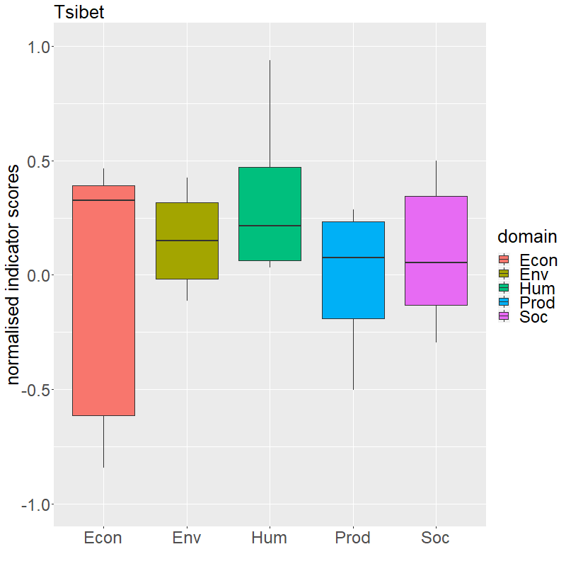
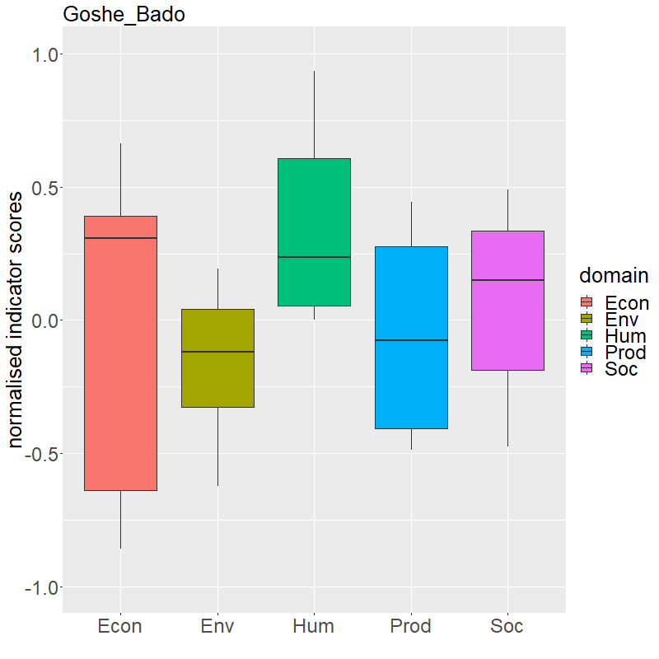
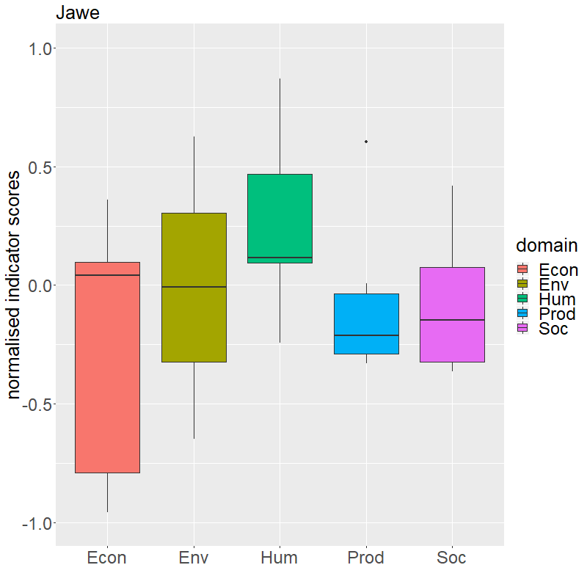
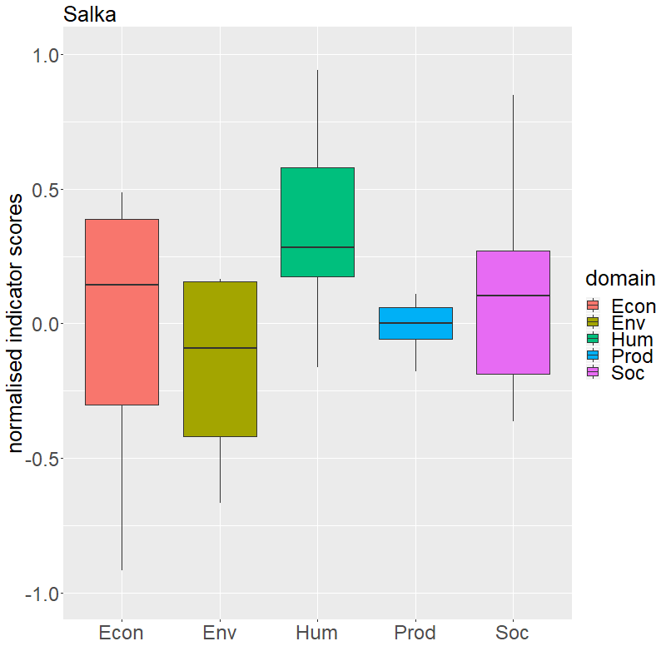
SIAF Results: Kebeles
Tsibet - Tigray
Goshe Bado - Amhara
Jawe - SNNPR
Salka - Oromia
Domain | Indicator | Traffic Light | Mean Score | Unit
Prod | Most Imp Crop Yield |  | 2078 | kg/ha.yr
Prod | Milk yield |  | 1.8 | l/animal .day
Env | Irrigation |  | 3.2 | mnth/yr
Env | Sustainable Land Practices |  | 6.6 | Count
Env | Farmer’s Soil Quality |  | 1.6 | Score (0-3)
Domain | Indicator | Traffic Light | Mean Score | Unit
Prod | Most Imp Crop Yield |  | 1413 | kg/ha.yr
Prod | Milk yield |  | 3.3 | l/animal .day
Env | Irrigation |  | 0.2 | mnth/yr
Env | Sustainable Land Practices |  | 5.1 | Count
Env | Farmer’s Soil Quality |  | 1.3 | Score (0-3)
Domain | Indicator | Traffic Light | Mean Score | Unit
Prod | Most Imp Crop Yield |  | 2431 | kg/ha.yr
Prod | Milk yield |  | 1.5 | l/animal .day
Env | Irrigation |  | 0.1 | mnth/yr
Env | Sustainable Land Practices |  | 2.5 | Count
Env | Farmer’s Soil Quality |  | 2.2 | Score (0-3)
Domain | Indicator | Traffic Light | Mean Score | Unit
Prod | Most Imp Crop Yield |  | 3794.5 | kg/ha.yr
Prod | Milk Yield |  | 1.9 | l/animal .day
Env | Irrigation |  | 0 | mnth/yr
Env | Sustainable Land Practices |  | 1.9 | Count
Env | Farmer’s Soil Quality |  | 2 | Score (0-3)

Slide 31
SIAF Results – Way forward
Are the right thresholds being used?
Should we use SIAF at Kebele level to give an overview of sustainability issues?
Should we use SIAF to attempt to compare impact of the project?
  We could compare the SIAF scores of households with different numbers of technologies
  Or with specific technology mixes / or technology comparisons
Should we use the SIAF approach to identify interesting outliers – either positive deviants (high-scores) or very deprived (low scores)
  Identification of interesting outliers could be per household
  Or per cluster of households

Slide 32









CGIAR Partners:
Notes:
Ethiopia

Slide 33
Local Partners (Phase 1)- Ethiopia
Academic institutions:
  Wachemo, Mekelle, Madawolabu, Debre Berhan and Hawassa universities; Maichew Agricultural College
Regional research organizations:
  Amhara Regional Agricultural Research Institute, Southern Agricultural Research Institute, Tigray Agricultural Research Institute, Oromia Agricultural Research Institute
Federal research organizations:
  Ethiopian Institute for Agricultural Research, Ethiopian Public Health Institute
Offices of Agriculture:
  Endamekoni (Tigray), Basona Worena (Amhara), Lemo (SNNRP) and Sinana (Oromia)
Private entrepreneurs: Fuji integrated farm
NGOs: GRAD, Hundie, SOS Sahel, Sunarma
Agricultural Transformation Agency (ATA)
Innovation laboratories: SIIL, ILSSI, PHIL, LSIL

Slide 34
Scaling Development Partners in the Different Sites/Regions (Phase II)- Examples
InterAide France | SNNPR, Lemo | NGO
Send-a-Cow | SNNPR, Lemo | NGO
Ethiopian Catholic Church | SNNPR, Lemo | NGO
Hundie | Addis Ababa | NGO
World Vision | SNNPR/Lemo | NGO
Woreda, zonal and regional livestock and fishery development offices, and agriculture and natural resources development offices | SNNPR, Amhara, Oromia and Tigray/Lemo, Basona, Sinana, Endamehoni | GOs
GRAD/REST | Tigray/ Endamehoni | NGO
Raya, Dashen and Habesha Breweries | Tigray/ Endamehoni and Amhara/ Debre Birhan | PLC
Oromia Seed Enterprise | Oromia/Sinana | GO
Madda Walabu, Wachemo, Debere Birhan, Mekele, Hawassa Universities | SNNPR, Amhara, Oromia and Tigray | GOV
Saint Mary and Michew ATEVT collages | Tigray/Endamehoni | GOs
Regional and Federal Research centers | SNNPR, Amhara, Oromia and Tigray/Lemo, Basona, Sinnan, Endamehoni | GOs

