Slide 1
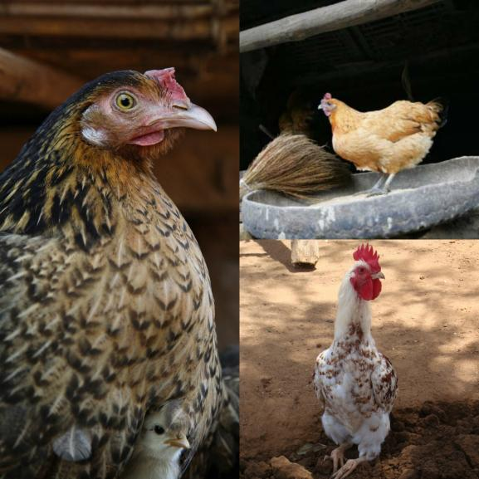
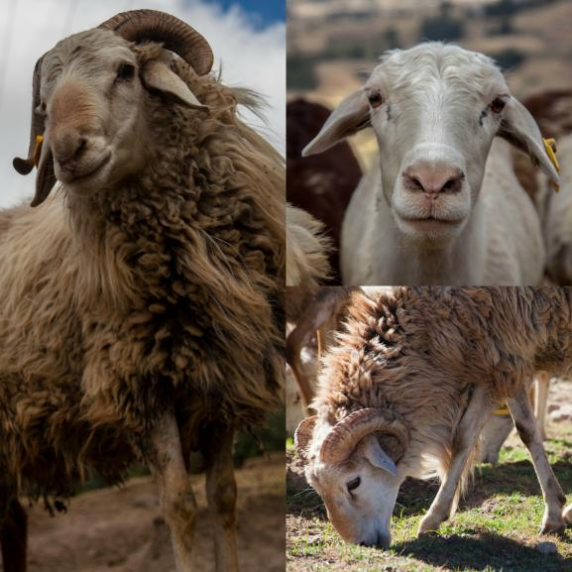
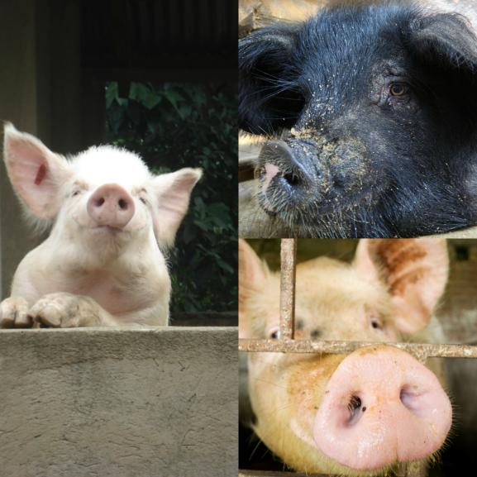
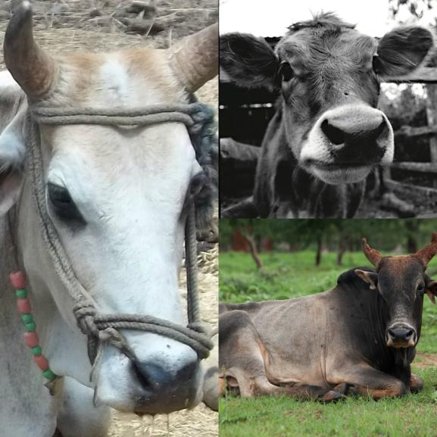
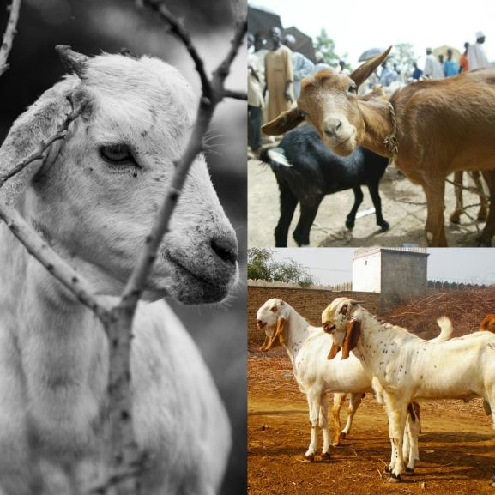


The role of livestock diversity
for more sustainable and resilient food systems
Jimmy Smith
Director General, International Livestock Research Institute, Kenya
Annual meeting of The Food Forever Initiative: Biodiversity for Resilient Food Systems
Wilmington, Delaware, 23-24 September 2018
Notes:
There MUST be a CGIAR logo or a CRP logo. You can copy and paste the logo you need from the final slide of this presentation. Then you can delete that final slide
To replace a photo above, copy and paste this link in your browser: http://www.flickr.com/photos/ilri/sets/72157632057087650/detail/
Find a photo you like and the right size, copy and paste it in the block above.

Slide 2
1800
breeds
of
chickens

Slide 4
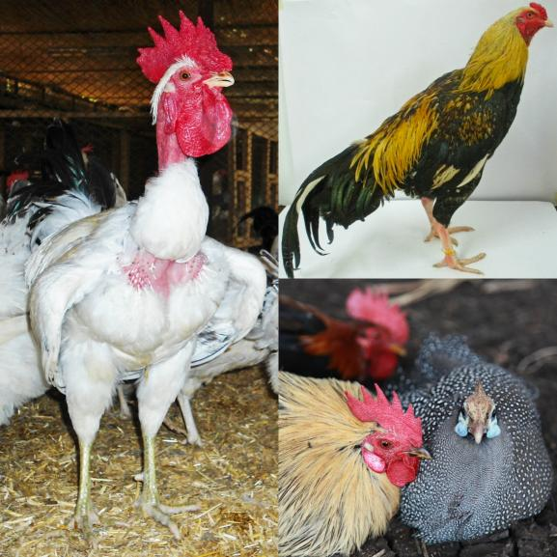

Slide 5
1500
breeds
of
sheep

Slide 7
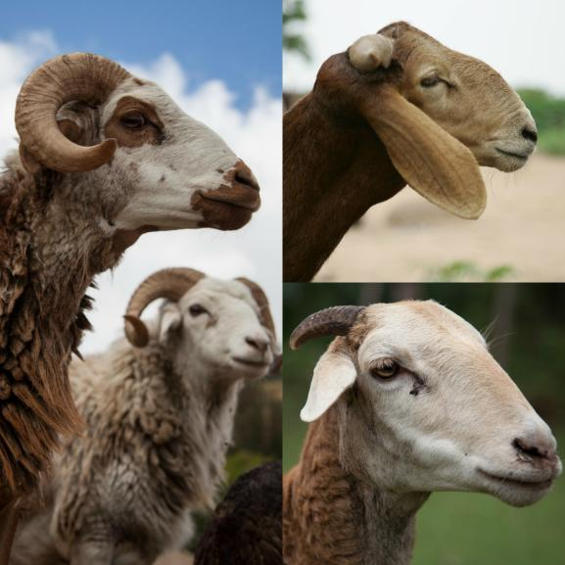

Slide 8
750
breeds
of
pigs

Slide 10
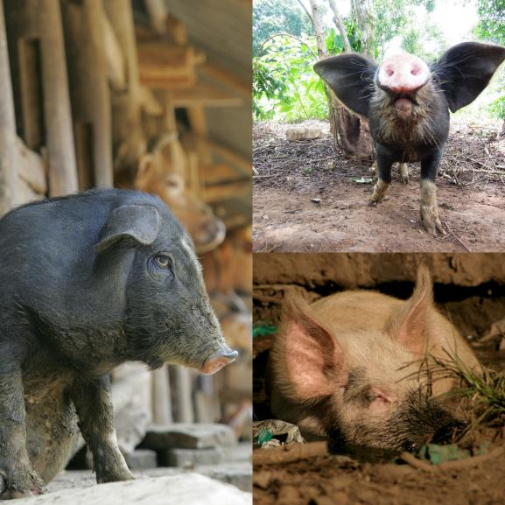

Slide 11
1400
breeds
of
cattle

Slide 13
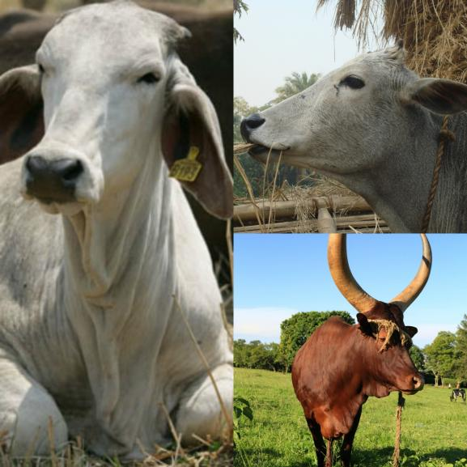

Slide 14
700
breeds
of
goats

Slide 16
