Slide 1
Crowdsourcing Information in the Drylands
Nathan Jensen
ILRI

Slide 2
Problem Statement
Information scarcity is severely limiting development and resource management in the drylands.

Slide 3
Problem Statement
Information scarcity is severely limiting development and resource management in the drylands.
Why?
There are few existing accurate public datasets available with which to learn about dynamics in the drylands.
Collecting data using conventional methods is extremely costly in these environments.
→ So we know little and it is expensive to learn more.

Slide 4
Problem Statement
Information scarcity is severely limiting development and resource management in the drylands.
Solution: To develop a data collection, verification, and dissemination platform that is:
Structured for public use
Cost-effective
Flexible and highly functional-can collect different types of data
Generates high-quality, trusted data
Sustainable

Slide 5
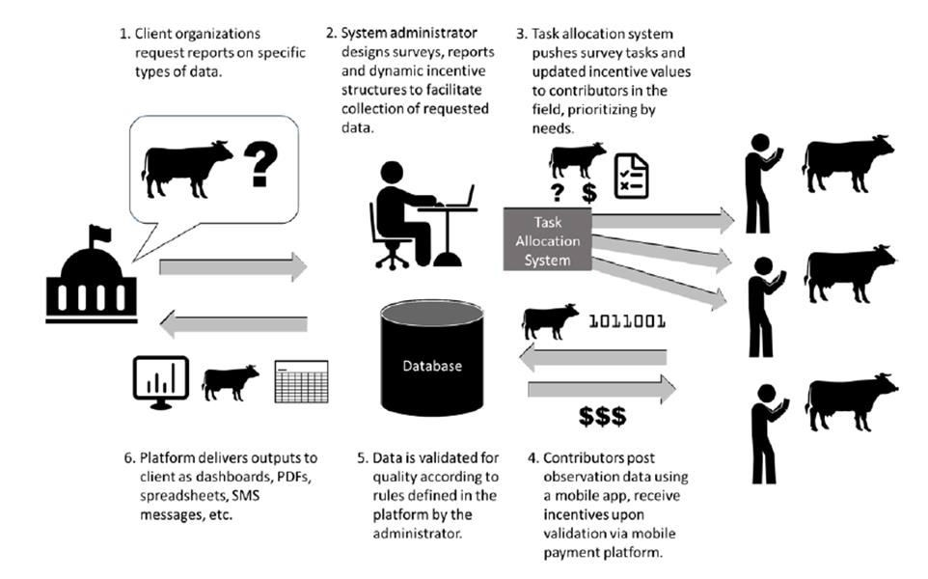
Dryland Information System

Slide 6

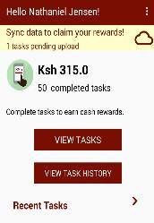
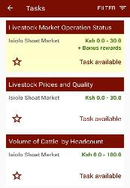
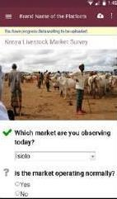
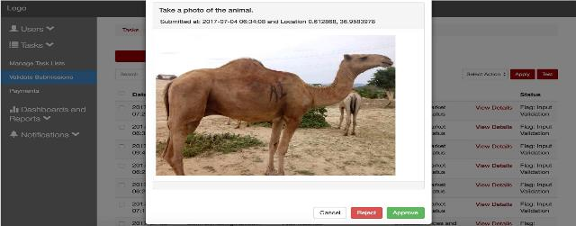
Dryland Information System: Implementation
Key system attributes:
Front end:
  Mobile app by which data collection tasks are pushed to contributors.
  Contributors execute on tasks, each of which is attached to a value to a reward.
Back end:
  Task authoring & parameterizing system for translating client requirements into specified tasks and incentives.
  Manual and automated validation checks
  Database from which a range of data products are delivered to clients.

Slide 7
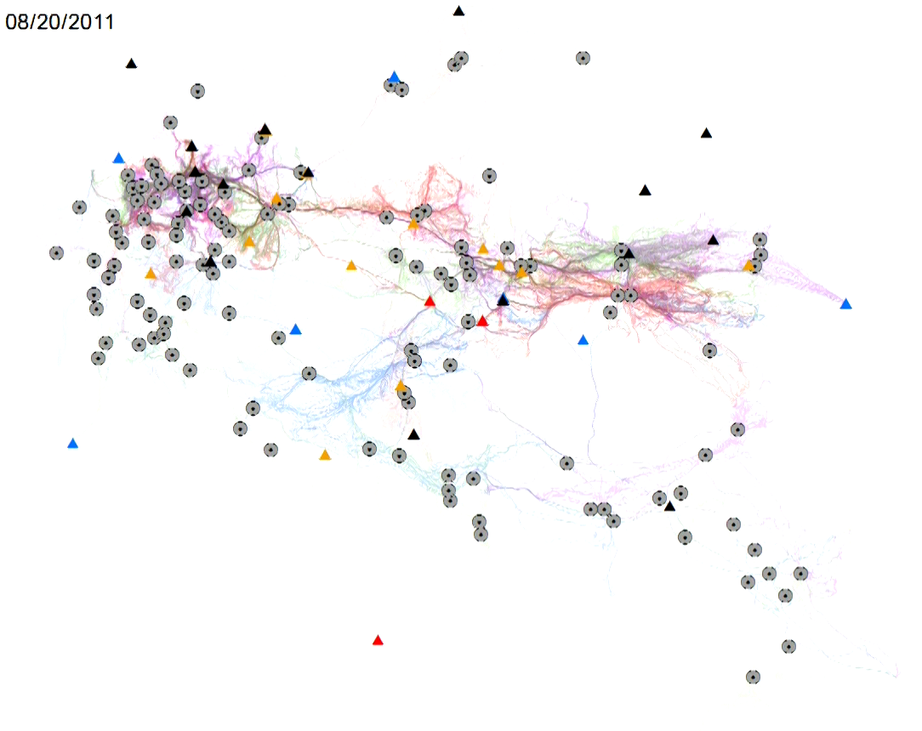


Progress to date
Passive data collection on migration
GPS collar traces of 60 cattle from 20 households in 5 villages, at 5-minute intervals over 3 years
Camp
Water point
Trajectories
(color varies
by household)

Slide 8
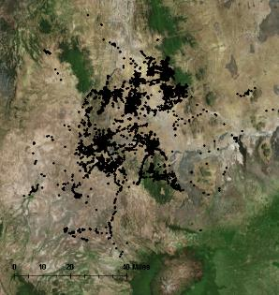
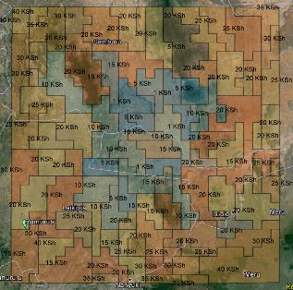
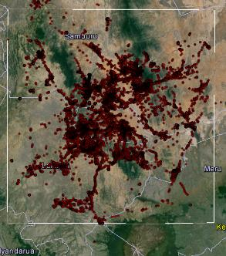
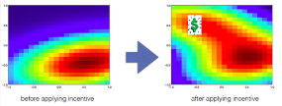
Progress to date
Passive data collection on migration
GPS collar traces of 60 cattle from 20 households in 5 villages, at 5-minute intervals over 3 years
Crowdsourcing rangeland conditions from pastoralists
Spatially and temporally varying rewards to reduce clustering
>110,000 submissions on vegetation abundance & palatability

Slide 9
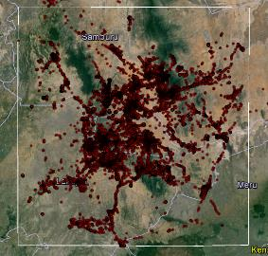
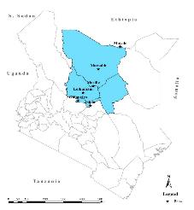
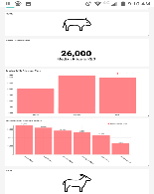
Progress to date
Passive data collection on migration
GPS collar traces of 60 cattle from 20 households in 5 villages, at 5-minute intervals over 3 years
Crowdsourcing rangeland conditions from pastoralists
Spatially and temporally varying rewards to reduce clustering
>110,000 submissions on vegetation abundance & palatability
Livestock market information from market regulars
5 weekly livestock markets for 5 months
Used geofencing and market calendars to reduce fraud
Multiple monitors per market for cross validation

Slide 10
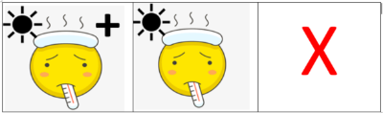

Progress to date
Passive data collection on migration
GPS collar traces of 60 cattle from 20 households in 5 villages, at 5-minute intervals over 3 years
Crowdsourcing rangeland conditions from pastoralists
Spatially and temporally varying rewards to reduce clustering
>110,000 submissions on vegetation abundance & palatability
Livestock market information from market regulars
5 weekly livestock markets for 5 months
Used geofencing and market calendars to reduce fraud
Multiple monitors per market for cross validation
Extension & training: client/agent profiling, extension, evaluations
Household-collected data on young child diet and health

Slide 11
n.jensen@cigar.org

