Slide 1
Dilution or drought coping mechanism? Household food aid redistribution in Ethiopia’s pastoral areas
Fiona Flintan and Kelvin Shikuku
Senior Scientists
Sustainable Livestock System/ILRI

Slide 2
Main research objectives
2019 study on Food Aid and Pastoralist Households funded by EC-SHARE through FAO
1. How was humanitarian aid delivered in 2016/17 in pastoral areas and to whom was it targeted?
  1.1 What were the aid-delivery strategies and to whom was aid targeted by aid agencies (NGO, IGO, govt) in 2016/17 drought period?
  1.2 If it was targeted to a “household,” how was that “household” defined?
  1.3 To what extent did aid agencies attempt to take account of and include in their aid delivery the diversity of ”HHs” in terms of membership, structure and entitlements to aid?

Slide 3
2. What is a pastoralist “HH”?
1.1 How do pastoralists themselves define a pastoralist “household” or “domestic group”?
1.2 What is the structure of an average pastoralist HH, and how do HHs form a social landscape or network – a community? What impact does gender have on this?
1.3 Does the position of a HH in the community, the position of a HH in the physical landscape, have an impact on a HH’s resilience – how it copes with drought?

Slide 4
3. What is the appropriate social/family unit for aid delivery in pastoral societies?
3.1 How do the definitions of a pastoralist household used by humanitarian and development actors in aid delivery compare with reality?
3.2 If there are differences, what implications does this have for aid delivery and for a HH’s resilience (ability to cope with drought)?
3.3 What is the most appropriate social or family grouping for aid delivery, can it be “defined,” and if so, what is the definition?

Slide 5
Data collection undertaken in 4 stages between February-September 2018
National - questionnaire to humanitarian actors
National, regional, local, organization - KIIs
Kebele level – 1,983 HHs interviewed – all HHs in one kebele in each region – 292 in Su’ula, Afar, 986 in Asli, Somali and 705 in Fuldowa, Borana, Oromia – focus on distribution and sharing of food aid and ‘other assistance.’ Analysed through social network analysis.
HH level – 6 HHs in each kebele (chosen based on SNA) approx. half female-headed, half male-headed. Participatory tools used.

Slide 6
Findings
1. How was humanitarian aid delivered in 2016/17 in pastoral areas and to whom was it targeted?
In 2016/17 aid was delivered to ‘vulnerable’ individuals based on selection criteria (including nutrition-related criteria) and not households. A household was defined as ‘vulnerable’ if it included an individual classified as vulnerable.
The ‘household’ was still used as a unit of reference (capping of individuals per HH) so still important to consider how it is defined.
There was no set definition, but general agreement amongst humanitarian actors:
A number of people, often a family, living in the same house (or flat) under the same roof or in the same compound, sharing meals eaten ‘out of the same dish,’ which can include the husband, wife, partners, children, and other close relatives, and who are sharing resources and livelihoods. Though some said it was “contested.”

Slide 7
Findings
In general aid agencies did not fully understand nor take into account the variability between and within ‘households’ in terms of structure, members and member characteristics, entitlements etc. Wealth was a factor in determining vulnerability – but difficult to measure and particularly problematic in polygamous HHs.
2. What is a pastoralist ‘household’?
For communities, though the term ‘household’ is used, this tended to be only in times of interaction with NGOs or government, and rather they would refer to their customary social units using their own terms.
Normally a core group of relations, with a wider circle of relatives or others. Boundary between two is porous. Membership is dynamic over time and circumstances. As one household head (HHH) put it: “for us, the definition of a ‘household’ just depends on the time that you are visiting…”.

Slide 8
Findings
As such though the definitions of a ‘household’ (HH) used by humanitarian aid actors and communities were similar, the term ‘household’ is more of an administrative one that is used by humanitarian aid and development actors together with government as a ‘tidy’ and simple unit of the population rather than the more complex and varied family social groupings that exist in reality and with which communities more commonly associate.
Pastoralists households are changing - increase in female-headed households. Female-headed HHs still reliant on male members. Women targeted with food aid.
Pastoralists part of a social landscape and network and women are key to this. Food aid was a good example of showing how strong this network is.

Slide 9
Social network analysis
99% of households interviewed in Su’ula, Afar, 65.7% in Asli, Somali region, and 86.5% in Fuldowa in Oromia said that they had received food aid in the last drought period.
69% of HHs (n=199) who received food aid from government/NGOs in Su’ula, Afar, 36% (n=234) in Asli, Somali region, and 61% (n=370) in Fuldowa, Oromia said that they gave part of that food aid to another HH, mainly to family members, and often more than once.
The main reason for giving the food aid to the other HH, was “because they had none” with 93% stating this in Asli, 60% in Fuldowa, and 39% in Su’ula. In addition, both in Fuldowa and Su’ula relationships between the giver and receiver were also important reason, as was “because it is normal to do so.”

Slide 10
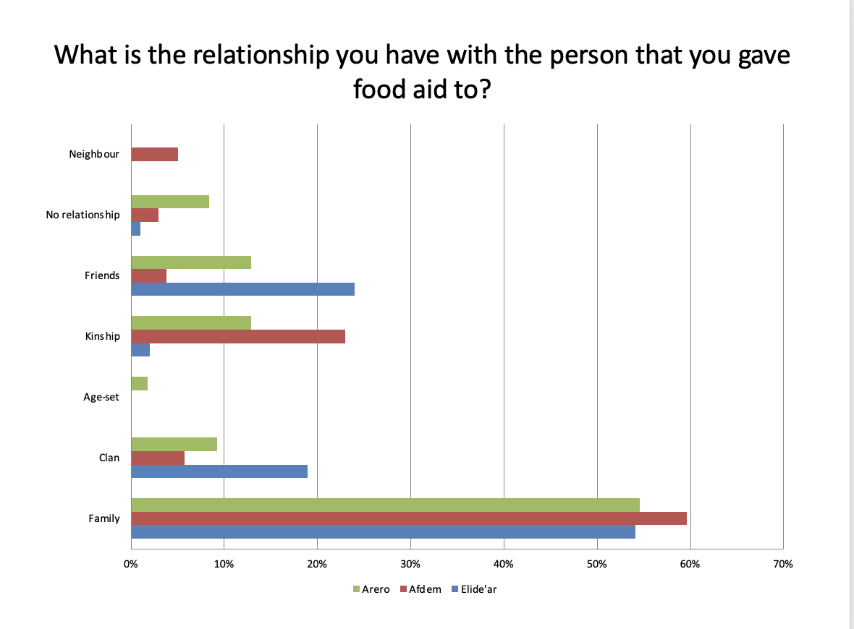

Slide 11
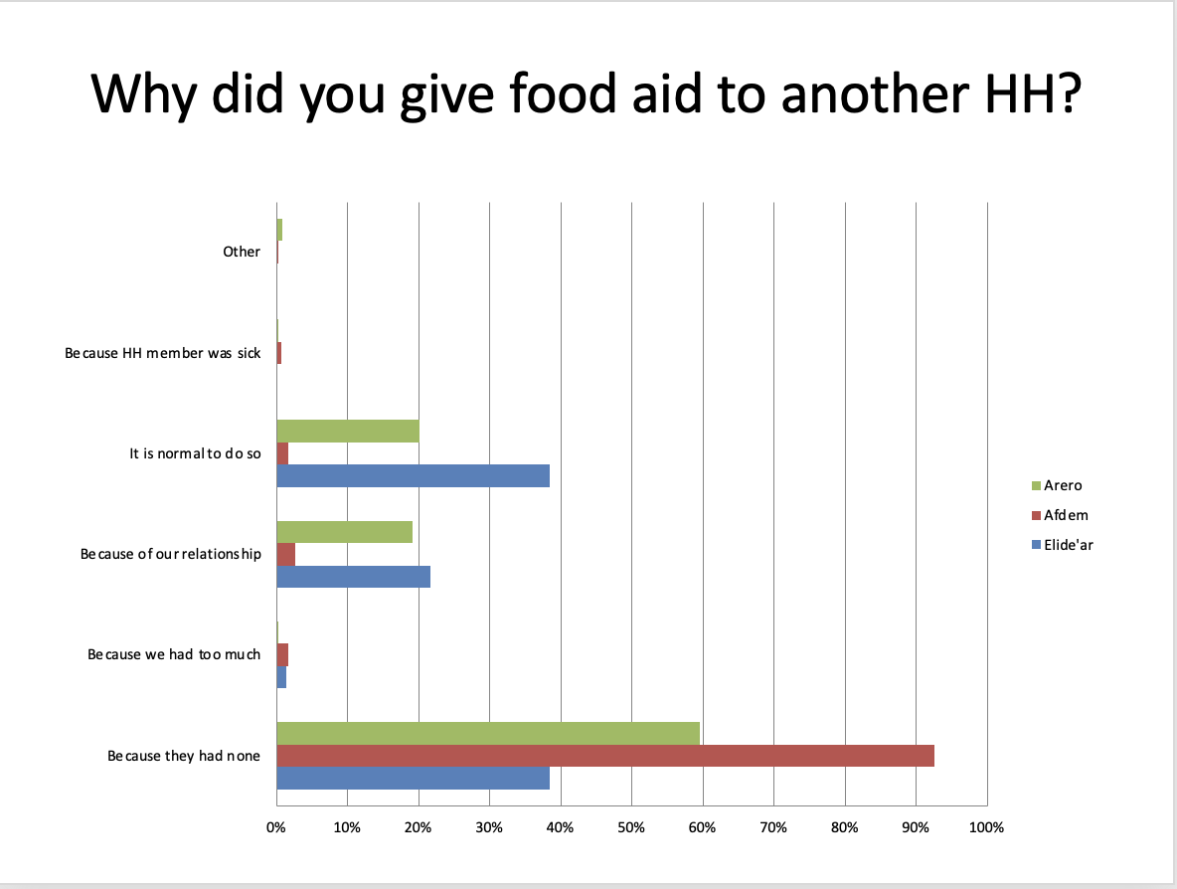

Slide 12
Example of social network analysis map in Su’ula Afar

Slide 13
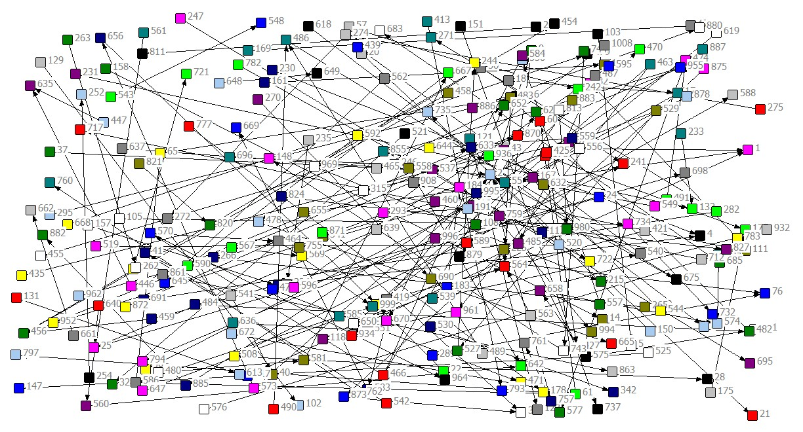
Example of social network analysis map in Asli, Somali

Slide 14
Example of social network analysis map in Fuldowa, Borana

Slide 15
Social network questionnaire and mapping
Many transactions were two-way, and long-term. Chains of connection. No HH dominated.
Around 60% of the population across all regions also gave other types of assistance, the most common being food (non-food aid) and cash.
Location didn’t matter in terms of accessing food aid and sharing it.
Ability to cope and recover from the last drought period was relatively low, with lowest scores found in Asli, Somali region (average 2.34 out of 10 for coping and 2.26 out of 10 for recovery, compared to 3.36 and 4.49 respectively in Fuldowa, Oromia). On average, households lost 77% of their livestock from drought-related causes and were food insecure 65% of the time during the drought.
The scores made by female-headed households were very similar to the scores of male-headed households indicating that female-headed HHs coped as well (or as badly) as male-headed ones and are recovering at the same pace

Slide 16
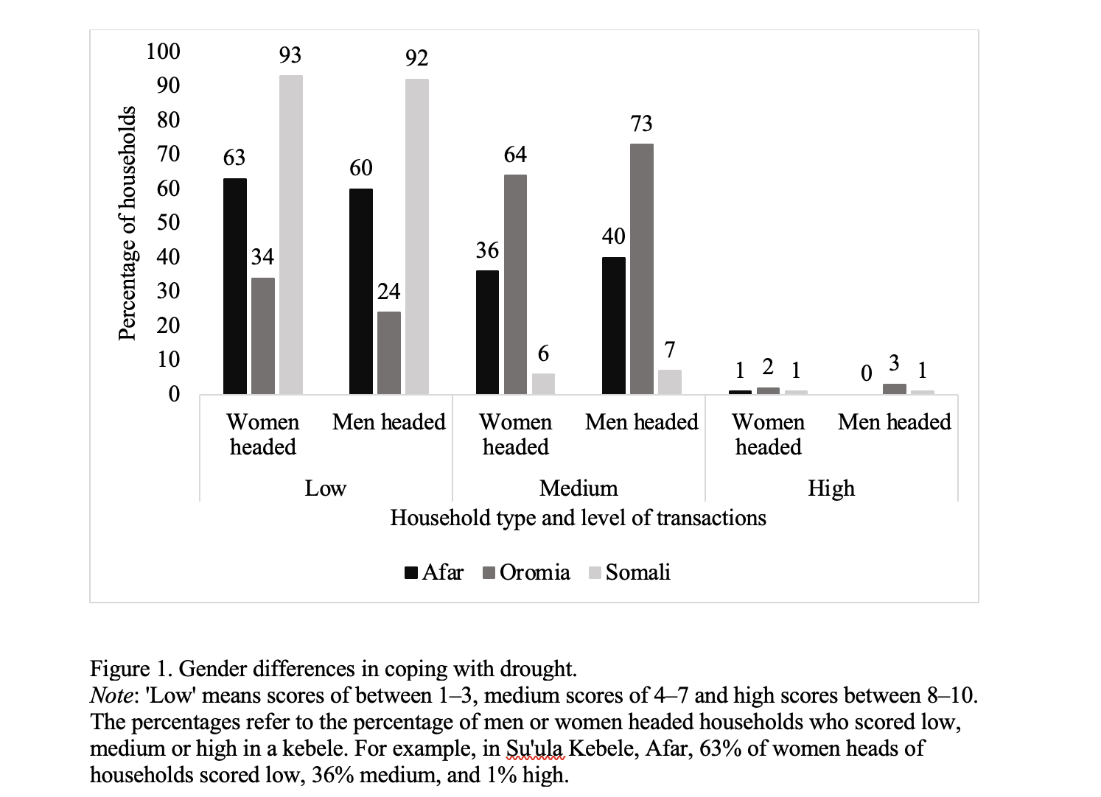

Slide 17
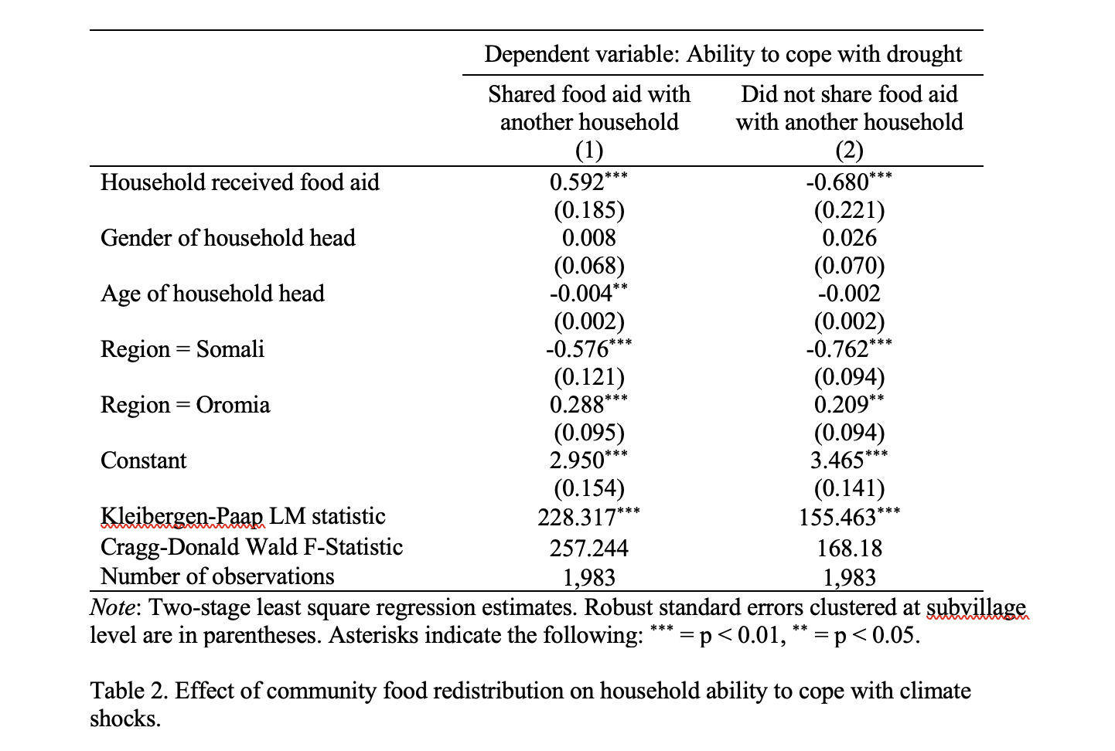
Relationship between sharing of food aid and coping with drought
Through econometric analysis, sharing food aid with other households increased the score for coping ability by 0.59 points, significant at the 1% level (column 1). Not sharing food aid reduced the score for coping ability by 0.68 points, also significant at the 1% level (column 2).

Slide 18
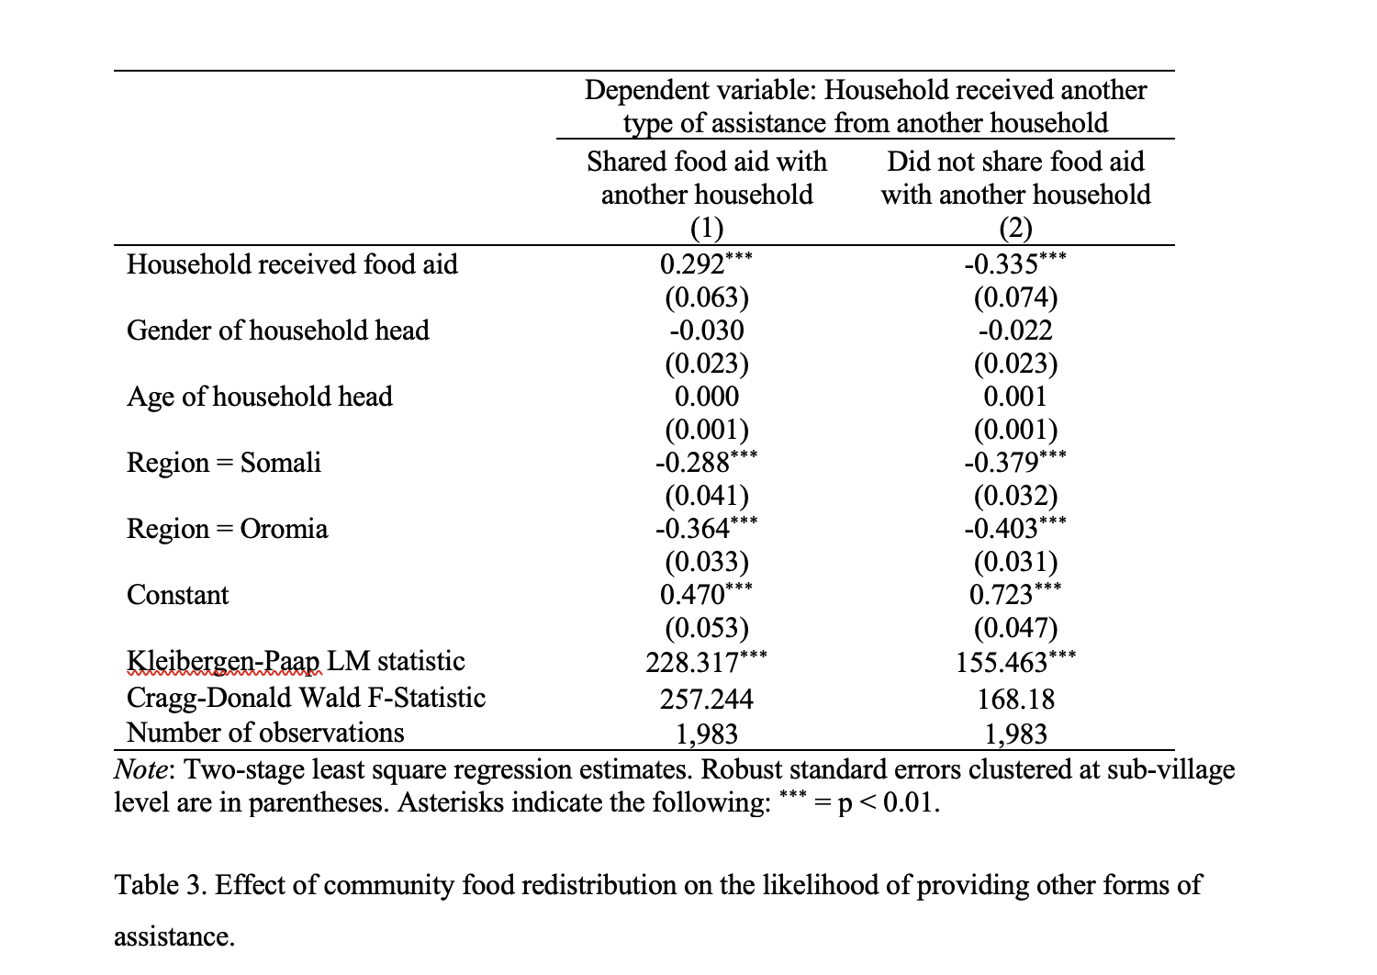
Relationship between sharing of food aid and receiving of other types of aid
Results in Table 3 show that households sharing food aid received from the government or NGOs have a 29-percentage point increased likelihood of receiving other types of assistance from other households, while those that do not share food aid have a 33.5 percentage-point reduced likelihood of receiving other forms of assistance from another household.

Slide 19
Conclusions, recommendations, way forward
Food aid sharing is common and is characterized by empathetic and reciprocal relationships built on investments in social capital. Households sharing food aid were more likely to receive other types of assistance from other households and coped better with drought compared to their counterparts receiving but not sharing food aid. Aligns with other work such as by Kim et al 2022.
Social networks appeared to have remained strong throughout the drought despite significant stress.
Sharing of food aid not only serves immediate food needs, but also contributes to the building of social networks that are needed to cope with drought – a reinforcing feedback loop. Sharing needs to be recognized and integrated into humanitarian aid programming (if it is not going to interfere with it!) . Women play a key role.
We are going to repeat the study (the food aid sharing part) this year with support from the FCDO-funded Supporting Pastoralism and Agriculture in Recurrent and Protracted Crises, and writing support from CGIAR Initiative on Fragility, Conflict and Migration

Slide 20



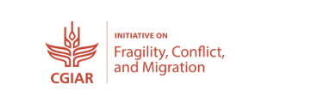

With thanks to the donors and projects who contributed to the undertaking and write-up of this study and presentation:

