Slide 1

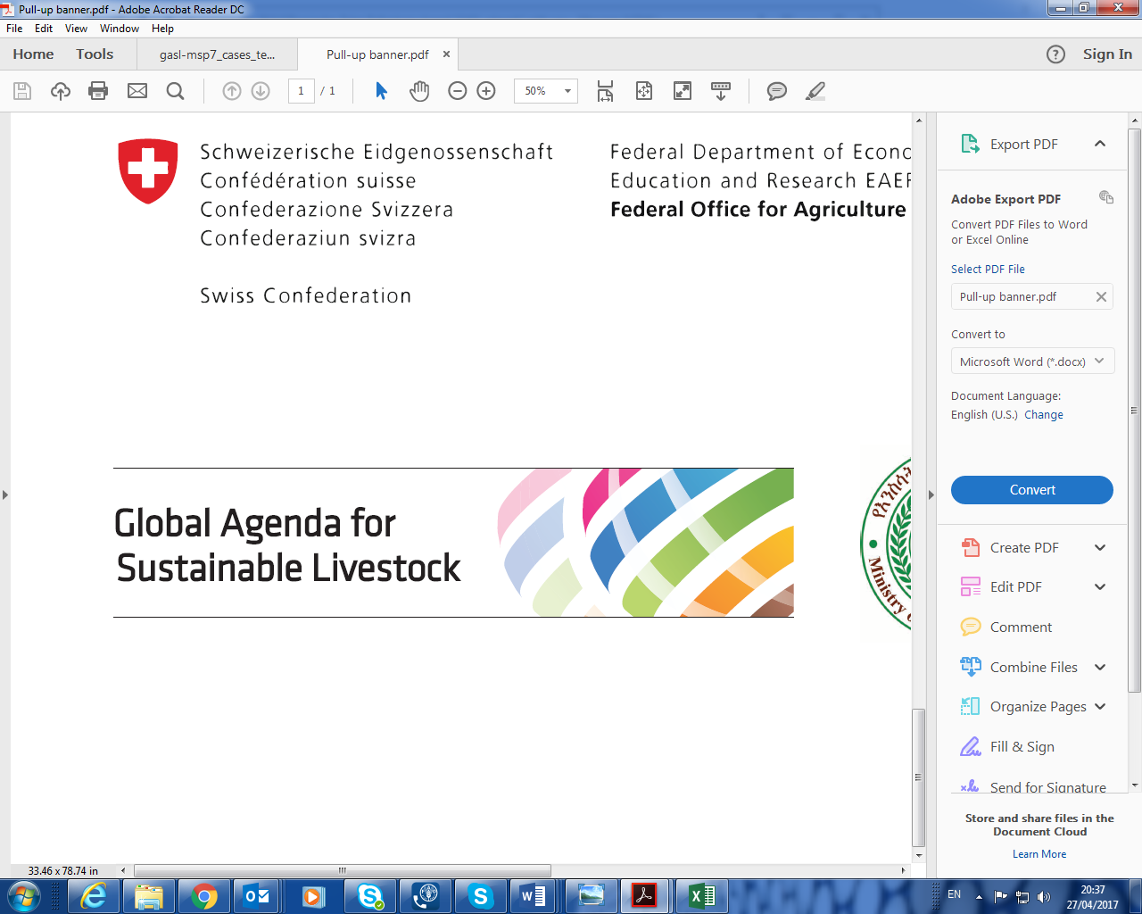
Fritz Schneider
Chair
Accelerating livestock research into use:
Multi-stakeholder value propositions
CGIAR Livestock CRP and GASL joint side event on national partnerships for sustainable livestock systems at the 7th All-Africa Conference on Animal Agriculture, Accra, Ghana, 30 July 2019
Meetings to prepare the 7th MSP in Addis Ababa, Ethiopia, 8 to 12 May 2016,

Slide 2
What is the Global Agenda for Sustainable Livestock?
The Global Agenda for Sustainable Livestock (GASL) is a multistakeholder partnership. It enhances the contribution of livestock systems to sustainable development and is a recognized platform for sharing solutions
For GASL, it is important to support and magnify the work of its partners with a multistakeholder approach; this is why meetings like the AACAA and this side event are crucial
There is a huge potential to make faster and better use of research results with context specific best practices towards a more sustainable livestock sector
www.livetsockdialogue.org

Slide 3
GASL Governance Structure
(109 institutional members)
Value to Grasslands
Clusters
Guiding Group
Objectives
Action Networks
Livestock for social development
Closing the efficiency gap
Public Sector
DIALOGUE
Private Sector
EVIDENCE
GUIDING GROUP
Multi-lateral Org.
LEAP
Acade-mia
Silvo-pastoral Systems
Social Move-ments
Donors
NGOs
LAMP
PRACTICE & POLICY CHANGE
Dairy Asia
Animal Welfare
Notes:
Clusters: The Clusters ensure an inclusive participation of all sectors of society in the multistakeholder process. They develop and implement the direction of GASL, communicate within and between Clusters and support the Global Agenda financially as well as in fundraising activities.
Guiding Group: Consists of five representatives of each of the seven Clusters. It is supported by the Agenda Support Team and an elected Chair. Members meet 2-3 times a year.
Objectives: The Global Agenda for Sustainable Livestock facilitates dialogue, assembles and communicates evidence and advocates for practice and policy change.
Action Networks: The Action Networks are thematic technical expert groups, creating evidence, making tools and guidelines available, and enhancing practice change.

Slide 4
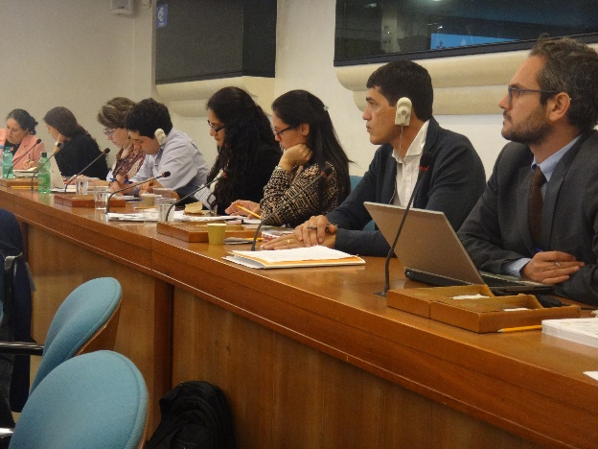
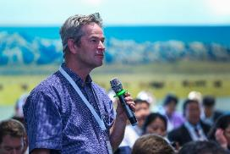
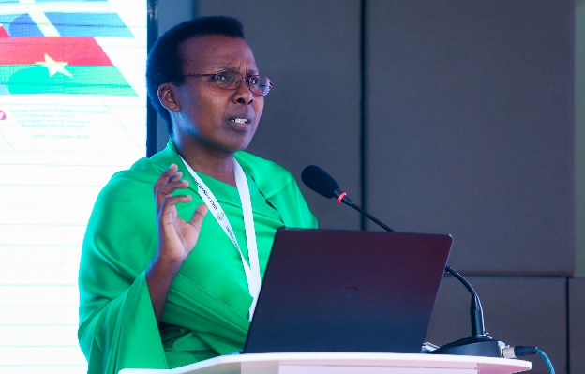
Main objectives of GASL
The Global Agenda
facilitates dialogue
assembles and communicates evidence
advocates for change in practice and policy
www.livetsockdialogue.org

Slide 5









The Global Agenda and the Sustainable Development Goals
The Global Agenda accepts the SDGs of the UN Agenda 2030 as its important reference framework
Basically all SDGs are relevant to livestock keeping
The Global Agenda has identified nine SDGs with particular importance for the sector

Slide 6
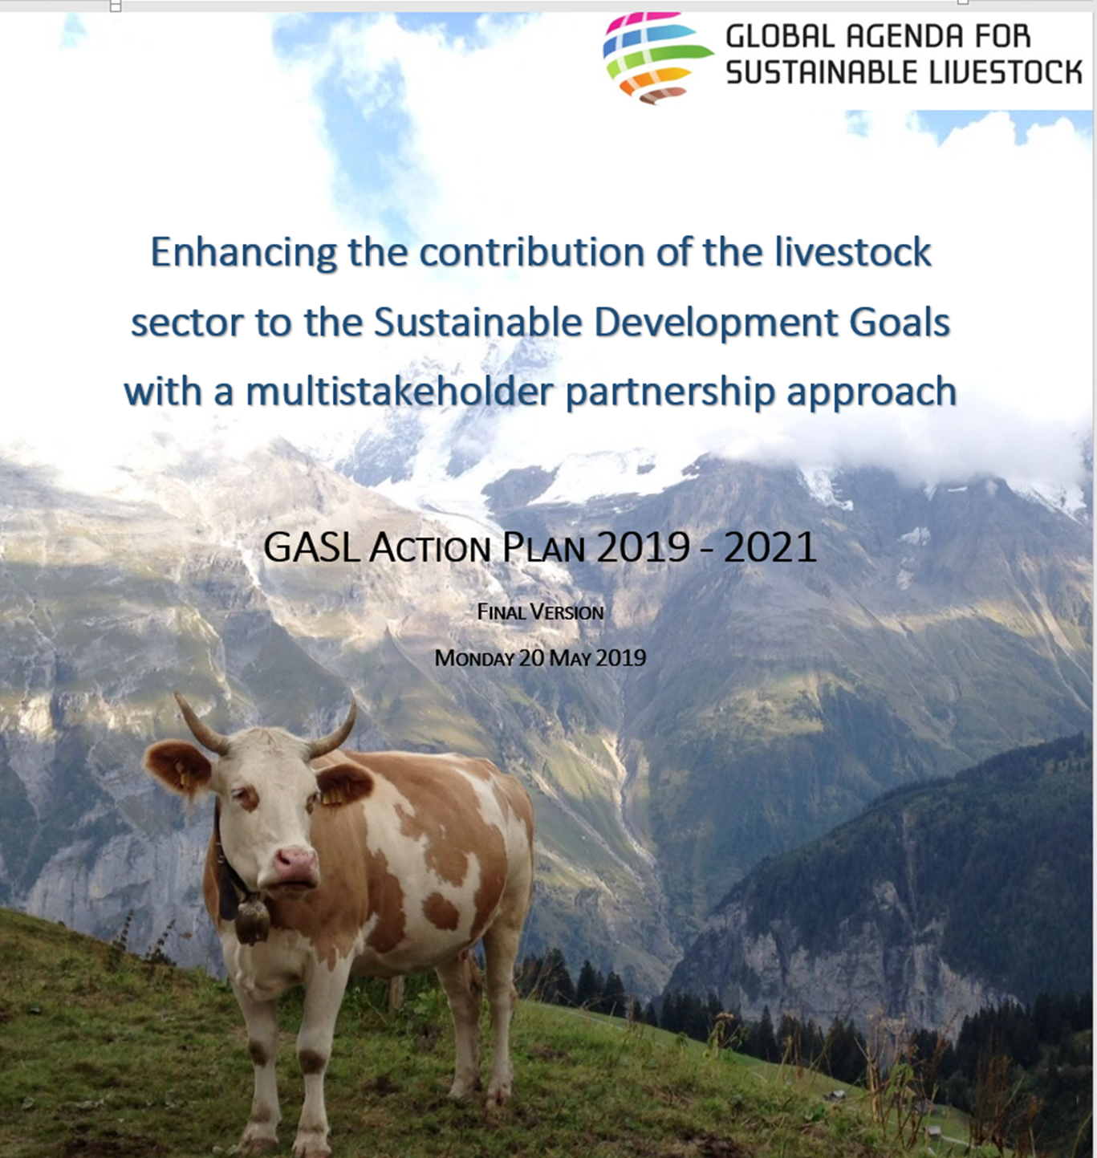


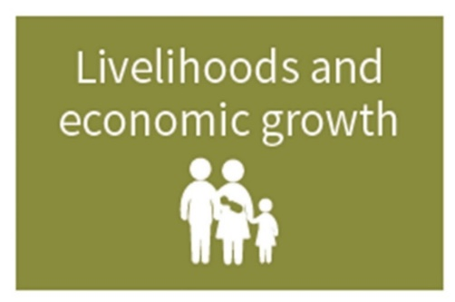




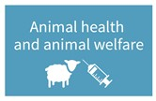
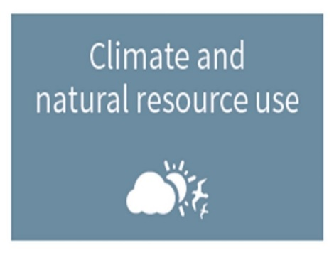


GASL, the Sustainability Domains, the SDGs and the 2019-2021 Action Plan
GASL adopted the four sustainability domains as an outcome of the Global Forum for Food and Agriculture (GFFA) in Berlin, January 2018.
The domains guide the work of the Global Agenda and serve as a framework along with the SDGs
www.livetsockdialogue.org

Slide 7

















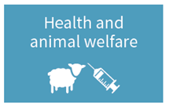


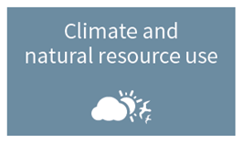

Work Areas
and the SDGs
NB – black outlines are those in more
than one place.
Darker colours are the 8 that livestock contribute
to directly plus goal 17

Slide 8
Research and GASL: Example GASL and CRP of ILRI
Work Area of GASL | Flagship of CRP | Acceleration Potentials and Challenges
 | Livestock Genetics FP1 Characterization of livestock production systems New breeds and tools for improving livestock productivity Delivery of research products to smallholder farmers. | Importance on genetics in multi-stakeholder processes underestimated. Especially in smallholder systems, investment in genetics will be very important Huge potential for sustainable intensification

Slide 9
Research and GASL: Example GASL and CRP of ILRI
Work Area of GASL | Flagship of CRP | Acceleration Potentials and Challenges
 | Livestock Health FP2 Identifies animal disease risks Develops methods to mitigate these risks through herd health management, diagnostics and vaccine innovations Tests approaches for delivering these products. | Excellent acceleration potential with GASL AN LAMP Risk of duplication (ILRI, FAO, OIE, GASL) Strong communcation is needed, GASL can play a role

Slide 10
Research and GASL: Example GASL and CRP of ILRI
Work Area of GASL | Flagship of CRP | Acceleration Potentials and Challenges
 | Feeds and Forages FP3 Develops feed intervention tools, which incorporate cross-cutting issues such as gender. Cost-benefit analyses for forage technologies, indicating suitability of technologies which are dependent on the market environment. Contributes to innovation platforms which aim at policy influence. | Collaboration with AN Restoration of Grassland Experience with policy work to be taken to scale with GASL support Cost benefit results to be dissiminated via GASL channels, e.g. common publication(s)

Slide 11
Research and GASL: Example GASL and CRP of ILRI
Work Area of GASL | Flagship of CRP | Potentials / Challenges
 | Livestock and Environment FP4 Addresses the possible impacts of climate change. Identifies forage intensification options to be disseminated in four countries (with FP3) Works with government agencies on policies and institutional arrangements to support rangeland management. | Potential of the FP is to look into context specific issues Best practices in four countries could be dissiminated through GASL channels Policy work for highly relevant for GASL Synergies with GASL AN Restoration of Grasslands

Slide 12
Research and GASL: Example GASL and CRP of ILRI
Work Area of GASL | Flagship of CRP | Acceleration Potentials and Challenges
 | Livestock Livelihoods and Agri-Food Systems FP5 Technologies and strategies developed through the CRP translate into positive impacts on the resource poor. Evidence to influence policies and investments through the Livestock Master Plan (LMP) work in Ethiopia, Tanzania, Rwanda and Bihar (India). | Focus on resource poor important to multi-stakeholder processes Policy work is highly relevant for GASL Experience with master plans to be disseminated via GASL channels

Slide 13
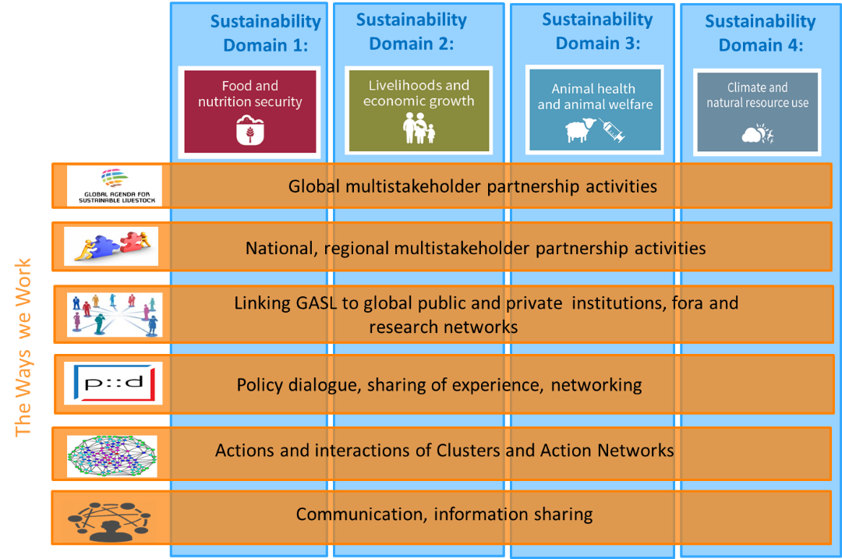
Sustainability Domains and the Ways we Work
www.livetsockdialogue.org

Slide 14
Added value of multi-stakeholder processes
Multi-stakeholder processes (e.g. GASL):
Multipliers
Ensure inclusiveness (GASL invests a substantial amount every year to make sure, representatives from livestock systems from marginal areas are able to participate)
Promote global understanding of local, national and regional contexts
(the GASL MSPs)
Research: Convey research needs to the researchers (participatory research)
Convey research results to the end user (scaling up and extension)
Policy dialogue: make use of the multi-stakeholder process to influence policies
www.livetsockdialogue.org

Slide 15
Conclusions
The example CRP – GASL shows:
The research foci and the objectives of GASL are well aligned, both programmes are working towards a more sustainable livestock sector development
There is unutilized potential for accelerating impact.
Strong coordination and exchange of experience are important
CRP and GASL should pay more attention to reduce food loss and food waste (stronger consumer focus)
Investment in strong communication activities is key
Meetings like the AACAA are important. It allows a context specific, regional focus.
www.livetsockdialogue.org

Slide 16
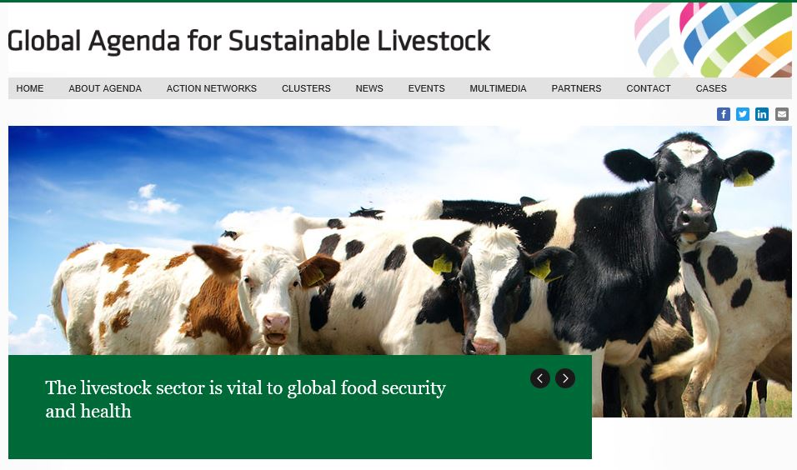
Thanks !
Website:
www.livestockdialogue.org
Fritz Schneider, Chair of GASL
fritz.schneider@bfh.ch
Eduardo ArceDiaz, GASL Manager
Eduardo.ArceDiaz@fao.org Agenda
Support Team
livestock-dialogue@fao.org

