Slide 1
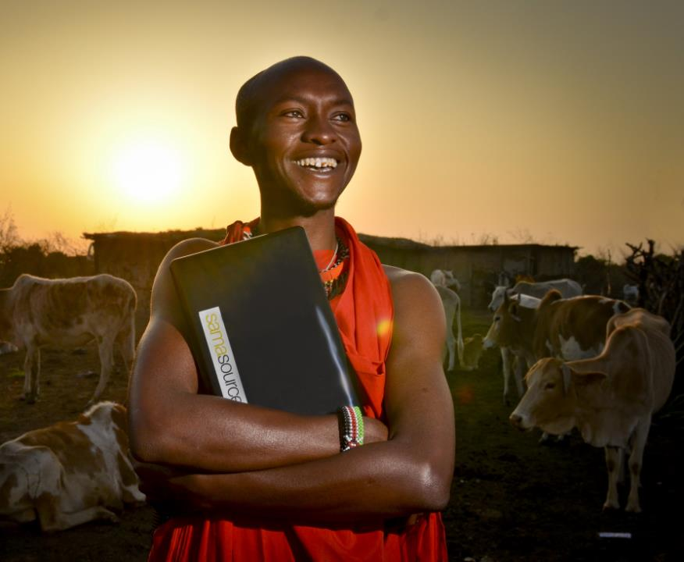
Capacity Development and Scaling for the Livestock CRP:
Past, Present and Future
Iddo Dror, Edwin Kangethe and Nicole Wu
CGIAR Livestock review and planning meeting, 15 June 2020

Slide 2
Capacity Development

Slide 3
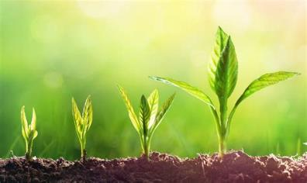
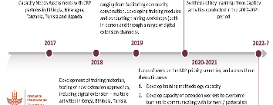
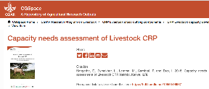
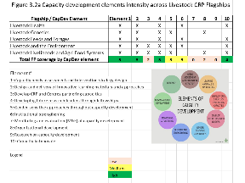
Context – Capacity Development in the CRP
A brief history – from the CRP proposal to today and looking ahead to Dec 2021
Lots of work taking place in the flagships – over 100 ‘significant’ CapDev activities reported in MARLO
Activities informed by capacity needs assessments, capacity development strategy - prioritized to a number of activities (e.g. training materials & workshop, digital extension etc.)

Slide 4

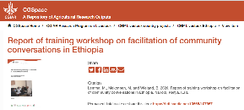
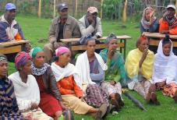
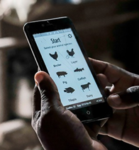

Capacity Development - some current highlights from priority countries
Digital learning & extension in livestock– solutions/services, learning materials, use cases in Uganda and Tanzania
Development of training modules, community conversations in Ethiopia
Gender capacity development of research and development partners

Slide 5
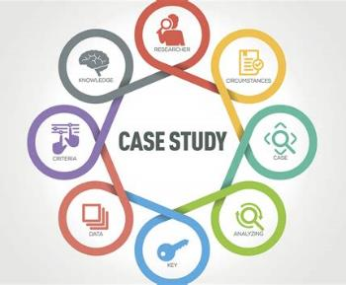

Key activities planned till Dec 2021 – and our ‘ask’
A synthesis document highlighting success and learnings from across the CRP (all flagships) tied to our theory of change and impact pathway. Lessons learned and positioning for future activities.
This will include individual ‘case studies’ of CapDev work in the CRP, mini outcome stories. Will be working with all flagships and priority countries on potential contributions.
Individual flagships who may do their own ‘deep-dives’ - similar to the health flagship – would be good to know if there are any plans for this, or any other major CapDev planned work in the flagships.

Slide 6
We’d like to hear from you!
Please type a short answer into the Zoom chat – please only post it when guided to do so by the facilitator
How would you describe the capacity development work of the Livestock CRP?
What CapDev activity should include as case studies and/or pay attention to as we do the summary report?

Slide 7
Short break
2 minutes to stretch your legs…followed by a Menti exercise get ready for scaling

Slide 8
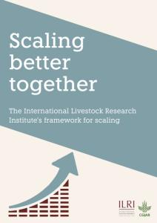
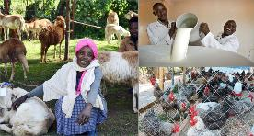
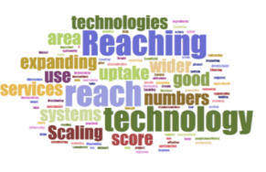
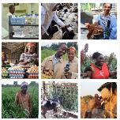
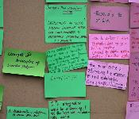
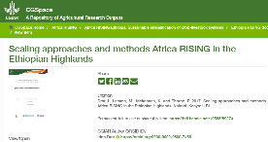
Context - scaling in the Livestock CRP
Part of the transformation needed to ensure our research investments translate into demonstrable positive impact on the ground.
An approach to scaling that integrates sustainability, systems change and responsible scaling, and build on existing best practices and materials.
Guiding Principles: Flexibility: A ‘mix and match’ approach using a combination of tools, use of scaling coordinators and scaling champions to support the process, an Agile approach, adapt and iterate quickly.
Some work in projects from 2017 onwards, but a more structured approach from 2018 onwards with a framework published 2020.

Slide 9
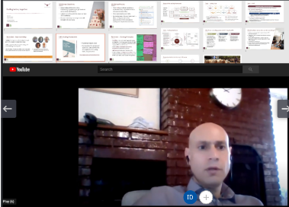
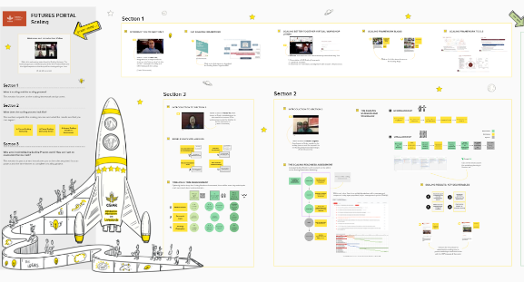
Scaling – current highlights
The CRP Mural details the work and process - including videos, links to documents etc. Will not be able to cover it in depth in this session given time constraints. Please visit the Mural ☺
Quick highlights: Framework developed, adaptation of the tools to the CRP’s context, scaling scans conducted in Uganda and Tanzania priority countries, scaling readiness ongoing in Uganda, set up complete for larger rollout.

Slide 10
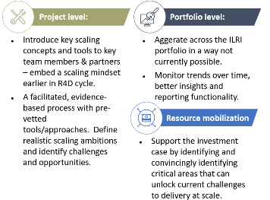
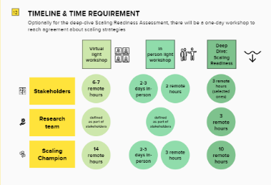
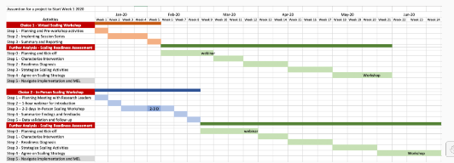

Key activities planned till Dec 2021 – & our ‘ask’
Accompany a handful of the CRP’s legacy products with a scaling assessment and co-create a scaling plan for the post-CRP era.
A range of communication materials packaging the scaling tools and materials.
Supporting individual flagship/product lines/projects beyond the key CRP legacy:
  Framework available, detailed tools available (open access) - so anyone can use independently or with partners.
  I@S team available to facilitate and support – clarify process, resource requirements and timelines.

Slide 11
Last question for today
What Livestock CRP work should we prioritize for a scaling assessment between now and Dec 2021?
Please type a short answer into the zoom chat and submit when guided to do so by the facilitator.

