Slide 1
RESTORE project
Afar, Southern Ethiopia and Tigray
Theo Knight-Jones, ILRI– Project lead
RESTORE project inception workshop. 08 Nov. 2024

Slide 2
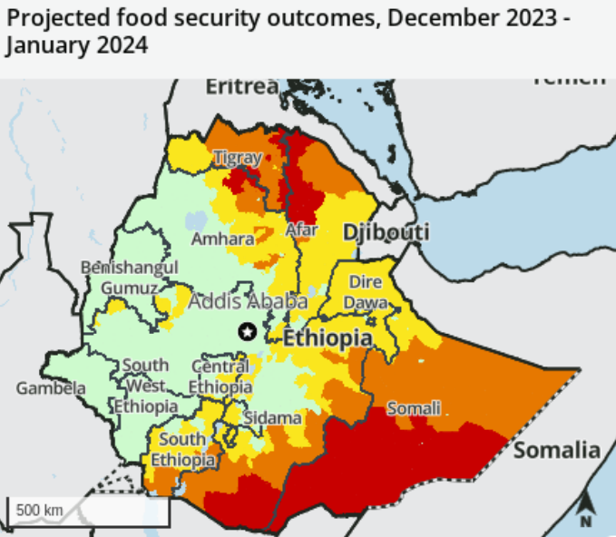
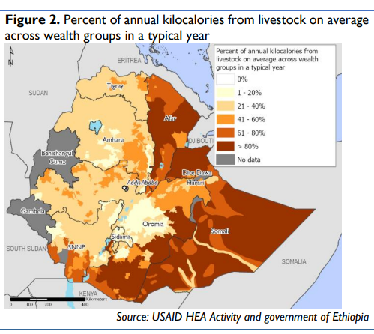
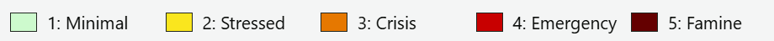
Background
Livestock critical for livelihoods and nutrition
Regions affected by severe drought (2021-2023) and devastating northern conflict (2020-2022)
Livestock importance for nutrition
FEWS-NET, 2022

Slide 3
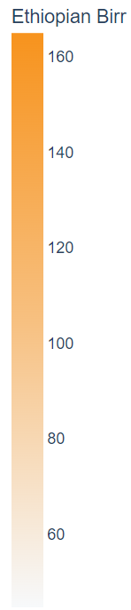
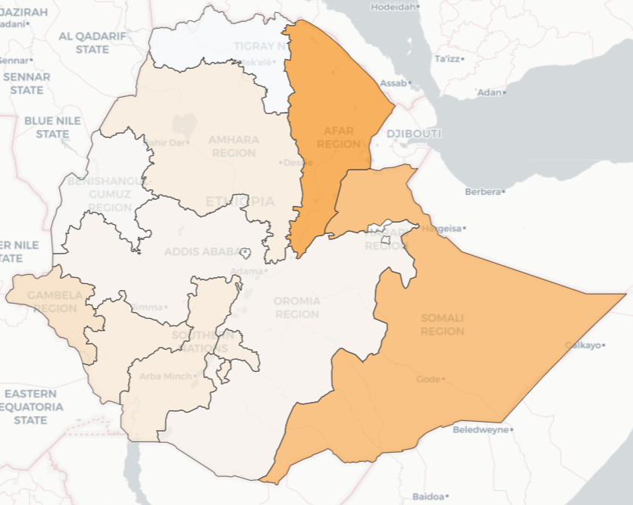
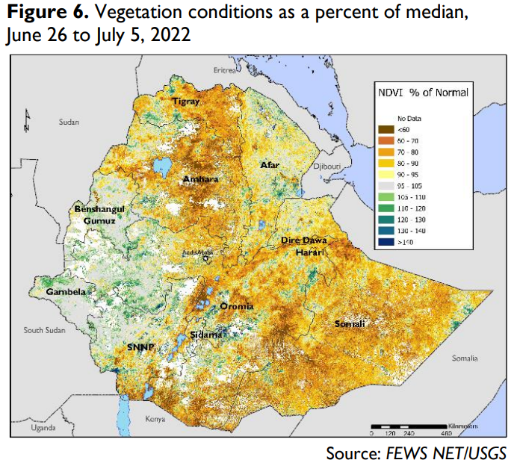
Background
Massive livestock disease burden
  50% of livestock output lost to disease
Drought related forage failures
  With flooding later
Cattle disease burden - Health Losses per KG of liveweight, by region 2021

Slide 4
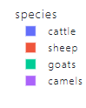
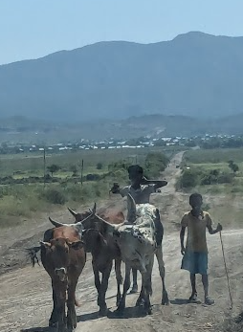

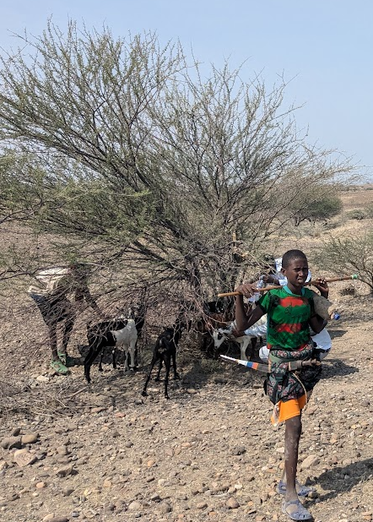
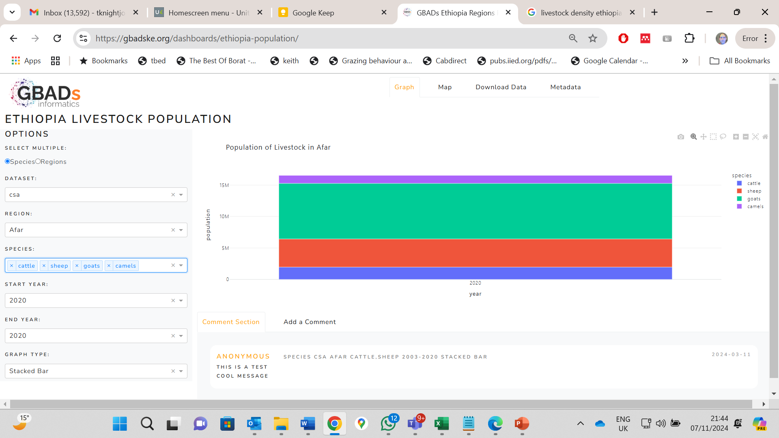
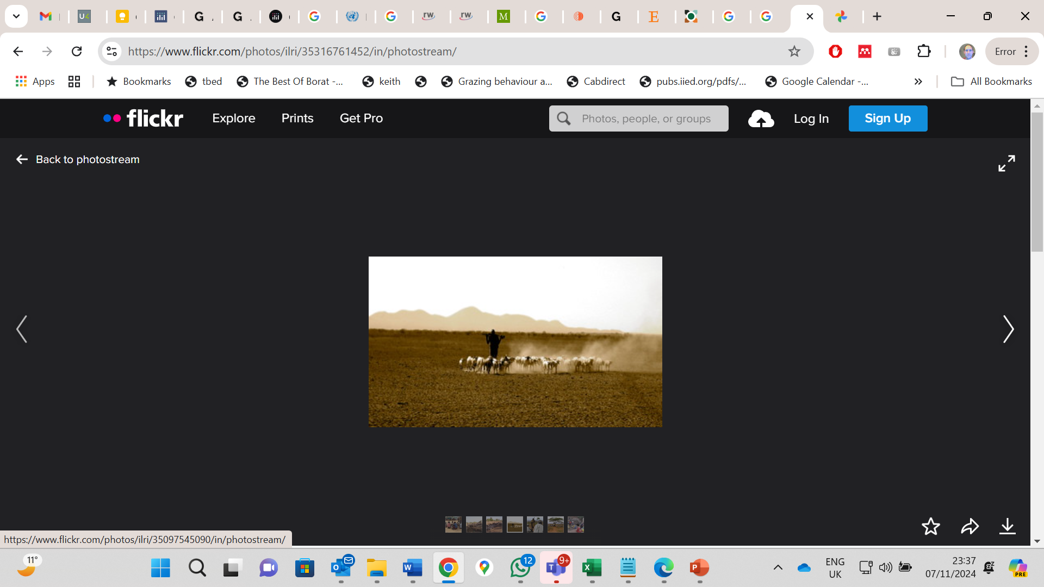

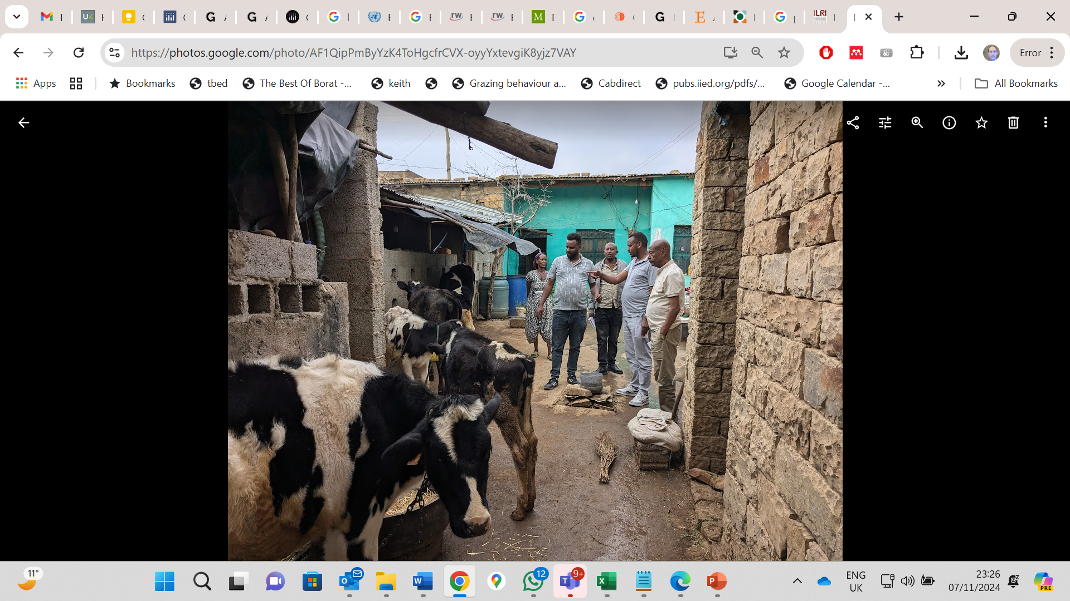
Livestock Systems and Populations 2020, CSA
Tigray
SNNPR
Afar
Southern Omo Zone

Slide 5
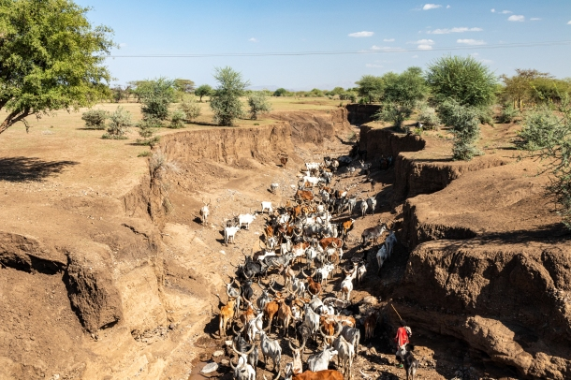
Objective
RESTORE seeks to bring about:
- Sustained recovery of the livestock system from conflict and drought
- Increase overall sector productivity, with improved marketing of livestock products
-with more efficient livestock production reducing GHG emission intensity

Slide 6
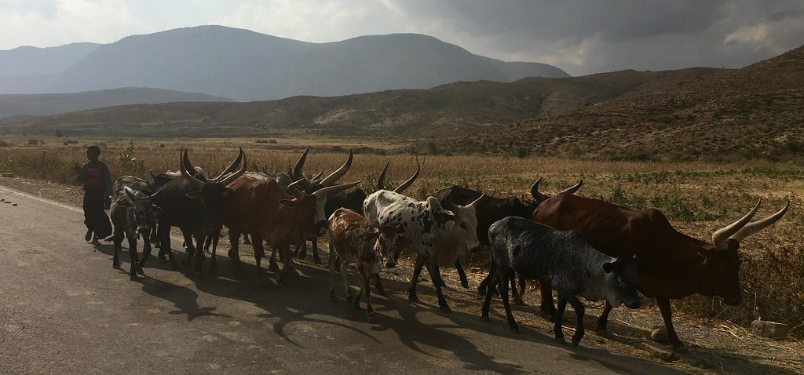
Approach
EU funded for 4 years 2024-2028
ILRI with the Ethiopian Veterinary Association will work with the regions of Afar, Southern Ethiopia and Tigray
Also support RESTORE – Amhara, Oromia and Somali regions
Build on HEARD project
Focus on restoring and building
  Livestock health services – public and private
  Livestock feeds and fodder production and marketing
  Animal health and food safety standards for market access
  Livestock hide sector
Empower women and improve gender equality

Slide 7
Logic
Impact: Enhance food security, nutrition, livelihoods in drought and conflict areas
SO: Livestock system recovery in conflict and drought areas with improved sector productivity and marketing
& greater efficiency delivering reduced GHG emissions
IO3: Market orientated improved food safety and animal health standards
IO5: Improved hide production
Efficient livestock production
IO4: Improved fodder production and markets
IO2: Improved
animal health service
IO1: Recovery of livestock systems

Slide 8
Activities
WP1: Restore Livestock Service Delivery Systems
A1.1 Rapid assessment
A1.2-3 Restore routine and emergency animal health equipment, systems and inputs in regions (clinics, vet labs…)
1.2.1-2 Upgrade and equip veterinary clinics
(equipment, consumables, motor bikes, solar refrigerator, etc.)
1.2.3 Provision of livestock emergency support (vaccine, drug, animal feeds)
1.2.4 Strengthen labs
1.2.5 Strengthen disease reporting with IT and trainings

Slide 9
WP2: Improved vet services
A2.1 Strengthening public services to control and regulate animal health
  Surveillance and disease control
A2.2 Strengthening the quality of public and private veterinary services
  2.2.1 Expand Public Private Partnerships in the delivery of animal health services (incl gender)
  2.2.2 contracting out selected public functions to private animal health service providers (including ambulatory health service, active disease surveillance, deworming and vaccination and extension services)
A2.3 Investigate how improved livestock production efficiency can reduce livestock ecological and climate change impacts
A2.4 Enhance the capacity of the animal health sector (EVA)

Slide 10
WP3: Improved health and food safety standards
A3.1 Support sanitary inspection and certification procedures to meet international trade requirements
A3.2 Strengthening Ethiopian Veterinary Service capacity to implement animal health standards
A3.3 Capacitate domestic meat value chains to improve hygiene, inspection and certification – Simple equipment, training (ToT)
A3.4 Strengthen surveillance and control of priority zoonotic diseases
  ToT

Slide 11
WP4: Improved fodder
A4.1 Develop feed and forage production banks and sustainable pastureland management
  4.1.1 Support farmer-private sector feed and fodder production
  4.1.2 Support industrialization by-products for livestock feeding
A4.2 Support manure management in each region

Slide 12
WP5: Improved hide and skin quality
A5.1 Conduct assessment on skin and hide damaging diseases
A5.2 Conduct awareness creation on hide and skin quality issues
A5.3 Provide Tot Training on the control of skin and hide damaging diseases in regions

Slide 13
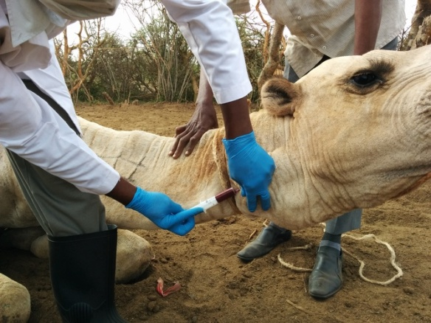
Finally, The need…
Photo- ICRC
Lots of sick animals
System failure
Healthy, productive animals
Unemployed vets
Livestock keepers willing to pay

Slide 14

Thank-You

