Slide 1
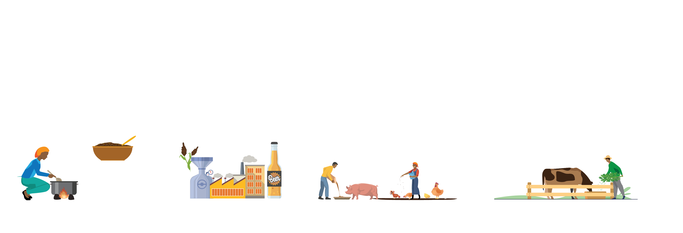
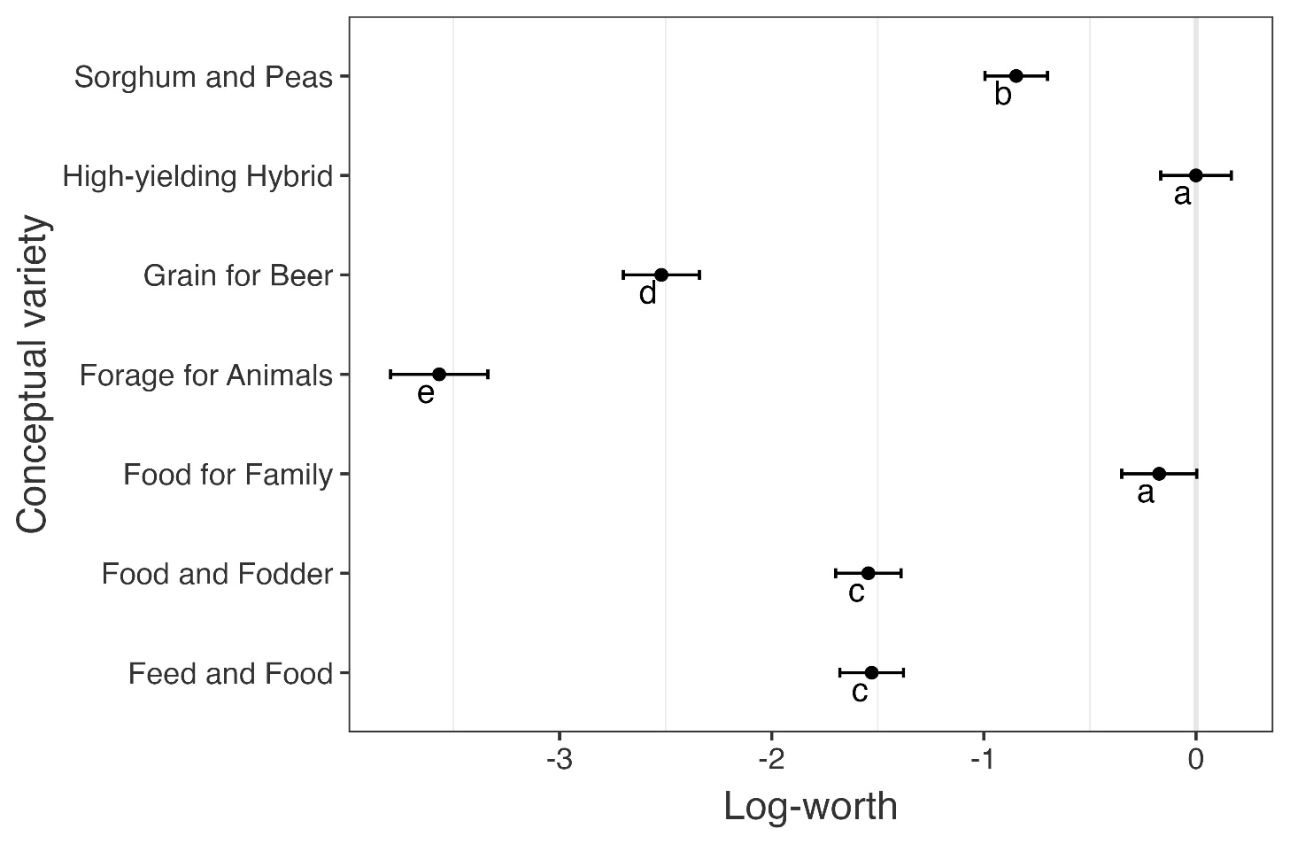
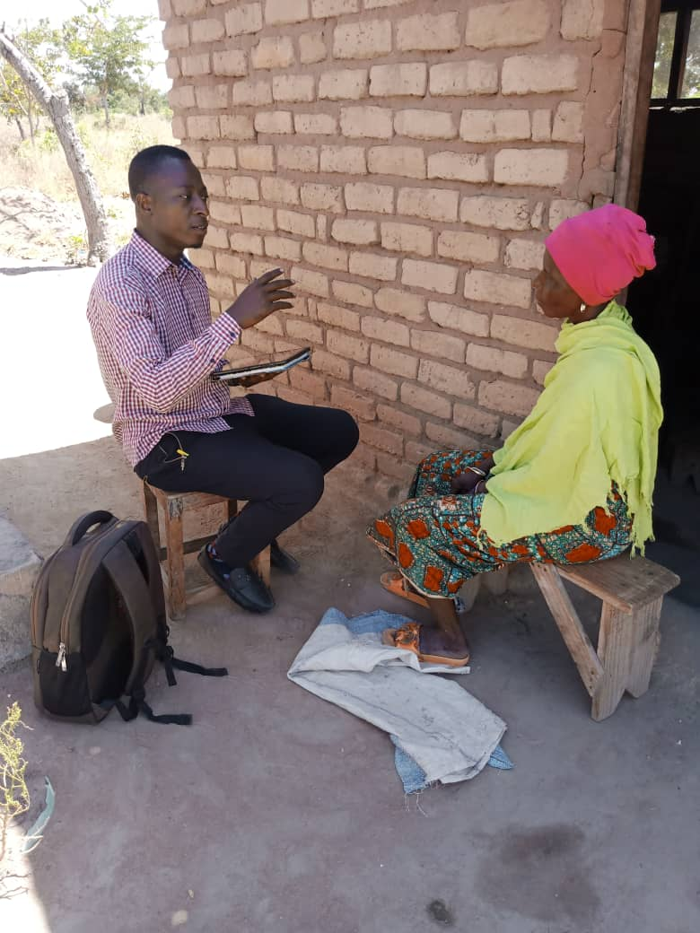
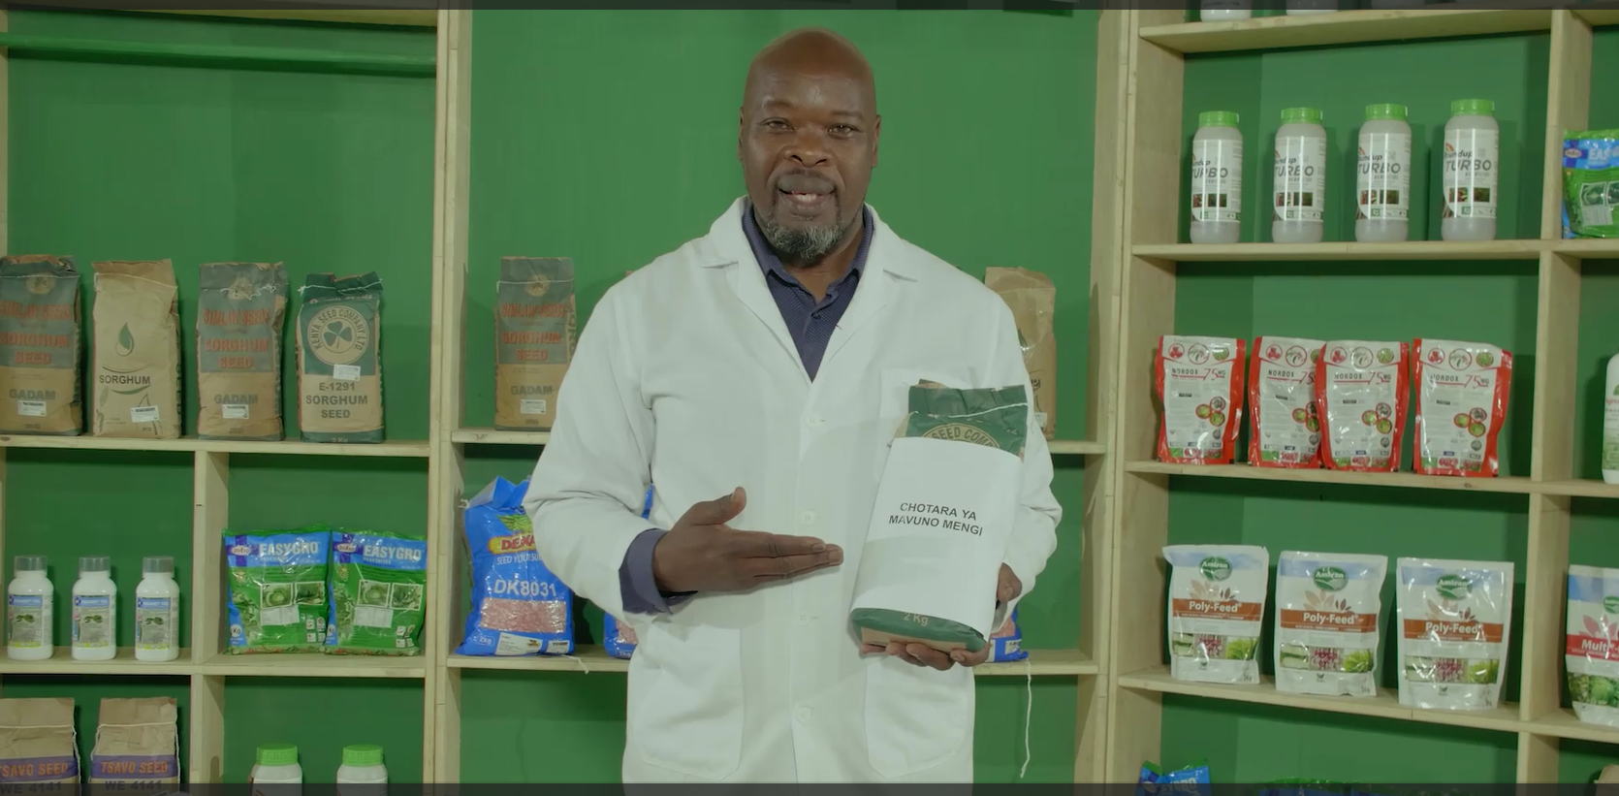

Sorghum market segments: What are farmers’ needs for seed products in Tanzania?
Mercy Mbugua, Jason Donovan, Pieter Rutsaert, Harish Gandhi, Mark Nas, Noel Templer, Kauê de Sousa, Harriet Mawia, Chris Ojiewo, Lilian Gichuru, Emmanuel Mwenda
CIMMYT
Motivation
The Tanzania Sorghum product development team (PDT) highlights two main criteria for defining sorghum market segments
  Material type (hybrid versus OPV) and colour (white/cream versus red/brown)
Each market segment as well as the TPP focuses on traits addressing all potential uses: food, feed, fodder, malting, and assumes monocropping systems
There are big questions within the TPP on primary sorghum end-use (i.e. trait prioritization), color preferences and the importance of production systems.
Research Questions
Do farmers require products that meet a host of possible end uses (e.g., food, feed, fodder, and malting) or are their requirements more focused on one or two end uses?
In what colour do farmers require the sorghum for different uses?
Is intercropping an important consideration?
Data Results and Findings
Methods
Tanzania: Dodoma and Shinyanga regions Survey: 1100 farmers interviewed Video-based product concept testing approach
Overall acceptability of product concepts of sorghum presented to farmers in Tanzania
2 weeks fieldwork with TARI
PDT meeting Sorghum TZ
Design 1
Internal team review
Design 3
Internal review
Design 2
Inputs breeding / seed system teams
Breeding team 2nd review
TARI review
Final design
Process and steps to design sorghum concepts
Sorghum seed product concepts
Conclusions and Future Research
The results support discussions on refinements to sorghum segmentation:
The hybrid segment should be prioritized
New segments : home use, intercropping, food and fodder, food and feed
The forage segment should be maintained as a future market segment.
Conversations with farmers, processors, and food scientists to understand
  What traits determine “good taste” and “good cooking qualities” for home use
  How best to measure these traits.
Product concept | Grower or end-use requirements and constraints
1. Food for family | Designed for food; nutrition, high flour conversion, good taste, cooks easily 20% reduction in yield
2. Feed and food | Grains optimized for livestock feed and human food Less attention given to cooking qualities
3. Grain for beer | designed for industrial beer-making For income purposes only (not for food/feed)
4. Forage | Stems and leaves optimized for livestock feed No grain production
5. Food and fodder | Provides grain for food and soft and big leaves for livestock feed Less attention is given to cooking qualities
6. Sorghum and peas | Optimized for intercropping with legume Increased cost of management and harvest
7. Hybrid | 30% increase in yields Increased cost of buying seed every season
Acknowledgements
This work was funded by the Bill & Melinda Gates Foundation through the Accelerated Varietal Improvement and Seed Systems in Africa (AVISA) project and the One-CGIAR initiative Market Intelligence, supported through the CGIAR Fund.

