Slide 1



TH2.3: Women and technology adoption: Does capacity building really count?
Women and fodder technologies adoption: Does capacity building really count?
Add your name here
Date
Location
Joan Kimaiyo
Junior Scientist
Cultivating Gender Equality Conference
12-15 October 2021

Slide 2
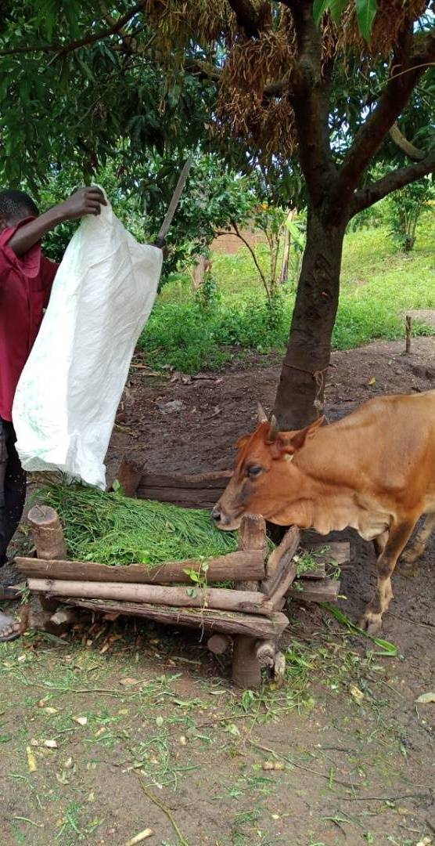
Fodder Tree Technologies (FTT)
Background
FTTs provide insurmountable benefits to women farmers: Increase milk yields leading to better nutrition of children and increased incomes, improves soil fertility, provides firewood, saves time, require little efforts and labour (Kiptot et al 2014)
Adoption of FTTS has been low especially by women farmers due to: (Franzel 2014 & Kiptot et al 2014)
  Limited control and/or access to and ownership of productive resources such as land
  Cultural beliefs and norms that limit women
  Limited access to inputs such as labour, fertilizer and other farm inputs
  Limited access to credits
  Dynamics in Household decision making
FTTs are also knowledge intensive, and women farmers often lack access to knowledge and skills needed to grow them (Franzel 2014)
Notes:
FTTs are very knowledge intensive
Farmers require appx. 400-500 fodder trees on farm/cow/year to adequately feed throughout the year

Slide 3

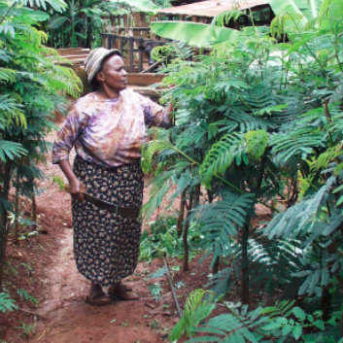
Objectives of study
The study aims to explore how building the capacities of smallholder farmers, especially women, would likely impact their adoption of improved technologies.
We use Fodder tree Technology (FTT) as a case study.
Research question:
Does access to extension and information through trainings lead to improved uptake of FTTS by women?

Slide 4
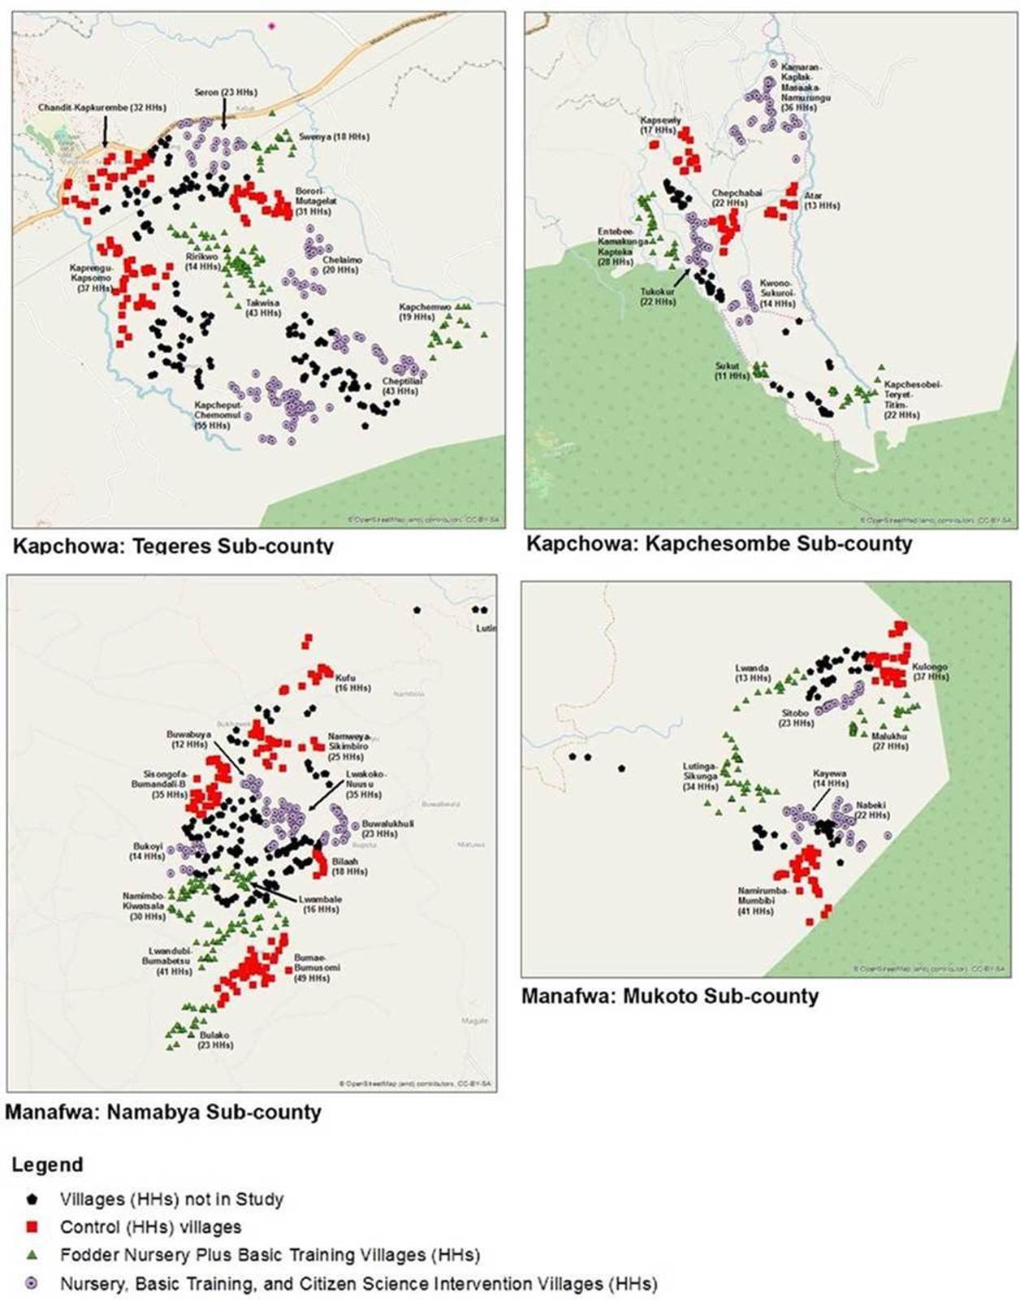
Research Methods
Site: Uganda Eastern Region, Kapchorwa and Manafwa districts.
Implementation: We used the design and results of a three-arm randomized field experiment
The Experiment:
  2- 2 ½ Hr trainings in 41 treatment villages and
  “Citizen Science” intervention to draw farmers into experiencing true benefits of the using the technology.
  Control village
Topics trained
  Benefits of fodder trees
  Fodder planting, management and harvesting
  Seedlings sources and transplanting
  Selected “citizen science” farmers share and validate impacts of fodder on milk yields
Data collection: Baseline Yr 2017, Endline Yr 2019

Slide 5
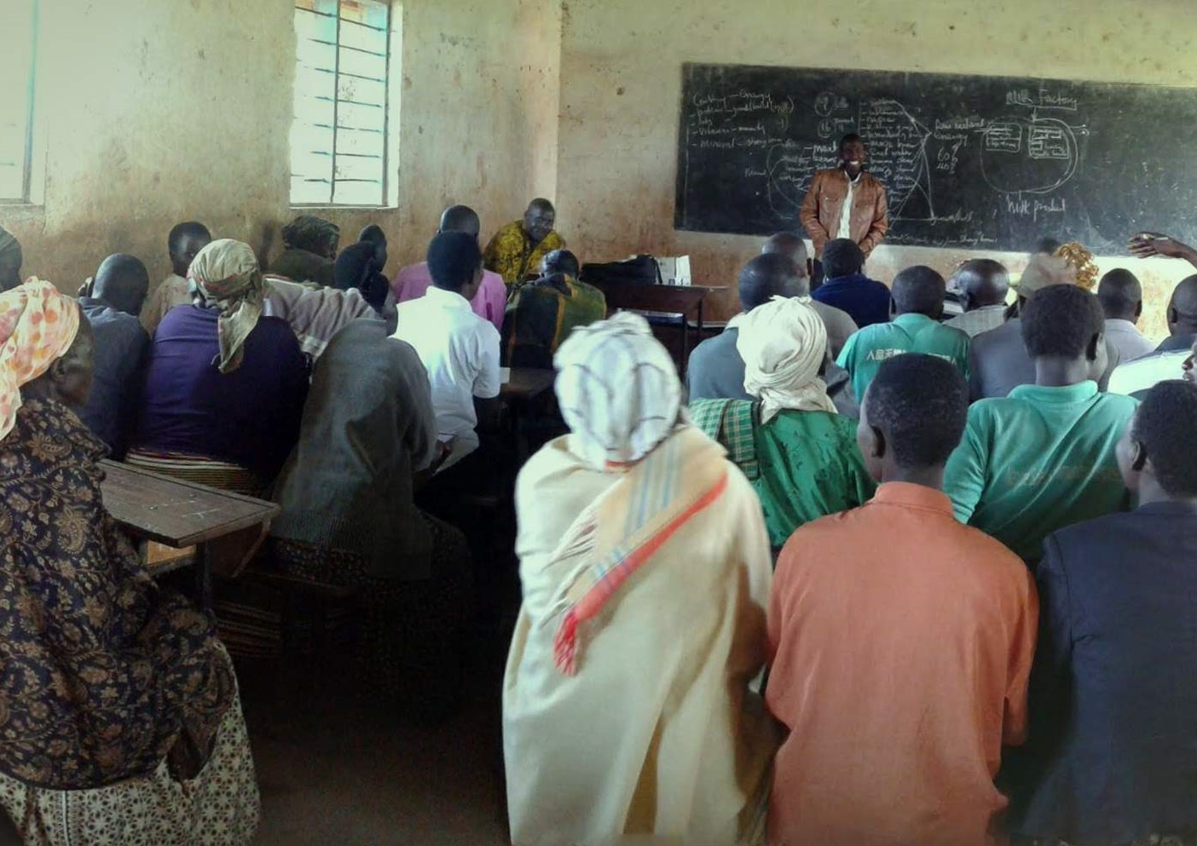
Project intervention to ensuring women participation in trainings
Trainings were conducted within villages to enhance participation
Training's venues were within walking distances from homes
The trainings times were negotiated to have better timings when women were less busy
Deliberate attempt to have a 50-50 balance between men and women

Slide 6
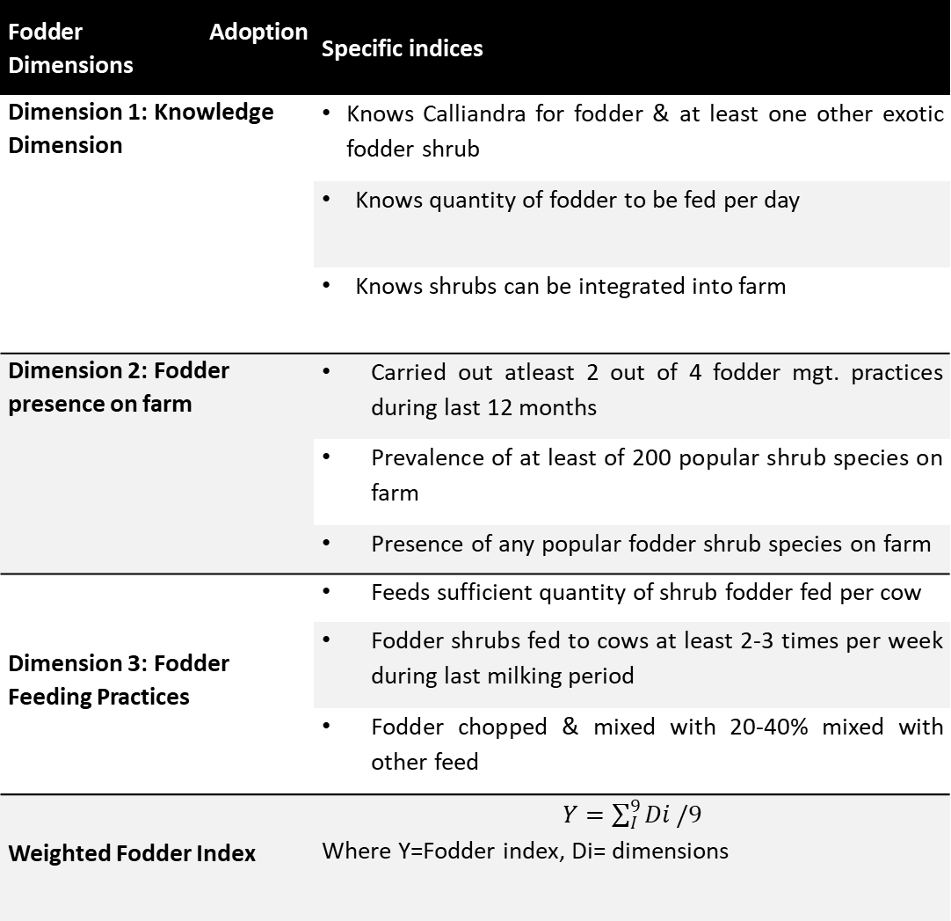
Data Analysis
Fodder Adoption Dimensions | Specific indices
Dimension 1: Knowledge Dimension | Knows Calliandra for fodder & at least one other exotic fodder shrub
 | Knows quantity of fodder to be fed per day
 | Knows shrubs can be integrated into farm
Dimension 2: Fodder presence on farm | Carried out atleast 2 out of 4 fodder mgt. practices during last 12 months
 | Prevalence of at least of 200 popular shrub species on farm
 | Presence of any popular fodder shrub species on farm
Dimension 3: Fodder Feeding Practices | Feeds sufficient quantity of shrub fodder fed per cow
 | Fodder shrubs fed to cows at least 2-3 times per week during last milking period
 | Fodder chopped & mixed with 20-40% mixed with other feed
Weighted Fodder Index | $Y=\sum_{I}^{9}{Di}/9$ Where Y=Fodder index, Di= dimensions
Using Difference in Difference (DiD) estimate the changes in weighted fodder index before and after intervention
The DID tests whether change was purely due to the farmers’ interaction with project interventions and not due to coincidence or other confounding factors.

Slide 7
Gender dynamics in dairy management
The two districts of study assigned different responsibilities to women and men:
In Manafwa, responsibility for dairy management and feedings, and decisions on land was done by men than women
In Kapchorwa dairy management and decisions on farm was a female responsibility
Use of revenue is a female affair in both districts

Slide 8
Farmer Attendance in project interventions
More women attended trainings in Kapchorwa than men
More men attended trainings in Manafwa than women

Slide 9
Weighted fodder index before and after intervention
Results
Baseline
Endline
From the figures shows a shift in the treatment density plots at endline compared to baseline
The fodder index was 0.11 units more for treated farmers than control post intervention
The shift was confirmed by a difference-in-difference estimation

Slide 10
Difference in fodder index between men and women
At baseline: There is no significant difference between men and women in control or treated villages
At endline: There was a significant difference between fodder index of women and men in control and treatment villages
Women, who were treated, had higher fodder adoption index than men who were treated post intervention

Slide 11
Diff-in-diff results for FTTs adoption
Difference in Difference (DID) |  | (1) |  | (2) |  | (3)
 |  | Total Sample |  | Men Only |  | Women only
Difference in Difference (DID) |  | β | se | β | se | β | se
Fodder index (Aggregate) |  | 0.11*** | (0.04) | 0.09* | (0.05) | 0.12*** | (0.04)
D1: Knowledge Dimension | 0.05** |  | (0.02) | 0.04* | (0.02) | 0.05* | (0.02)
D2: Utilization of fodder on farm |  | 0.01 | (0.02) | 0.00 | (0.02) | 0.01 | (0.02)
D3: Fodder prevalence on farm |  | 0.06*** | (0.02) | 0.05* | (0.02) | 0.07*** | (0.02)
Observations |  | 1504 |  | 704 |  | 800
Adjusted R² |  | 0.139 |  | 0.133 |  | 0.149
(a) Fodder aggregate index is positive and significant for all subsamples
(b) Women only coefficient, β, is higher by 0.03 units than that of men
(C) Women also had significantly higher indices for knowledge and fodder presence on farm than men
Knowledge dimensions (D1): There was slight difference in change (0.01 units) of knowledge between men and women
Fodder prevalence on farm (D3): Women were 2points more likely to have fodder on farm than men
Standard errors in parentheses
* p < 0.1, ** p < 0.05, *** p < 0.01

Slide 12
Diff-in-diff results for FTTs adoption- Kapchorwa
Difference in Difference (DID) | (1) |  | (2) |  | (3)
 | Total Sample |  | Men Only |  | Women only
Difference in Difference (DID) | β | se | β | se | β | se
Fodder index (Aggregate) | 0.19*** | (0.05) | 0.16** | (0.06) | 0.21*** | (0.04)
D1: Knowledge Dimension | 0.09** | (0.03) | 0.07* | (0.04) | 0.10*** | (0.02)
D2: Utilization of fodder on farm | 0.01 | (0.01) | 0.01 | (0.01) | 0.02 | (0.01)
D3: Fodder prevalence on farm | 0.09*** | (0.02) | 0.08** | (0.03) | 0.09*** | (0.02)
Observations | 722 |  | 346 |  | 376
Adjusted R² | 0.04 |  | 0.010 |  | 0.069
In Kapchorwa:
(a) Fodder aggregate index is positive and significant for full sample and men and women only subsample
b) the coefficients are high for women than men
Overall, in Kapchorwa district, project interventions led to Significant changes in overall uptake, practice or knowledge by men and women, but more for women farmers than men
Standard errors in parentheses
* p < 0.1, ** p < 0.05, *** p < 0.01

Slide 13
Diff-in-diff results for FTTs adoption- Manafwa
Difference in Difference (DID) |  | (1) |  | (2) |  | (3)
 |  | Total Sample |  | Men Only |  | Women only
Difference in Difference (DID) |  | β | se | β | se | β | se
Fodder index (Aggregate) |  | 0.02 | (0.05) | -0.00 | (0.07) | 0.05 | (0.06)
D1: Knowledge Dimension |  | 0.00 | (0.02) | 0.01 | (0.02) | -0.00 | (0.03)
D2: Utilization of fodder on farm |  | 0.01 | (0.02) | 0.01 | (0.01) | 0.02 | (0.02)
D3: Fodder prevalence on farm |  | 0.03 | (0.02) | 0.01 | (0.03) | 0.04 | (0.02)
Observations |  | 782 |  | 358 |  | 425
Adjusted R² |  | 0.04 |  | 0.010 |  | 0.069
(a) Fodder aggregate index not significant for all subsamples in Manafwa
b) The project interventions did not lead to any significant changes in all Fodder dimensions
Overall, in Manafwa district, project interventions did not lead to any changes in overall uptake, practice and knowledge by men or women farmers
Standard errors in parentheses
* p < 0.1, ** p < 0.05, *** p < 0.01
Notes:
Mention something about the earlier attendance

Slide 14
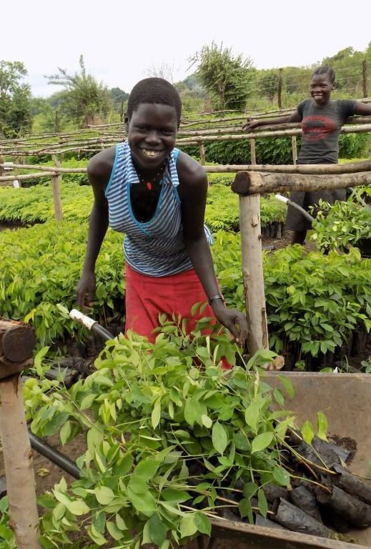
Key Findings
The positive changes in the fodder adoption index reflect that the capacity building intervention was effective in increasing overall fodder adoption as well as knowledge and fodder presence on farm among women farmers in Kapchorwa, but not in Manafwa.
Despite the project’s efforts to deliberately engage women, existing gender dynamics around dairy influenced who was attending trainings and benefitting from the capacity development activities.
The low fodder adoption index in Manafwa suggests that men might not have shared information and skills from the trainings and consequently failed to implement the trainings on farm.
This findings suggest that the same capacity development efforts have a potentially higher marginal effect on adoption among women than on men
Notes:
Should look for

Slide 15
Conclusion
We conclude that providing platform for knowledge provision and access to women, is likely to lead to improved adoption of practices and technologies, as long as women are effectively engaged in such activities and in decisions relevant to them
Women interests and responsibilities regarding promoted technologies are likely to hold weight in overall adoption and are a motivating factor in seeking information and participating in training
Deliberate efforts to include and target women in trainings, access to extension agents and demonstration of benefits would likely lead to better technology adoption, if the right enabling environment is in place
Notes:
Should look for

Slide 16
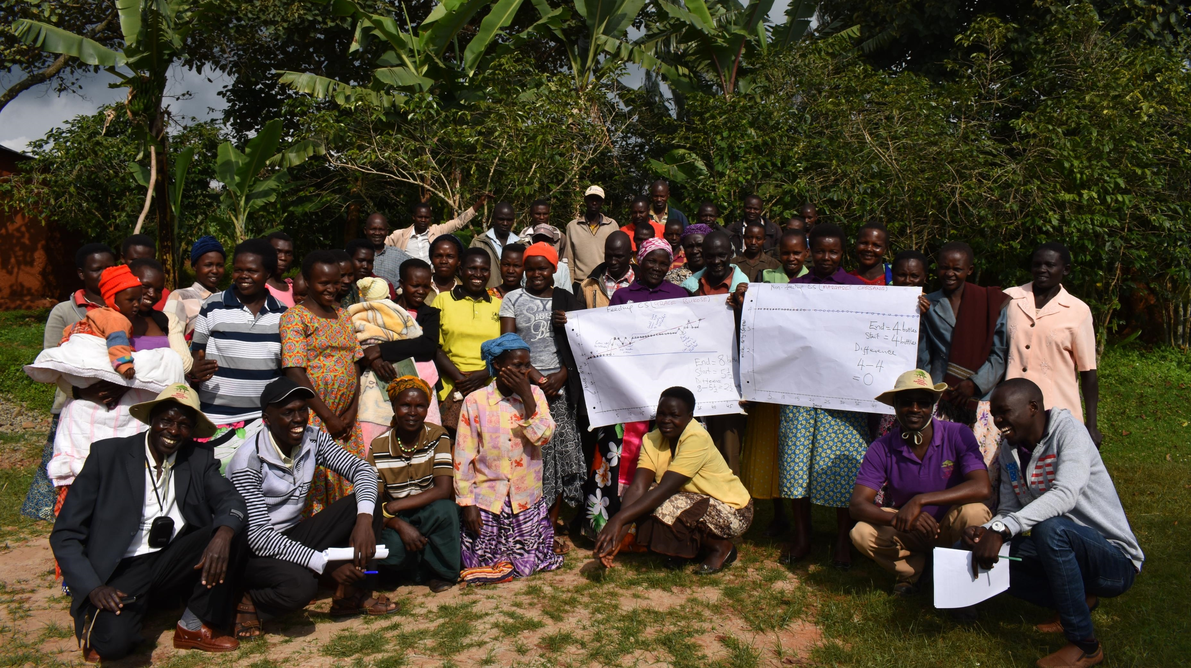
THANK YOU
THANK YOU

