Slide 1
The CGIAR Impact Area Platforms
A Brief Introduction
Frank Place
For the ILRI Townhall Meeting 19 May 2023

Slide 2
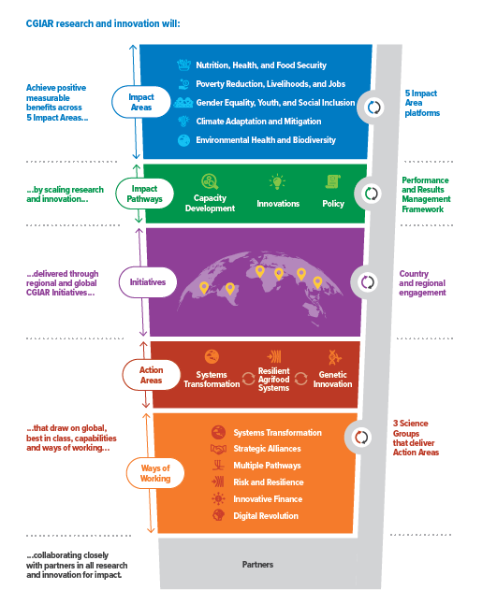
Impact Area Platforms in the CGIAR Ecosystem
Impact Area Platforms serve to strengthen the impact orientation of research in, and coherence across, CGIAR’s 3 Action Areas.
But all CGIAR entities collectively work towards contributions to the achievement of the impacts
While the Impact Area Platforms reside administratively to the Systems Transformation Science Group, they will provide functions and services across the full spectrum of CGIAR research and innovation work, including all three Science Groups, as well as engaging staff from Global Engagement and Innovation (GE&I) and Institutional Strategy and Systems (IS&S)

Slide 3
Four Interlinked Roles of the Platforms
Foster global critical thinking, use of evidence, and appropriate metrics around the Impact Area
Raise internal capacity across the Action Areas through strengthening and sharing common tools, standards, data sets, cutting-edge science and knowledge management
Advise management on the identification and performance management of CGIAR Initiatives
Amplify CGIAR’s external profile and voice, by engaging in and shaping global policy discourse, and by leading external communication plans to influence well beyond agriculture and food sectors

Slide 4
Introducing the Impact Area Platforms
Four of the five Impact Area Platforms are led by directors appointed from across the CGIAR entities.
Nutrition, Health and Food Security Impact Area Platform (Nutrition Platform):
  Dr. Shakuntala Haraksingh Thilsted (S.Thilsted@cgiar.org)
Gender Equality, Youth and Social Inclusion Impact Area Platform (Gender Platform):
  Dr. Nicoline de Haan (N.deHaan@cgiar.org; https://gender.cgiar.org/)
Climate Adaptation and Mitigation (Climate Platform):
  Dr. Aditi Mukherji (A.Mukherji@cgiar.org)
Environmental Health and Biodiversity (Biodiversity Platform):
  Dr. Cargele Masso (C.Masso@cgiar.org)
Poverty Reduction, Livelihoods and Jobs Impact Area Platform : TBC

Slide 5








To help achieve CGIAR’s Climate adaptation & mitigation in CGIAR strategy
Turn agriculture and forest systems into a
net sink for carbon by 2050
Equip 500 million small-scale producers to be more resilient by 2030
Support countries in implementing NAPs and NDCs, and increased ambition in climate actions by 2030
Building up from
previous work
2

Slide 6
[Approach] Module 1: Expertise and Themes
Expertise and themes
Searchable database of climate scientists at CG and NARES
Thematic insights showcasing policy implications of best available science
Trainings for CG and NARES scientists
10-12 thematic climate groups based on interest and expertise

Slide 7
[Approach] Module 2: Methods and Metrics
Methods and Metrics
Repository of innovative methods on all aspects of climate science
Metrics on how do we measure progress of climate action in agri-food systems
CGIAR’s Annual Report on the State Agri-Food Systems under a Changing Climate

Slide 8
[Approach] Module 3: Synthesis and Gaps
Synthesis and Gaps
Rigorous evidence synthesis/meta reviews on climate topics with high policy interest
Identification of gaps in knowledge
Facilitating gap filling research through bringing in diverse voices together

Slide 9
Module 4: Influencing Global Climate Processes
Influencing Global Climate Processes
Facilitating CGIAR wide submissions to Climate COPs, CBD COPs etc.
Knowledge and synthesis products to feed into and influence global processes

Slide 10
Ambition: Climate Platform will be the go to place where:
Latest policy relevant science created by CGIAR and others on climate change and agri-food systems is curated
  Helping CGIAR to play global thought leadership role on climate and food systems
Climate experts within CGIAR and NARES find an intellectual home
  Helping tap into diverse expertise and matchmaking with various demands, and keep themselves updated
Global climate policies on agri-food are influenced by CGIAR science
  Helping shape global climate and food systems agenda for a warmer world

