Slide 1
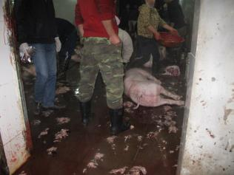
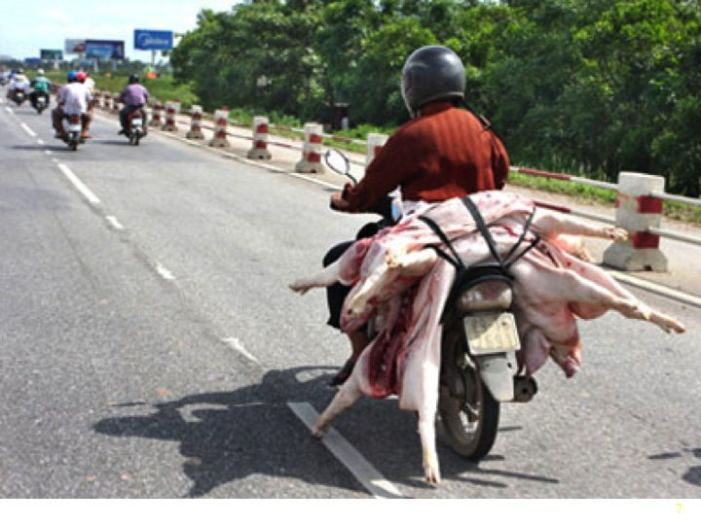
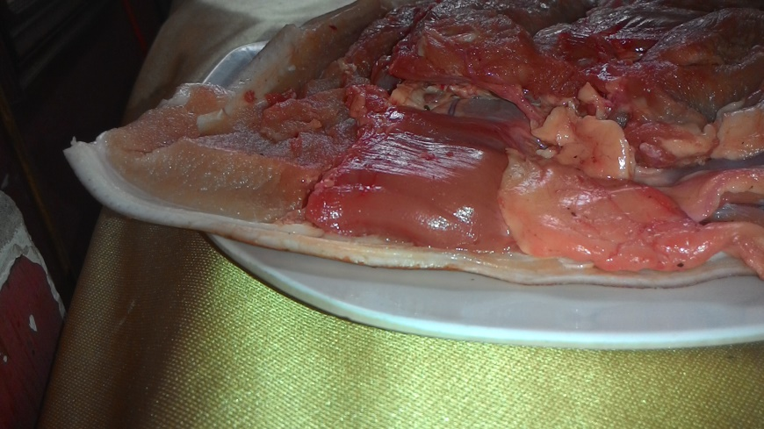
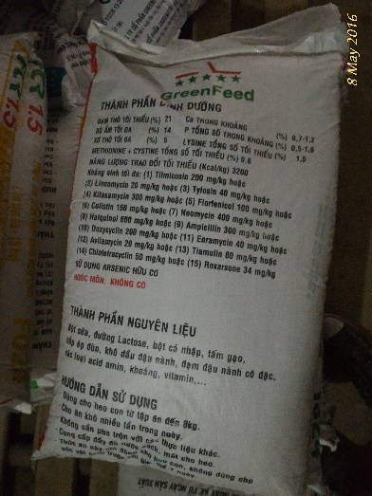
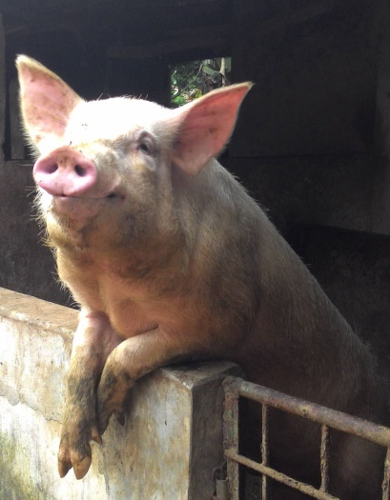


Food safety in the pork value chain and pathways towards safer pork in Vietnam
Fred Unger¹, Hung Nguyen-Viet¹, Pham Duc Phuc², Sinh Dang Xuan², Pham Van Hung³, Huyen Le Thi Thanh⁴, Tuyet-Hanh Tran Thi², Kohei Makita⁵ and Delia Grace¹
¹International Livestock Research Institute, ²Hanoi University of Public Health, ³Vietnam National University of Agriculture, ⁴National Institute for Animal Science, Vietnam, ⁵Rakuno Gakuen University, Japan
15th International Symposium on Veterinary Epidemiology and Economics
Chiang Mai, Thailand
13 November 2018
Notes:
There MUST be a CGIAR logo or a CRP logo. You can copy and paste the logo you need from the final slide of this presentation. Then you can delete that final slide
To replace a photo above, copy and paste this link in your browser: http://www.flickr.com/photos/ilri/sets/72157632057087650/detail/
Find a photo you like and the right size, copy and paste it in the block above.

Slide 2
Outline
Background
Objectives
Materials and methods
Results
Conclusions

Slide 3
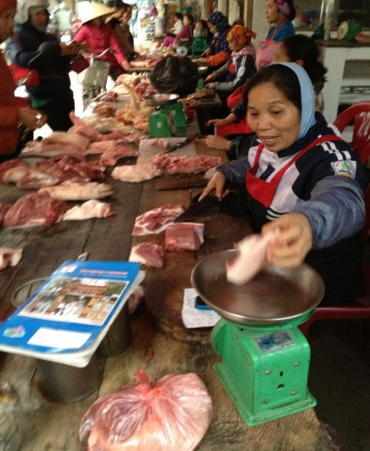
Background - pork in Vietnam
Pork is an important component of the Vietnamese diet
  The most widely consumed meat: 56% of total meat intake
  Annual pork consumption per capita in Vietnam: 29.1 kg
  83% comes from very small or small farms
  76% of pigs are processed in small slaughtering, nearly 30,000
  Preference for fresh ‘warm’ pork supplied
  in retail traditional markets
  (>80% of all pork marketed)
    affordable, address local demands
    often escape effective control

Slide 4
Background: Food safety in Vietnam
Perception
Food safety is perceived as one of the most pressing issues by Vietnamese people, more important than education or healthcare
Risk due to chemical hazards perceived as most important
Market
Food exports relatively well managed but deficits in domestic markets
Consumer
Willing to pay 5–10% premium for safer food, not easy to decide for consumer what is ‘safe’
Legislation
Vietnam has a modern food safety law but deficites in implementation
Risk-based approach
Deficites in use of risk assessment
Food safety initiatives
Various initiatives, different scope and scale (e.g. VietGAHP, LIFSAP)
Market Situation

Slide 5
ILRI’s and partners pig value chain work in Vietnam
2008 -2012
Jun 2012
Sep 2017
Oct
2017
Mar 2022
Production diseases
Small holder pig sector is important and competitive
Food safety local pigs
AMR
Viet GAHP*survey
PFBD** local pigs
Pig competiveness
PigRISK
SafePORK
To assess impacts of pork-borne diseases on human health and the livestock.
To develop and test market based food safety interventions
Policy engaegement
Capacity building, publications
*VietGAHP (Good Animal Husbandry Practices)
** PFBD (Parasitic Foodborne Diseases)

Slide 6
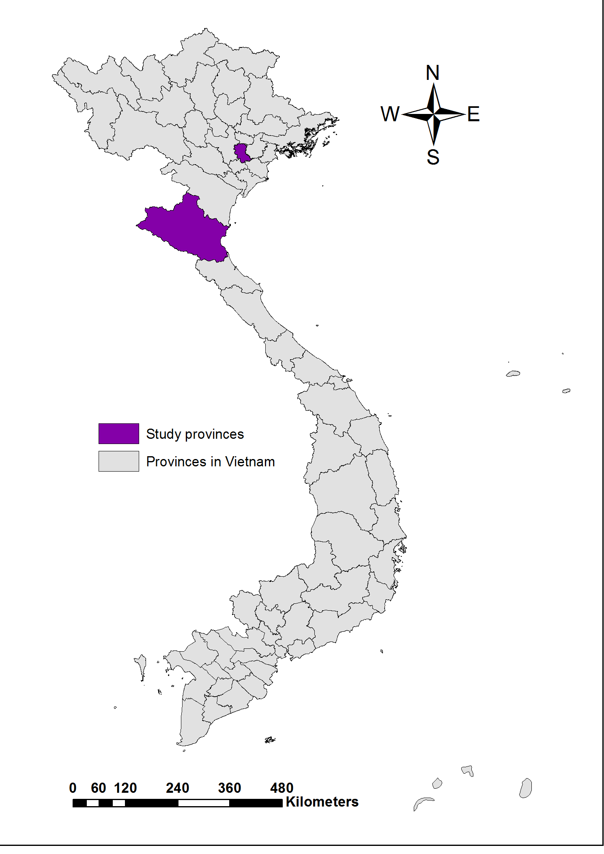
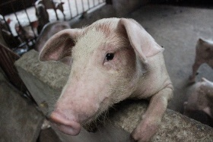
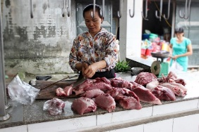
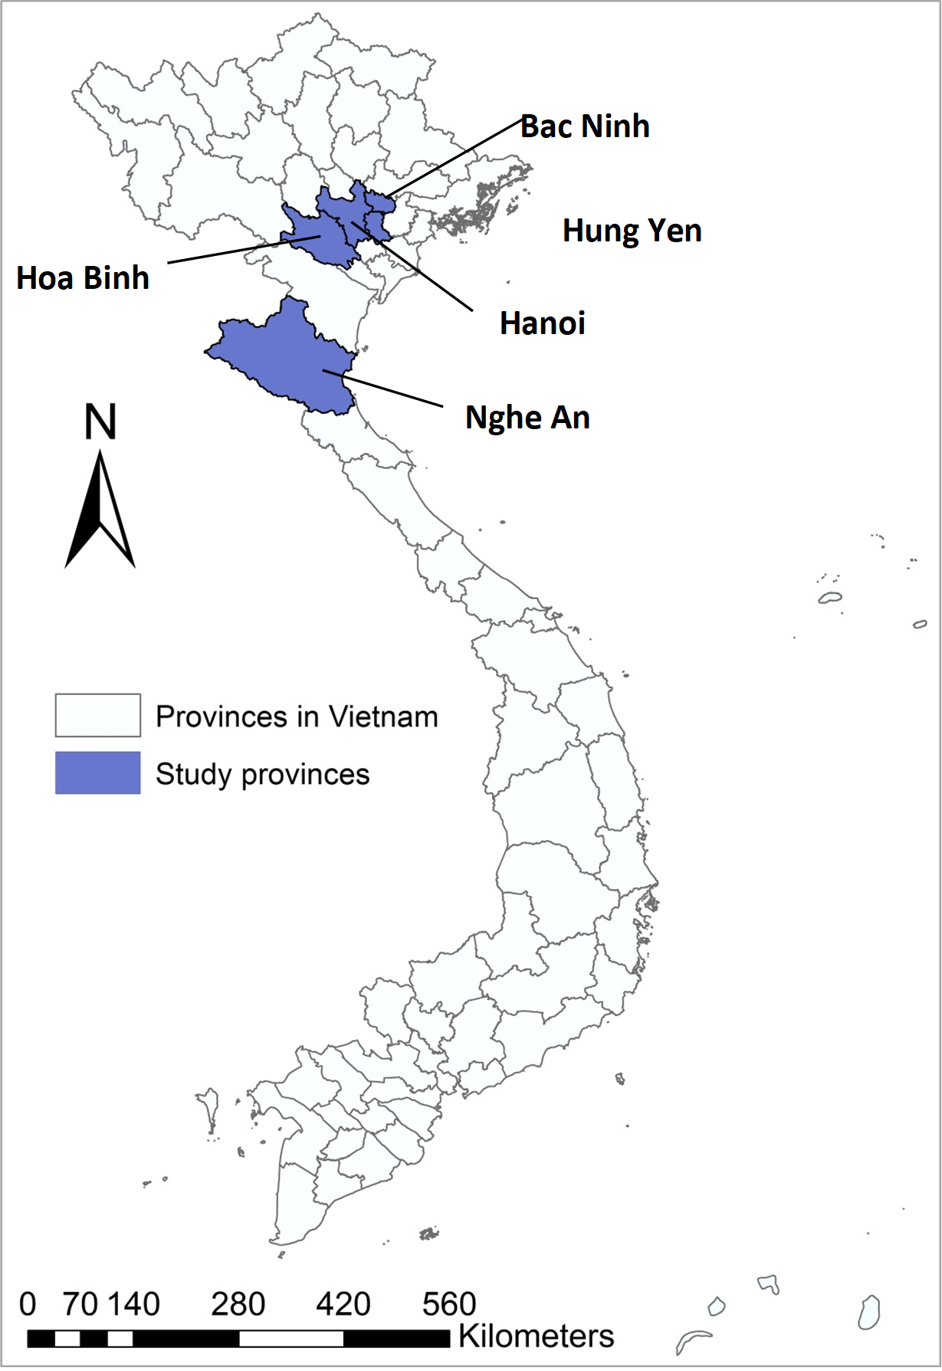

Pork safety assessments and pathways towards safer pork
PigRISK (2012–17) Safe Pork (ongoing)
Interdisciplinary team
Risk based approach
Food safety hazards:
  Biological and chemical
From farm to fork
Research questions
Is pork safe and are the risks serious?
Methods:
Quantitative and qualitative risk assessment
Assess cost of foodborne disease illness (hospitalisation)
VietGAHP adaption (survey)
Cross-contamination Salmonella (household)
Research questions
What are feasible interventions on food safety?
Methods:
Food safety performance of value chains
Food safety interventions (e.g. randomized control trial)
Risk communication

Slide 7
Pig RISK key results (2012–17)
Food safety risk assessment along the pork value chain
Microbial risk assessment:
Salmonella contamination started at farm and increased along the pork chain (farm – slaughter – market) mainly related to poor hygienic practices 44.7% of pork at market
- No difference between upgraded (VietGAHP) and traditonal retail
Risk for pork consumer: 1 – 2 person (17%) from 10 estimated to suffer Salmonella caused FBD annually
Hospitalization costs of foodborne diarrhoea per treatment episode and per day: USD 107 and USD 34, respectively
Chemical risk assessment: Risk due to chemical hazards is low (heavy metals, grow promoters and antibiotics) low – overwhelming majority of meat samples tested negative
VietGAHP adaption: Farmers find some GAHP guidelines unreasonable to achieve or do not follow as concrete benefits are not clear

Slide 8

Investments in FS can save lives and $$$
Potential health impact – Foodborne disease in Vietnam
Based on PigRISK results
94 million people
Cases of foodborne diseases by Salmonella in pork at 17%: 16 million get sick annually
Cost $107 to treat a case: $1,712 million (0.8% GDP)
Potential intervention to reduce 20% foodborne disease burden: $342 million SAVED

Slide 9
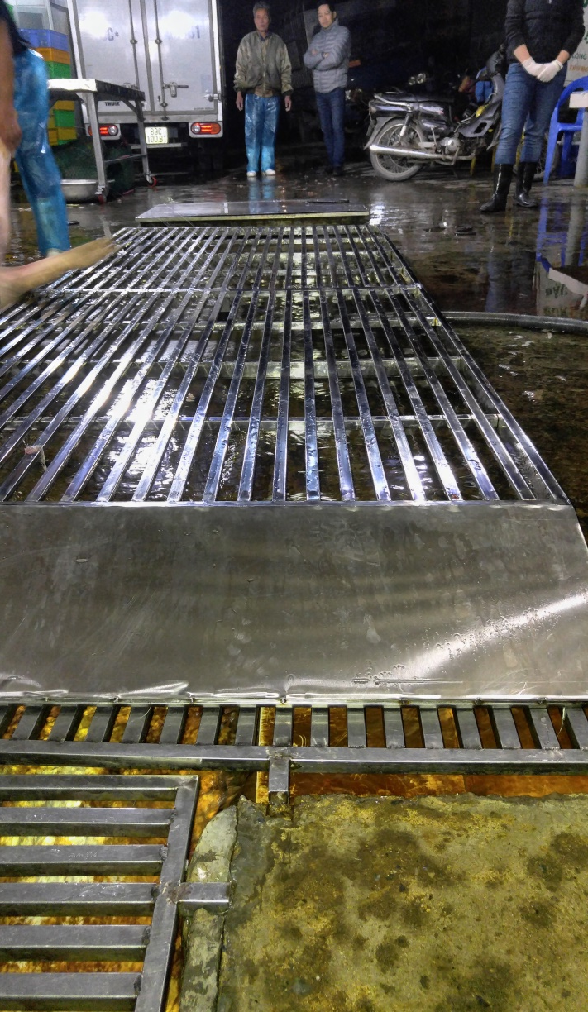
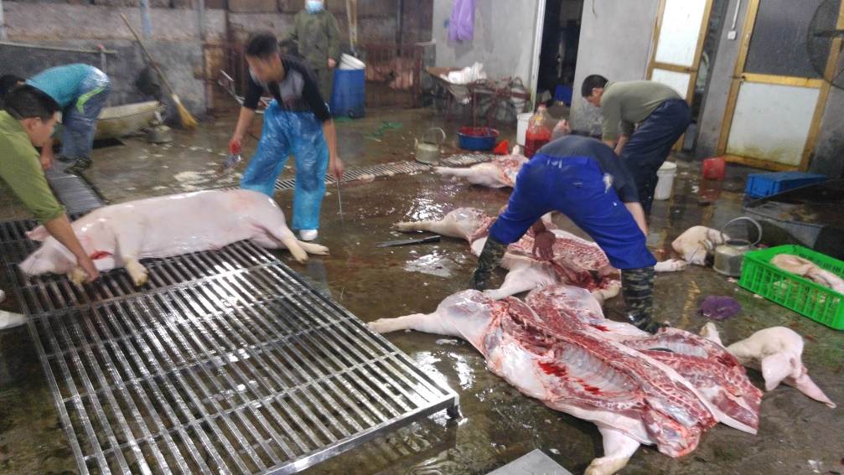
PigRISK results - Pilot intervention
The pilot trial also demonstrated that technical solutions must go along with behaviour change of butchers.
The improvement in hygiene (using grid versus floor) was indicated by lower coliform load (p = 0.002) on the carcass surface compared to the control.

Slide 10
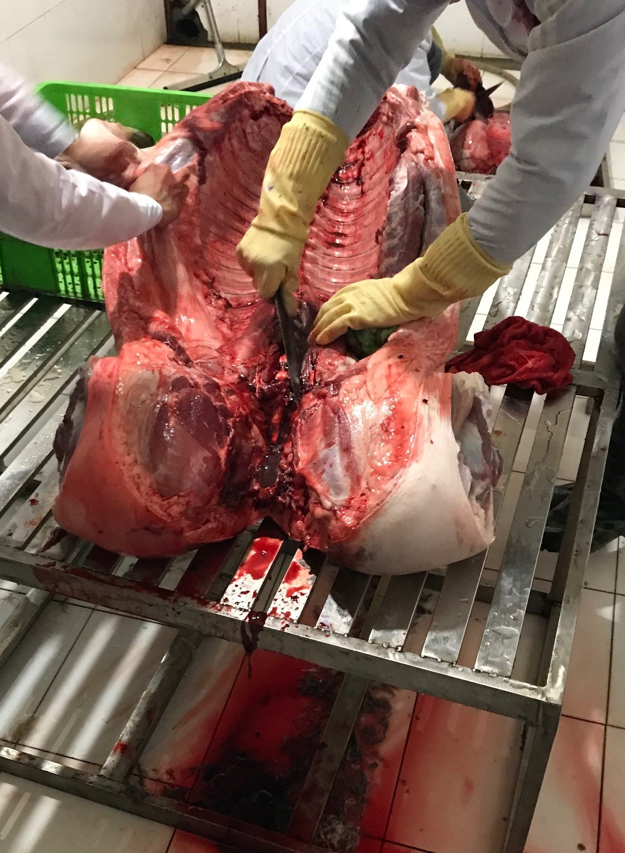
From assessment to interventions
Pig RISK quantified the risk for the consumer due microbial and chemical hazards
Is pork in Vietnam safe? - It is not !
Are the risks serious? - Considerable!
Study sites: Hung Yen
& Nghe An
Limited progress has been made on how to actually reduce the risk for the consumer
Safe Pork
Focus on food safety interventions along pork value chains
Goal: To improve pork safety, by developing, testing and promoting incentive-based interventions that are sustainable and scalable

Slide 11
Safe Pork
Pathways towards safer pork
Objective 1: To generate evidence on current approaches to pork safety
Assessing the food safety performance of pork value chains (ongoing)
Objective 2: To develop, pilot and test light-touch, incentive-based approaches to food safety
Randomized control trial, QMRA and cost-of-illness studies, costs/benefits
Objective 3: To develop, with stakeholders, a roadmap for scaling of interventions (theory of change).
Use of existing channels e.g. food safety task force, food safety working group and private sector
Objective 4: To suggest strategies for enhanced engagement and benefit sharing for men and women in the pig value chain
Analyze gender and equity constraints to adoption of food safety interventions
Objective 5: To build capacity in food safety risk management and communication
Needs assessments, targeted training, various approaches

Slide 12
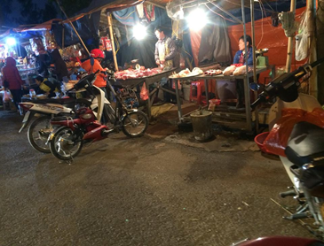
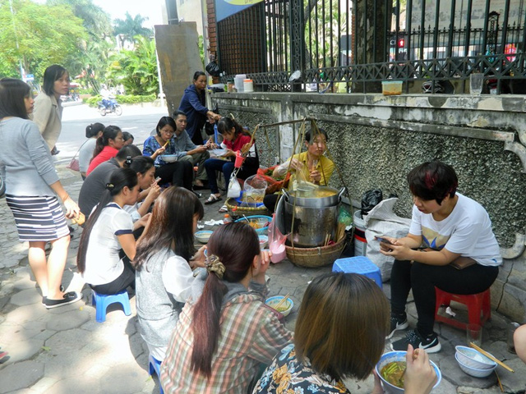
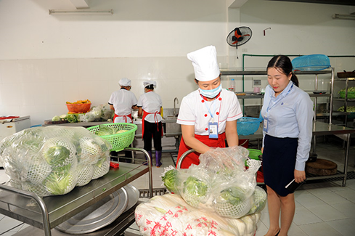
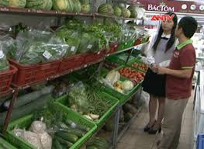
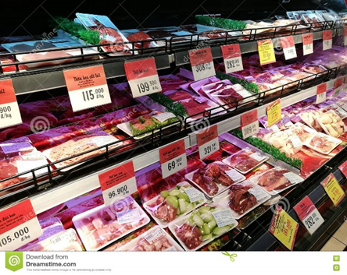
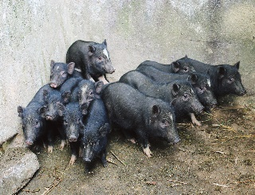
Safe Pork
Objective 1: Assessing food safety performance
Methods:
Standardized food safety performance tool
Focus group discussions/key informat interviews and biological sampling
Selection criteria for value chains: contribution to pork supply, novel approaches, scalability, local support, complementary to other initiative (e.g. Cau Giay) or project sites (e.g. Hoa Binh)
Traditional/
wet market (80%)
Street food
Canteens
‘Organic’ food chains, niche but emerging
Supermarket/ convienient stores
Native pigs,
niche market, ‘safe’ by nature

Slide 13
Assessing food safety performance (cont.)
Qualitative tool applied to value chain actors:
Producers, slaughterhouse owners, retailers (modern and traditional), street food vendors, canteens and consumers (purchasing from different retail types)
Key contents:
Broad context (e.g. scale, trends, plans, food safety)
Knowledge, attitudes and practices (food safety)
Food safety behaviour and incentives
Food safety governance and trust
Interventions to improve food safety
Sample size: 367 for value chain actors and 154 for consumers (survey ongoing)
2. Biological hazard sampling across different retail types:
Salmonella and total bacterial count; Sample size: 369
Retailers (modern/traditional), canteens, street food and native pigs retailer and/or restaurants) (ongoing)

Slide 14
Safe Pork – interventions
Challenges for improving food safety including pork
Various approaches to improving safety had been tried, largely based on systems used in developed countries e.g.:
  Good Agricultural Practices, traceability, certification, modernizing retail etc.
However, safe meat production has not yet take a significant share of the market in Vietnam (e.g. VietGAHP < 5%)
The key constraints to uptake include:
  high cost of adoption, lack of direct, visible benefits from changing behaviour, low consumer trust
To overcome these constraints our focus will be on:
  gradual improvements to the food system in place, rather than introduction of a new system
  incentive-based, light-touch interventions

Slide 15
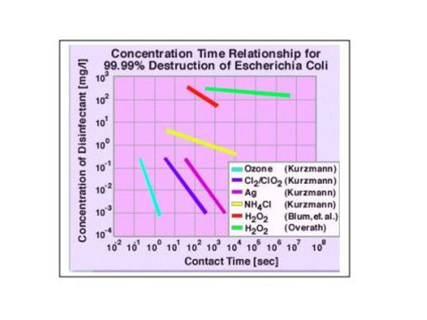


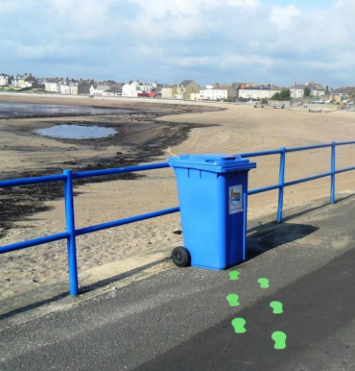
Safe Pork: Examples of low-cost innovations
To be tested under objective 2
Simple, rapid, cheap tests that detect contaminated food
  Could be used directly by retailers or consumer to have direct verification of safety e.g. food sniffer
Reduce contamination of pork
  Portable ozone machines to plug into water supply
  Avoid floor slaughter
  Training, antimicrobial cutting board, clothes etc. (retailer)
  Reduce use of antimicrobial (in collaboration with private sector)
  Replacement of antimicrobials by pro-biotics
Increasing transparency and traceability in food system
  24 hour on farm, branding and certification, done with private sector
Assessment of the potential to use nudges for improved
food safety in the pork value chain in Vietnam

Slide 16
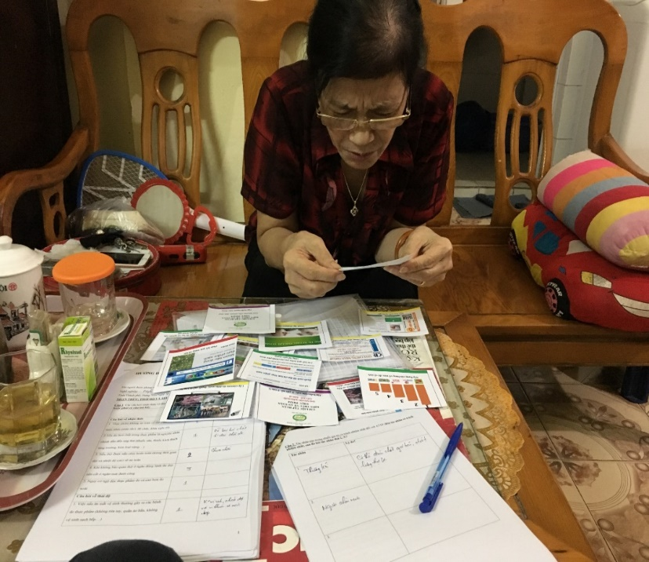
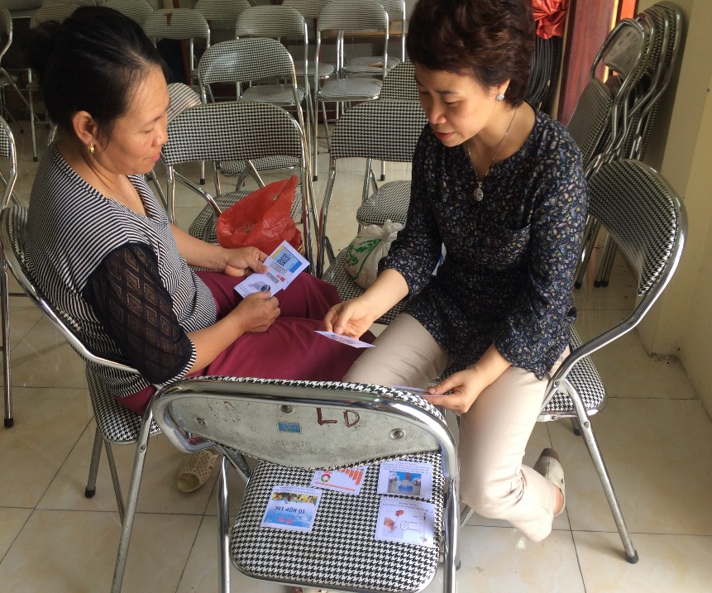
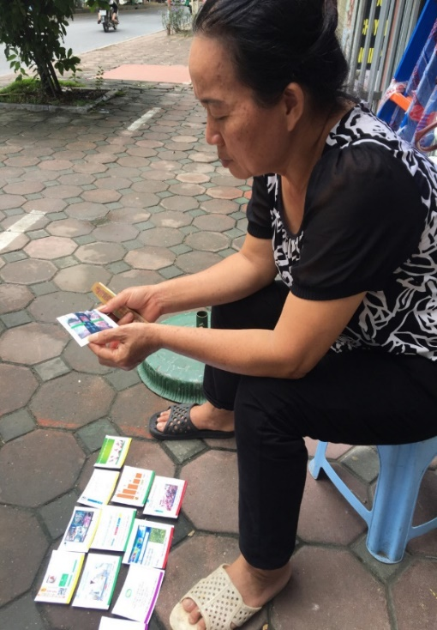
Safe Pork: Preliminary results
Food safety performance tool
Focus group discussion and key informant interview
Attitude questions – yes answers | Prod | SH | Retailers | Street food | Cons
It is the government’s responsibility to ensure food is safe
Hung Yen and Nghe An | 15.9 | 20.0 | 19.8 | 15.9 | 43.5
Hoa Binh (indígenous pig systems) | 83.3 | 81.8 | 70.0 | 88.9 | 82.0
Rural area: Goverment seen as the mainly responsible body for food safety

Slide 17
Safe Pork
Food safety performance tool
Focus group discussion and key informant interview
Knowledge questions – Yes answers | Prod | SH | Retailers | Street food | Cons
If pork is fully cooked (for long time and high temperature), then it is safe
Hung Yen and Nghe An | 20.5 | 20.0 | 45.0 | 0 | 29.4
Hoa Binh (indigeneous pig system) | 76.2 | 54.5 | 60.0 | 100 | 62.7
Hung Yen and Nghe An: Less safe – alighned to chemicals

Slide 18
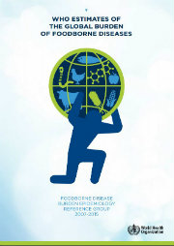
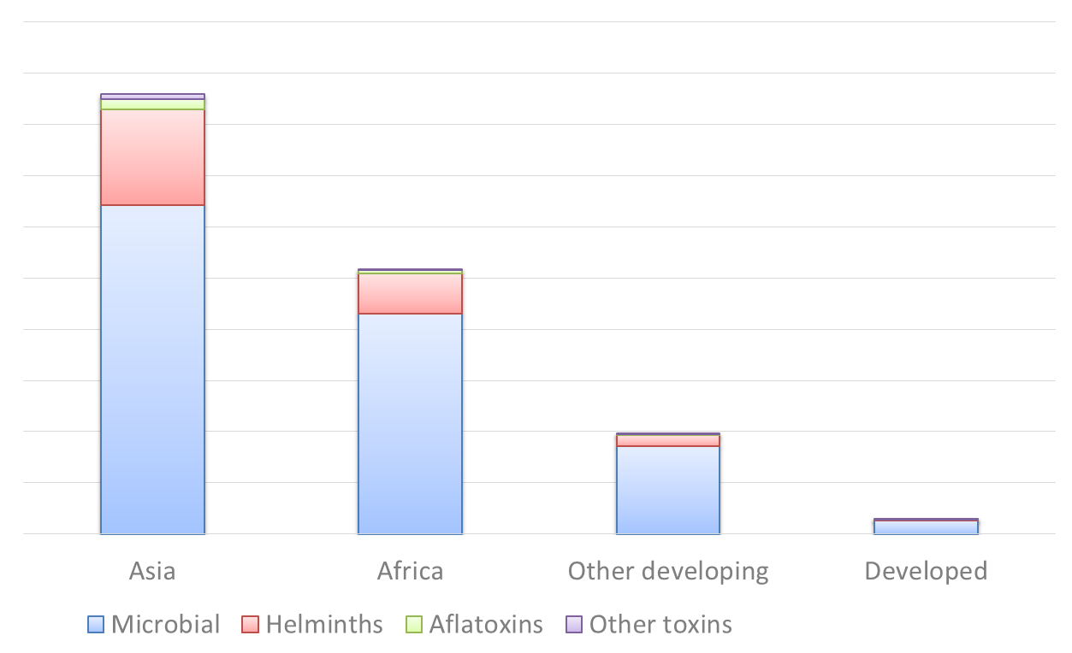
FBD- a new priority – most from livestock
Millions DALYs lost per year (global)
Conclusions and next steps
From assessments:
Pork is not safe and the risk is considerable
Similar to FERG report (WHO 2015) microbiological hazards are most important while, contrary to public perception, chemical hazards are less important
Related health risk and cost of illness have been quantified
(first time)
Pathways towards safer pork:
Various approaches on food safety have been tried but limited evidence
on actual improvements, uptake and scalabilty
Techincal innovations required also practice change of value chain actors and incentives
Food safety related knowledge, attitudes and practices differ between value chain actors and in between regions
Next steps (2018–19):
Determine health risks by retail type (modern/traditional)
Interventions (ozone) and retailer package

Slide 19
Acknowledgements
National/local partners and authorities and value chain actors and communities
SAFE Pork advisory committee
Royal Veterinary College, United Kingddom
National Institute for Veterinnary Research, Vietnam
Selected publications:
Hung Nguyen-Viet, Tran Thi Tuyet-Hanh, Unger, F., Sinh Dang-Xuan and Grace, D. 2017. Food safety in Vietnam: where we are at and what we can learn from international experiences. Infectious Diseases of Poverty 6: 39.
Sinh Dang-Xuan, Hung Nguyen-Viet, Meeyam, T., Fries, R., Huong Nguyen-Thanh, Phuc Pham-Duc, Lam, S., Grace, D. and Unger, F. 2016. Food safety perceptions and practices among smallholder pork value chain actors in Hung Yen province, Vietnam. Journal of Food Protection 79(9): 1490–1497.
Sinh Dang-Xuan, Hung Nguyen-Viet, Unger, F., Phuc Pham-Duc, Grace, D., Ngan Tran-Thi, Barot, M., Ngoc Pham-Thi and Makita, K. 2017. Quantitative risk assessment of human salmonellosis in the smallholder pig value chains in urban of Vietnam. International Journal of Public Health 62(Supplement 1): 93–102.
Tran Thi Tuyet-Hanh, Dang Xuan Sinh, Pham Duc Phuc, Tran Thi Ngan, Chu Van Tuat, Grace, D., Unger, F. and Hung Nguyen-Viet. 2017. Exposure assessment of chemical hazards in pork meat, liver, and kidney, and health impact implication in Hung Yen and Nghe An provinces, Vietnam. International Journal of Public Health 62(Supplement 1): 75–82.
Dang-Xuan S, Nguyen-Viet H, Pham-Duc P, Grace D, Unger F, Nguyen-Hai N, Nguyen-Tien T, Makita K. 2018. Simulating cross-contamination of cooked pork with Salmonella enterica from raw pork through home kitchen preparation in Vietnam. International Journal of Environmental Research and Public Health 15(10): 2324. doi: 10.3390/ijerph15102324

