Slide 1



TH5.3: Systemic transformational change and empowerment for women smallholder farmers through engagement of key critical partners
Jemimah ODUMa – UNIVERSITY OF NAIROBI
Cultivating Gender Equality Conference
12-15 October 2021
Notes:
The title of our presentation is systemic transformational change and empowerment for the women small holder farmers through engagement of key critical partners., In this model we use outcome mapping as a tool to analyze the systems that are barriers across the vaccine value chain, and develop opportunities to create an enabling environment that will sustain outcomes at scale after the project has ended.

Slide 2
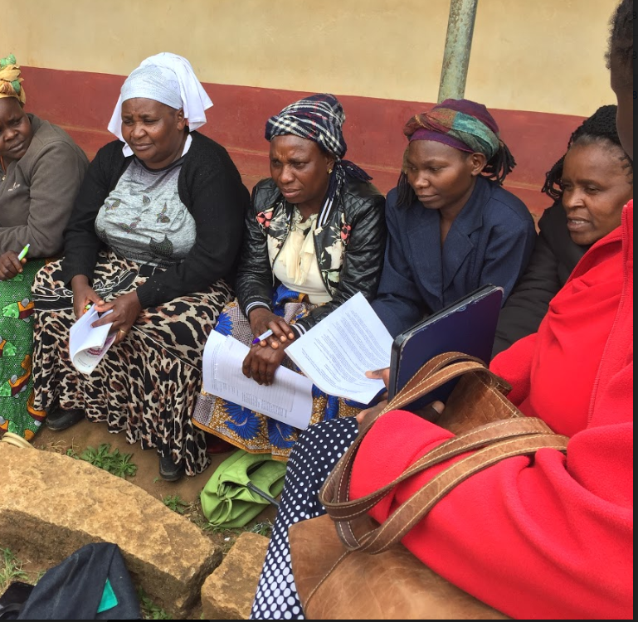
Hearing their voices: Action research to support women’s agency and empowerment in livestock vaccine distribution, delivery and use in Rwanda, Uganda and Kenya.
Funded by IDRC-LVIF

Slide 3
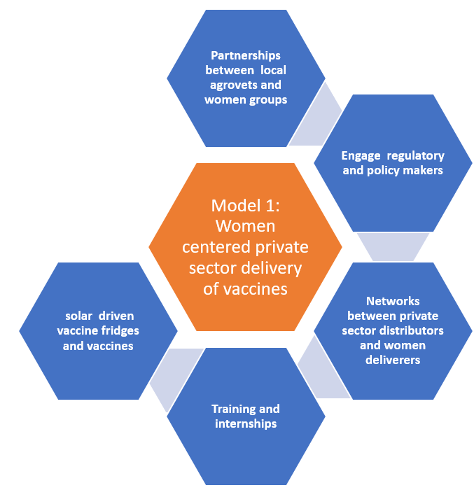
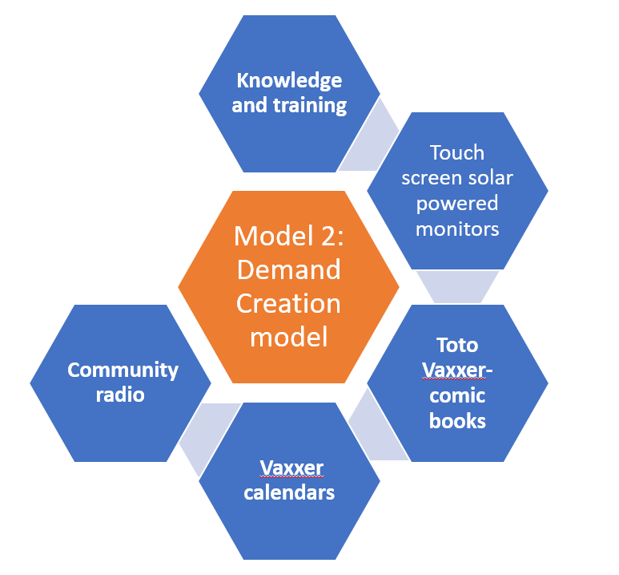
INCREASED VACCINE ADOPTION THROUGH
Increased vaccine accessibility
Increased
vaccine
Demand
Notes:
We have created two models. Model 1: A women-centered private sector delivery model for vaccines (tested mostly in Uganda and numbers bumped up slightly in Kenya). Model 2: A demand creation model (tested in Rwanda).
These models target women’s individual and collective processes which address issues of entrepreneurship, self-reliance, and cooperation to challenge power structures. They are potentially beneficial to women small holder farmers along the VVC as end users, entrepreneurs, service providers and distributors.

Slide 4
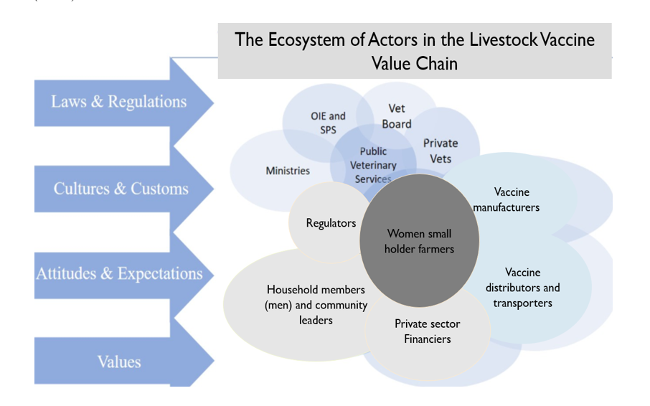
Notes:
Our theoretical framework focuses on the interrelations between our women small holder farmers and the other key players in the vaccine value chain (VVC).
We look at the vaccine value chain as an ecosystem of many actors, each one of them contributing to our ultimate vison of women empowerment along the VVC where women’s capabilities (skills, education, health) and agency (participation, voices, influence) are strengthened.

Slide 5
NCD Vaccine & Poultry Value Chain
MOALFI
Ministry of Health
International Organizations: OIE, FAO
2
1
Vaccine movement
1
Live poultry movement
Vaccine R&D
Exporter
Regulators
1
Regulator VMD/KVB/DVS
1
Consumers
3
Vaccine Supplier
Extension workers
2
Drug Company (Importer/ Manufacturer)
1
2
3
Transporter
Power
Main Distributor
1
3
2
Day Old Chick Supplier
Sub-Distributor (e.g. Chemist, Agrovet
2
Informal distributors
2
1
Extension Worker
1
Private Technical Consultant
Market
Brooker
1
Small Farmer
Large Farmer
1
2
Notes:
Kenya VVC stakeholder map for poultry value chain Consumers Market Regulators
SIDAI Africa Limited – Big business similar to an agrovet but bigger and assist with training and franchising
K’LIFT – NGO that offers credit for animal health businesses
Big corporations need to develop social responsibility

Slide 6
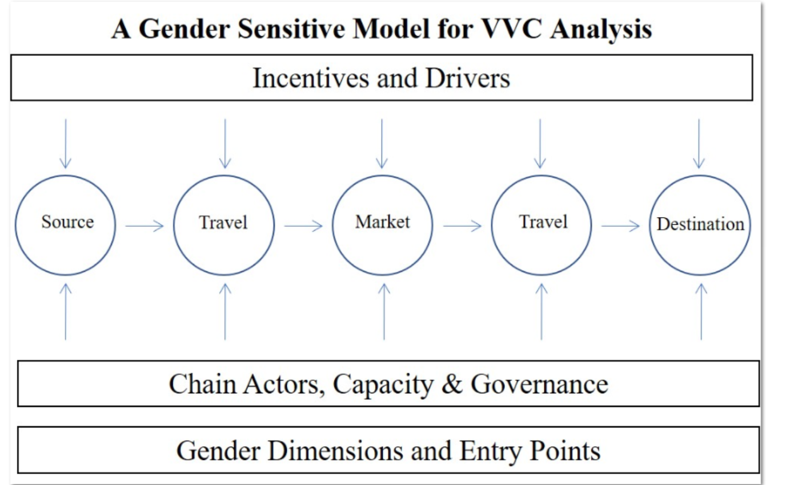
Notes:
In this case we analyze the capacities of key actors recognize what drives them and incentives and based on tat dentify gender dimensions and viable entry points into the LVVC

Slide 7
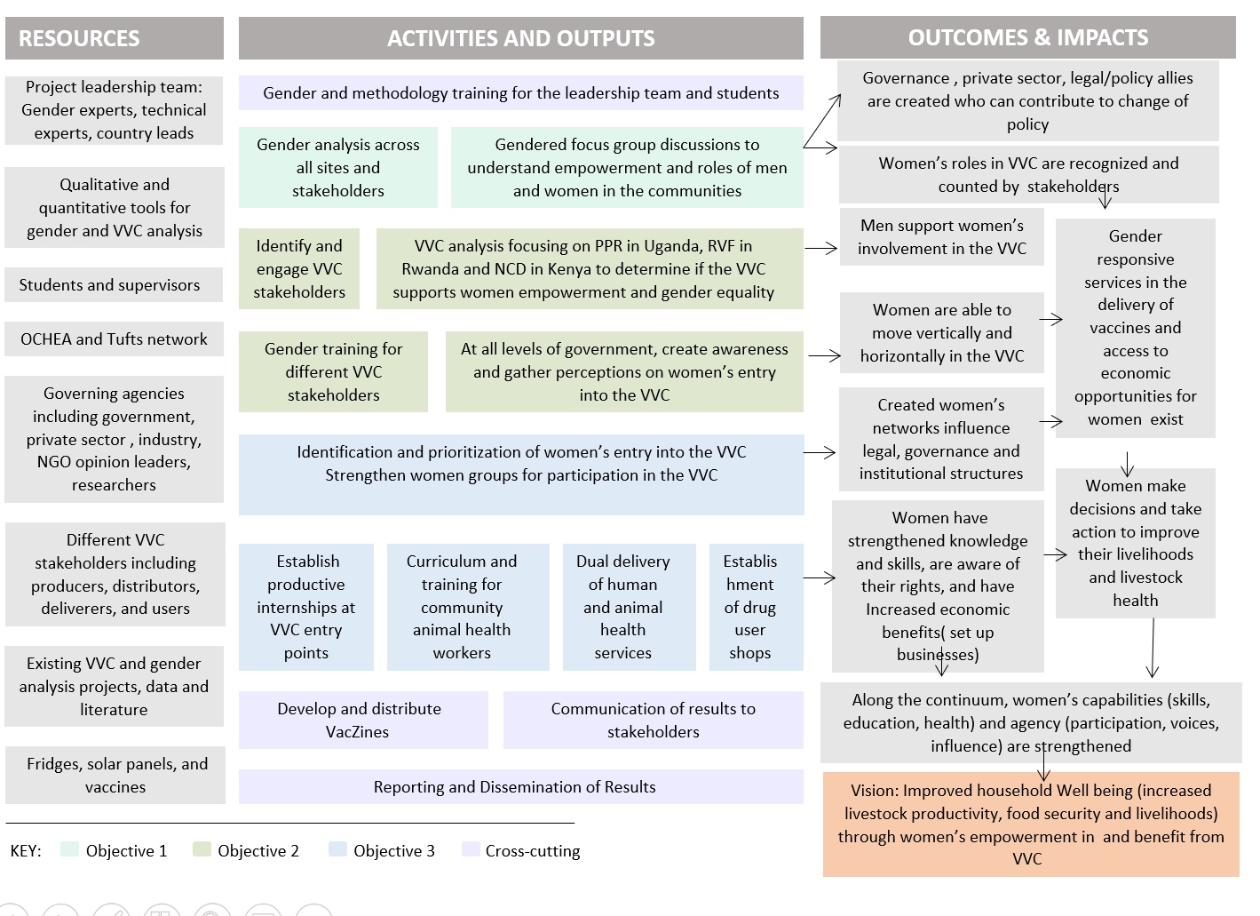
Notes:
In our Theory of change, creating allies and an enabling environment is important. For sustainability Go over outcomes and impacts and pont out the crtica partners included- governance structures, private sector men as womens support, policy makers, vaccine deliverers and users

Slide 8

Why WE use
Outcome Mapping?
Outcome Mapping (OM) is a structured participatory tool that uses a bottom-up collaborative process to engage all Spillover Ecosystem stakeholders (both traditional and non-traditional)
Through the OM process, stakeholders will map their outcomes and work to identify, design and implement interventions to address spillover.
The OM process focuses on effecting changes in behavior, relationships, actions, and activities in the people, groups, and organizations that will lead to stopping spillover.
Allows stakeholders to MAP their expected OUTCOMES

Slide 9
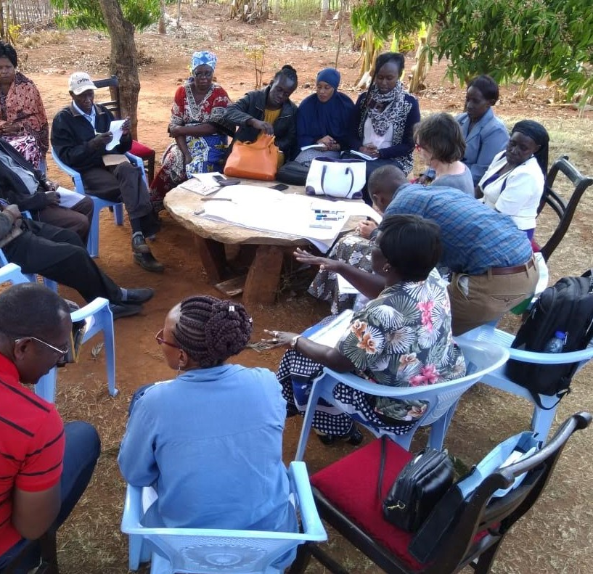
OM is about:
Systems in a Room
Listening to local actors and allowing them to define their role: communities, civil society, the private sector, academia, and ministries.
Understand Local Systems. Identify key local actors, understand relationships and interdependencies, and support local actors in developing and leading their own development solutions/interventions that positively transform systems.
Build networks and relationships between local actors that lead to enduring positive systemic change and sustainability.
Support Local Leadership. Shift priority-setting, decision-making, leadership, and power to local actors. Support local actors in identifying, achieving, and measuring their own priorities.
Measure what matters to local actors - and measure whether and how locally led collaboration results in systemic change, and behavior change, including unexpected outcomes.

Slide 10
Outcome mapping approach
Identify and systematically engage critical multisectoral partners to achieve the project vision.
Use a process of analyzing current limitations (social, political, and cultural norms), challenges (barriers to partner support) and opportunities (both systemic and programmatic).
Create an enabling environment and a change in the surrounding systems for ensuring women engage, participate, benefit and can influence the VVC.
Establish sustainable networks and partnerships between vaccine end users, deliverers and distributors that go beyond the project life.
Engage regulators and policy makers to examine regulatory mechanisms that can create gender sensitive vaccine delivery systems.
Create opportunities for effective and efficient vaccine distribution chains.

Slide 11
Critical Partner | Their role | Example of Outcome
Women | Small holder farmers and female actors along the VVC | Women have agency and can make decisions, take action to improve their livelihood, and create networks that influence legal governance and institutions. Knowledge and skills on vaccines are continuously strengthened.
Men | These are the husbands, heads of households community leaders, men along the VVC | Men continuously and increasingly support women’s participation and engagement and systems for women to effectively engage and benefit from VVC.
Government | Policy makers and regulators of vaccines | Creation of gender responsive policies specific to VVC developed. A change in discourse discussing gender issues.
Animal health service providers | DVOs, VOs, CAHWS & Agrovet dealers in both private and public sector | Increased accessibility and availability of vaccines. Continued retooling and skilling of service providers. Provide services to women smallholder farmers
Private sector: manufacturers, importers, distributors of vaccines | Manufacturers, importers and distributors of vaccine, banking institutions | Package vaccines that can be afforded by women smallholder farmers e.g. 50/100 dose vials of NCD. Deliver vaccines to rural communities. Support women entrepreneurs. Financial institutions have special packages for smallholder women farmers.
Research and academic institutions | Academic and research training institutions for professionals | Institutions carryout evidence-based studies that influence gender related decision making and policies. Training institutions imparting the relevant skills in the professionals involved in the VCC. Ensure subjects relevant to women smallholder farmers are covered adequately, e.g. poultry and goat production.
Notes:
We have engaged different critical partners. As above –then explain how you did it in Kenya through stakeholder meetings, having hem deliver trainings, help in develop materials and do community visits together

Slide 12
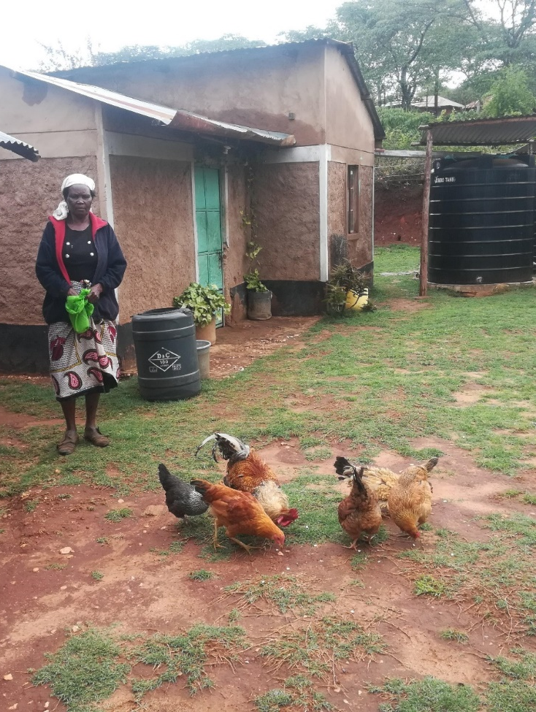
We use photovoice for women to tell their stories
Can reach policy makers, and other partners
Influence change that is occurring
A photo-story. She has a few chick, did she have more before? What happened to the rest, did they die if so why, were they vaccinated or not……

Slide 13
Intended outcomes
Our tools and model intensify vaccine adoption through an improved enabling environment
Increased vaccine accessibility and demand for women smallholder livestock farmers
Catalyze engagement of our critical partners from the onset, facilitating networking and collaboration between our women smallholder farmers and value chain actors with the aim of institutionalizing sustainable change in the VVC
Focus on the systems, policies and regulations that govern vaccine availability, the different chain actors and their capacity, professional knowledge, and the gender dimensions as influenced by attitudes and culture

Slide 14
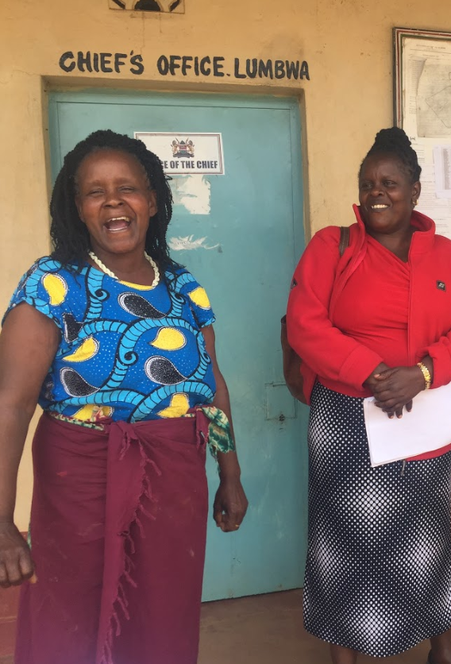
THANK YOU!
FUNDING FOR THIS PROJECT WAS PROVIDED BY CANADA’S INTERNATIONAL DEVELOPMENT RESEARCH CENTRE (IDRC) - LIVESTOCK VACCINE INNOVATION FUND WHICH IS SUPPORTED BY THE BILL & MELINDA GATES FOUNDATION (BMGF) AND GLOBAL AFFAIRS CANADA (GAC)

Slide 15



