Slide 1
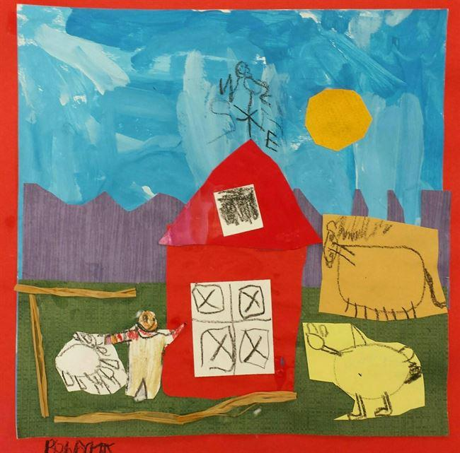

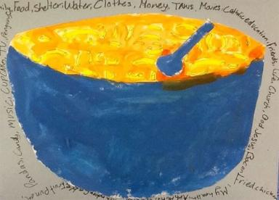


Africa’s agricultural development promises much more than food security
Jimmy Smith, Director General,
International Livestock Research Institute (ILRI), Kenya
With Dolapo Enahoro, Susan MacMillan, Shirley Tarawali
University of Illinois, Champaign
12 October 2016

Slide 2
CGIAR: a global agricultural research partnership
15 CGIAR Research Centres
ICARDA
Beirut
Lebanon
IFPRI
Wash. DC
USA
Bioversity
International
Rome Italy
IRRI
Los Banos
Phillippines
ICRISAT
Patancheru
India
IWMI
Colombo
Sri Lanka
World Fish
Penang
Malaysia
CIMMYT
Mexico City
Mexico
CIP
Lima
Peru
CIAT
Cali
Colombia
ILRI
Nairobi
Kenya
Addis Ababa, Ethiopia
IITA
Ibadan
Nigeria
World Agroforestry
Nairobi
Kenya
CIFOR
Bogor
Indonesia
AfricaRice
Cotonou
Benin

Slide 3
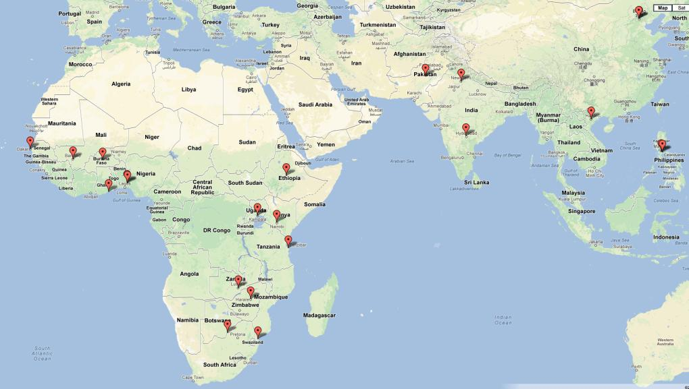
ILRI: a global livestock mandate
Main campuses: Nairobi and Addis Ababa
Offices in 16 other countries
About 750 staff
High end biotechnology (vaccines, genomics, feeds); food safety and zoonoses; environment, livelihoods, policies, markets, gender….
….better lives through livestock…..

Slide 4
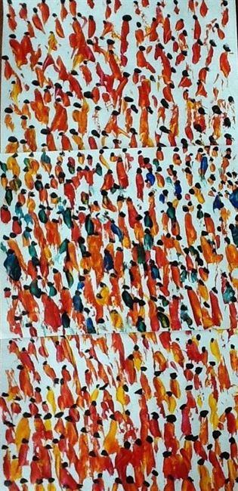
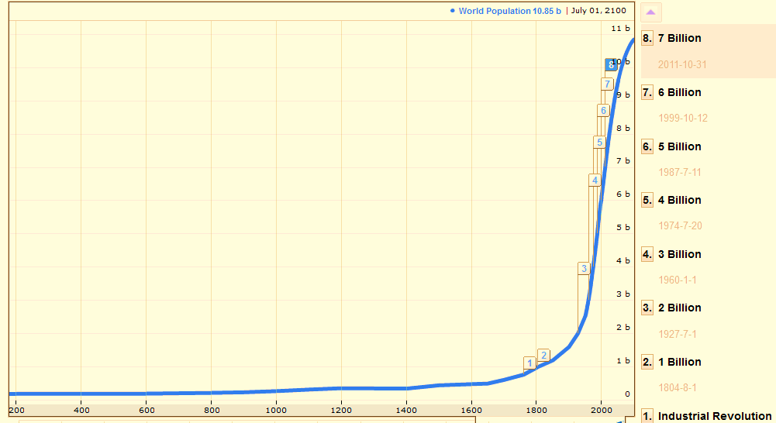
How to feed 10 billion people?
Notes:
"Market scene"
created by Rebecca6475 in Grade 6 at Lincoln Community School
from school project "Glover Market Practise"
art id #27793211

Slide 5
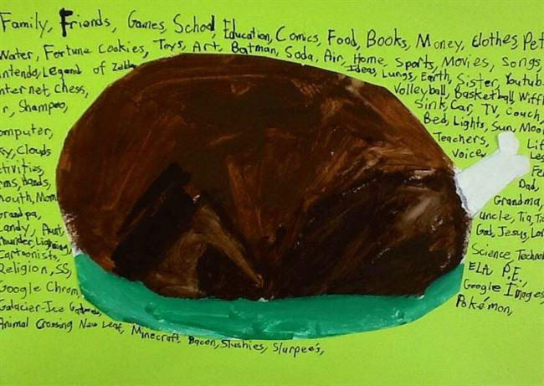
Food price crisis 2007/08:
What can we learn?
$$$
$$$
$$$
$$$
$$$
$$$
$$$
$$$
Notes:
created by Anthony12356 in Grade 5 at St. Elizabeth Catholic School
from school project "Thankful Food- 5th Grade"
art id #32137957
From: artsonia.com

Slide 6
The crisis:
The doubling of food prices
Notes:
created by Mia5071 in Grade 5 at St. Elizabeth Catholic School
from school project "Thankful Food- 5th Grade"
art id #32137940
From: artsonia.com

Slide 7
Food comes from the supermarket
(NOT)
Notes:
created by Bobby1674 in Kindergarten at Clippard Elementary School
from school project "Kindergarten Farm Landscapes"
art id #33283187
From: artsonia.com

Slide 8
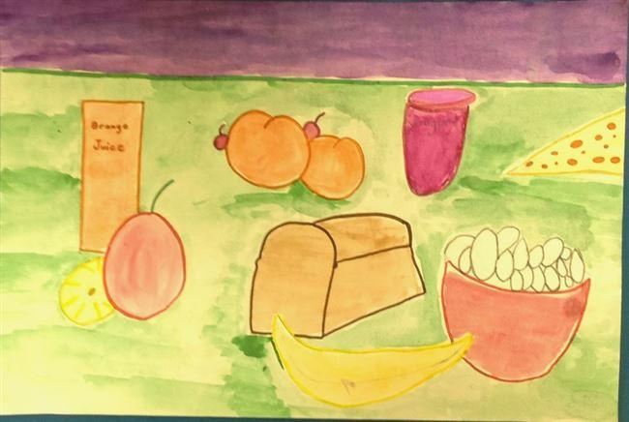
Feeding the World: 60% more food productivity gains, not expansion
Notes:
created by Hailey7687 in Grade 3 at Blessed Sacrament School
from school project "3rd gr - Healthy food still life"
art id #29874040

Slide 9
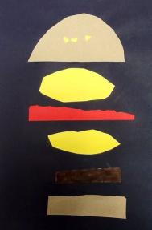
Demand for food in Africa
million metric tonnes, projections to 2050
Livestock: 163% increase
Notes:
The demand for food by households in Africa is projected to increase 153% on average, in quantity terms. A breakdown by commodity types show that demand for livestock-derived foods will expand more substantially (2.6 times, or 163%) than the demand for grains (115%). Note, however that grain demand from the livestock industry will increase more than that for food, at more than three times (269%) over current levels. The demand for all other plant-based foods increases 170% from 2010 to 2050, driven in part by increased demand for roots and tubers in some countries, and for fruits and vegetables in others as populations and incomes increase in these countries.
created by Ben4301 in Grade 5 at Memorial Drive Elementary School
from school project "5- Pop Art Food Collage"
art id #29561970

Slide 10

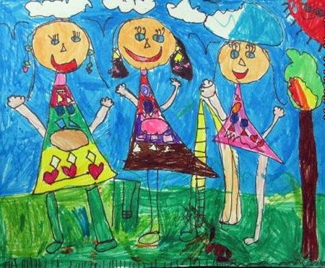
Where is the food coming from?
70% of the hungry and poor are also those producing food
In low income economies at least 70% of meat and milk is from smallholder farms
Over half the meat and milk and almost half the cereals are from mixed crop livestock farms
90% of the meat, milk and eggs produced are consumed in the same country
In many rural economies, women constitute over half the farm work force
Notes:
created by Maha71 in Kindergarten at American International School Of Guangzhou from school project "The Shape of Me and My Friend"
art id #19422295

Slide 11
Africa’s food imports: a major opportunity (lost?)
Projections on Value of Africa’s food imports to 2030 (million US dollars)
……by 2030, Africa’s net import bill for cereal, livestock, and oilseed products could
increase over 2010s levels by up to 47%, 167% and more than 400%, respectively
Notes:
Between the 1990s and 2010s, the value of imports increased on average 8% annually for all livestock products, 9% for cereals and 15% for oilseeds. In addition import value for other fodder types (not include in chart) increased more than 10% annually. From back-of-the-envelope calculations using economic model’s projections of net trade quantities and world prices of commodities, it is estimated that by 2030, Africa’s net import bill for cereal, livestock, and oilseed products could increase over 2010s levels by up to 47%, 167% and more than 400%, respectively. Can Africa’s agriculture be improved to meet this food need? What are the compelling reasons to address this?

Slide 12
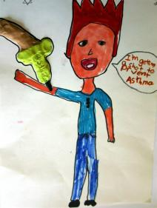
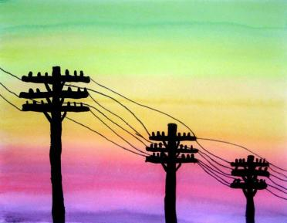
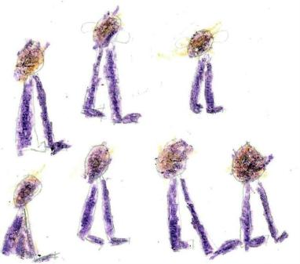

The cost of food imports: much more than money
Notes:
created by groupproject183 in Grade 3 at Lee Expressive Arts School
from school project "medical illustrations"
art id #16425022
created by Kylee509 in Grade 4 at Allen Academy
from school project "Powerful Pictures"
art id #13099493
About this School Project (Powerful Pictures)
Even an ordinary subject becomes powerful when seen in silhouette against a beautiful sky.
Fourth and fifth grade students created these powerful paintings after observing images related to electricity – power poles, power lines, and local power plants. The sky was first painted with a watercolor wash in color wheel order. Next, images were drawn and painted in opaque black tempera. A thin, black marker was used for some power lines.
created by Melzeler1 in Grade 1 at Visiontrust Liberia
art id #9941107

Slide 13
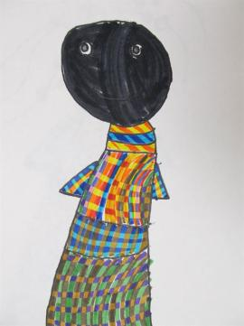
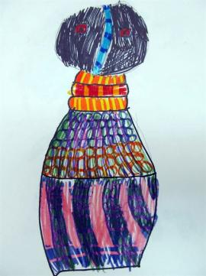
Africa’s untapped potential?
People | Land | Water
Notes:
1. created by Ty916 in Grade 1 at Richardson Elementary from school project "Ndebele Dolls"
2. created by Mac290 in Grade 1 at Richardson Elementary from school project "Ndebele Dolls"
About this School Project (Ndebele Dolls)
These dolls are from the Ndebele tribe in Southern Africa. One of the smallest tribes of the region, the people are noted for their beautiful beadwork. The bead work on these Ndebele dolls is as detailed as the clothing of the women themselves. Students learned that among other things, the dolls were used for STORYTELLING. Students discussed the LINES and PATTERNS on the dolls and then combined SHAPES to draw a doll of their own.
From: artsonia.com

Slide 14
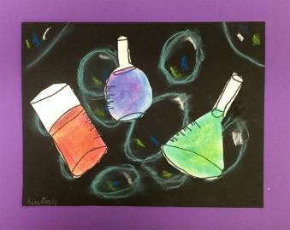
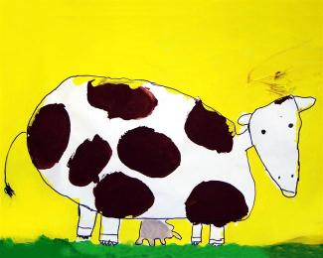
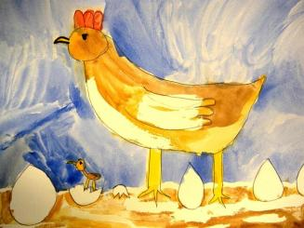
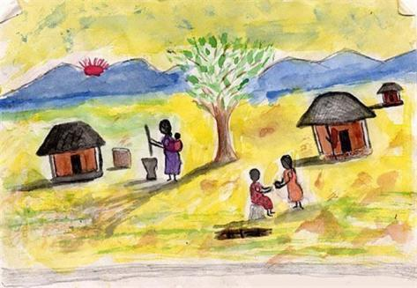
Food and nutritional security: the heartland of African agriculture
Notes:
created by Joanna909 in Grade 1 at Scottsdale Christian Academy
from school project "Chicken Farm - Summer Art Enrichment"
art id #32181801
created by Owen4829 in Grade 3 at Little Chute Elementary School
from school project "Cow Painting"
art id #26206865
"International Children's Art Exchange"
created by Libes1 art id #650
created by Cristian1193 in Grade 2 at St. Michael the Archangel School
from school project "Science Experiment in Color"
art id #47439151

Slide 15
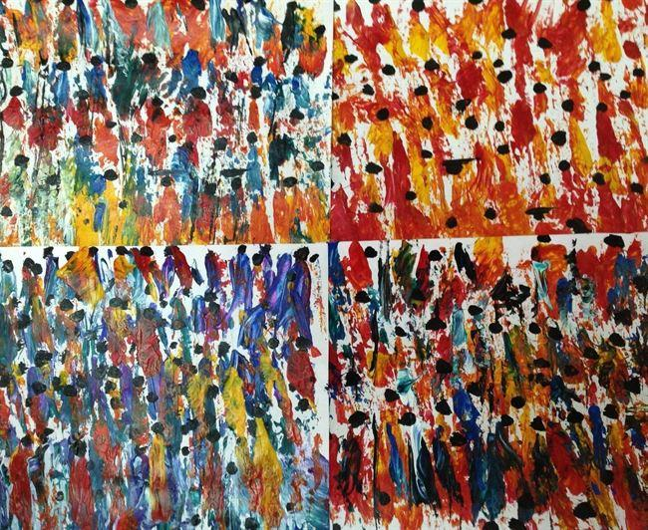
African agriculture:
Beyond food and nutrition security
Regional projections to 2050, of total and youth (15 to 24) populations in millions
Notes:
Youth (15 to 24) currently make up 20% of Africa’s population. Compare to 14% in North America. According to the UN projections, youth population in Africa will be 452 million in Africa, compared to 52 million in North America and 72 million in Europe. Can agriculture be an important part of a multi-sector effort to meaningfully engage this important segment of Africa’s workforce in the future?
"Market Scene"
created by Tonya169 in Grade 6 at Lincoln Community School
from school project "Glover Market Practise"
art id #27793188

Slide 16
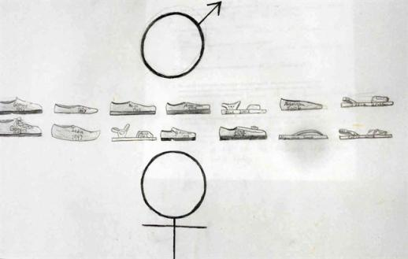
Global ramifications
Africa: refugees, 2014
Internally displaced people = 9.9 million
Refugees originating from Africa = 4.6 million
Africa: unemployment, 2013
Total for the six highest = 11.8 million
(Nigeria, South Africa, Uganda, Morocco, Algeria, Ghana)
Notes:
created by Nathan12691 in Grade 11 at Oakridge Middle and High School
from school project "Art III Refugee Inspired Art"
art id #44399056
Data on refugees: UNHCR
Data on unemployment: World Development Indicators (World Bank)

Slide 17

What’s needed?
A ‘Marshall plan’ for Africa’?
Livestock contribute at least 40% of
agricultural GDP in many
African countries
ODA investment in agriculture is less
than 5% of the total, and of that, less
than 5% goes to livestock
In Africa, average government
expenditure on agriculture was 4.7% in
2012.
Only Mali, Senegal and Burkina Faso
spent over 8%, six countries spent
5 – 8%, others all less than 5%
Notes:
created by Cameron14504 in Grade 10 at Virginia High School
from school project "Faux Notebook Page"
art id #45213952
Data: IFPRI, Statistics on Public Expenditures for Economic Development (SPEED)

Slide 18
For Illinois?
Capacity development
Research in developing countries
Upstream partnerships

Slide 19
Artwork from: Artsonia.com

