Slide 1
CIMMYT Smallholder’s Mechanization Strategy for Sustainable Intensification Agriculture
Rabé Yahaya, Walter Mupangwa, Ephrem Tadesse and Frédéric Baudron
SIP – Sustainable Intensification Program
CIMMYT
SAIRLA Second National Learning Alliance Workshop
ILRI, Addis Ababa, 23 November 2017

Slide 2
Presentation Content
  Rationale of mechanization and farm power
  Strategic mechanization approach for Africa (Ethiopia)
  Farmers & SPs perspective - business opportunity in Ethiopia
  Challenges & lessons learnt

Slide 3
Rationale & Farm Power

Slide 4
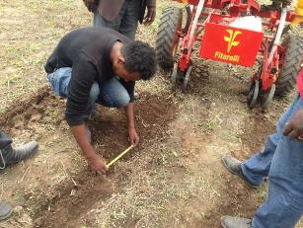
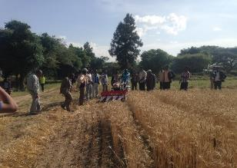
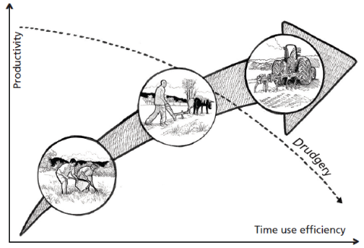
Rationale for mechanization
Mechanization improves the quality of field operations (e.g. row planting, more precise plant population, seed and fertilizer placement, efficient utilization of soil moisture during planting window)
Mechanization helps in timeliness of operation
  especially important for planting where delays can have a serious negative impact on final crop yields
  and for harvesting and threshing where there is labor shortage
Reduced drudgery
Increased labor productivity
Increased agricultural productivity
Source: FAO, 2013d

Slide 5
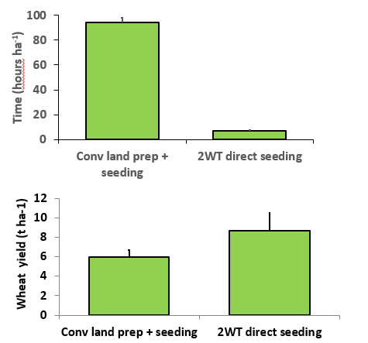
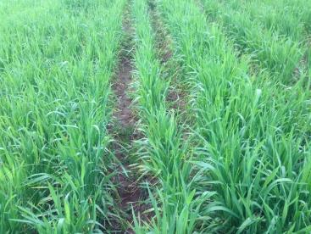
Rationale for mechanization (contd.)
Mechanization allows easier application of post-emergence operations such as weeding or spraying.
Drastically saves time and labour compared with conventional crop establishment systems
According to our assessment result, agricultural mechanization can significantly increase gross margin of farmers
In general by introducing mechanization
    the reliance on draught animal power can be reduced
    agricultural productivity can be increased
    labor can be channeled towards other high-value adding activities and sectors.

Slide 6
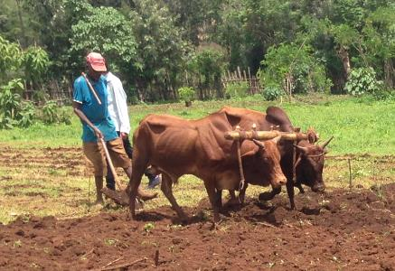

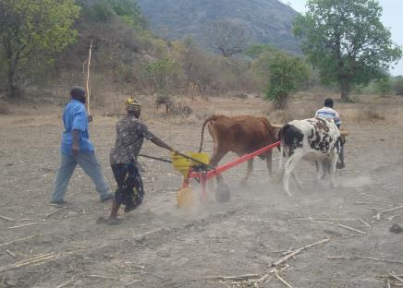
Farm Power relies mostly on Human & Oxen
Source: Own adaptation from FAO, 2006

Slide 7
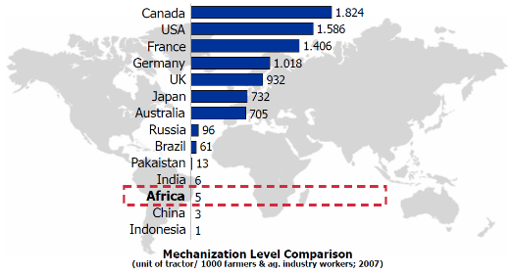
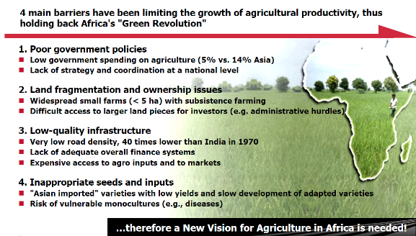
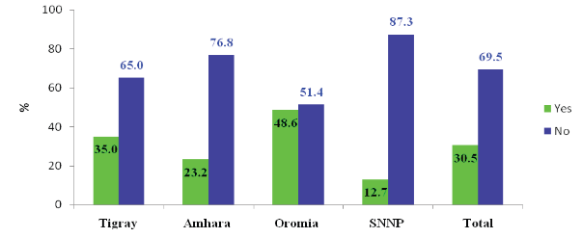
Farm Power & other Barriers require a new Vision
Source: World Development Indicators, World Bank
Use of Any Improved AMTs’ by Smallholder Farmers (%)
Source: “Base line study report on agricultural mechanization use in selected regions of Ethiopia (MoANR, ATA,CDR, Nov. 2016)

Slide 8
Strategic Mechanization Approach

Slide 9
CIMMYT’ Works - Mission and Vision
CIMMYT works throughout the developing world to improve livelihoods and foster more productive, sustainable maize and wheat farming. Through collaborative research, partnerships and training, CIMMYT targets the challenges of food insecurity and malnutrition, climate change and environmental degradation.
VISION
CIMMYT contributes to the development of a world with healthier and more prosperous people – free from the threat of global food crises – and with more resilient agri-food systems.
MISSION
Maize and wheat science for
improved livelihoods

Slide 10
CIMMYT Mechanization Strategy
Use mechanization to increase smallholder productivity at farm and beyond
Use mechanization to eradicate hunger and rural poverty
Use mechanization to increase national food production and security
Use mechanization to make farmers more resilient to climate change
Use mechanization for sustainable natural resources management & biodiversity
Use mechanization for rural youth employment creation
Use mechanization for rural industrialization
Use mechanization to build up capacity of researchers, scientific staff, DAs, extension services, universities, etc. across the entire value chain

Slide 11
CIMMYT Mechanization Strategy (contd.)
Our mechanization strategy is based on:
Climate Smart Agriculture (CSA)
Building up farmers resilience to climate change
Sustainable Intensification
Conservation & precision agriculture
Research in 3D printing
Research in using of drones in agriculture for smallholders
Produce more with less
Increase power availability and decrease it use

Slide 12
CIMMYT Mechanization Approach (contd.)
Review literature on ag mechanization over decades and outline best fits findings for SM
Document the failure reasons, correct, adapt, validate and scale
Conduct research in line with Climate Smart Agriculture (CSA) that builds up farmers resilience to climate change
Identify and analyze the potential of precision agriculture for sustainable intensification in Africa
Initiate and adapt technologies that increase power availability at farm (AD, 2WT, 4WT, etc.) and beyond
Conservation agriculture that underlines:
Direct row planting (no till)
Crop rotation
Crop residue on the soil
Strip tillage
Conduct research in 3D printing in to build up the capacity of engineering in aftersales services
Conduct research in the use of drones for fertilizer, pesticides/herbicides application and seeding

Slide 13
Strategic Approach- Key Activities in Ethiopia
Adapting, testing, piloting and scaling 2 WT technologies for improving soil fertility (direct row planting) in Bako, Debre Markos, and Adwa sites of Oromia, Amhara and Tigray regions
Testing of 2nd generation of cereal planters
Awareness/demand creation
Training & mechanization curriculum development with the private vocational training centres
On-farm demonstrations to generate evidence on crop performance and profitability under small mechanization technologies
Establishing network of spare parts dealers in Oromia, Amhara and Tigray regions
Investigating leasing scheme using created revolving fund
Support initiatives for importing or local assembling/production of 2WT/4WT based technologies
Promote inclusive market development (not necessarily linking farmers directly with importers or manufacturers but work with the range of businesses in the value chain)
Customized to the needs of the target group, their context, and identified market opportunities.
Market-based - with solutions offered by commercial actors on a profitable basis
Conduct periodic needs assessment to identify the most impactful mechanized technology opportunities and identify the niche for each technology and region

Slide 14
Business Models for scaling up
Manufacturers
Micro-finance
Transfer of funds
Equipment and spare parts
Seasonal loans
Transfer of machinery
Cooperative Union
Primary Cooperative
Service provider
- Guarantee to micro finance
- Procurement of equipment and spare parts
Farmers: primary cooperative members

Slide 15
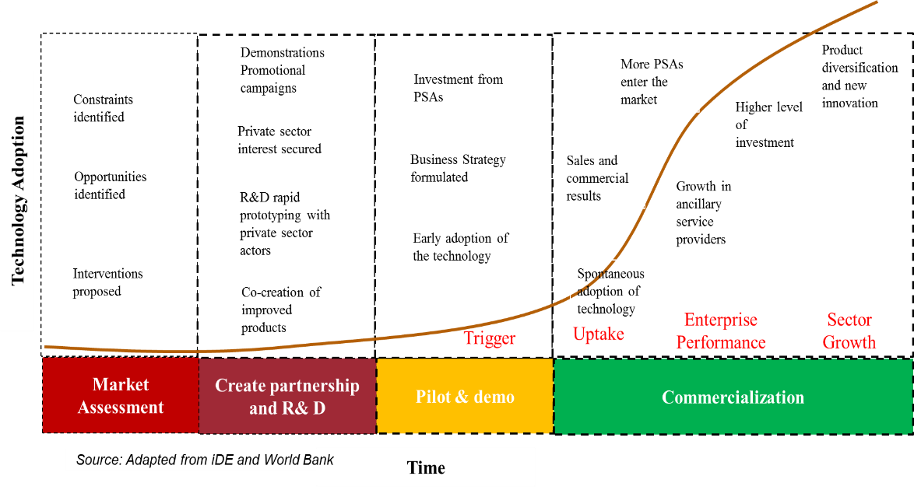
Commercialisation and Scaling Phases

Slide 16
Strategic Approach - Impact intervention map

Slide 17
Strategic Approach - Impact Pathway

Slide 18
Steps in Promoting SM (contd.)
Site selection
Examine the potential for mechanization within specific agro-ecological areas – topography, soil types, land holdings, farming activities, etc.
Comparative advantage of small-scale mechanization compared to conventional farming system
Availability of support services (repair and maintenance workshops, mechanics, agro-dealers, manufacturers etc.)
The capacity of farmers to pay for services
Private sector partners - to drive the supply chain and scale up processes.

Slide 19
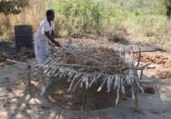
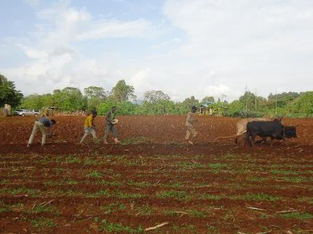
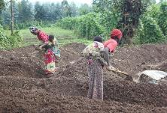

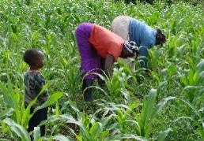
Steps in Promoting SM (contd.)
Identifying tasks to be mechanized
Value chain analysis of major crop - identify constraint and opportunity on the chain
Selection of technologies and their cost-benefit analysis
In line with technical criteria of suitability to the site – soils, topography, stoniness, rainfall pattern, costs, etc.
Sourcing of technologies
Imports or locally manufactured
Land preparation, seed and fertilizer placement
Rural transport

Slide 20
Steps in Promoting SM (contd.)
Appraisal of the market for small mechanization
Identifying potential importer/manufacturers
Identifying potential local dealers
Identify potential service providers
Appraisal of hire service business models
Technical, ownership, management aspects

Slide 21
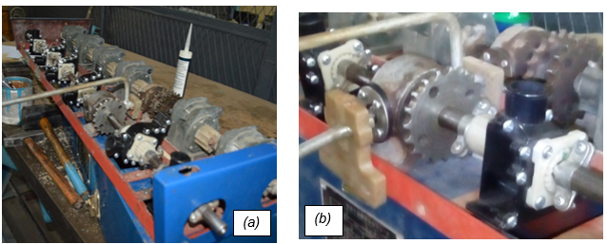
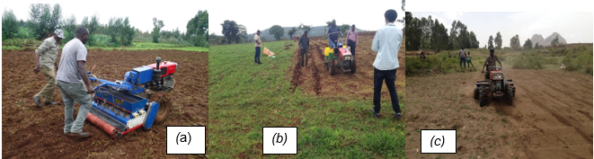
Strategic Approach - 2nd Generation planter
(a) & (b) 2BFG seeder metering units replaced by imported seed metering unit.
(a) Modified 2BFG-6A seeder for teff crop in action at Machakel, Amhara region, (b) Maize trial farm in Gudeya Bila district, (c) Wheat trial farm planted in Adwa district (2017).

Slide 22
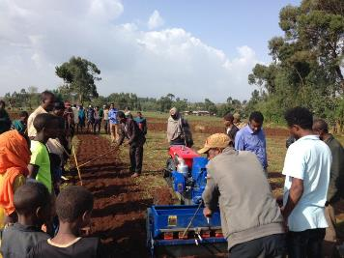
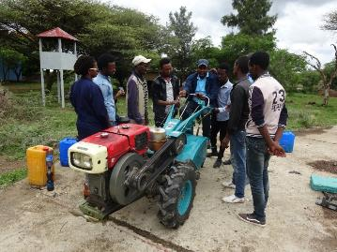
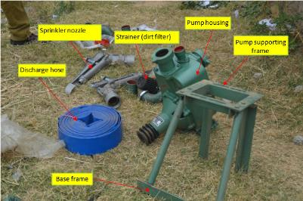
Strategic Approach - Training
Technical & agribusiness aspects of small mechanization
Youth groups and individual service providers
Training of mechanics facilitated by Amio in October 2017
Training of trainers in four regions of Ethiopia
Training of individual service providers at GIZ Debre Markos site
Training of youth group service providers under MoANR and CIMMYT
Training during field day demo for SP in Adwa

Slide 23
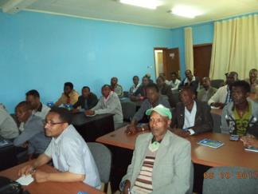
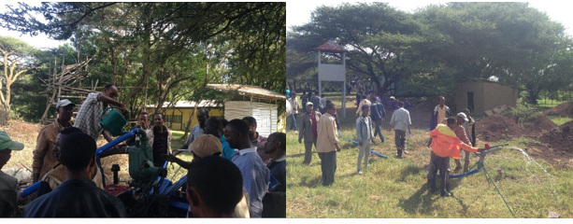
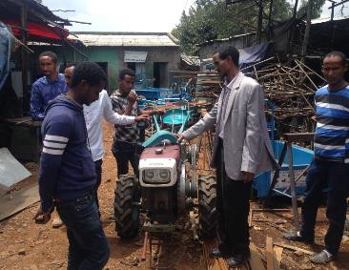
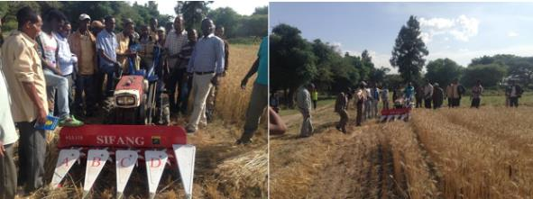
Training of mechanics & SP at Melkassa (contd.)

Slide 24
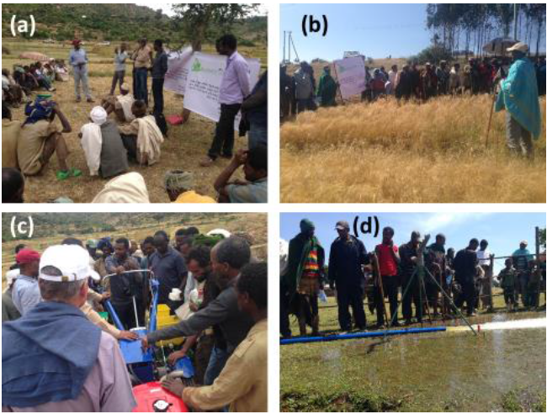
Strategic Approach - Awareness creation
(a) Field day at Adwa woreda in Tigray region; (b) field day at Amanuel zuria woreda in Amhara region; (c) field day at Adwa woreda in Tigray region; and (d) field day at Amanuel zuria woreda in Amhara region.
Total – 79 (22 females) participants

Slide 25
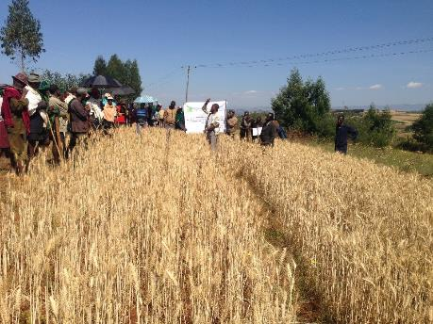
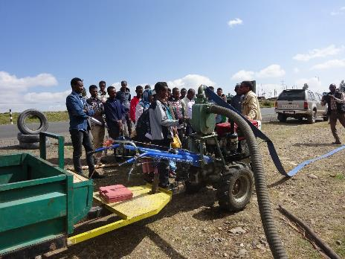
Strategic Approach - Awareness creation (contd.)
Awareness/demand creation: involving EIAR, MoANR, private sector e.g. Amio, site coordinators - promoting awareness on-farm demonstrations, field days, awareness campaigns where farmer or youths are gathered for other activities e.g. Abiye farm in Debre Markos
Field day at Machakel in Amhara region
Small mechanization awareness in Debre
Birhan (25 October 2017)

Slide 26
Strategic Approach - in Numbers
Number of service providers and implements | Year |  | Total
 | 2015 & 2016 | 2017
No of service providers | 19 | 13 | 32
No of 2WT | 19 | 40 | 59
Planter (wheat and Maize) | 18 | 24 | 42
Water pump | 8 | 0 | 8
Harvester/reaper | 6 | 18 | 24
Thresher/sheller | 5 |  | 5
Trailer | 17 | 20 | 37
Number of people trained on 2 WT and different technologies (including service providers) | 35 | 402 | 437

Slide 27
Farmers & SPs Perspective-
Business Opportunity

Slide 28
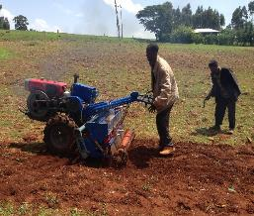
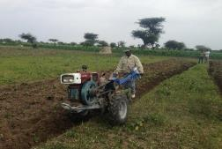
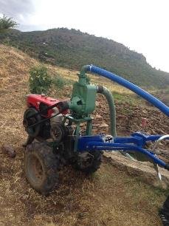
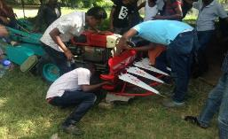
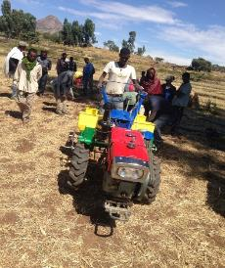
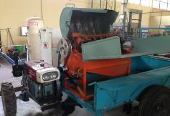
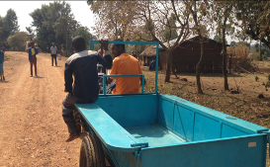
Currently promoted Technologies (innovations)
2 wheel tractor with ploughing tool
2 wheel tractor attached with seeder/for direct planting
2 wheel tractor mounted water pump
Reaper / Harvester
Maize seeder
Sheller/thresher

Slide 29
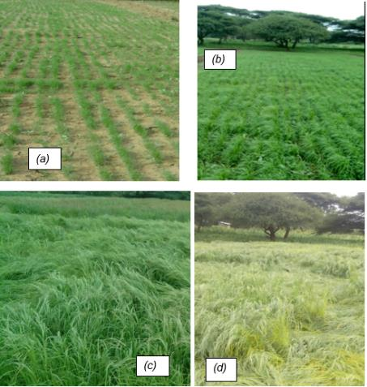
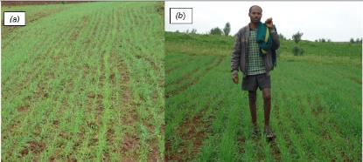
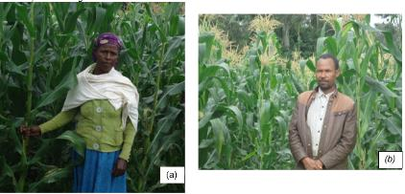
Performance of planter
(a) and (b) wheat planting performance of the 2BFG-6A rotary tillage seed drill at Machakel Woreda, Amhara region.
(a) and (b) show how the maize seeder does quite at Gudeyabila Woreda, Oromia region on a female farmer’s field and male farmer’s field.
(a),(b),(c) and (d) teff crop establishment performance under modified 2BFG-6A rotary tillage
seed drill at Melkassa Research Center, September 2017

Slide 30
Economic viability of small mechanization
Indicators | Seeder+ thresher+ trailer+ water pump | Thresher+ trailer+ +water pump | Thresher + trailer | Trailer | Seeder, trailer, and water pump | Seeder, thresher and trailer | Seeder + trailer | Seeder + water pump | Seeder | water pump
NPV ($) | 24,976 | 20,362 | 19,318 | 14,725 | 20,384 | 23,932 | 19,340 | 2,404 | 1,360 | -2,211
IRR (%) | 62% | 58% | 59% | 64% | 67% | 63% | 70% | 30% | 26% | -10%
B/c ratio | 1.66 | 1.66 | 1.69 | 1.72 | 1.69 | 1.69 | 1.73 | 1.25 | 1.22 | 0.66
Increase in cost (10%)
NPV ($) | 21,195 | 16,886 | 16,168 | 12,398 | 17,425 | 20,476 | 16,707 | 1,447 | 728 | -2,862
IRR (%) | 52% | 48% | 49% | 54% | 57% | 53% | 59% | 24% | 21% | -17%

Slide 31
Challenges and Lessons

Slide 32
Challenges of Mechanization in Ethiopia
Research and Technology Development
  Limited information on the agricultural mechanization needs in the country
  Limited resources allocated to agricultural mechanization research and development
Manufacturing and import
  Infant domestic manufacturing sector
  Lack of machinery standards and testing
  High import tariffs (which drive up the cost of agricultural machinery)
Distribution
  Lack of efficient and effective distribution models for agricultural technologies

Slide 33
Challenges of Mechanization in Ethiopia (contd.)
Promotion, Purchase and Usage
  Limited awareness of mechanization among farmers and other potential users
  Lack of financial services to facilitate the use of mechanization services
  Weak institutional capacity for promoting mechanization
After sales services
  Lack of available spare parts and after-sales services
  Poor aftersales infrastructure in rural areas

Slide 34
Lessons learnt
Dynamics of mechanization: entry points for expansion of scope and diversification
Flexibility: re crops, machines, farmers, and locations despite the lead mandate CIMMYT.
Market development: design of subsidies aimed at creating a virtuous cycle of market demand amongst the supply chain stakeholders.
Select countries where there is potential for market development and a clear current demand for mechanization technologies.
Intervene in countries and locations where a positive momentum already exists.
Notes:
Small mechanization should be recognised as a dynamic process where different operations can be seen as an entry point for 2WT based mechanization or alternatively a way of diversifying the 2WT based planting operations into an additional lucrative line of business.
Hire service business also needs to be understood as dynamic adapting to changes in supply and demand. For instance custom hire charges are likely to drop as more SPs come into the business.
Farmers may also begin to purchase their own low costs machines reducing the demand for hire services. SPs are likely to adapt to this changing market by moving into other lines of operation.

Slide 35
Lessons learnt (contd.)
Understanding farmers’ needs and capacity: there tends to be an emphasis on the supply push but it is necessary to ask what farmers need
Support demand and supply creation simultaneously
Develop business models from actors already in related business
Market linkage, in particular with financial institutions - guarantee fund??
Risk is a more important consideration than is usually expected. SP and user time horizons are short and related to prospective financial returns
Raise awareness of enabling environment constraints (e.g. licensing and import duty) and advocate for the development of small mechanization.

Slide 36
Lessons learnt (contd.)
It can be difficult to start the commercialization process with poorer and more vulnerable smallholders and it might sometimes be more effective to work outside of the zone of influence to eventually have an impact on the target population once the innovation goes to scale
Partner with private sector companies from the start; insist on a largely co-equal relationship where partners share risk and make a financial co-investment.
Start with one or two key private sector partners interested in being first movers to create proper signals and incentives and to deepen and broaden the market.
Subsidies and the public sector are important and often play a significant role in commercialization, even when promoted through commercial pathways.

Slide 37
Lessons learnt (contd.)
Encourage domestic manufacturing and assembly of equipment - Joint-venture partnerships with foreign companies.
Provide business services on a regular and continuous basis to support prospective machinery buyers with economic and financial advice
Implementation for business development conducted by partner organizations with market oriented experience and capacity, but CIMMYT has a role in monitoring the work of implementation partners and providing technical support to them.

Slide 38
Criteria used for site selection
Availability of mechanics, local repair workshops and finance institutions
Availability and affordability of fuel
Relatively commercially-oriented agriculture (e.g., presence of cash crops)
Agriculture constrained by labour shortages, at least seasonally
High cost of maintaining draught animals (e.g., feed shortage)
Field accessibility (e.g., feeder roads)
Existence of hire services (e.g., ox ploughing)
Relatively deep and stone-free soils

Slide 39
Criteria for selection of SPs
The most effective criteria for the selection of SPs are:
  Previous experience in the shelling business
  Youth with no alternative sources of income
  People with an entrepreneurial personality, prepared to move out of their village or district to seek new business opportunities
  Experience in maintaining and repairing similar technologies
  Some formal education and discipline to keep records and use them to analyse business performance

Slide 40








… and with our special thanks to:

