Slide 1

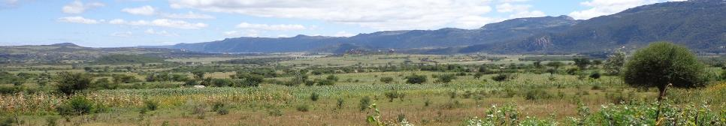

Bringing evidence to bear on negotiating ecosystem service and livelihood trade-offs in sustainable agricultural intensification in Tanzania, Ethiopia and Zambia
Leigh Winowiecki, Hadia Seid, Mieke Bourne, Constance Neely, Kiros Hadgu, Niguse Hagazi and Fergus Sinclair (ICRAF)
SAIRLA Second National Learning Alliance Workshop
ILRI, Addis Ababa, 23 November 2017

Slide 2
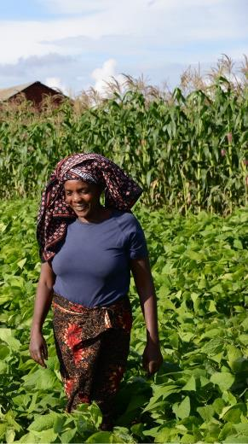
Research Questions of the Project
Primary Question: How can the trade-offs between increased production and environmental impact be analysed and managed across different scales?
Secondary Question: What are the key policy processes? How can engagement structures, tools and metrics help decision makers create an enabling environment for resource-poor smallholders, especially women and young people, to sustainably intensify agricultural enterprises?

Slide 3
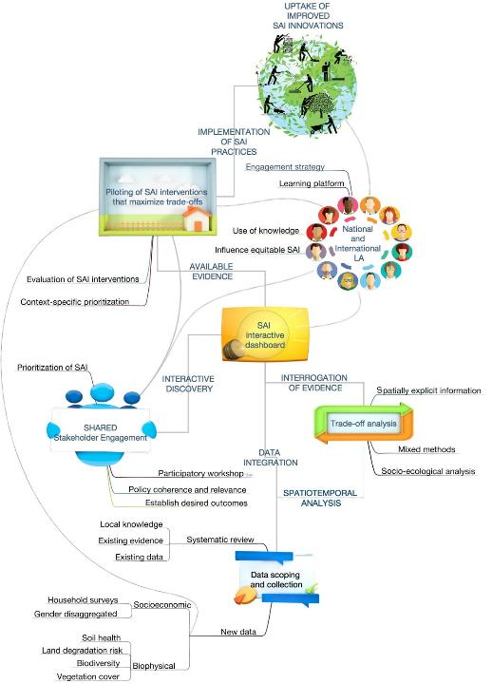
5 Main Activities
Baseline assessment,including use of and existing evidence on the effectiveness of SAI
Engage stakeholder groups using the SHARED approach to reflect on SAI-relevant policies & interventions
Multi-scale, socio-ecological trade-off analysis conducted on promising SAI interventions and results communicated and assessed with stakeholders using the SHARED approach.
Facilitate piloting of promising, innovative SAI interventions, using mixed methods to assess their cost-effectiveness
Develop an interactive, open access platform—’SAI Dashboard’— for project action sites to support the engagement of decision makers to interact with evidence.
Conceptual Framework

Slide 4
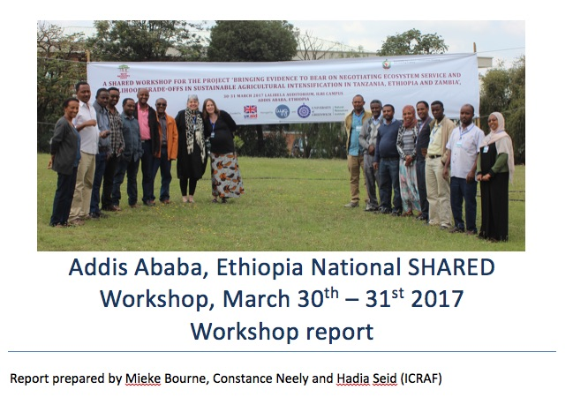
National Stakeholder Workshop in Addis Ababa

Slide 5
Objectives of the National Workshop
• Engage country stakeholders on SAI -relevant
interventions, scaling mechanisms and indicators,
including existing evidence and gaps.
• Capture and discuss current and potential policy and investment decision making approaches to enhance scaling of SAI-relevant interventions Zambia.
• Reflect on important trade-off themes and indicators for SAI interventions.
• Discuss the development of the SAI Dashboard.
All reports online:
http://www.worldagroforestry.org/sites/default/files/outputs/ICRAF%20Report_Ethiopia%20SAIRLA%20National%20SHARED%20workshop_March%202017_final.pdf

Slide 6
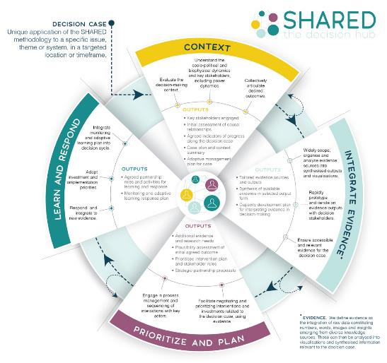
Using Stakeholder Approach to Risk Informed and Evidence Based Decision Making (SHARED)

Slide 7
How best to share the results from the workshop (and other) findings and evidence with decision-makers?
Question:

Slide 8
Potential solution:

Slide 9
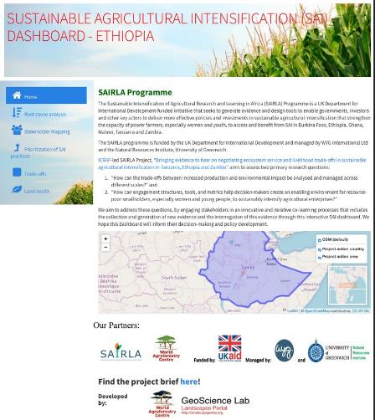
SAI open-source, online dashboard
To facilitate communication of data and analysis between scientists and stakeholders
To provide robust data management and graphical tools to allow users to interact
Co-designed with stakeholders and the project team
Modeled after the Turkana and Laikipia county dashboards in Kenya
http://landscapeportal.org/sharedApp/
Front page of the prototype of SAI Dashboard

Slide 10
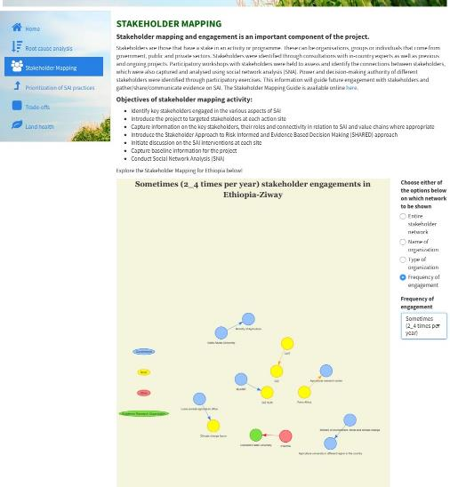
Modules created using the data from the workshops – Stakeholder Mapping
Stakeholder Mapping module
Interactive
By organization
By frequency
Arrows indicate direction of information
Visualize interactions amongst stakeholders

Slide 11
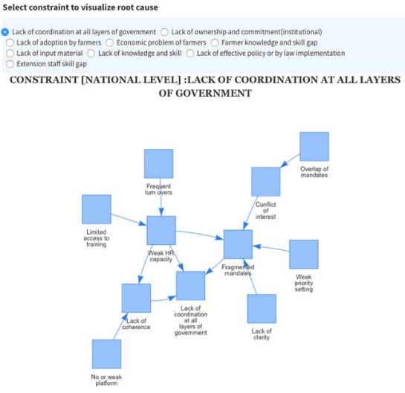
Modules created using the data from the workshops – Root Cause Analysis
Root Cause of Lack of Coordination

Slide 12
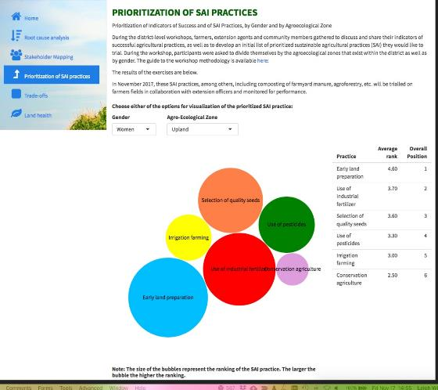
Modules created using the data from the workshops – Prioritization
Farmer Preferences - Differences by gender and AEZ
Example: Upland women- Ziway

Slide 13
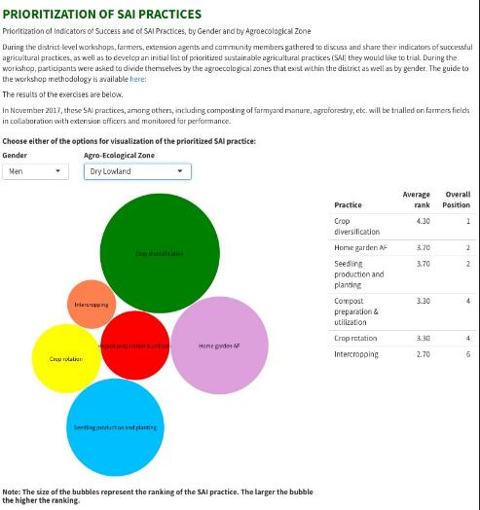
Modules created using the data from the workshops – Prioritization
Farmer Preferences - Differences by gender and AEZ
Example: Lowland men- Ziway

Slide 14
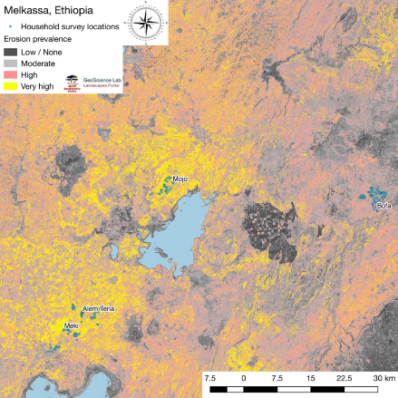
Land and Soil Health Module of the Dashboard
Ziway, Ethiopia
Maps of key ecosystem health indicators - for inclusion in the dashboard
Soil organic carbon (SOC)
Soil erosion prevalence
Soil pH
Other…
Soil Erosion Maps of Ethiopia site

Slide 15
Data identified for incorporation in the dashboard during the national workshop
Type of data | Scale of data | Who has it
Baseline study on livestock and irrigation | District / PA | ILRI Lives project
Zeway – Shalla subcatchment watershed project | Adame-tulu- woreda watershed | Rift Valley sub-basin project Adame tulu agricultural office
Homegarden agroforestry | District | Adame tulu research center
SWC Research and NRM and Irrigation | District | ATRC Adame tulu research center
SNV Horticulture project | District (Meki and Zeway) | SNV and Adame tulu agricultural office
Livestock, Poultry and Trees | District | ATRC, Adame Tulu research center
Small scale irrigation and on farm SWC and mechanization | District | IDE, International DVT enterprises
Gender and social equity, small scale irrigation | District and Comm level | Rift Valley Womens Development Association
Education | District | FH, ADRA (Adventist development and relief agency) food for hunger
Emergency seed, participatory variety selection | District | CIMMYT
Intercropping | District | ICRISAT
Organizing women groups | District | IDE
Land health | Agricultural inputs/chemicals at farm level | Research institutions and University MEFCC
Human population data | Woreda | Woreda administration
Meteorology | Agroecology / woreda | MET agency
Market information | Woreda | Cooperative and marketing office in the woreda
Credit facilities | Woreda | Microfinance institutions
Fisheries | Woreda | Woreda Agricultural office

Slide 16
Next Steps for the dashboard - Volunteers needed for the
SAI Dashboard Advisory Group? Below is the list identified during workshop – Who else would like to volunteer?
Name | Area of interest | Preferred communication method
Regassa Terefe | CA / Agroforestry | Email
Tiruneh G/giorgis | Food security, credit facilities, market infrastructure, land health, livelihoods | Email, online training, skype
Merga Diyessa | Spatial data analysis | Email
Getachew Mekuriya | Integrated watershed management | Email, online training
Hadia Seid | Soil health, agroforestry, nutrition | Email or skype
Mesfin Tsegaye | Land health, soil | Email
Sofiya Kassa | Soil health | Email
Abate Taye | Small-scale mechanisation | Email
Miheretu Fufa | Agricultural research | Email
Hussien Uregesa | Soil and water conservation | Phone
Mamusha Lemma | Gender, inclusiveness | Email, skype, online training

Slide 17
Proposed process for the SAI Dashboard – Please comment
Volunteers from district and national level to agree on process for engagement and form an active SAI dashboard advisory group
Available data collected and shared with the dashboard advisory group (see suggested table of table to be included in the dashboard)
Dashboard advisory group to
  Advise on appropriate modules (based on additional data)
  Gather the data
  Advise on display of data for easy use in the dashboard
  Support the piloting of the dashboard with stakeholders

Slide 18
For Discussion: How to ensure sustainability and use of the SAI Dashboard?
The current dashboard is being prepared for Ziway
  training on local and provincial staff on use a priority
Determine opportunities to integrate dashboard into local level planning through SHARED workshops, NLA workshops, government workshops, AfricaRising?
Share dashboard at the national level and identify opportunities for use and continued development –
  for example through the new EC Evergreen Agriculture scaling project or other new projects
Advisory group to continue to refine the dashboard
What else?

Slide 19

Please contact us for more information or to be part of the SAI Dashboard
Kiros Hadgu - k.hadgu@cgiar.org
Hadia Seid - hadi03seid@yahoo.com
Leigh Winowiecki – l.a.winowiecki@cgiar.org

